Slide 1

OOoCon 2008
2008-11-07, Beijing
OpenOffice.org & ODF Accessibility Today
Malte Timmermann
Technical Architect
StarOffice/OpenOffice.org
Sun Microsystems

Slide 2
About the Speaker
Technical Architect in Sun's StarOffice/OpenOffice.org Development Team
Working on StarOffice/OpenOffice.org since 1991
Member OASIS OpenDocument TC
  Accessibility SC & Requirements SC
http://blogs.sun.com/malte

Slide 3
Agenda
Accessibility
Assistive Technology & Accessibility APIs
ODF Accessibility
Accessible Document Creation
Q&A

Slide 4

Accessibility
People with disabilities should be able to work with OpenOffice.org
Access for people with disabilities must be comparable like for people without disabilities

Slide 5
Accessibility
Keyboard Navigation
Colors and Fonts
Accessible Documentation
OpenOffice.org Accessibility Features
Assistive Technology

Slide 6
Keyboard Navigation
All features must be usable via the keyboard!
  Some users cannot use a mouse
If they can't access every function without one, productivity may suffer, or the application might be unusable
  Some users cannot see the screen
But they still have a good mental picture of what's there, so require consistent, reliable keyboard navigation to get around
Many users find it faster to use the keyboard
Keyboard Accessibility improves the user experience for everyone, not just for those with special needs!

Slide 7
Colors & Fonts
Adapt to the color schemes and contrast display settings of the operating system
  Users chose colors and contrast settings by intention
Offer additional settings for colors which are not specified in any system color schemes
Support for High Contrast and Large Fonts
  Document content might be rendered differently
  OpenOffice.org User Interface uses the default system font, but the user can choose a different one

Slide 8
Accessible Documentation
Provide documentation in an accessible format, like HTML or PDF
Keyboard shortcuts should be well documented
The help system itself must be accessible
Templates and sample documents follow rules for accessible document creation

Slide 9
OpenOffice.org Accessibility Features
Read-Only cursor
  Makes it much easier to navigate in read only documents
  Text selection with keyboard is possible
Theming for help viewer
Animations for images and text can be switched off
“Automatic Font Color” as the default for new documents
  To make sure text is readable regardless of the color theming
Force Automatic Font Color for screen display
  Needed for documents which do not use automatic font color

Slide 10
Demonstration
OpenOffice.org
  Scheming, Fonts and Colors
  Accessibility Options and Features

Slide 11
Assistive Technology
Screen Readers
  Use speech or refreshable Braille to "read" the content of the screen
Screen Magnifiers
  Magnify the portion of the screen that the user is interacting with
  Tracking mouse movement, keyboard focus and text entry
Onscreen Keyboards
  Use the mouse or a simple switch to enter text and to control the application

Slide 12
Assistive Technology
Voice Control
  Use speech to control the application and to dictate the document content
Keyboard/Mouse Enhancement Utilities
  Key debouncing, sticky keys, repeat delay/rate
Alternate Input/Output Devices
  Eye-gaze, simple switches, braille devices, alternate mice

Slide 13
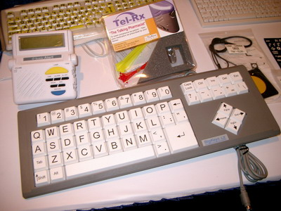
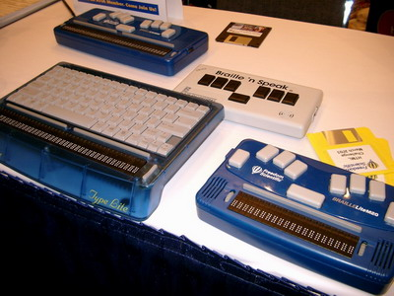
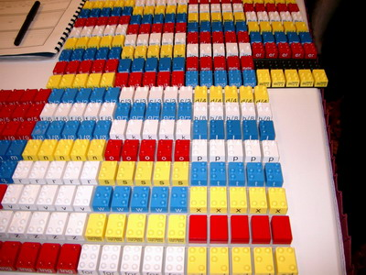
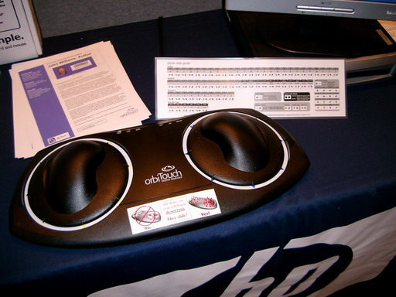

Slide 14
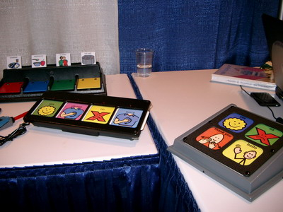
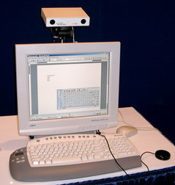
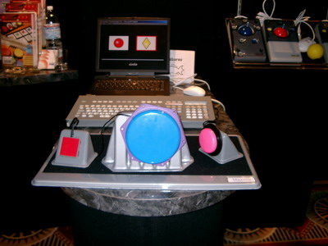
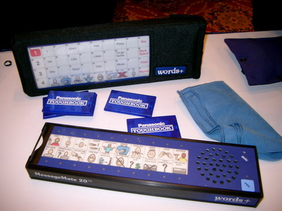

Slide 15
Evolution of Assistive Technology
History
  First generation - access to TTY systems
    Access to content was quite ease (video buffer)
  Second generation - access to the GUI
    Access very difficult
      Accessing Windows Screen was not possible for a long time!
    Patching of OS and video drivers was needed
    A lot of guessing from AT tools
  Third generation - access via API
    This is where we are now!

Slide 16
Accessibility API
To actively support Assistive Technology (AT)
  AT shouldn't have to guess something or to patch the system
  Well defined Accessibility frameworks on GNOME and Mac OSX
    On Windows, no well defined Accessibility framework, so patching OS and video drivers still bad, but needed, practice
    Standardization and broader adoption of IAccessible2 should fill this gap
  With standard Accessibility APIs, AT doesn't have to “special case” for certain applications
    When an AT supports one Office suite via that API, it automatically has support for other Office suites implementing that API
    Customizations for certain applications are only needed for convenience features or for improving efficiency of certain work flows

Slide 17
OpenOffice.org Accessibility API
Accessibility API very important for OpenOffice.org
  OOo doesn't use the system's standard widgets, so a lot of the old tricks from (Windows) AT don't work
Special API needed for accessing the document
  When starting with OOo Accessibility, no existing API was sufficient to expose the (complex) document content
  For some “standard” applications, AT accesses the document information via the application's specific API
    This only works for the specific application, but doesn't help for OOo
    AT vendors are not much interested in doing the same for OOo :(

Slide 18
OpenOffice.org Accessibility API
Derived from Java and GNOME Accessibility
  To support multiple platforms
Used for UI and for document representation
  No just the document content, but also positions on the screen
  Made enhancements for exposing the document content, which also led to improvements in Java and GNOME APIs
  OpenOffice.org is probably the first application that fully exposes the document content and layout via Accessibility API

Slide 19
OpenOffice.org Accessibility API
Bridged to the platforms standard Accessibility API
  AT doesn't have to know anything about OpenOffice.org or about that specific Accessibility API
  Bridged to JAA (Java Accessibility API) on Windows
    Because on Windows there was no better choice – MSAA is not sufficient. There is UIAutomation for some time now, but UIAutomation has some drawbacks and therefor no broad adoption
    Nowadays there is also IAccessible2, but the work on that bridge is somewhat “stalled”.
  Bridged to ATK on GNOME
    Since OOo 2.0.1 – before that we also used Java on GNOME, but this had drawbacks on performance, features and stability
  Bridged to NSAccessibility on Mac OSX
    Starting with OOo 3, the first native Mac port of OOo

Slide 20

AT Support for OpenOffice.org
GNOME
  Good support for OOo because of GNOME's
  well defined Accessibility framework
  Orca (Screen Reader and Magnifier) and GOK (On Screen Keyboard).
  Good (and ongoing) communication with the Orca team helps for continuously improving/extending OOo Accessibility
    Also leads to enhancements in ATK, because sometimes new API is needed for accessing sophisticated features
  All Open Source!
Mac OSX
  VoiceOver, and therefor probably VisioVoice too
  Collaboration with Apple directly was very helpful

Slide 21
AT Support for OpenOffice.org
Windows
  Most AT Vendors don't care much about support for OOo :(
  Some have limited support for OOo through the Java Access Bridge
  No AT vendor supports the OOo Accessibility API directly
  Overall status on Windows: AT support for OOo is not sufficient
  This could change with IAccessible2:
    IBM derived this API from OOo Accessibility API
    IAccessible2 fills the gaps from things not covered by MSAA
    Only additional interfaces to MSAA, so easy to adopt for AT vendors
    Submitted to the “Free Standards Group” (called “Linux Foundation” nowadays) for standardization
    Now Windows finally gets a real accessibility framework!

Slide 22
Status IAccessible2 for OpenOffice.org
IBM already has IAccessible2 implemented in Lotus Symphony, which is based on OOo 1.1 code
  They plan to contribute this for OOo :)
  OOo already received some of the contributions
Unfortunately the contributions are in a condition that we can't easily integrate them
  Patches are based on a very old code base (OOo 1.1)
  Patches only contain the bridge code, but not the necessary changes in the applications
  Our engineers are working with IBM's engineers on solving the issues and help to migrate that code to OOo 3 code base
  Good news – IBM announced in their OooCon keynote talk that they finally will contribute their stuff to the OOo 3 code line!

Slide 23
Demonstrations
Windows Screen Reader and Magnifier (ZoomText)
GNOME Screen Reader and Magnifier (Orca)
GNOME Onscreen Keyboard (GOK)

Slide 24
ODF Accessibility
OASIS OpenDocument Accessibility SC
  Ongoing review of the OpenDocument specification to determine whether any accessibility support is missing in the file format, propose necessary changes or enhancements to the TC
  Provide guidelines for ODF applications and document authors
  Launched January 2006
    Identified 9 accessibility issues in ODF 1.0
    (This is really not much, considering a 700 pages specification!)
    Most of the proposed changes made it into the ODF 1.1 specification
  With proposed changes, we believe that ODF will meet or exceed the accessibility support provided in all other office file formats.
  Continuing the work on further improvements and on guidelines for ODF implementors and document authors

Slide 25
ODF Accessibility
ODF Plug-in for MS Office
  Enable MS Office to read and write ODF
  Helps solving ODF Accessibility issues:
    People can keep using their AT solutions which are optimized for MS Windows / Office / Internet Explorer
    No new learning, training or expenses required

Slide 26
Accessible Document Creation
Accessibility capabilities and features alone are not enough
Authors of documents must make sure to help for good accessibility!
W3C Web Accessibility Initiative
  Web Content Accessibility Guidelines
    Version 1 (1999) concentrated on HTML
    Version 2 (public working draft) is more general

Slide 27
Accessible Document Creation
Some simple rules
  Create well structured content
    Use named styles ( “Heading 1”, ... ) instead of font changes
    Mark table column and row headers
    For forms, use logical tab order
    Well structured content also helps for automatic document processing!
  Don't rely on color alone
    Ensure that information conveyed with colors is also available without color
  Use luminosity contrast ratio
  Provide text alternatives for all non-text content
    Each image and each object should have a (unique) name and a description
    Provide names and descriptions for hyper links

Slide 28
Accessible Document Creation
Make sure to keep you documents as accessible as possible
  When exporting documents to an other portable format, use HTML or PDF
    There is more AT support for browsers than for PDF viewers
    Latest versions of Adobe Reader are better accessible now, including Self-Voicing on Windows and Linux
  When using OpenOffice.org to create PDF files, make sure to create “Tagged PDF”
  When creating PDF files, make sure to not lock out AT by setting security restrictions!

Slide 29
Q/A
OpenOffice.org Accessibility
http://www.openoffice.org/Access
OASIS OpenDocument Format
http://www.oasis-open.org
W3C Web Accessibility Initiative
http://www.w3.org/WAI
Malte.Timmermann@sun.com
blogs.sun.com/Malte

Slide 30

OpenOffice.org & ODF Accessibility
Malte Timmermann
Malte.Timmermann@sun.com
http://blogs.sun.com/malte

