Slide 1

Writer 3.0 -
What's new -
What's going on
Oliver-Rainer Wittmann
OpenOffice.org Writer team
Sun Microsystems Inc.

Slide 2
The next 40 to 45 Minutes
Who is od@openoffice.org?
What's new in/for Writer in OOo 3.0?
What's going on in Sun's OpenOffice.org Writer team?
How does the OpenDocument file format (ODF)
influence the feature work in OpenOffice.org?

Slide 3

Who is od@openoffice.org?
Born in Hamburg,
37 years old,
married, two daughters.
Study of computer science
at university of Hamburg,
diploma in 1999.
Since 1993 working as a
software engineer.
Since June 2002 working for
Sun Microsystems Inc. at OpenOffice.org Writer.
Since December 2006 active member of the
OASIS OpenDocument TC.

Slide 4
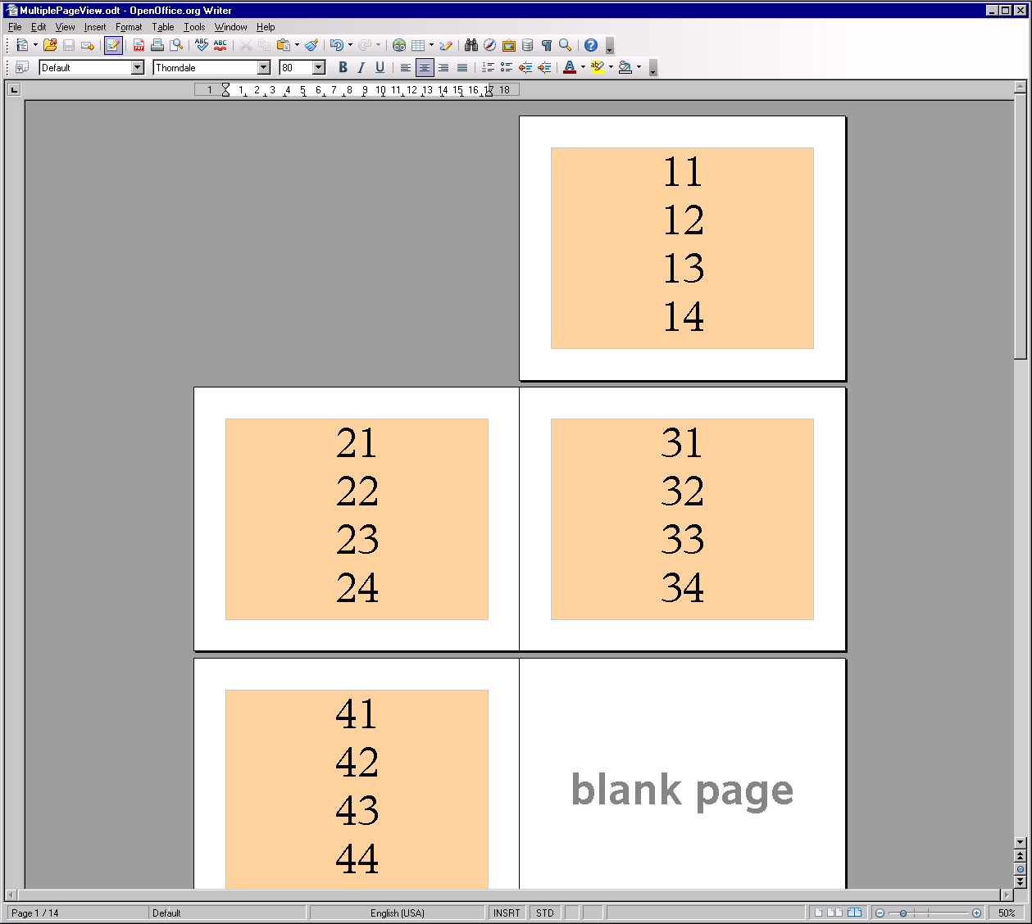
OOo 3.0 – Multiple Page View

Slide 5
OOo 3.0 – Multiple Page View
Joined project with community.
  Leonard Mada (discoleo@openoffice.org)
    specification owner evaluating the user requirements and doing a competitive analysis of other word processors
  Andreas Schuderer (arger-schnitter@gmx.de)
    JavaScript prototypes showing some possible approaches
    to this feature.
  Further community members giving feedback and ideas on the user experience mailing list (discuss@ux.openoffice.org).
Specification is found under OOo's specification project
  http://specs.openoffice.org/writer/statusbar/Multiple_Pages_View_and_Zoom_Control.odt
Further details are found at http://blogs.sun.com/GullFOSS.

Slide 6
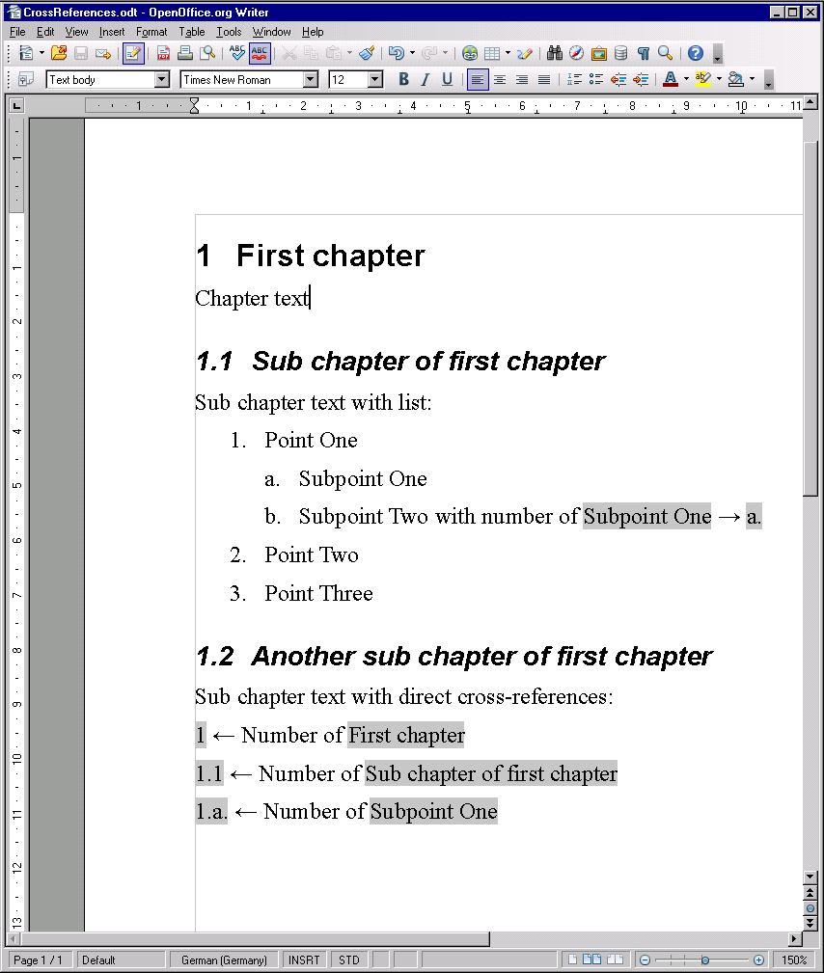
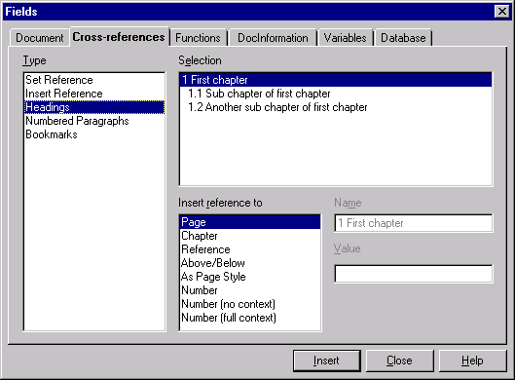
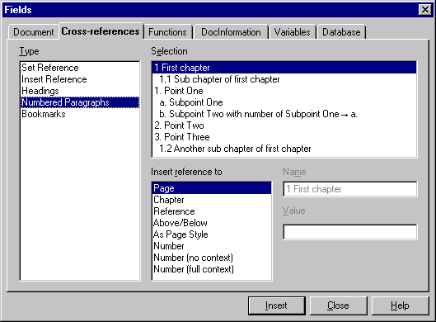
OOo 3.0 – Direct Cross-references to Headings and Numbered Paragraphs

Slide 7
OOo 3.0 – Direct Cross-references to Headings and Numbered Paragraphs
Community contribution via feedback to specification by Jacqueline Rahemipour (jr@natural-computing.de)
Specification found at http://specs.openoffice.org/writer/numbering/Direct_Cross_References_to_Headings_and_Numberings.odt.
The new reference formats had to be also introduced in ODF - see approved ODF 1.2 proposal found athttp://lists.oasis-open.org/archives/office/200701/msg00061.html.

Slide 8
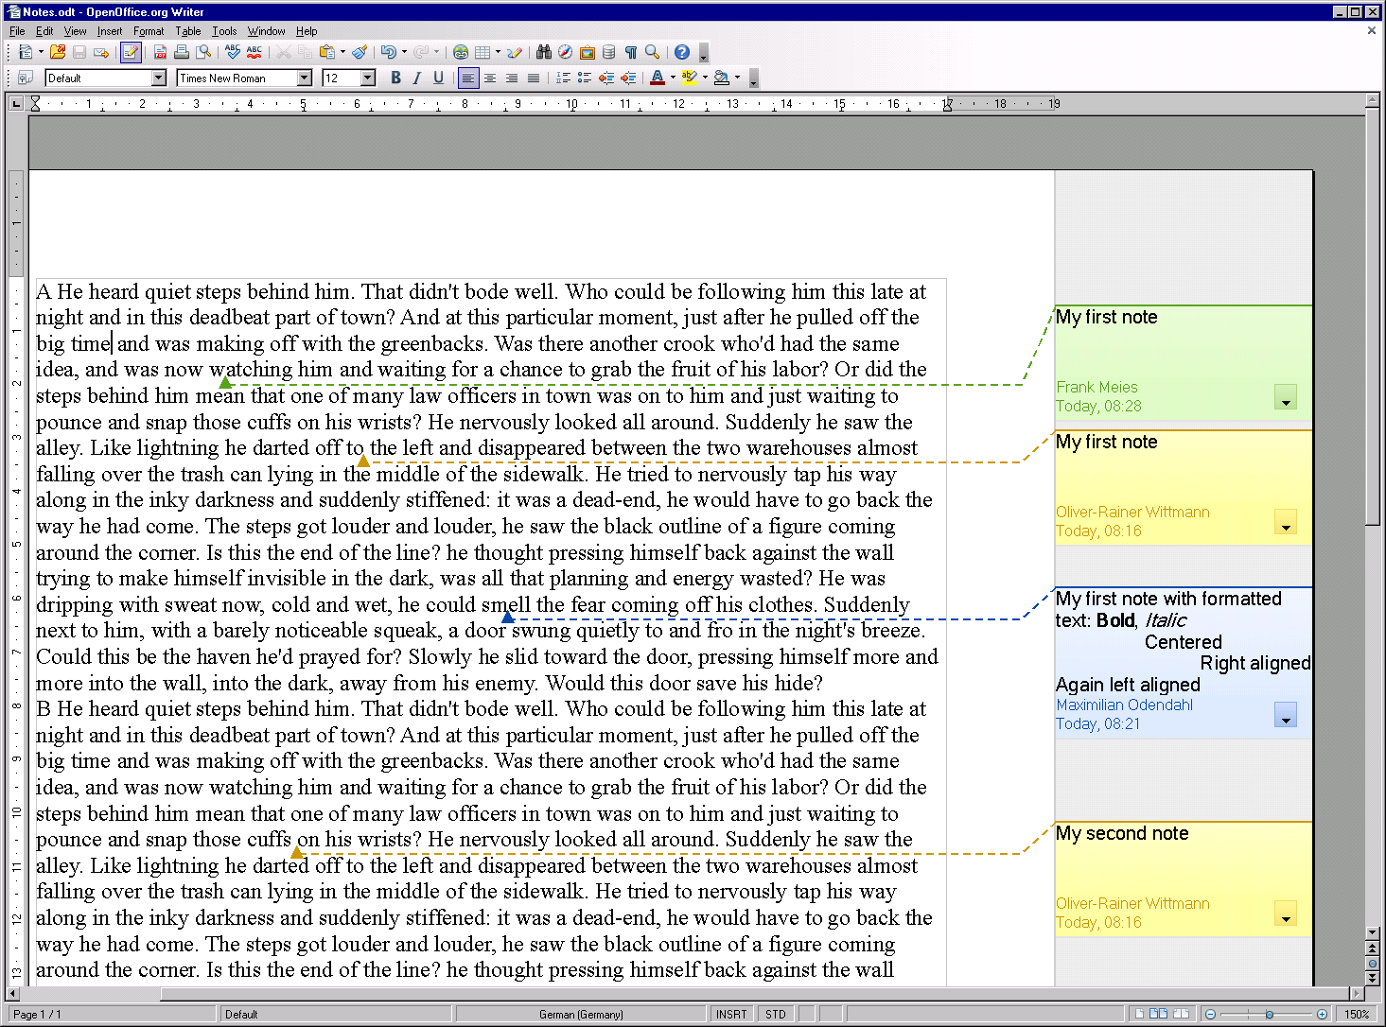
OOo 3.0 – New Notes by M. Odendahl

Slide 9
OOo 3.0 – New Notes by M. Odendahl
Project by developer Maximilian Odendahl
(info@sept-solutions.de) supported by
  Community member Christoph Noack – user experience.
  Sun's OpenOffice.org Writer team – implementation support.
  Sun's OpenOffice.org quality assurance team – QA of CWS.
See following OOoCon 2008 presentation:
  Making the New Notes - Community, Cooperation, Concepts
Enhancement for notes to annotate an arbitrary selection has been already proposed for ODF 1.2, but is not yet implemented - approved ODF 1.2 proposal found at http://lists.oasis-open.org/archives/office/200708/msg00007.html.

Slide 10
OOo 3.0 – Dictionary Extensions
Dictionaries for spell checking, hyphenation and the thesaurus can now be provided as extensions as well.
This also solved the issue 72559 which was a major
trouble when upgrading OOo.
An additional advantage for dictionaries extensions is
that it is already part of the extension mechanism to
check for updates and to install those.
See http://wiki.services.openoffice.org/w/index.php?title=Extension_Dictionaries for a reference about dictionary extensions.
All dictionaries available in the download repository
can be found at http://extensions.services.openoffice.org/dictionary.

Slide 11
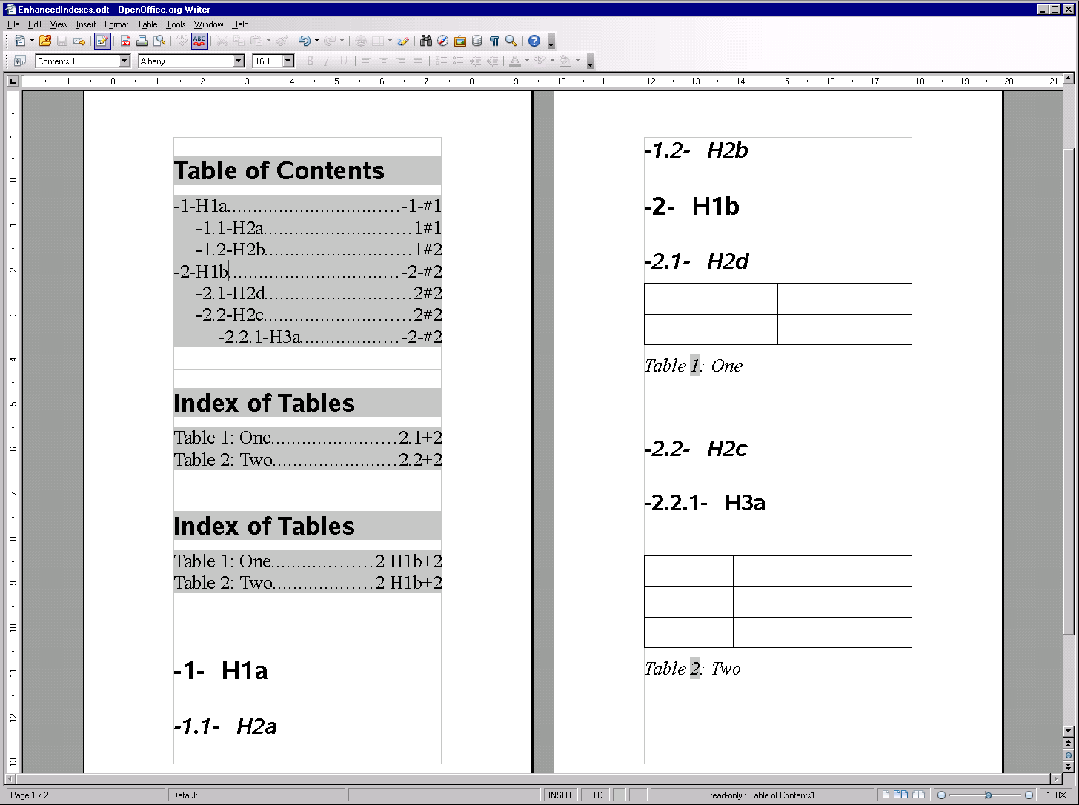
OOo 3.0 – Enhancement of Indexes by G. Castagno

Slide 12
OOo 3.0 – Enhancement of Indexes by G. Castagno
Project by developer Giuseppe Castagno (beppec56@openoffice.org) supported by
  Sun's OpenOffice.org Writer team - implementation review
  Sun OpenOffice.org quality assurance team - QA of the CWS.
OOo specification found at http://specs.openoffice.org/writer/index/index_and_tables_dialog_enhancement.odt.
Approved ODF 1.2 proposal found at http://lists.oasis-open.org/archives/office/200702/msg00173.html.

Slide 13
OOo 3.0 – Text Grid Enhancement for CJK by Novell
Extension of the text grid feature in order to meet the
CJK user's expectations and to improve interoperability
with Microsoft Word.
  former text grid mode → “squared page mode”.
  new text grid mode → “standard page mode”.
Project by Novell supported by
  Sun's OpenOffice.org Writer team – implementation review.
  Sun's OpenOffice.org quality assurance team – QA of the CWS.
OOo specification found in issue 76247.
Approved ODF 1.2 proposal found at http://lists.oasis-open.org/archives/office/200702/msg00149.html.

Slide 14
OOo 3.0 – New List Level Attributes
Former attributes
Para-Indent
+ Firstline Indent
Indent
minimum label width
Text of 1st line of paragraph
Left
min. dist. label<->text
[optional]
Right
Center
- Firstline Indent
Text of following lines of paragraph

Slide 15
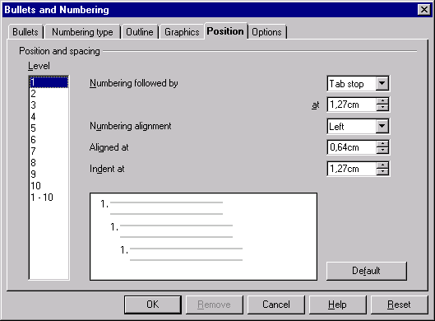
OOo 3.0 – New List Level Attributes
New Attributes
Aligned at
Tab stop
Indent at
Left
Tab
Text of 1st line of paragraph
Right
Space
Text of 1st line of paragraph
Center
Text of 1st line of paragraph
nothing
Text of following lines of paragraph

Slide 16
OOo 3.0 – New List Level Attributes
OOo specification found at http://specs.openoffice.org/writer/numbering/NewListLevelAttrs.odt.
Approved proposal for ODF 1.2 found at http://lists.oasis-open.org/archives/office/200703/msg00031.html.
Allows better compatibility with the list levels of Microsoft Word list styles.

Slide 17
OOo 3.0 – Internal Changes to Lists for ODF 1.2
Refactoring of Writer core model of lists due to the made enhancements and clarification to lists in ODF 1.2:
  Different list items of a list are allowed to have different list styles.
  Two Lists with the same list style are still two separate lists.
  Improved continuation of an arbitrary list by another list.
  Clarification of and improvement for ODF numbered paragraphs.
Approved ODF 1.2 proposal found at http://www.oasis-open.org/committees/download.php/23418/07-04-05-proposal-lists.odt.
Refactoring also considers that support for meta data at lists and list items should be possible in the future.

Slide 18
OOo 3.0 – Import for MS Word 2007 file format
New filter concept with the goal to adapt
the existing import filters (RTF and WW8) also on it.
Reasons:
  New implementation needed anyway.
  Existing filters are becoming more and
  more unmaintainable.

Slide 19
OOo 3.0 – Import for MS Word 2007 file format
Concept:
Benefit: The domain mapper can be reused for more than one source format file.
Developer Fridrich Strba from Novell (fstrba@novell.com) also contributed in the beginning.

Slide 20
OOo 3.0 – Joining Paragraphs
New rule: If two paragraphs are joined, the attributes and characteristics of the first paragraph will survive.
  Exception: The first paragraph is empty respectively its content is deleted by the join action and the second paragraph has content.
Join actions are:
  Hit Delete-Key at end of a paragraph.
  Hit Backspace-Key at beginning of a paragraph.
  Hit Delete-Key having a selection affecting more than one paragraph.
  Cut a selection affecting more than one paragraph.
Reasons:
  Former rules are not intuitive and are confusing.
  Former rules depend on change tracking being active or not.

Slide 21
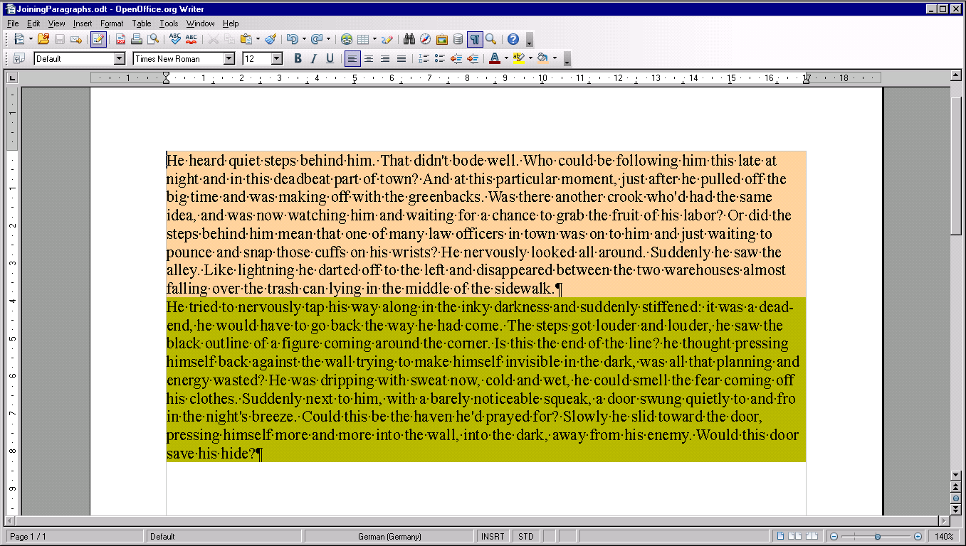
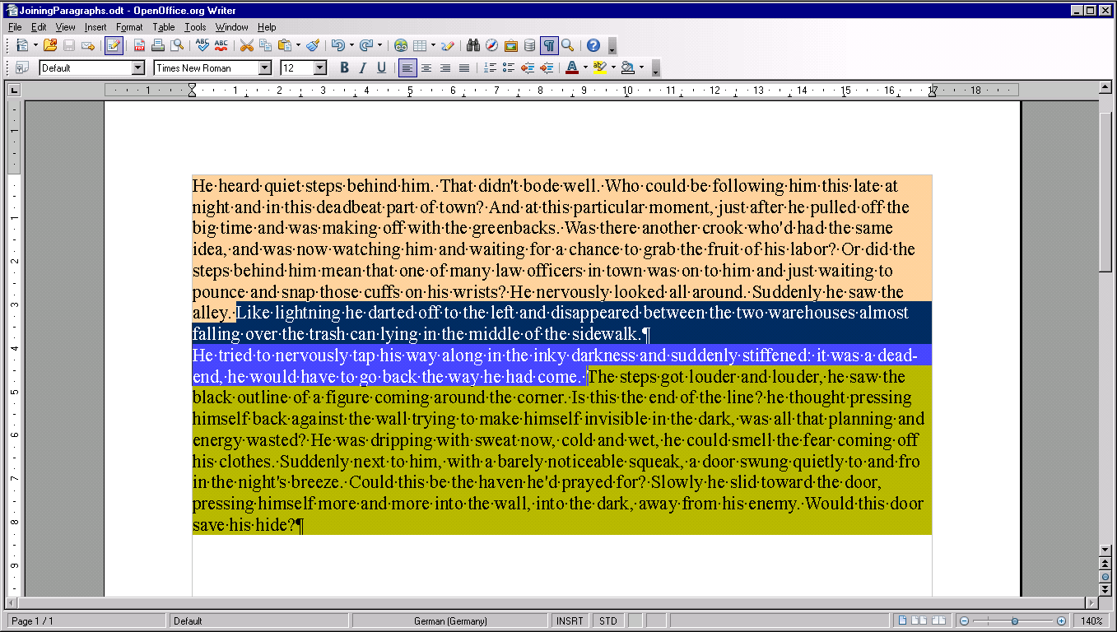
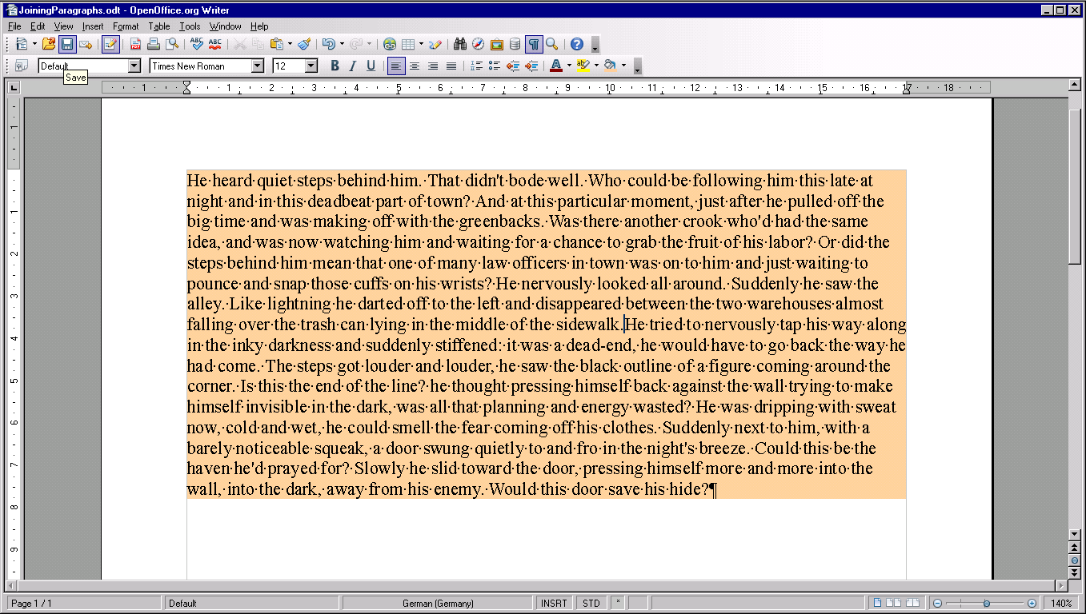
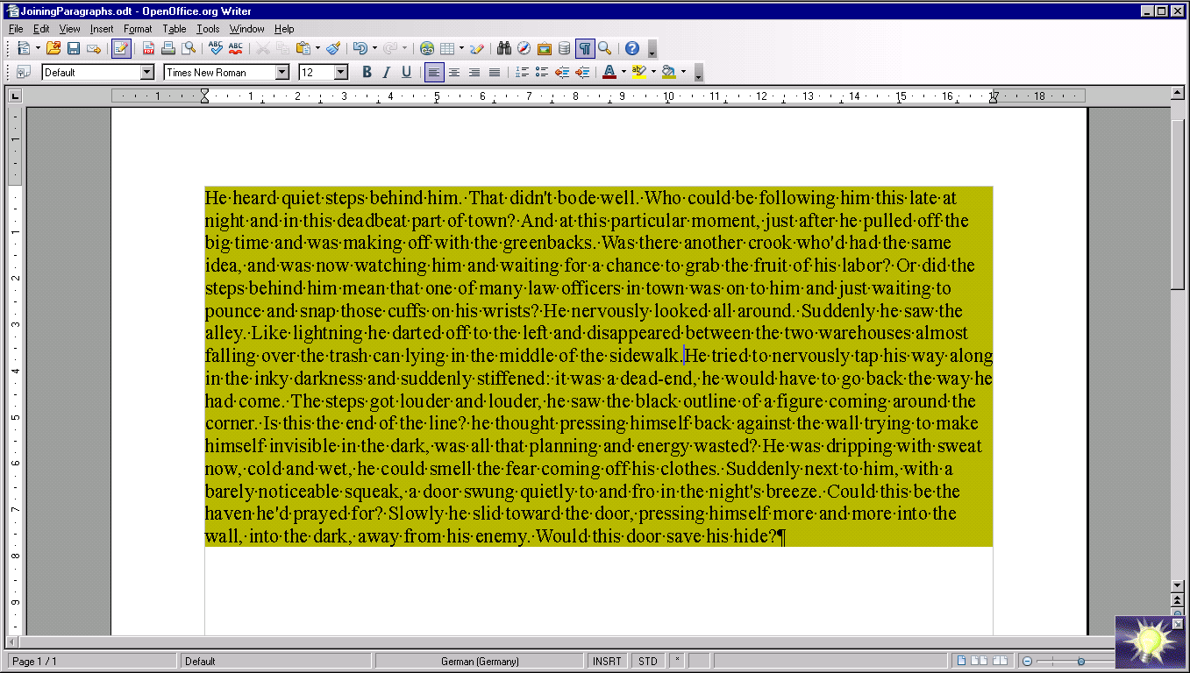
OOo 3.0 – Joining Paragraphs
OR
OOo 3.0
former OOo
former OOo
OOo 3.0
former OOo
former OOo

Slide 22
OOo 3.0 – Changes for Bullet Characters of the Default Bullet List
Bullet characters in font OpenSymbol are adjusted in order to better fit the ones used by Microsoft Word.
  Unicode code points of the bullet characters now match the ones which are typically used for bullets in fonts.
  Bullets are smaller than before.
Bullet characters are now growing/shrinking with the paragraph's font size for a default bullet list.

Slide 23
OOo 3.0.1 – Grammar Checking Framework
Grammar checking will become available for
Writer text documents.
Proof reading of complete sentences will be possible.
This should finally allow to check and correct
Chinese, Korean and Japanese text properly.
We are excited to see the first extensions providing
proof reading functionality for those languages
in the near future.
OOo specification found at http://specs.openoffice.org/appwide/linguistic/Spelling_and_Grammar.odt.

Slide 24
OOo 3.1 – Introduction of outline level
Improving the handling of headings.
Better support for corresponding ODF feature.
Joined project with RedFlag2000 developer Zhao Jianwei (zhaojianwei@openoffice.org).
Community contributions via feedback to specification by
  Jacqueline Rahemipour (jr@natural-computing.de)
  Andre Schnabel (andre.schnabel@gmx.net)
  Christoph Noack (christophnoack@openoffice.org)
OOo specification found at http://specs.openoffice.org/writer/numbering/OutlineLevel.odt

Slide 25
OOo 3.1 – ODF Numbered Paragraphs
ODF numbered paragraphs are an alternative to
represent lists and list items in ODF.
They are declared by <text:numbered-paragraph>
XML elements.
These will be imported and converted into lists and
list items in OOo 3.1.
OOo will not export ODF numbered paragraphs.
Instead ODF lists and list items will be written
into the ODF.

Slide 26
OOo 3.x – Support of ODF 1.2 Meta Data
Currently working on (CWS odfmetadata2):
  Implementation of a RDF/RDFa repository for
  all OpenOffice.org applications.
  Support for metadata at paragraphs and headings.
  Support for metadata at bookmarks.
  Implementation of metadata text.
  Implementation of metadata field.
Future tasks are to complete the support for metadata
for the other text document entities.
All is based on the approved ODF 1.2 metadata
proposal found at http://www.oasis-open.org/committees/download.php/26847/08-01-16-ODF-Metadata-Proposal-Committee-Draft.odt.

Slide 27
OOo 3.x – Support for Multiple Different Views for a certain Text Document
Implementation of support for different views with
different view options in Writer.
Joined project with OOo Writer team of RedFlag2000.
Certain refactorings of the Writer layout are needed.
Benefits:
  Browse view beside HTML source view.
  Normal view beside view with field codes.
  Further views are easier to support, e.g. outline view.

Slide 28
Influence of ODF on OOo
The following facts
  The OpenDocument file format (ODF) is a standardized
  file format under the control of Organization for the
  Advancement of Structured Information Standards (OASIS).
  OpenOffice.org is an ODF supporting application.
    The most important one in my eyes.
  A new feature or enhancement for OOo which needs to be made persistent in a document's file typically requires a change of ODF.
mean that
  the conformance of OOo to the OASIS ODF standard
  and the interoperability to other ODF supporting application
  have to be considered.

Slide 29
Influence of ODF on OOo
Several solutions are possible to keep OOo conforming to ODF and to respect interoperability to ODF supporting applications.
Proposed solution is:
  Check support for the proposed change in the OASIS ODF TC and submit a corresponding proposal to OASIS ODF TC.
  Be open for amendments and changes to the proposal.
  Implement the feature and assure
    that the OOo user is supported on the creation of ODF documents conforming to ODF's highest conforming level and
    that the created ODF documents containing the feature are at least conforming to ODF's lowest conforming level.
  Adjust the implementation, when OOo in general supports the
  new ODF version containing the proposed change.

Slide 30
Meet the Sun Experts at the Sun Booth
Oliver-Rainer Wittmann
oliver-rainer.wittmann@sun.com
od@openoffice.org

