Slide 1

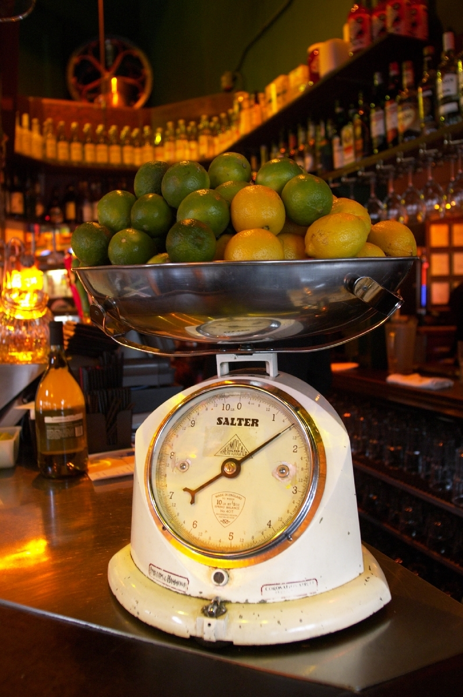
Numbers, Numbers,
Numbers
Andreas Bartel
Christian Jansen
User Experience Engineering
Sun Microsystems, Inc
11

Slide 2
Data is Good Because
Only a small portion of OO.o users can or are
willing to share their usage experience verbally
User reports are biased to individual
perceptions and attitudes
User reports are limited in their validity to uncover the real usability problems
User reports consume a lot more effort to analyze
We need to find usability issues that appear systematically and concern a wide
range of users

Slide 3
User Feedback

Slide 4
User Feedback Extension
The „OpenOffice.org User Feedback Extension“ is an extension that collects data about how OpenOffice.org is used
This information is used to better understand how people use OpenOffice.org

Slide 5
We Want To Know...
Which commands are used frequently?
Which are not?
In which order do they use them?
Are there features people request
(IssueZilla, Mailing Lists, etc), because they
do not find them?

Slide 6
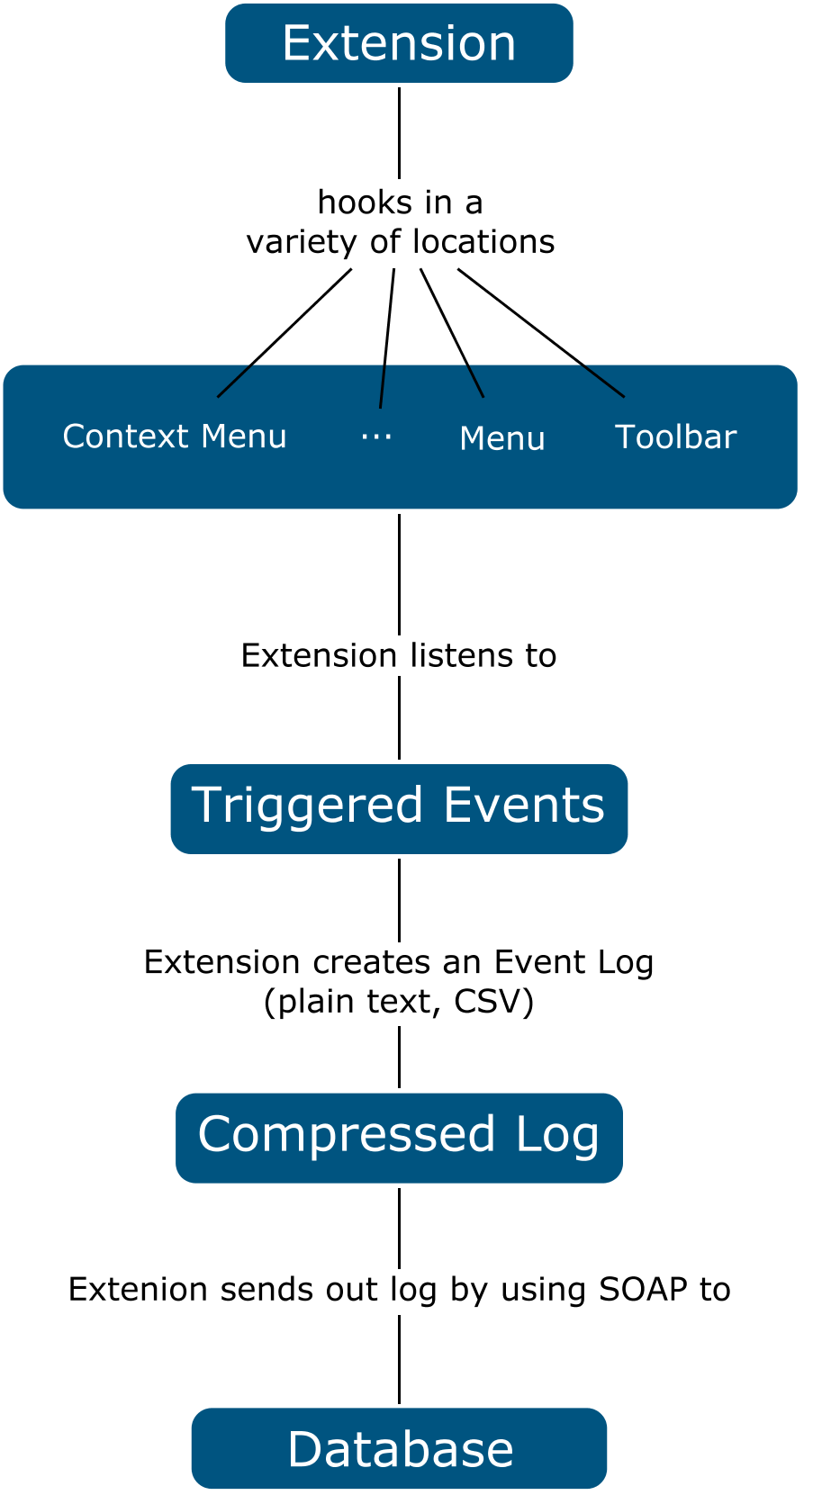

Slide 7
Privacy
The data is collected anonymously
The extension does not collect any document related keyboard input
The extension does not send any
user specific type of data
No relation ship between IP Address and sent report by SOAP request

Slide 8
Next Steps

Slide 9
Analysis
Results will be published on ux.openoffice.org
  OpenOffice wide use of features
    Ranked by count & percentage
  Application wide use of features
    Ranked by count & percentage
  Usage of features compared by applications
  Feature usage compared by UI elements
    menu, context menu, tool bar, keyboard shortcut
  Heat Maps
  Click Path Analysis

Slide 10
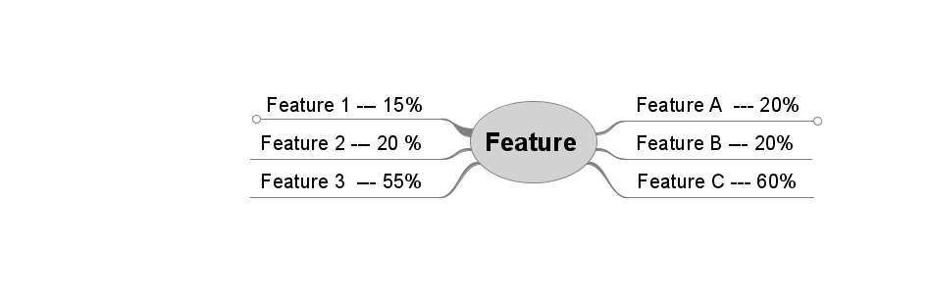
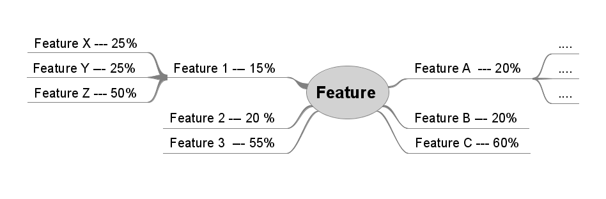
Click Paths

Slide 11
References
Project Home:
  http://wiki.services.openoffice.org/wiki/User_Experience/OpenOffice.org_User_Feedback_Extension:

Slide 12
IsoMetrics

Slide 13
Why using a questionnaire
No bias to an interviewer or a laboratory setting
  Users remain in their natural environment
Ability to reach a large set of users quickly
  Online version
A low-cost method
  No need for expensive equipment and laboratories
A systematic approach that can be repeated easily
  Redistribute the questionnaire at any time

Slide 14
Why using IsoMetrics
It is based on an international norm
  ISO 9241-10
It is fully standardized
  The questions, their order and the rating scale are fixed
Proven in academia and in the field
  Meets the required objectivity, reliability and validity
Available for summative and formative evaluation
  Ability to clarify how and why usage is good or bad

Slide 15
What are the ingredients
A set of 75 questions or statements called items
Organized in 7 user perceived quality criteria
  Suitability for the task (15)
  Self descriptiveness (12)
  Controllability (11)
  Conformity with user expectations (8)
  Error tolerance (15)
  Suitability for individualization (6)
  Suitability for learning (8)
A rating scale for the level of agreement

Slide 16
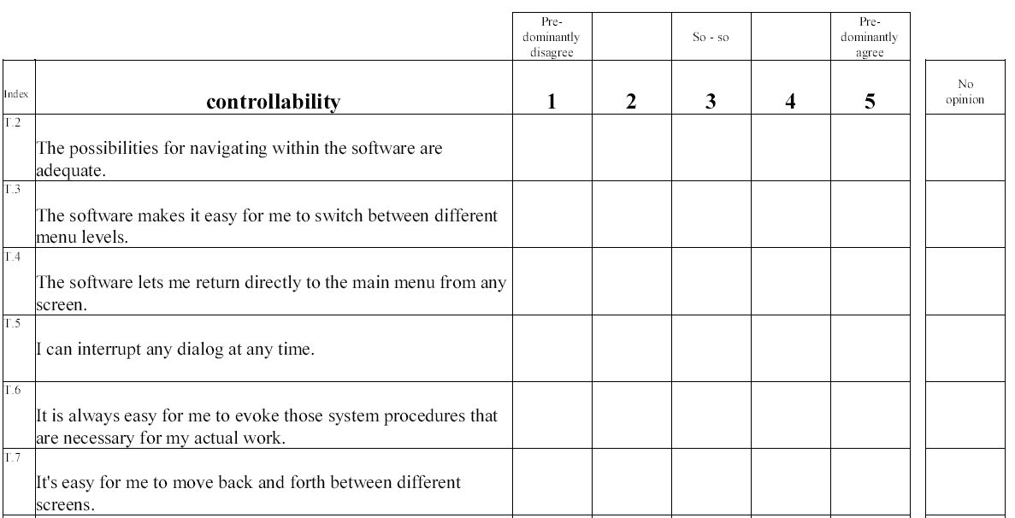
IsoMetrics example

Slide 17
What is the gain for OpenOffice.org
How good?
  Does OO.o meet the criteria in ISO 9241-10?
  Where are our strengths and our weaknesses?
Why bad?
  What are the reasons for usability problems?
  How can we improve?
Which is better?
  Do we improve over major releases?

Slide 18
First IsoMetrics-S rollout
Teamed up with a local insurance company
  VBG is using OpenOffice.org since 2004
  They have 1800 seats
  Very interested in improving usability and productivity
Started collaboration in April 2008
  Clarified the context
  Ensured company-wide acceptance
  Implemented an online version using LimeSurvey
Started collecting data in October 2008
  So far, over 180 responses

Slide 19
Preliminary results I

Slide 20
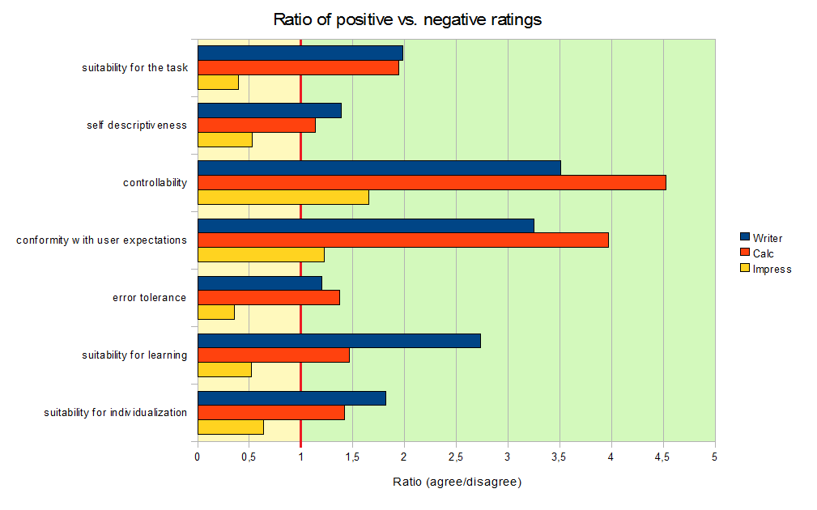
Preliminary results II
Suitability for the task
Self descriptiveness
Controllability
Conformity with user expectations
Error tolerance
Suitability for learning
Suitability for individualization

Slide 21
Is it bad doctor?
We did not fail!
  35% of users rate predominantly positively
  25% of users rate predominantly negatively
We did not win a trophy!
  40% of users certify us meritocracy
We have a lot room for improvement
  Error tolerance
  Self descriptiveness
  Suitability for learning

Slide 22
What is to come
A thorough data analysis
  OO.o versions
  Linux vs. Windows
  Users' knowledge
Rollout of IsoMetrics-L
  We want to know why things go wrong
Benchmarking in other contexts
  How is user perceived quality rated in a different context
  Are there any commonality of usability problems

Slide 23
References
http://www.isometrics.uni-osnabrueck.de/index.htm
ISO (1992). ISO 9241 Part 10. Ergonomic requirements for office word with visual display terminals (VDTs), Part 10: Dialogue Principles, First Committee Draft, September 1991.
Hamborg, K.-C, Vehse & B, Bludau, H.-B. (2004). Questionnaire Based Usability Evaluation of Hospital Information Systems. Electronic Journal of Information Systems Evaluation, 7 (1), 21-30.
Gediga, G & Hamborg, K.-C. (1999). IsoMetrics: An usability inventory supporting summative and formative evaluation of software systems. In: H.-J- Bullinger & J. Ziegler (eds.). Human-Computer Interaction.
Gediga, Hamborg & Düntsch (1999). The IsoMetrics Usability Inventory: An operationalization of ISO 9241-10, Behavior and Information Technology, 18, 151 - 164.

Slide 24
Q&A

Slide 25


Andreas Bartel, Christian Jansen
ux.openoffice.org

