Slide 1


Registration and how OpenOffice.org benefits
Martin Damboldt
  Program Manager OpenOffice.org
    Sun Microsystems Inc.
1

Slide 2
Agenda
Registration whats that?
  Where to trigger
  Service Tags how they work
  How does it look like
Benefits / What we can read from it
  One way communication vs. two way
  Promote OpenOffice.org special offerings
  Become more data driven for future development
Summary
Q&A

Slide 3
Product Registration whats that?

Slide 4
Product Registration whats that?
It's not the OOo user Survey I'm going to talk about
(This was mentioned in the UX track on Thursday)
Starting with OpenOffice.org 2.3.1, product registration was introduced
Triggered
  at the end of the First Start Wizard
  or from the correspoding icon of the backing window
  or via menu entry “Help->Registration...”

Slide 5
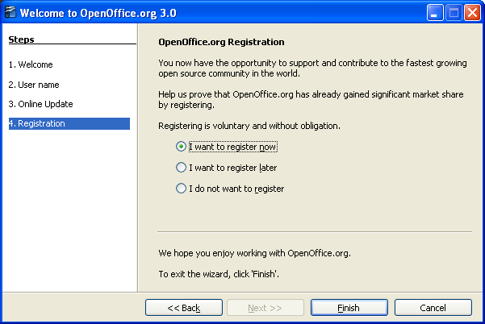
Registration at First Start Wizard

Slide 6

Registration in the Start Center

Slide 7
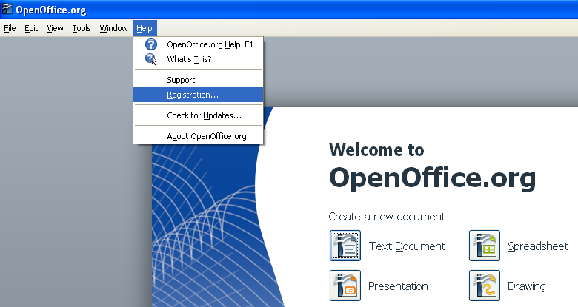
At the menu “Help->Registration...”

Slide 8
Product Registration whats that?
It's optional
The OOo User Survey is still there
The mechanism behind product registration we call
Service Tag

Slide 9
What Service Tags are

Slide 10
Service Tag
Service Tag – basically a small unique product ID stored in the OOo configuration files
  urn:uuid:00c01e7f-36f9-11dd-9b49-080020a9ed93
Different product use different ID's
This product ID is being put into an xml file together with additional informations like product name, product version, an instance id, platform information and a time stamp
Together this looks like the following...

Slide 11
Service Tag (2)
Whats included in the product registration
  Example of a Service Tag xml file – part 1
<?xml version="1.0" encoding="UTF-8" standalone="no"?>
<registration_data version="1.0">
<environment>
<hostname>md-vaio</hostname>
<hostId/>
<osName>Windows XP</osName>
<osVersion>5.1</osVersion>
<osArchitecture>x86</osArchitecture>
<systemModel>PCG-V505BP(DE)</systemModel>
<systemManufacturer>Sony Corporation</systemManufacturer>
<cpuManufacturer>GenuineIntel</cpuManufacturer>
<serialNumber>28108251-5320307</serialNumber>
</environment>

Slide 12
Service Tag (3)
  Example of a Service Tag xml file – part 2 of 2
<registry urn="urn:st:61275b18-d72b-4876-8c6d-a4de02f0aca2" version="1.0">
<service_tag>
<instance_urn>urn:st:7002e77e-af3b-43ad-a996-b9e22bebc7a3</instance_urn>
<product_name>OpenOffice.org 3.0</product_name>
<product_version>3.0</product_version>
<product_urn>urn:uuid:00c01e7f-36f9-11dd-9b49-080020a9ed93</product_urn>
<product_parent_urn/>
<product_parent>OpenOffice.org 3.0</product_parent>
<product_defined_inst_id/>
<product_vendor>Sun Microsystems, Inc.</product_vendor>
<platform_arch>x86</platform_arch>
<timestamp>2008-10-29 15:03:22 GMT</timestamp>
<container>global</container>
<source>OOO300m9(Build:9358)</source>
<installer_uid>-1</installer_uid>
</service_tag>
</registry>
</registration_data>

Slide 13
Service Tag (4)
Informations are being send via POST request
Temporary stored
Without registration stored informations will be deleted within an hour
After registration product informations are stored in the database and can be viewed within your personal account.

Slide 14
How does it look like

Slide 15


Slide 16
Benefits / What we can read from it

Slide 17
One way vs. two way communication
Users who register are willing to receive additional informations related to the product they register.
This is our chance!

Slide 18
Get in touch with users
Make people aware of items they might don't know yet
Remember, they are willing to receive additional product related items. They are willing to get in touch. This is an excellent opportunity to get more informations about their needs.
Some examples...

Slide 19
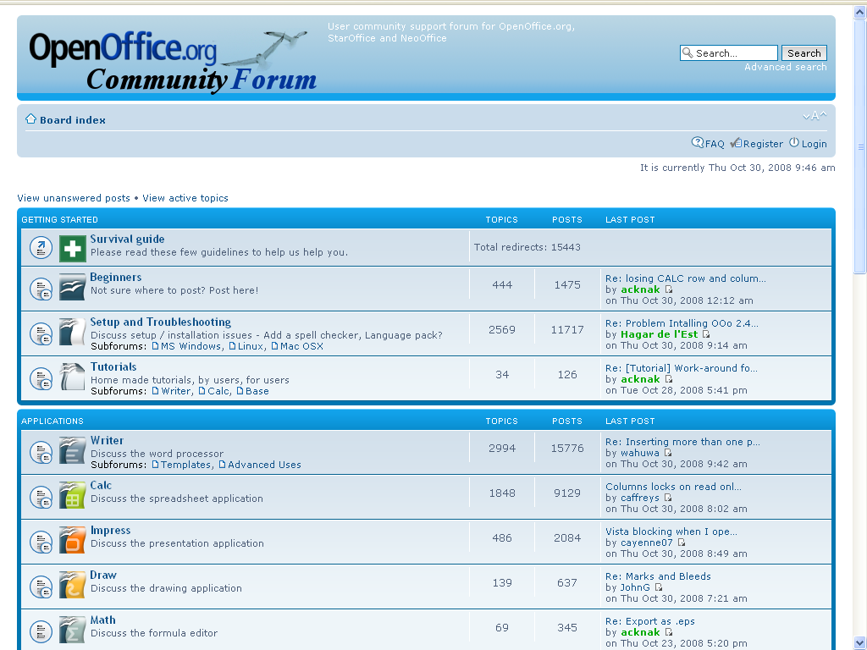

Get in touch with users
For example to promote the new OpenOffice.org Community Forum
http://user.services.openoffice.org/en/forum/listforums.php
NEW!

Slide 20
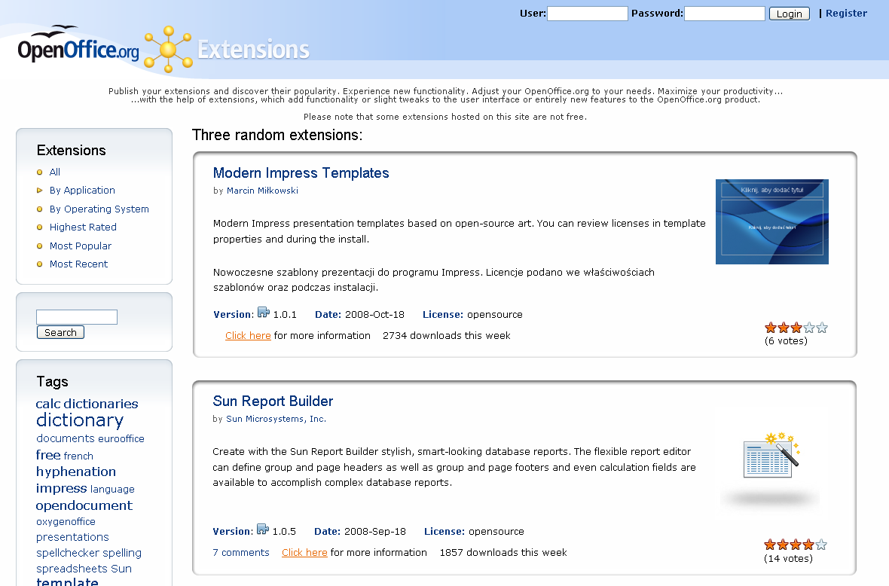
Extension Repository
<link to Extension Repository>
http://extensions.services.openoffice.org/

Slide 21
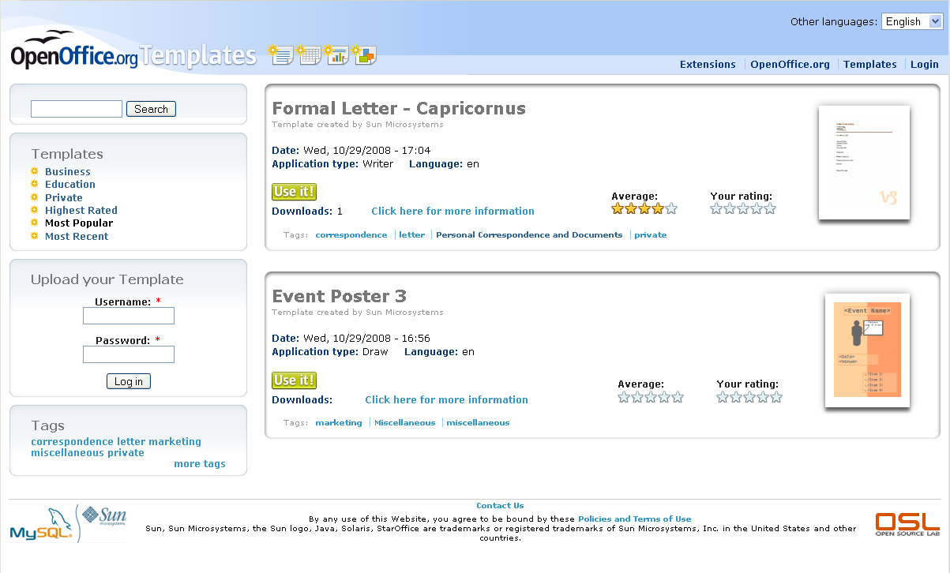
New Template Repository
http://templates.services.openoffice.org/

Slide 22
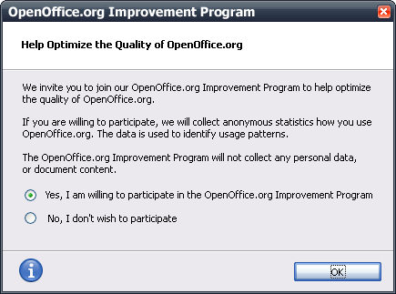
New OOo User Feedback Extension
An Extension that collects data about how OpenOffice.org is used
Very simple way to provide feedback
The information is used to better understand how people use OpenOffice.org
Detailed presentation today at 14:00 to14:45 Numbers,Numbers, Numbers
http://wiki.services.openoffice.org/wiki/User_Experience/OpenOffice.org_User_Feedback_Extension

Slide 23
More we can think of...
Notification of new versions, patches and updates
  Promote the latest release in detail e.g. the latest features or even for the newest security fixes which are part of the release
Access to early releases and documentation
  Invite former Beta users to the upcoming release
Get in touch with MacOS X users who registered their product and do a survey about missing Mac specific features they hardley miss.
And sure you guess it already...

Slide 24
Become more data driven for future development
Find out details from product registrations which can help to make development decisions.
  Did you know that nearly 30 % of all OOo product registrations are being done on Vista?
  The native MacOS X version of OOo 3.0 seem to appear from nowhere right to nearly 13 % of all?
  Older platforms like Win2k we can see dropping from
  1.2 % to 0.9 % comparing OOo 2.4 vs. OOo 3.0

Slide 25
Summary
Registration identifies those that may want to more actively participate.
Receive numbers which can help to nail down decisions for future development.
Registration also shows market share which can show the adoption of OpenOffice.org by the world and convince others to adopt it as well.
If people register the product, they likely want to interact with us. And registering allows us to interact more with you. Nothing subversive. Nothing to hide. And it's optional :)

Slide 26
Last but not least something really cool...

Slide 27
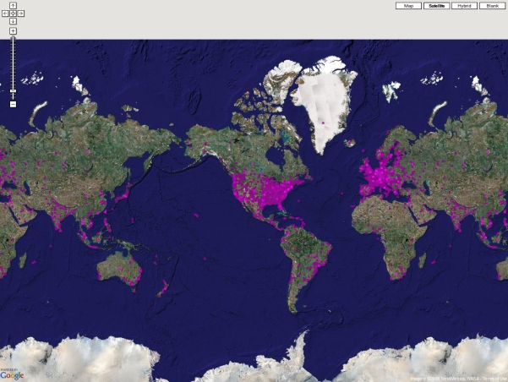
OpenOffice.org 3 product registrations

Slide 28
Q&A
Meet the Sun Experts at the Exhibition

Slide 29

Thank you!
Martin Damboldt
  martin.damboldt@sun.com
1

