Slide 1

Notes:
Honour to be here
We think the conference is a huge success, so we do our best not to spoil it
We have an interesting topic to present

Slide 2

The New Drawing Core
State-of-the-Art Vector Graphic With OpenOffice.org
Armin Le Grand, Sun Microsystems
Herbert Duerr, Sun Microsystems
Thorsten Behrens, Novell
Notes:
AW: If there is a “Mr. DrawingLayer-Rework” it is him
Speakers:
HDU: gets things done where others have long despaired
THB: throws away what's beyond fixing

Slide 3
Outline
DrawingLayer: What is it?
Why a new DrawingLayer?
Traits of the New DrawingLayer
Status of the Rework
DrawingPrimitives: What are they?
Demo
Perspective

Slide 4
DrawingLayer
somewhat of a middle layer between rendering subsystems and application cores
used by all of OpenOffice.org's applications: Draw/Impress, Chart2, Calc, Writer to view & control these shapes
shared application trunk for those pesky
'Draw Shapes'
Notes:
it is used by all apps for their “drawing needs”:
-painting
-interaction
-calc: pictures, ole objects, etc
-writer: draw shapes
Really all apps (except math)
There are some problems with the old drawing layer
concepts & code base

Slide 5
(Some) OOo Architecture
Top Layer
GUI
CUI
ODF
UNO
Writer
Math
Wizards
Calc
Base
XML
Impress
IDE
Mid Layer
GUI
CUI
UNO
FWK
i18n
Common GUI
Drawing Layer
BASIC
System Integration
Help
Utilities
Framework
UNO
VCL
Notes:
DejaVu? Yes, the architecture is the same as two years ago
Here are the applications that users see
Here is the middle layer, that does most of the work for the applications
Below that are the system abstraction layers
And HERE is the DrawingLayer
Yes, that little box there...
also the whole drawing was painted with the DrawingLayer
when you have edited a presentation in Impress you know what you can do with e.g. graphics: click to select them, group/ungroup, etc. the drawinglayer is responsible for that

Slide 6


DrawShapes
Notes:
3d rotation object, with line & fill style & transparence
colored polygon
hatched polygon
bitmap-textured polygon

Slide 7
Why a New DrawingLayer?
graphics requirements are evolving steadily
the old DrawingLayer is insufficient for that
it is difficult to maintain
it is very hard to extend
no separation between model and view
tight coupling with application code
and with system layer code
Notes:
due to evolution the old code finally suffered from
hacks+workarounds sedimentation sclerosis, meaning that with every
change you do, you generate several new non-trivial bugs (which
effectively means, every change makes the whole system worse than
before) – both behavioural & from code maintainability

Slide 8
Traits of New DrawingLayer
allowing hierarchy of model objects
extracting common functionality into tooling libraries
extracting view into renderers
decoupling data structures from algorithms
the migration strategy is guided by:
Backward Compatibility
Notes:
traits == design target
hierarchy of model objects:
drawinglayer (DrawingPrimitives)
tooling libraries:
basegfx, drawinglayer
- extracting view into renderers
- decoupling data structures and algorithms
- conditio sine qua non: compatibility, and a migration strategy
=> finally allowing complex transformations of the view (perspective, shearing,
gradients, texturing)

Slide 9
Additional Benetfits
important information is not lost too early
which also helps to improve the performance because algorithms have the big picture
“the forest is more than a number of trees”
finally allowing complex transformations of the view
  perspective
  shearing
  gradients/texturing
Notes:
further benefits:
=> important geometric information is not lost too early
=> solving performance problems when decomposing into line-segments
many algorithms are O(n)O(n*logn) O(n^2) e.g. for intersection
concrete example: clipping of rectangle with circle – if you do it on the polygon level, it's expensive. if you do it on the higher geometry level, it's trivial
=> finally allowing complex transformations of the view (perspective, shearing,
gradients, texturing)

Slide 10
History of the Rework
CWS aw024 (2004-2005)):
  reworked paint handling
  introducing View/Object/Control into the DrawingLayer
  start extracting helper code into own libraries
CWS aw033 (2005-2008):
  DrawingPrimitives
CWS aw057 (2008):
  Fixing Regressions
  Removing obsoleted code
Notes:
DrawingLayer rework ChildWorkspaces are some of the most long-lived CWSses known to be integrated

Slide 11
DrawingPrimitives?!
represent the look of the model objects
complex DrawingPrimitives are based on simpler DrawingPrimitives
this hierarchy mirrors the hierarchy of model objects
DrawingPrimitives can be decomposed
Notes:
methods on an abstract DrawingPrimitive:
getRange()
decompose()
are retrievable from XShapes → usable from extensions/UNO components

Slide 12
An Example
A Text
Notes:
Sample:
- Simple Text
- double underline
- underline waves
- color of underline
- shadow of all of the above
- the animation aspect

Slide 13
An Example (cont.)
the animation
  with properties like speed, path, etc.
the text
  with properties like color, font, BiDi, locale
the decoration
  double waveline below
    with properties like line thickness, color, amplitude, wavelength

Slide 14
Core Primitives
polypolygon with color
hairline
simple text
bitmaps
a metafile
...
there is no fixed set!
Notes:
No fixed set
rule: if it is cannot be split up into lower BasePrimitives (“Decomposition”)
all renderers have to implement all core primitives

Slide 15
Benefits
allows excellent backward compatibility
fixes many dead ends / missing features / bugs that showed the limits of the old code
makes new features affordable that would have been prohibitively expensive before (both performance and effort-wise)
allows major performance improvements
same approach is used for 3D
Notes:
allows fast jump start by allowing full functionality by just rendering a minimal set
major performance improvements possible by implementing specialized and optimized Primitives
- maybe also “merging/optimizing of DrawingPrimitives”?
e.g. a clip primitive followed by geometry that is fully clipped away

Slide 16
Decomposition Details
two kinds of decompositon:
  view independent (e.g. filled rectangle →polygon)
  view dependent (e.g. hair line → AreaPolygon)
  allows the visually best rendering
only decompose into Primitives that are more simple
Note: the toplevel primitive from each model must be view independent
Notes:
toplevel primitives
complex primitives
core primitives

Slide 17

Demo (before)
Notes:
corners of the rectangle – nicely rounded in new DrawingLayer
shadow in the clamped fill
!!ANTIALIASING!!

Slide 18
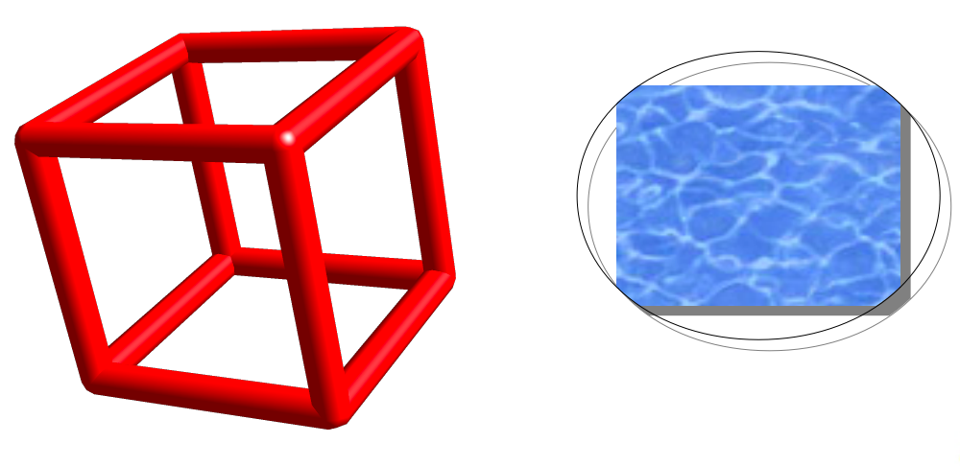
Demo (after)
Notes:
corners of the rectangle – nicely rounded in new DrawingLayer
shadow in the clamped fill
!!ANTIALIASING!!

Slide 19
Where Are We?
the major rework has been done
many minor bugs and problems like missing features or dead ends are gone for good
very good backward compatibility
anti-aliasing can be enabled
rendering is much more correct (“round circles”, correct shadows)

Slide 20
What's Up Next?
3.1 will have new DrawingLayer handle:
  hit testing and interactions
  full repaints and partial repaints
  pages, grids and previews
DrawingPrimitives can potentially be used in all places where MetaFiles are still needed:
  slideshow
  PDF-export, printing and flash export
adding UNO access to base DrawPrimitives

Slide 21
Q & A

Slide 22


