Slide 1
OpenOffice UI layout
November 2008
Michael Meeks
michael.meeks@novell.com
“Stand at the crossroads and look; ask for the ancient paths, ask where the good way is, and walk in it, and you will find rest for your souls...” - Jeremiah 6:16

Slide 2
Overview
The problem
  understanding the issues
  comparing ourselves with the others
Outline of dialog layout
  the curious design
  the minimal code changes
  the end result
Getting it & helping out ...
Conclusions

Slide 3
The problem(s)

Slide 4
OO.o's GUI problems ...
Scale
  ~½ million lines of .src/.hrc, >1 million lines of GUI interacting code
  Comparison: mozilla's browser.jar: all 47 .xul = <7000 lines.
The UI looks 'ugly' ...
  no layout support in toolkit
  native theming not perfect.
  no User Experience UI editing ...
Fairly tight coupling code -> VCL
Defeatist attitude ...
  no-one has succeeded => it is impossible => no-one can succeed => no-one tries: it can't be done !
  “it can only be fixed by a 100 man-year effort”...

Slide 5
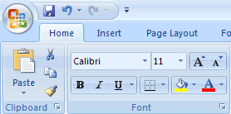
Cell formatting … MS
Beautiful Ribbon all well & good (or not) but …
Ultimately – a thinnish wrapper hiding some of the underlying dialogs for some tasks:

Slide 6
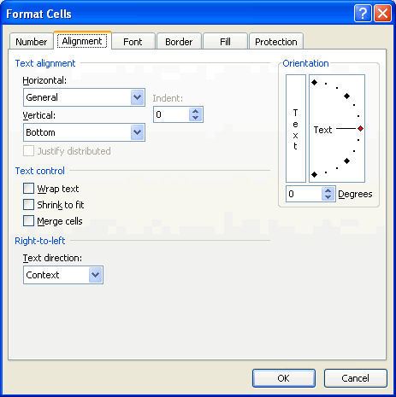
Cell formatting … MS

Slide 7
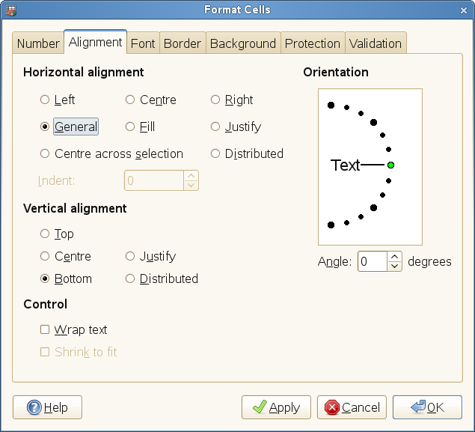
Cell formatting … Gnumeric

Slide 8
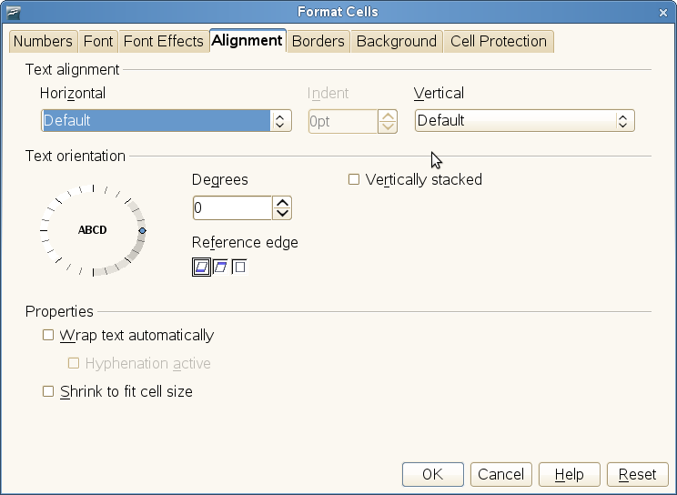
Cell formatting … Calc

Slide 9
Platform widgets ...
OS/X 's widgets are “chunkier” than ours
So to fit the widgets in can either:
  leave extra space for them ?
    Makes other people's apps look ugly
  or render & interpolate down the widgets
    Making them look extremely ugly
Previously seen in eg. properties dialogs
  I assume the Mac people chose one of the above.
Some platform's widgets “pulse” or do odd things
  By far the best to use the native widgets where possible.

Slide 10
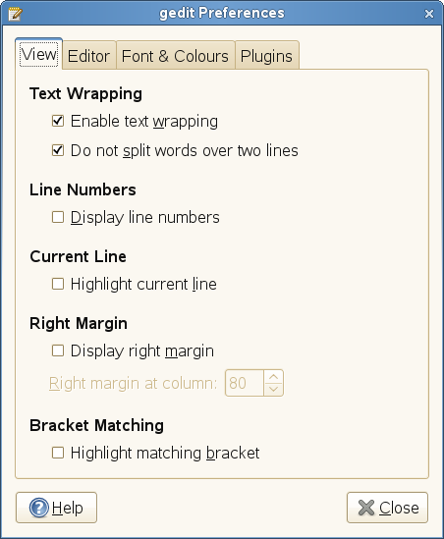
HIG compliance ...

Slide 11
A solution ...

Slide 12
An incremental solution ...
Try not to do all 10man-years of work for the 1st release:
flat .RES
format
XML incl.
layout
layout-src2xml
(Kohei Yoshida)
toolkit/source/awt
Huge pile of
old OO.o code
awt::VCLXWindow
VCL
VCL-like-API
awt::VCLXWindow
Gtk+
toolkit/layout/source/vcl

Slide 13
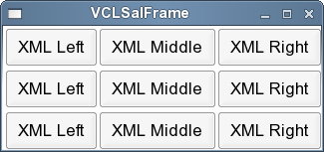
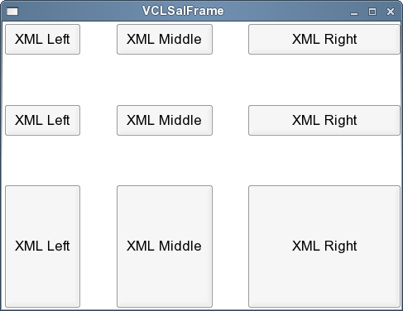
A container base: the box ...
Re-sizing & re-layout ...
<vbox>
<hbox cnt:expand="false" cnt:fill="false">
<pushbutton label="XML Left"
cnt:expand="false" cnt:fill="false"/>
<pushbutton label="XML Middle"
cnt:expand="true" cnt:fill="false"/>
<pushbutton label="XML Right"
cnt:expand="true" cnt:fill="true"/>
</hbox>
<hbox cnt:expand="true" cnt:fill="false">
...
<hbox cnt:expand="true" cnt:fill="true">
...

Slide 14
Yet-Another-XML-format ...
<modaldialog xmlns="http://openoffice.org/2007/layout"
xmlns:cnt="http://openoffice.org/2007/layout/container"
id="dialog" title="Test-Dialog" optimumsize="true" border="true"
sizeable="true" moveable="true">
<hbox padding="4">
<vbox cnt:expand="true" cnt:fill="true" padding="4">
<fixedline label="Zoom factor" cnt:expand="true"/>
<radiobutton group="zoom" id="WholePage" label="Whole Page"/>
<radiobutton group="zoom" id="PageWidth" label="Page Width"/>
<radiobutton group="zoom" id="Optimal" label="Optimal"/>
<radiobutton group="zoom" id="Zoom200" label="~200 %"/>
...
<hbox padding="2">
<align v-align="0.5" cnt:expand="false">
<radiobutton group="zoom" id="BtnUser" label="~Variable"/>
</align>
<metricfield id="User" value-step="1" custom-unit-text="%"
repeat="true" border="true" cnt:expand="true"/>
</hbox>
</vbox>
<vbox padding="4">
<okbutton id="OkButton" cnt:expand="false" default="true"/>
<cancelbutton id="CancelButton" cnt:expand="false"/>
<helpbutton id="HelpButton" cnt:expand="false"/>
</vbox>
</hbox>
</modaldialog>

Slide 15
The massive code changes:
zoom.hxx
@@ -1,12 +1,9 @@
#ifndef _SVX_ZOOM_HXX
#define _SVX_ZOOM_HXX
+#include <layout/layout.hxx>
+
-class SvxZoomDialog : public Dialog
+class SvxZoomDialog : public layout::Dialog
{
private:
- FixedLine aZoomFl;
RadioButton aWholePageBtn;
RadioButton aPageWidthBtn;
RadioButton aOptimalBtn;

Slide 16
The massive code changes:
zoom.cxx
SvxZoomDialog::SvxZoomDialog( Window* pParent,
const SfxItemSet& rCoreSet ) :
- SfxModalDialog( pParent, SVX_RES( RID_SVXDLG_ZOOM ) ),
+ Dialog( pParent, "zoom.xml", "dialog" ),
- aZoomFl ( this, SVX_RES( FL_ZOOM ) ),
- aWholePageBtn ( this, SVX_RES( BTN_WHOLE_PAGE ) ),
- aPageWidthBtn ( this, SVX_RES( BTN_PAGE_WIDTH ) ),
- aOptimalBtn ( this, SVX_RES( BTN_OPTIMAL ) ),
...
+ aWholePageBtn ( this, "WholePage" ),
+ aPageWidthBtn ( this, "PageWidth" ),
+ aOptimalBtn ( this, "Optimal" ),
...
(Can be hugely shrunk by re-defining SVX_RES as a 'stringifying' macro ... )

Slide 17
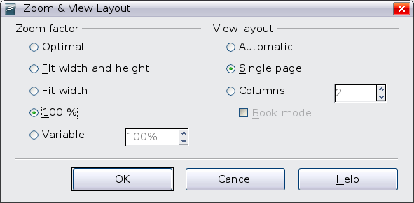
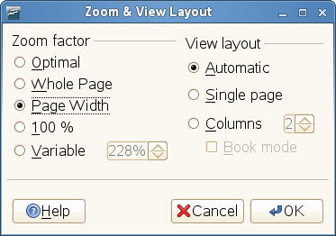
The result ...
Slightly different font sadly

Slide 18
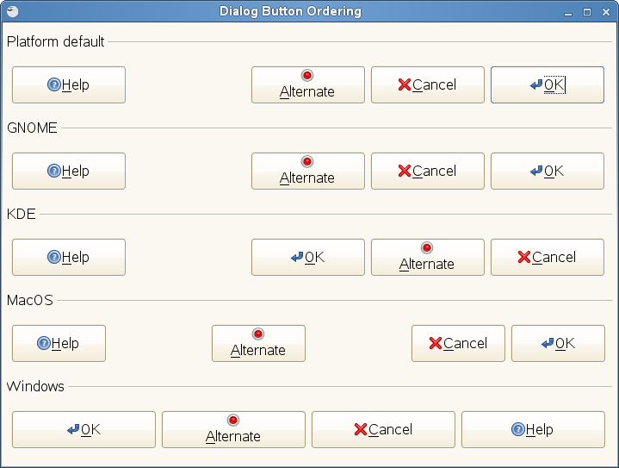
Platform button ordering ...

Slide 19
Demo ...

Slide 20
Getting it ...
Some of the work is already integrated:
  CWS awtfixes01 (pre 3.0)
    adding virtual sizing for VCL:Window
    Adding XPropertySetInfo to toolkit widgets 'What properties do you have?'
    Fixes a number of sizing & other bugs.
  CWS layoutdialogs (in 3.0)
    conditional compilation – configure with –enable-layout
    otherwise core layout code enabled by default
    i18n / translation: couple of sample dialogs: “Zoom” and “Wordcount”
Other bits in CWS:
  cd toolkit/workben/layout ; dmake
  ./TEST boxtext.xml # load an XML file
  ./TEST –test # zoom dialog
  ./TEST –editor foo.xml # basic dialog editor ...

Slide 21
Ongoing work
More complex calc dialogs
  Format cells dialog ...
  filling out missing VCL wrapper API as we go ...
Tab dialogs
  more tricky =>
  short-circuiting the purist approach
    Embed non-layout widgets inside layouted ones & vv.
Java.properties for i18n ?
Packing up app UI XML files in a .zip container
Bug fixing
CSS for properties ?

Slide 22



Conclusion / Q&A
One solution for improving the UI by
adding layout
Simple code changes / minimal skills required
  A great place to get involved with OO.o
  Lots of bang & prettiness added for very little buck.
  Contact me, or janneke@gnu.org with your patches
  Or quizz us about it on irc.freenode.net #go-oo
Better, grab OpenSUSE 11.1, give the split build just a single component – and start prodding it's UI.
Thanks to Ricardo (Google), and Janneke ...
Oh, that my words were recorded, that they were written on a scroll, that they were inscribed with an iron tool on lead, or engraved in rock for ever! I know that my Redeemer lives, and that in the end he will stand upon the earth. And though this body has been destroyed yet in my flesh I will see God, I myself will see him, with my own eyes - I and not another. How my heart yearns within me. - Job 19: 23-27

