Slide 1
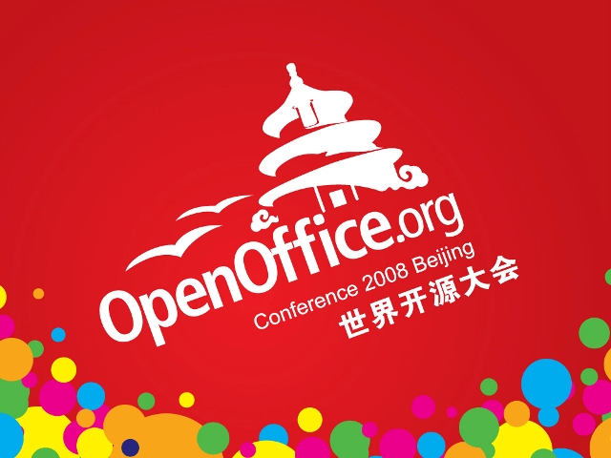

Slide 2
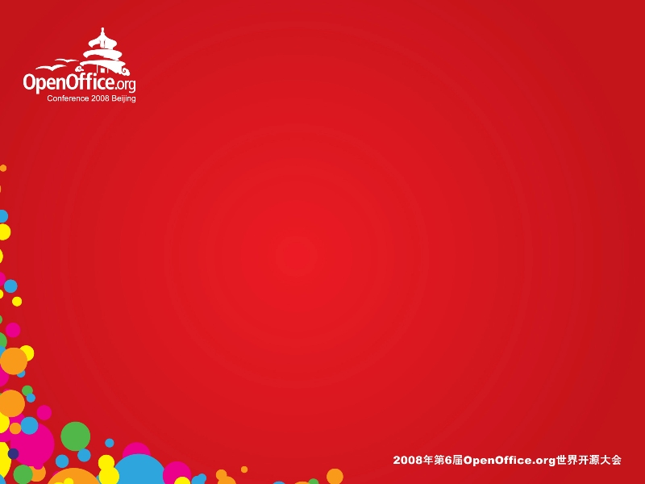
Complex Text Layout Issues with examples from Myanmar
Keith Stribley
Graphite Font Integration / Myanmar Localisation

Slide 3
Overview
Background of Complex Text Layout
  Requirements for Myanmar Languages
Integration of Graphite Font support into OpenOffice
  Demo and examples
Font Features
  Benefits and examples
  Language features
Line breaking issues
This presentation requires
OpenOffice with Myanmar
patches, Graphite Font
support and Burmese fonts.

Slide 4
Complex Text Layout
Many South East Asian Languages require Complex Text Layout features such as:
  Reordering of glyphs
  Context specific ligatures
  Context specific positioning
These need to be implemented in a complex rendering engine such as:
  OpenType – already in OOo through Uniscribe/ICU
  SIL Graphite – in graphite01 CWS
  Apple Advanced Typography (AAT)

Slide 5
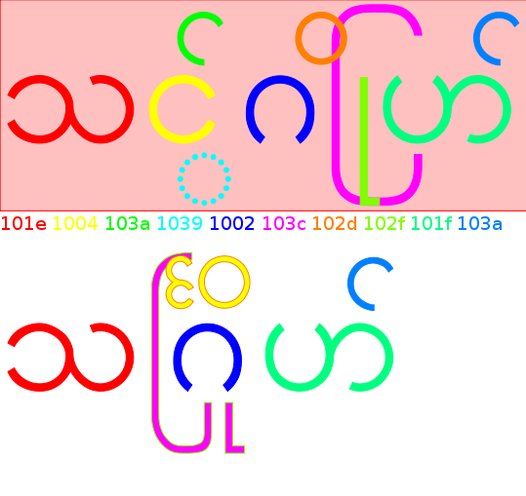
Complex Rendering Example for Burmese
1 to 1 Unicode to
glyph mapping
  Unreadable without renderer
Correct rendering
  Reordering
  Ligatures
    103C 102F
    1004 103A 1039 102D

Slide 6
Benefits of Graphite Fonts
The reordering, ligature and positioning rules are all stored in the font
  The rendering engine does not need to be modified for each new CTL script
  Basic Line breaking rules stored in the font
    no need for source code modifications to application
  The rules are quick to write in the Graphite Description Language
The Graphite library is cross-platform
  Consistent rendering across platforms

Slide 7
Limitations of OpenType for newly encoded scripts
The Default OpenType features applied to all languages are limited
  e.g. no many to many substitutions – making reordering hard to implement
For optimal performance the OpenType renderer has to be modified for each script
  this hasn’t been done for Myanmar yet (though some effort is under way for ICU and HarfBuzz)
There are discrepancies between the feature implementations in Uniscribe/ICU/HarfBuzz
  e.g handling of marks

Slide 8
Demonstration of Graphite enabled OpenOffice
Graphite has been integrated into the font rendering code in the VCL module
  In graphite01 CWS
Doulos SIL
ä̃́ɛ̃̈̀ɩ̂́ɔ̃̂ʉ̄̈ɠ̪̥̈ŋ̥n̥n̪̰
k͡p m͡i l͡w l͡i m͡w Ɛ̈ Ɔ̈
Padauk (Myanmar)
ပိတောက်နဲ့ မြန်မာအက္ခရာရေးနိုင်သည်။ မြို့ကြီးမှာကွန်ပျူတာသုံးသူများသည်။
Pig Latin Font
Pig Latin Demo
Scheherazade (RTL)
الإعلان العالمي لحقوق الإنسان

Slide 9
Font Features
Features allow the user to modify the rendering of a font without changing to a different font
  Many people prefer a slightly different rendering of a character to the default
  They apply to a run of text in a similar way to bold/italic attributes
Features provide many more options to the user than separate fonts
  Not practical to provide a separate font for every feature combination e.g. Doulos has 37 features: >2³⁷ possibilities, though not all will be useful.

Slide 10
Graphite Features in OpenOffice (preliminary)
Implemented by appending to the font name
  Required no change to ODF format
  “:” separates font name from features
  “&” delimits features
  (“;” “,” already used as alternate font delimiters)
Font name/feature setting | Doulos SIL | Doulos SIL:1039=1&1024=2
Rendering | ⱤŊ | ⱤŊ
1039 Capital R-tail alternate | Upper case | Lower case
1024 Uppercase Eng alternates | Large eng with descender | Capital N with tail

Slide 11
Language Features
Features are commonly used to customize a font’s appearance to the preferences of a specific language community
  Several features may be involved, so it is easier to just specify the language and the rendering engine will select the relevant features
Language needs to be passed to VCL font code
  Font object language field wasn't being set
  Many minority languages in ISO639-3 don’t have a corresponding Microsoft Locale ID or are not currently selectable from the language menu

Slide 12
Language Feature Examples
Vietnamese has diacritics off centre, unlike other languages:
  ềắểốậấ (Doulos SIL, no features applied)
  ềắểốậấ (Doulos SIL:1029=1/Doulos SIL:lang=vie/OOo language=Vietnamese)
Some Burmese prefer ကြို to have a tall u ကြို
Burmese prefers ကွဲ ပှ Karen prefers ကွဲ ပှ

Slide 13
Improving font feature support
Features need to be added to ODF for Graphite, OpenType and AAT
  IDs are numeric or 4 char tags, values are numeric
  e.g. <style:text-properties ...
  style:font-features="1039=2 ulon=1"
  style:font-features-complex="hsln=2"
  style:font-features-asian="3=2"/>
Need a proper GUI to set features in Character/Font dialog
  Graphite stores localized feature names in the font
  OpenType and AAT have registries maintained by Microsoft and Apple respectively

Slide 14
Line Breaking in Myanmar
Burmese uses spaces for phrase breaks, not word breaks
  Users can use ZWSP, but it is hard to train users
  Automated approaches:
    Syllable based algorithm often sufficient, but breaks multisyllable words
      Padauk's Graphite rules have syllable based breaking
      Syllable based breaking can be added as a patch to ICU
    Dictionary based algorithm
      A combination of dictionary lookup and syllable parsing can be used to avoid breaks in mulitsyllable words e.g. by patching ICU
      Only as accurate as the data in the dictionary

Slide 15
Line breaking example using an ICU based dictionary
မောင်မောင်အလွန်ကြိုးစားသဖြင့်ကန်ထရိုက်ထာဖြစ်သွားသည်။ Padauk
မောင်မောင်အလွန်ကြိုးစားသဖြင့်ကန်ထရိုက်ထာဖြစ်သွားသည်။ Myanmar3
Need 3 Levels:
  Dictionary (word level)
    Uses syllables
    Can't handle rare or loan words
  Syllable
    To break long words
    Not handled by break iterator
    Font e.g. graphite (writer)
  Character
    Last resort

Slide 16
Summary of Outstanding Myanmar Layout issues
Graphite Font support
  CWS needs to be integrated
Font Features need:
  Support in ODF
  A proper user interface
  To be selectable by ISO 639-3 language
Line Breaking
  Currently requires patching of ICU for Myanmar
  May require intermediate level between Word / Character breakiterator similar to hyphenation

Slide 17


