Slide 1



Slide 2

Lotus Symphony Extension Model
  Jin Hua, Chen
  IBM

Slide 3
Agenda
Introduction and overview
Lotus Symphony programmability
Extending Lotus Symphony
Lotus Symphony extension examples
Future plan
Q&A

Slide 4

IBM Lotus® Symphony™ Overview
A set of office productivity applications
  Create, edit, share documents, spreadsheets, and presentations
  Can handle the majority of tasks required
  by end users
  Support OpenDocument Format (ODF)
  Support Microsoft® Office and other formats
Available at no charge to anyone and everyone
  www.ibm.com/software/lotus/symphony
  Web-based support and community forums

Slide 5
Reference: Symphony Sessions
IBM Lotus Symphony Technical Overview
Lotus Symphony extension model
Accessibility in Lotus Symphony
Symphony performance improvement best practices
Introduction of SMIL Animation and Implementation in IBM Lotus Symphony
Properties Sidebar, make editing much easier
Learn more about office users - Feature usage study by document element statistics
Visualize Writer Document Structure for Productive Development

Slide 6
Why extension?
Developing independent third-party extensions
Enrich the base functionality
Linkage to customer's business logic and data
Customizing for business need

Slide 7
Lotus Symphony architecture
Lotus Symphony is a set of plug-ins and features based on a Symphony profiled Lotus Expeditor platform.

Slide 8
Comparison with OpenOffice.org extensions

Slide 9
Benefit from Lotus Expeditor
To end users
  An Eclipse-based rich client application
  A world-class user interface across Lotus portfolio
  An extendable platform more than a stand-alone product
To business partners and developers
  Integration and reuse
  A world-class Java IDE
  Native look and feel across platform
  A customizable platform
  Seamless tool integration
  The ability to reuse knowledge and skills from the Expeditor and Eclipse ecosystem

Slide 10
Introduction to Symphony Programmability
Programming model
  OpenOffice.org programming model
  Rich Client programming model
  Composite Application programming model
  Domino/Notes programming
  Scripting model
Symphony Toolkit
  Developer's Guide
  API Documentation
  Samples
Symphony Developer's forum
  plug-ins
  Issues and Troubleshooting
  Hints and Tips

Slide 11
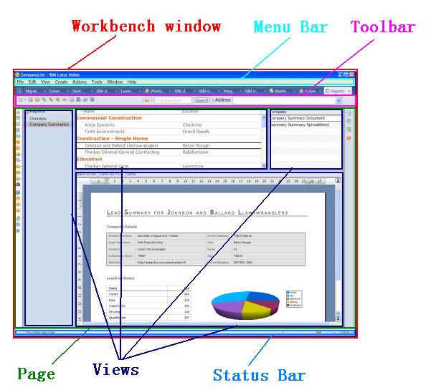
Rich Client Application programming model

Slide 12
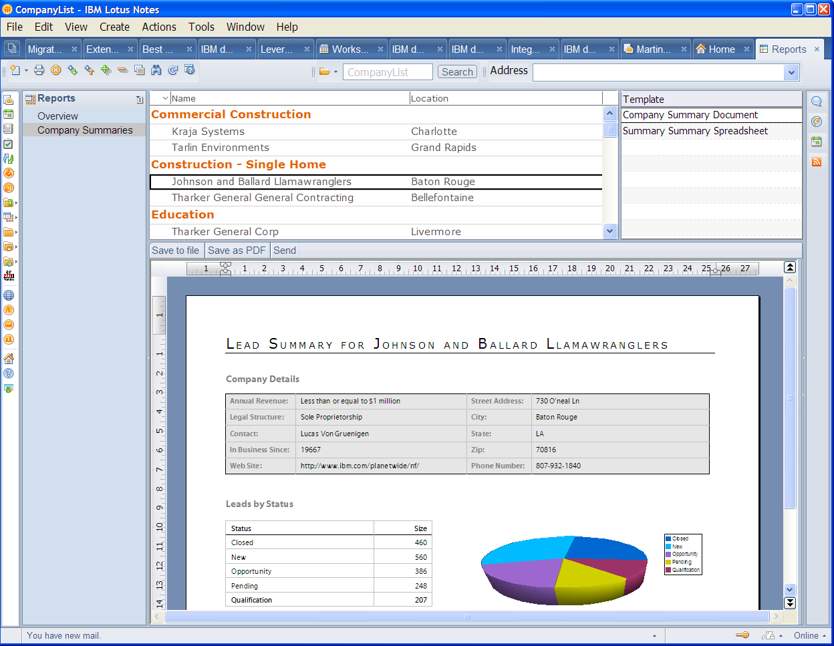
Composite application programming model
Composite Applications are generally a collection of loosely coupled components that define a particular business logic. These components could be a mix of Notes components and Eclipse based Lotus Expeditor components.
Symphony as an Eclipse based component in Notes 8.x
  Properties
    FileSaved
    SelectionChanged
  Actions
    LoadFile
    Insert

Slide 13
Domino/Notes programming
Symphony is a great alternative for Notes office integration
Typical scenario: controlling Symphony from Notes application
LotusScript support is critical for Notes developers
  COM based LotusScript APIs are not enough
  Native LotusScript APIs are preferred
Load document
Create chart

Slide 14
Scripting model
Scripting is highly expected from developers and knowledge workers
StarBasic is supported in Lotus Symphony
VBA interoperability is challenging and in the Symphony future plan
LotusScript APIs for Lotus Notes developers will be supported

Slide 15
Extending Lotus Symphony - features
Plug-in based extensions
  Plug-ins
  Features
  Update site
Eclipse/Expeditor IDE
Extensible user interface
A set of programming elements
Deployment

Slide 16
Programming elements

Slide 17
User Interface extensions

Slide 18
Deploying extensions
To end users
  Deploying and managing the extensions through user interface
To business partners
  Patched installation package
  Server managed deployment pushes to client

Slide 19
Lotus Symphony extension examples
Lotus Quickr connector plug-in
Websphere Translation Server plug-in
Database connection plug-in
Exporting presentation to flash plug-in
Note: all extensions can be found from http://symphony.lotus.com/software/lotus/symphony/plugin.nsf/home

Slide 20
Future plan
Support OpenOffice.org extensions
Enhance with user-friendly Java APIs for document models
VBA interoperability
More customizable user interface
Local composite application programming model
Full Lotus Expeditor integration
More options on extension deployment

Slide 21
Summary
Lotus Symphony is the combination of OpenOffice.org and Lotus Expeditor
  Lotus Symphony Leverages the plug-in framework from Lotus Expeditor
  Lotus Symphony inherits and enhance the base functionality for writer, spreadsheet and presentation from OpenOffice.org
Lotus Symphony is extensible and designed for integration
  Lotus Symphony provides highly extensible user interface and many APIs for third party extensions
  Lotus Symphony is easy to integrate with Eclipse/Expeditor based applications, such as Lotus Notes
Lotus Symphony is developer friendly
  OpenOffice.org developers can start developing directly, UNO APIs are supported
  Eclipse/Expeditor developers can leverage their existing skills; new developers can leverage lots of articles, tutorials, books from Eclipse
  Lotus Symphony toolkit is provided for both stand-alone Symphony and Symphony in Notes

Slide 22


