Slide 1



In the Brazilian
Public Administration
Claudio F Filho
Brazilian NLP Lead / Developer at Tegnix

Slide 2
Agenda
Issues;
Scenarios (actions);
Reactions;
Achievements.
Notes:
Quais são os problemas em relacao a admin publica;
Quais são os cenarios q o Brasil apresentou em:
* instalacao de produtos FOSS no Gov Federal
* problemas de resistencia dos funcionarios
* intercambio entre gov fed, est, mun e outras admins.

Slide 3

Issues
Implemement FOSS in all federal public administration
Promote FLOSS products inside the public administration;
Solve interoperability issues between the several layers of the society.

Slide 4
Scenario 1
FLOSS deployment
Migration initiative started in 2004 by ITI – Instituto Nacional de Tecnologia da Informação.
  Migration proposal of servers and clients to GNU/Linux
  Lack of skilled personnel in FLOSS solutions
  High rejection especially by lack of planning and end-user education & training
  File format issues.
Notes:
Em 2004 assumiu Samadeu, com ex. dos telecentros, iniciou o trabalho no gov fed
Migracao de todos os produtos, de todas as camadas do bolo.
Falta de pessoas especializadas DENTRO do governo. Maioria eram hackers e desenvolvedores e todos FORA do mercado
Rejeicao pelas tentativas anteriores

Slide 5

Scenario 1
Consequences
Projetct too ambitious (all client applications) which resulted in excess of issues beyond support capacity
No planing for Education and Training, which resulted in a negative perception by end-user, forcing a rollback.
End-user resistance and
rebellion.

Slide 6

Scenario 2
FLOSS promotion
New products resistance (same technologies and usage), especially because of the previous failures.
Public administration proverbial inertia
http://flickr.com/photos/jesusmolina/2220784355/

Slide 7
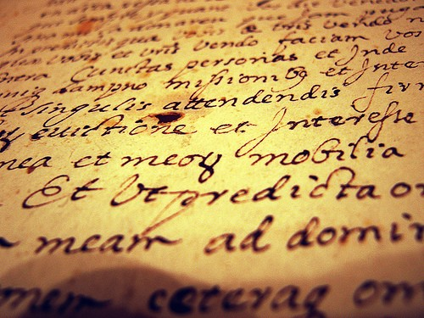
Scenario 3
File interchange
Federal Government is composed of common 3 parts (as usual in modern democracies)
  Executive, Legislative e Judiciary
Initial actions in Federal Executive
  Issues in file interchange between:
    Ministeries;
    Federal Official Banks
    Other admins;
    Legislative &
    Judiciary.
http://flickr.com/photos/cyteck/2389713958/

Slide 8

Reaction
Gov. New policies
Knowledge of BrOffice.org mandatory for public admission career;
Caixa Federal issues a public bid for BrOffice support services requiring hiring of BrOffice.org local developers;
Creation of the CISL- FLOSS Deployment Committee, where the 1st step is:
MIGRATE to BrOffice.org!

Slide 9
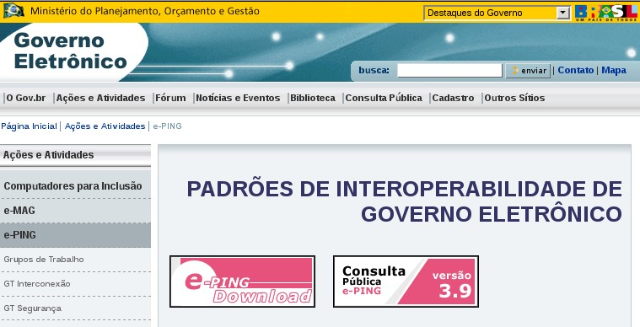

Reaction
Open Standards
e-PING gains strengh and Standards are required in services
Brazil votes NO for OpenXML in ISO
ABNT aproves ODF as Brazil. Standard

Slide 10


Reaction
BrOffice.org Communities
Local user groups (2004)
Investiments in main OSS events (FISL e Conisli);
Relationship with communities and seek of a sustainable marketplace;
Sustainable marketplace
http://flickr.com/photos/lumaxart/2137737248/

Slide 11


Achievements
Federal Gov
Infraero adopt BrOo – USD 2M / year;
Linux Educacional;
  2008: 29.000 labs = ~36.000.000 estudantes;
  2009: 53.000 labs = ~52.000.000 estudantes.
All levels of the Labor Judiciary
House of Representatives saves USD 2,5M
Dataprev – 38.000 estações – USD 12M
Banco do Brasil – 90.000
desktops – USD 30M.

Slide 12
Achievements
State Gov.
State Govs.
  Ministério Público de TO = USD 225K;
  Education in PR = 2.000 schools = 40.000 workstations w/ BrOffice.org;
  Tribunal de Contas de MT e MS;
Standards
  State of Paraná aproves ODF Bill and other states considers the same.
  House of Representatives for a National ODF bill

Slide 13

Achievements
Community
Gov. seeks to involve its workers in FLOSS projects
Brasilia Protocol signed (ODF in Public Administration)
Increase in demand for services and concern to address hiring of
community players:
Sustainable marketplace!
Investiments in community Projects – 3rd BrOffice.org Annual Meeting.

Slide 14
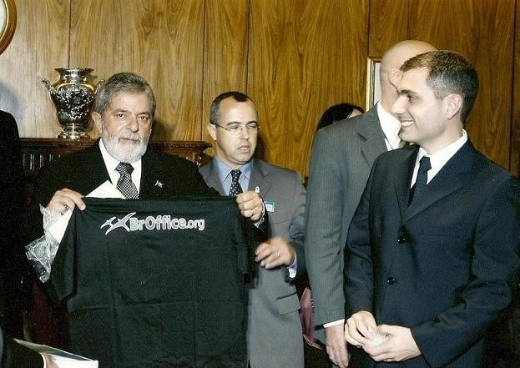

Questions ???
Luís Inácio Lula da Silva, President of Brasil, with t-shirt of BrOffice.org.
Thanks !!!
OpenOffice.org e.V.
Olivier Hallot by
Translation. ;-)
Contatos:
filhocf@openoffice.org

