Slide 1

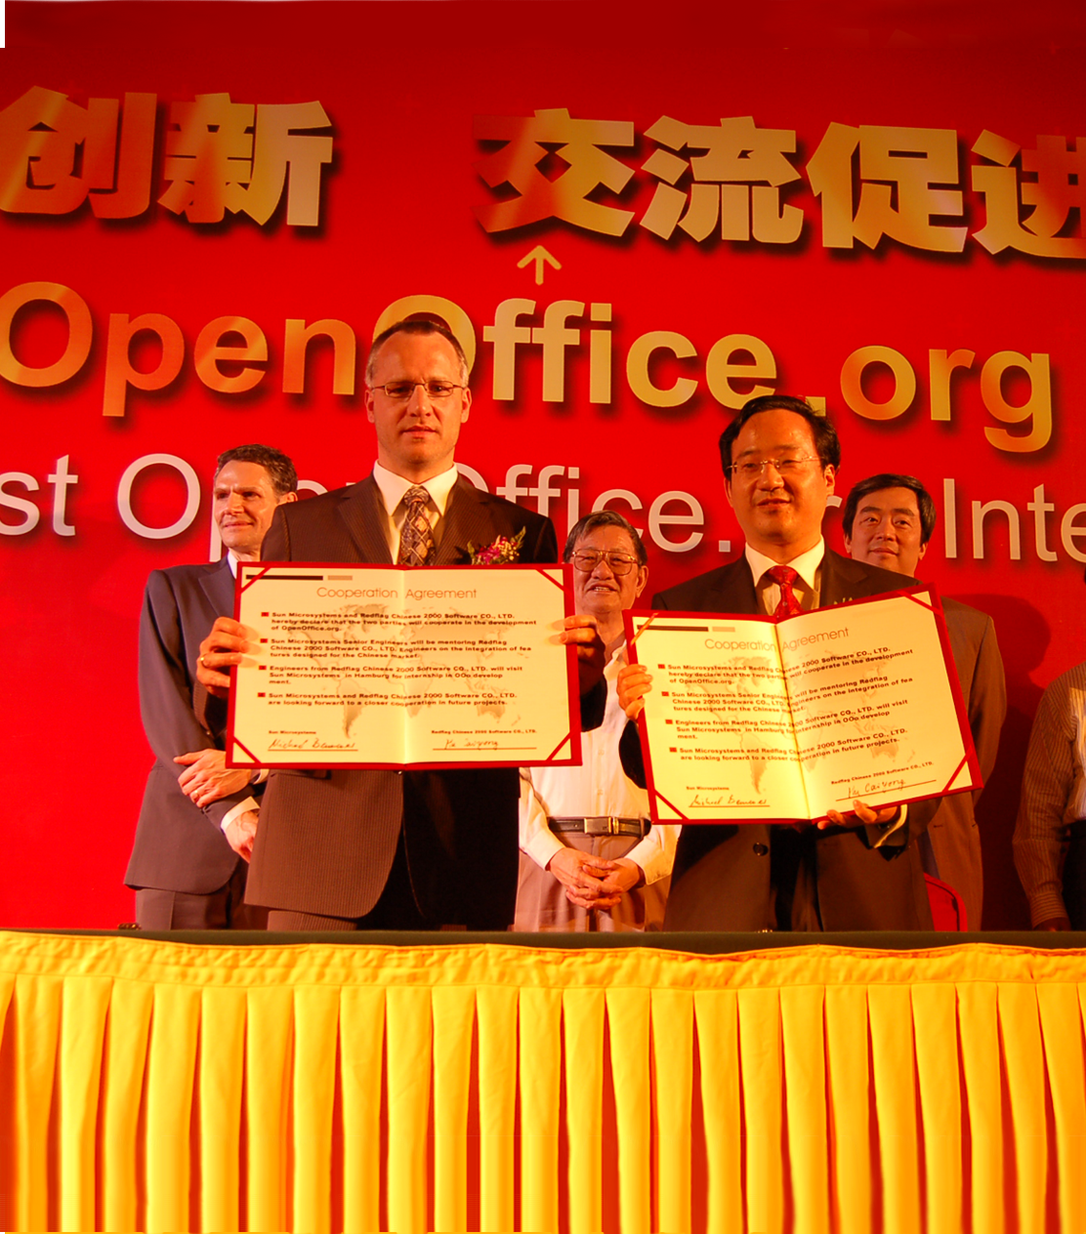
OpenOffice.org –
One giant leap for mankind
Michael Bemmer
Sr. Director, Collaboration Engineering
Sun Microsystems

Slide 2
Agenda
Acknowledgements
Major changes in 2008
Community Innovation Award
Sun's Commitment to OpenOffice.org
How we measure success
What's next

Slide 3
Acknowledgements
Redflag 2000
The Sino-I group
Peking University
China OSS Promotion Union
The Administration of the Business Development Area
The Organizational Committee

Slide 4
History of OOo conference locations
2003: Hamburg, Germany
2004: Berlin, Germany
2005: Koper/Capodistria, Slovenia
2006: Lyon, France
2007: Barcelona, Spain
2008: Beijing, China
It was time to go to Asia!

Slide 5
Major changes: we're listening
New Sun Contributor Agreement (SCA) replaced former Joint Contributor Agreement (JCA)
LGPLv3 replaced former LGPLv2 license
Great new website look & feel, including 1-click download
Improved tools: migration to Subversion is done.
A distributed system being the next step.

Slide 6
Community Innovation Award
In 2008 Sun announced a $1 Million Open Source Community Innovation Awards Program, $175.000 of that amount dedicated to OpenOffice.org
Winners received between $3,333 and $13,750
The winners not present at the Conference:
  GOLD: Per Eriksson, Daniel Naber and Marcin Miłkowski, Regina Henschel
  SILVER: Jean-Marie Gouarné, Dmitri Popov, Bruno Cavaler Ghisi, Gabriel Gurley, Anthony Bryan, Jim White
  BRONZE: Ihsan Faisal, Guillaume Maillard (Team Leader), Filip Molčan
  HONOURABLE MENTION: Dysmas de Lassus, Alan C. Baird, Roland Mundloch

Slide 7
Community Innovation Award Winners here at the Conference

Slide 8
Why we are doing this
Open standards and open source have always been key elements of Sun's strategy
More and more governments and enterprises around the world mandate the use of open standards
More and more governments around the world mandate the use of open source products
Sun is the world's largest contributor to open source
We just love the project and the product

Slide 9
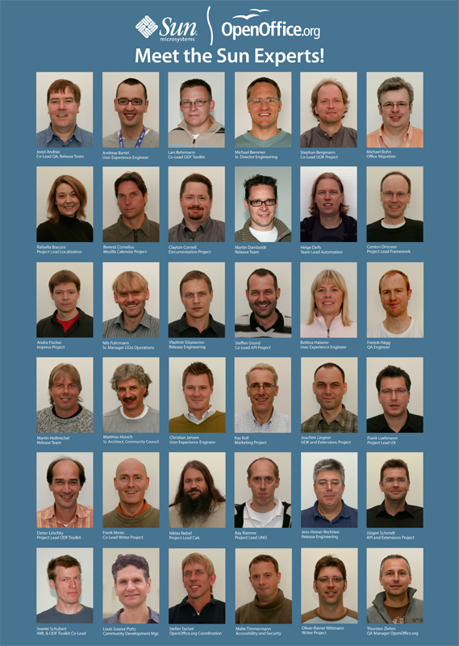
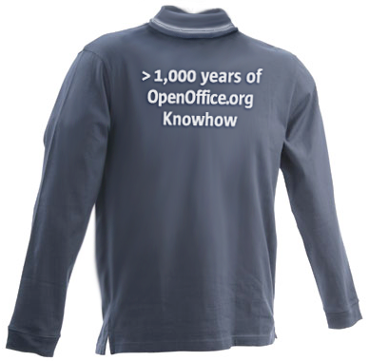
Our team at the conference
Footnote position, 12 pts.

Slide 10
How we measure success: numbers
Downloads:
  >2.5 million a week on average (compared to about 1m/week a year ago)
  First week after Ooo3.0 launch >3m downloads
  New MAC version in high demand
Community
  28 accepted projects
  100+ localizations
  1000+ contributors
  180 code contributors

Slide 11
How we measure success: numbers
Around 70% of submitted patches fixed and integrated
Quality: 10.000+ bug fixes between 2.0 and 3.0
Extension Repository
  150+ extensions
  Many different authors
  Most popular ones downloaded >300.000 times
Users: we believe to have >100 million around the globe

Slide 12
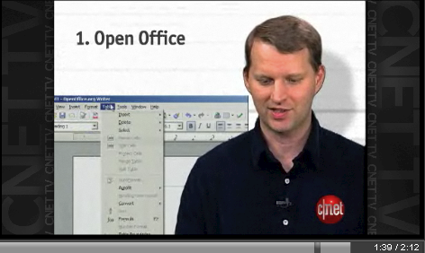
How we measure success: awards
CNET Top 5: Best downloads of 2007
CNET, February 2008

Slide 13
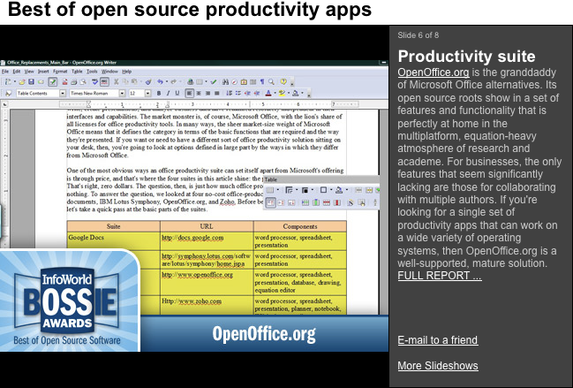
How we measure success: awards
Infoworld, August 2008

Slide 14
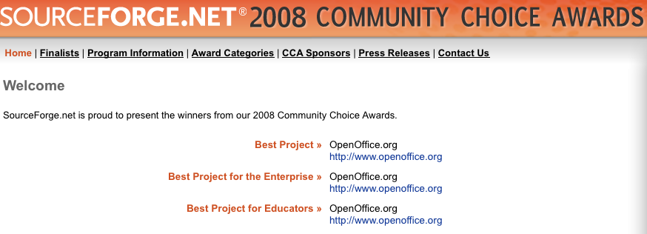
How we measure success: awards
Category: Best Project
“Let's start with the big one. The Best Project award goes to the project with the best technical design, most helpful community, and most powerful product.”
SOURCEFORGE.NET, July 2008

Slide 15
How we measure success: OOo 3.0 reviews
“The final version of OpenOffice 3 is out today, and if you're looking to save yourself plenty of money, download it instead of buying Microsoft Office --- you could save yourself hundreds of dollars, and not lose out on many features.”
Computerworld, October 2008

Slide 16
How we measure success: OOo 3.0 reviews
“...for the first time, I'm ready to recommend this new version as a viable alternative to Microsoft's offering. It still has rough edges, but it has an impressive feature set, a generally lucid interface, pure open-source credentials, and—in the current economic climate—the decisive advantage of being absolutely free.”
PC Magazine, October 2008

Slide 17
How we measure success: what the competition says
“ODF has clearly won.”
Stuart McKee
Microsoft's US National Technology Officer
Red Hat Summit
June 2008

Slide 18
How we measure success: what the competition says
"Today, they have very primitive stuff," Ballmer said of Google (Apps).
“We get more competitive pressure from OpenOffice and StarOffice.”
Steve Ballmer
CEO Microsoft, Oct. 17th, 2008
http://adtmag.com/article.aspx?id=23455

Slide 19
What's next
New compelling user interface
  Collaboration with other efforts in this area
  Complex, long-term effort
Performance improvements. Focus on:
  Startup (e.g. Configuration)
  Loading / Saving documents:
    loading parts on demand
    saving modified parts
  Calc: Spreadsheet calculations
  Impress: Slideshow performance

Slide 20
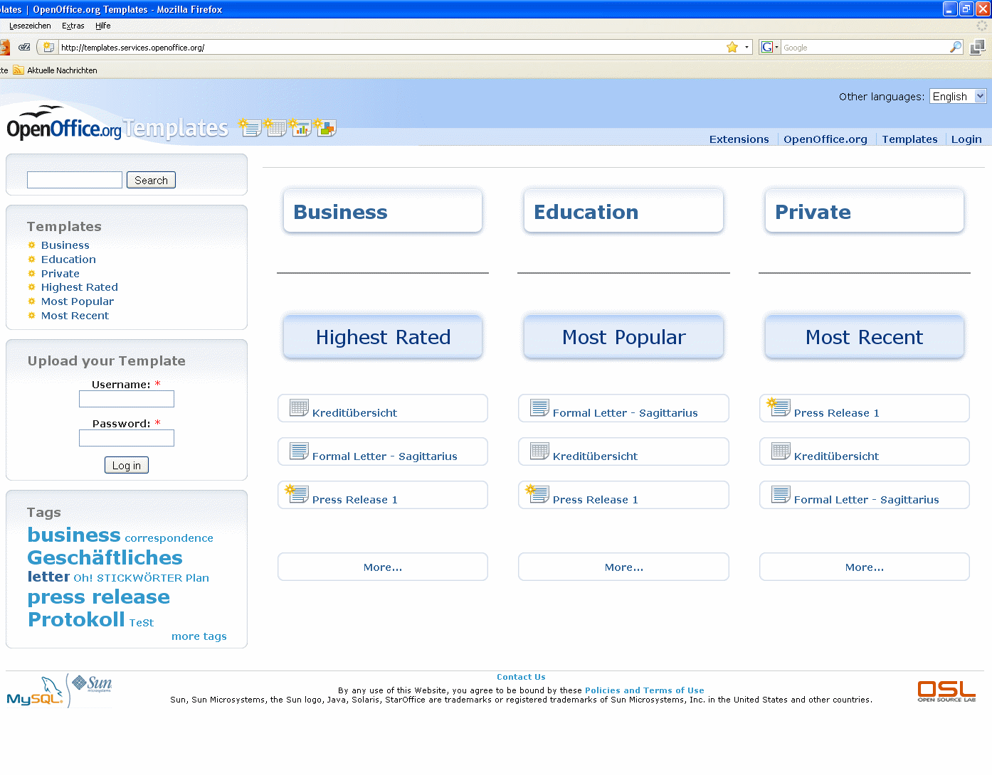
What's next: Template Repository

Slide 21
Join the community!
“One small step for a Man, one giant leap for Mankind”
Neil Armstrong, 1969

Slide 22

Thank you and enjoy the conference!
Michael Bemmer
michael.bemmer@sun.com

