Slide 1


Slide 2

The full adoption of OpenOffice in the Cambodian Education System
5 – 7 November 2008
Present by:
Mr. Khoem Sokhem – KhmerOS project
FOSS Localization Coordinator / Open Institute
Mr. Kheng Piseth – Open Schools Program
FOSS Application Training Coordinator / Open Institute

Slide 3
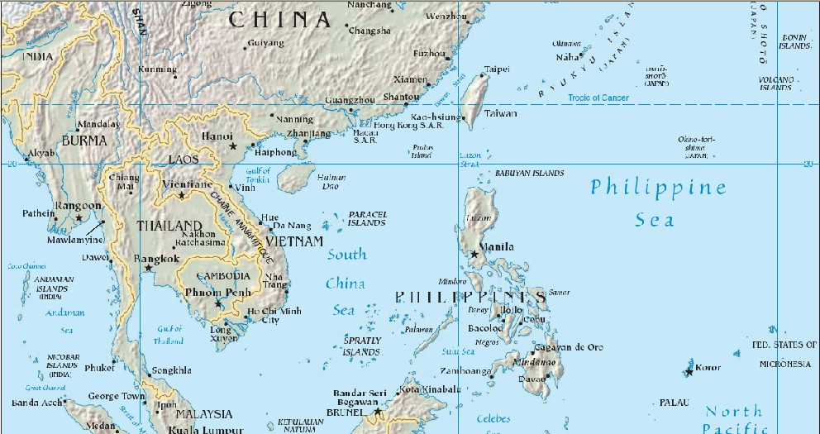
Size: 181.035 sq km
Language: Khmer (95% of pop.)
24 provinces/cities
Literacy: 70%
Population: 13,388,910 (80% agriculture)
GPD per capita: under $592

Slide 4


Slide 5
2003
A problem
to be solved:
Economic and social
development require
technology, and...
Widespread use of
technology can only happen
if the technology
is in the local
language
PREPARATION OF THE PROJECT
Social goals
For impact
the project
must include
required
Strategy
Promote
added value
Reduce
barriers to change
Multi-stakeholder
Identification of
solution:
Only possible with
Free and Open Source
Software
Localisation
Distribution
Training

Slide 6
2004
Development of an
English-Khmer
Computer Glossary
(2 months)
Translate small
applications to gather
experience
Received
some funding from
UNDP-APDIP
and Internet Society
Localisation of
OpenOffice 2.0
(August-December 2004)
Start localisation of
OpenOffice help
Localisation of browser, web-mail
chat, locales, support for Khmer script
in OpenOffice, KDE,...

Slide 7
2005-2006
Finish OpenOffice 2.0
localisation
Development of
training materials
and a user guide for
OpenOffice in Khmer
ICT Authority of Government
joins in the project,
assuming co-ownership.
Dedicates 12 person team
Development of a
Master Plan for the
deployment of FOSS
Government and NGO start training
50 teachers a week, under
German cooperation funding
(InWEnt)
Finish localised
Linux distribution
Training
on Linux
Administrators

Slide 8
2005-2006
Finish OpenOffice 2.0
localisation
Development of
training materials
and a user guide for
OpenOffice in Khmer
2007
The KhmerOS project is selected
as one of the best development projects
that uses ICT to improve economic development
(Finalist of the Stockholm Challenge/GKP Award)
ICT Authority of Government
joins in the project,
assuming co-ownership.
Dedicates 12 person team
Development of a
Master Plan for the
deployment of FOSS
Government and NGO start training
50 teachers a week, under
German cooperation funding
(InWEnt)
Finish localised
Linux distribution
Training
on Linux
Administrators

Slide 9


Slide 10

Open Schools Program
A joint initiative of
the Ministry of Education, Youth and Sport
and the Open Institute
Working together to use ICT
to improve the quality of Education
MoEYS
To create of the necessary plans, structures, human resources,
curricula and training materials for the successful use
of ICT in Education in Cambodia.

Slide 11
Create MoU with MoEYS
To prepare a Master Plan for ICT
in Education for 2009-2010
To implement
the current policy
To produce training materials
for teaching ICT in Schools
To coordinate with
the existing projects
To train teachers in all the schools
that have computers for Education
To upgrade
training facilities
To research was are the most
adequate technologies for sustainable
use of ICT in Education

Slide 12
Master Plan for ICT in Education
  To build ICT skills in the future workforce
  Effective use of ICT to improve the quality of education
  Automation of school management
To prepare the Ministry of Education
for the growing role of ICT in Education

Slide 13
2007 – Accomplishments - Training
Training at the schools
Trained all ICT school teachers
on how to teach OpenOffice and
computer maintenance
Training at the High School
Teacher Training Centre (NIE)
Trained all ICT teacher educators on how
to teach OpenOffice and computer
maintenance to future ICT teachers.
Trained all other teacher educators
on how to use OpenOffice to
improve their efficiency.
Trained all teacher trainees on how to use
OpenOffice to improve their efficiency.
Primary and Medial school Teacher Training Centres
All the ICT teacher educators were trained on how to teach OpenOffice to future teachers, and on computer maintenance
Ministry
Training the Ministry of Education
officials to use OpenOffice starts

Slide 14
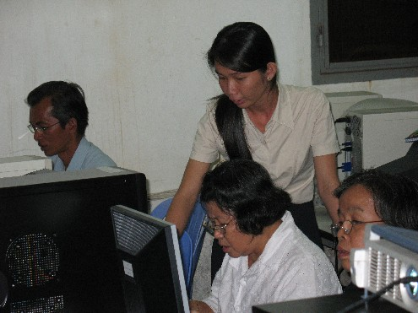
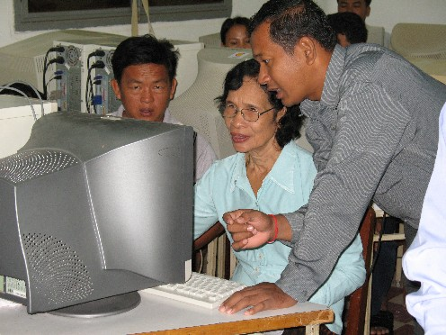
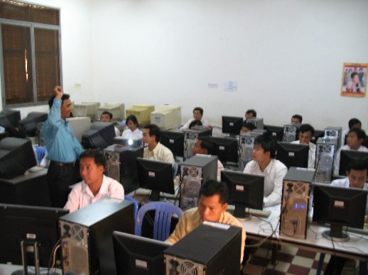


Slide 15
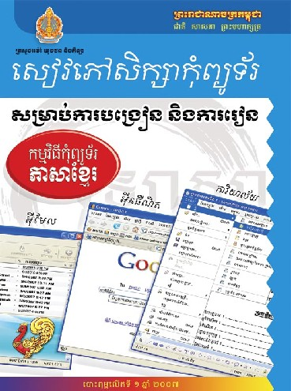
2007 - Official ICT Textbook:
OpenOffice on Windows
    For teacher training centers and all public training institutions, specially upper secondary schools
    Covers basic applications (OpenOffice), Internet, e-mail.
    Structured as a textbook. Adequate for Khmer school year.
    Problem solving approach.
8.000 free copies given to the Ministry
Notes:
The 350-page full-color textbook has been one of the key factors that have led to adoption of OpenOffice.
It has been the last of a number of actions that have led to the end.

Slide 16
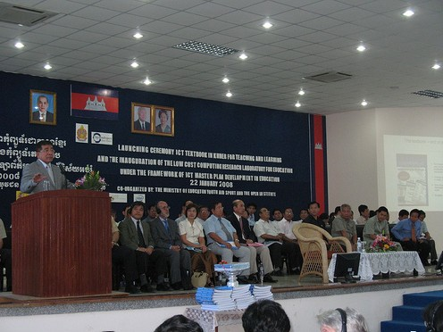
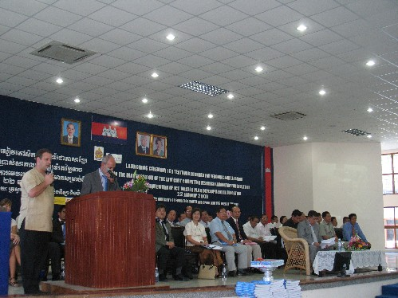
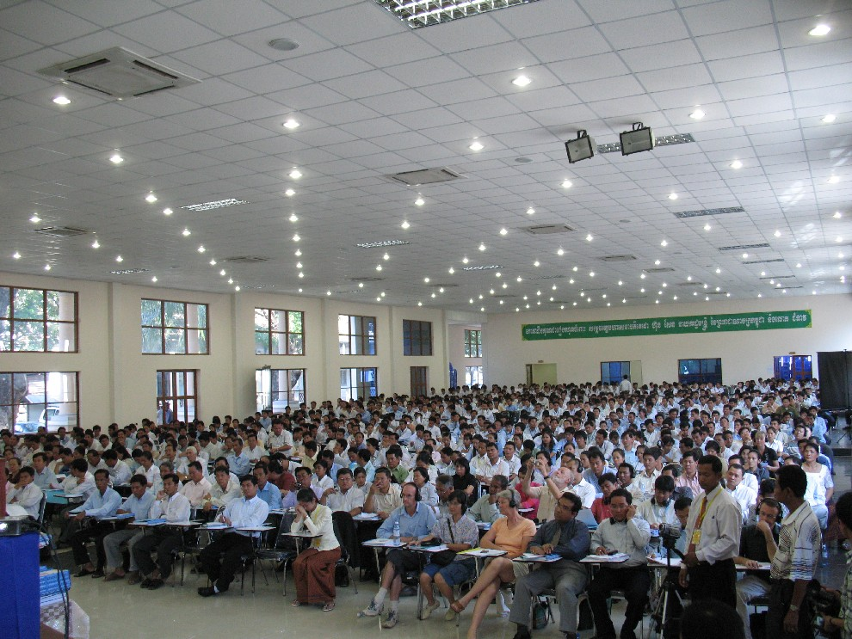
Launching ceremony of ICT textbook and inauguration of the low cost computing research lab for education
January 2008 – Government mandates distribution of textbooks and teaching of
OpenOffice in Khmer in all public educational institutions
Notes:
The Cambodian Ministry of Education mandated, in january 2008, that all public educational institutions must use - for teaching the use of computers OpenOffice in Khmer language.
The announcement was done together with the presentation of the new official ICT textbook of the Ministry, which mainly teaches OpenOffice (together with other FOSS programs).

Slide 17
2008 – Accomplishments
Low Cost Computing Lab for Education
In charge of undertaking a
Feasibility and Sustainability Study to define
low-cost sustainable computer facilities
that are optimal for schools.
Low cost Hardware
Low cost Software
Low Electricity Consumption
Low cost maintenance
Low cost Connectivity
Low cost Teacher Training

Slide 18
Low Cost Computing Lab for Education (cont.)

Slide 19
2008 – Accomplishments - Training
Develop a full curriculum for
high school ICT teacher trainees
ICT teacher educators started to teach
OpenOffice, openSUSE, maintenance, e-learning,
web 2.0 and other ICT to high school ICT teacher
trainees academic year 2007-8 / 2008-9
Re-train all the ICT school teachers
and teacher training centres more advance
on the use of OpenOffice in Khmer and computer
maintenance and networking.
Train ICT educators in all public and private
universities to teach OpenOffice in Khmer
Train the ministry officials (provincial and city)
to use OpenOffice, created sufficient trust
to mandate the change to OpenOffice.
4 pilot schools teaching OpenOffice on Linux
Train ICT school teachers on the use of OpenOffice,
basic KDE and troubleshooting on Linux to make them
being able to teach on Linux for the pilot project.

Slide 20
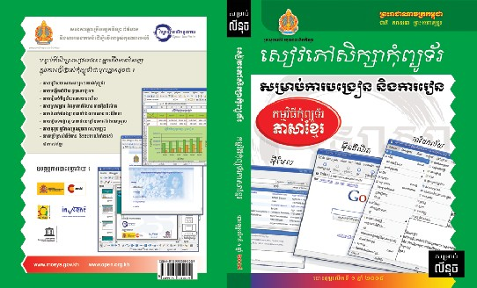
2008 – Accomplishments
Books and training materials
OpenOffice on Windows (2nd edition, 6,000)
OpenOffice on openSUSE (2,000)
Linux Administration (openSUSE, 2,000)

Slide 21
2008 – Intel Teach methodology
Will start using Intel Teach materials to train all high school teacher trainees to the use of computers (OpenOffice, Gimp) in Khmer language.
Have localized Intel teach materials (teacher book and help guide) for OpenOffice on Windows.
Pilot project for these materials will start in January 2009.

Slide 22
2008 – Policy
Defining the specific goals of
the Master Plan for ICT in Education,
based on the most pressing needs of the Ministry
for which ICT can be of some help.
Start work on the Action Plan

Slide 23
Conclusion
From
How
Users and teachers use and teach
MS in English
Government
TOP
Lobby and
support
NGO
Everybody
DOWN
What
CHANGE
Localization
Added Value
Materials and books
Partnership with government
Work on policy
Training
To
Only OpenOffice in Khmer is taught
Users of both MS and OpenOffice in English
Funding

Slide 24
Why is the government interested?
Facilitate teaching and usage of ICT, a national priority for economic development
Can implement the policy that has been written
Pride of using ICT, gaining credibility with donors
Can be used to improve the quality of education

Slide 25
Lessons learned
  Develop the right Product
    Localization is not enough, must also include training materials and books.
  Find the right Market
    Education systems are the future
  Work on complete solutions for your customer
    Must help government accomplish their goals, while you accomplish yours
  Look for funding
    Can start small, but change requires having sufficient resources
    Donors do not support technology, they support social and economic change.

Slide 26
FLOSSInclude
Open Institute is a partner of
FLOSSInclude
A EU project to strengthen Europe's participation in international research in FLOSS and open standards, by studying what is needed to increase the deployment, development and societal impact of FLOSS in Africa, Asia and Latin America.
Partners: University of Maastricht – MERIT (Netherlands), Universidad Rey Juan Carlos (Spain), FUNDECYT (Extremadura, Spain), Canonical Ltd. (England), Tsinghua University - China Education and Research Network, Open Institute (Cambodia), Fundación Vía Libre (Argentina), University of the Western Cape (South Africa), Ghana-­India Kofi Annan Centre of Excellence in ICT, IT for Change (India), Sarai - Centre for the Study of Developing Societies (India).

Slide 27


