Slide 1
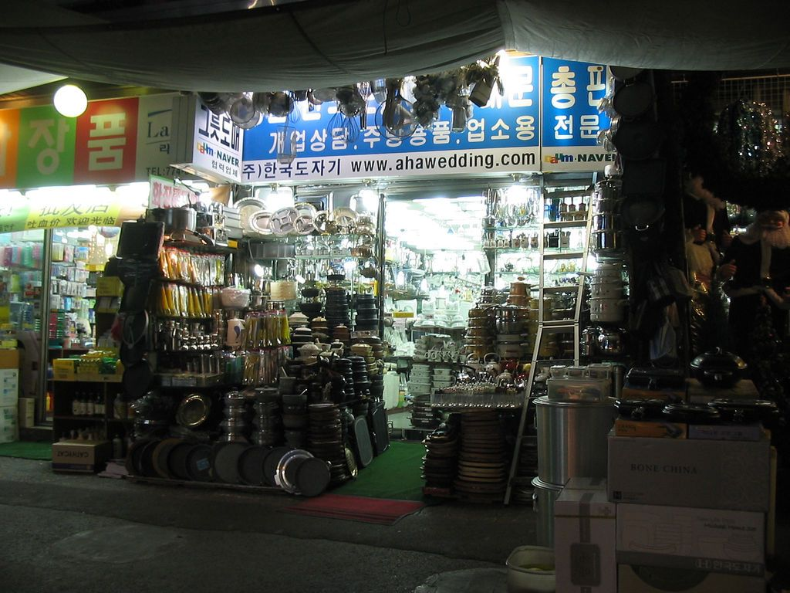

On-Site Requirements Engineering for OpenOffice.org
ux.openoffice.org
Matthias Müller-Prove
Christian Jansen
  Sun Microsystems
1
Notes:
Photo: http://flickr.com/photos/seaniz/8867641/

Slide 2
Agenda
The User Experience Project
User Research Matters
Example: Cooperation with VBG & UIDesign
  Scope and Objective
  Project Timeline
  Results
Summary

Slide 3
Agenda
The User Experience Project
User Research Matters
Example: Cooperation with VBG & UIDesign
  Scope and Objective
  Project Timeline
  Results
Summary

Slide 4

ux.openoffice.org
Project Charter
We are the OpenOffice.org User Experience Community. Our intention is to improve the usefulness and usability of OpenOffice.org for our users. We work in close cooperation with development, quality assurance, Sun's User Experience Design Organizations, marketing, documentation, and - last not least - the OpenOffice.org community. We use methods and strategies in the areas of user-centered software design, user research, expert evaluation and UI-design to achieve our main goal, to make our products more successful in the market.

Slide 5
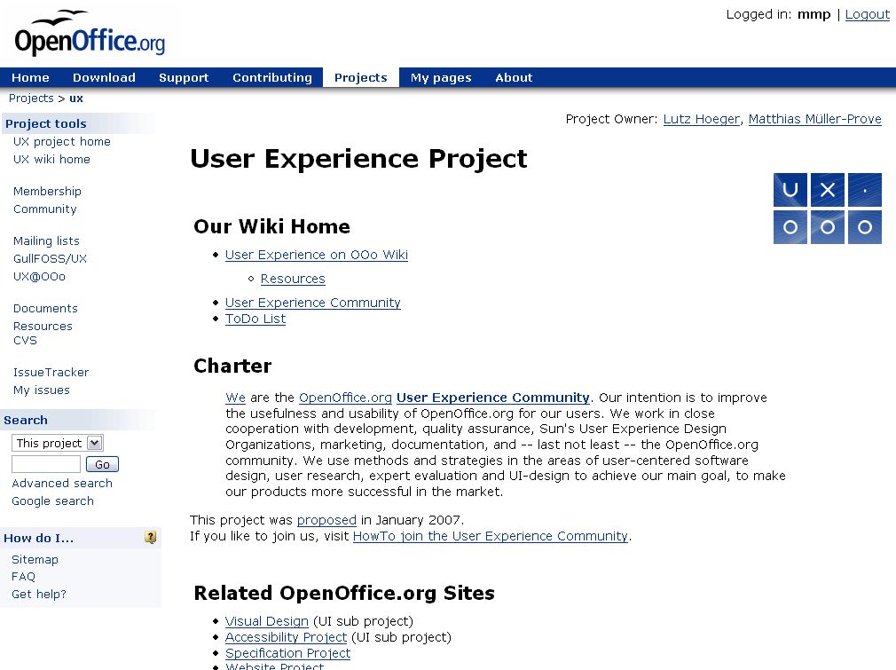

Slide 6
Agenda
The User Experience Project
User Research Matters
Example: Cooperation with VBG & UIDesign
  Scope and Objective
  Project Timeline
  Results
Summary

Slide 7
User Research
Requirements Engineering
Competitive Analysis
Heuristic Evaluations
Usability Studies
Reports
User
Research

Slide 8
User Experience Design
Interaction Design
UI Design
Graphic Design
Layout
Terminology
Accessibility
Globalization (G11N)
Specifications
UX Design
User
Research

Slide 9
HCI Know-How
GUI Styleguides
OOo Styleguides
Usability Metrics
Papers
UX Design
User
Research
HCI Know-How

Slide 10
Agenda
The User Experience Project
User Research Matters
Example: Cooperation with VBG & UIDesign
  Scope and Objective
  Project Timeline
  Results
Summary

Slide 11
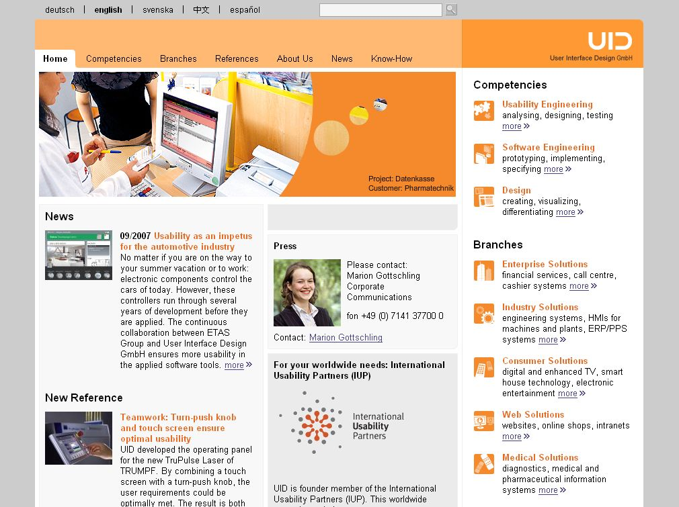

Slide 12


Slide 13

VBG
VBG is an insurance company in Germany
VBG migrated approx. 2.000 seats to Linux Desktop and OpenOffice.org some years ago
OpenOffice.org is integrated into custom Enterprise Resource Planning-Software (ERP)
  Macros connect OpenOffice.org with back-end system and corporate templates
  OpenOffice.org is also be used stand-alone

Slide 14
Scope and Objective
UID consults VBG on new version of ERP system
We participate in the usability process to harvest insights for OpenOffice.org
On-site requirements gathering
  Interviews with “average” users
  Unfiltered real life observations
SYNERGIES!!!

Slide 15
Project Timeline
Project Kick-Off (March 2007)
3 Workshops at VBG with trainers and experienced users of OpenOffice.org – (May/June)
  Impress
  Calc
  Writer
Report created (July)
Presentation to Writer and Calc engineering teams (August)
Usability improvements for OOo 2.4 and OOo 3.0
Notes:
2 hours for each workshop

Slide 16
Qualitative Results
Impress: 12
Calc: 23
Writer: 51

Slide 17
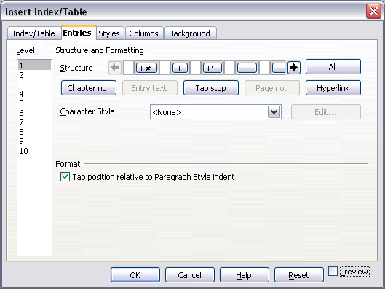
Example: Table of Contents
  This feature rocks, but needs to be much
  easier to handle
  It is nearly impossible to reference easily,
    Word is doing a much better job
  Deleting tokens by hitting “DELETE” is unintuitive
  “Token Control” is cryptic

Slide 18
Example: Collaboration in Writer
Collaboration & Track Changes
  Is frequently used, but could be more robust
  4 users work on one document
  File locking is a problem
  Versioning is used for project work and documentation
  There should be an option that rises the “Documents Properties” dialog before saving
    Meta data is important, users tent to forget to fill this out
    Without meta data search in the intranet is hard to realize

Slide 19

Some examples :: Calc
Auto-Capitalization on cells in Calc
Fixed for OpenOffice.org 2.4
  The first letter of a cell will never be capitalized automatically. The feature will start working after the first sentence entered to a cell

Slide 20
Agenda
The User Experience Project
User Research Matters
Example: Cooperation with VBG & UIDesign
  Scope and Objective
  Project Timeline
  Results
Summary

Slide 21
Summary
The cooperation between
VBG, UID and UX.OOo is a win-win-win situation
VBG and other professional users
get a better office suite
We get valuable user feedback on existing functionalities and ideas for new features

Slide 22

On-Site Requirements Engineering for OpenOffice.org
Matthias Müller-Prove
Christian Jansen
  mprove@sun.com
  christian.jansen@sun.com
1

