Slide 1

The Evolution of a Relational Database Layer over HBase
@ApachePhoenix
http://phoenix.apache.org/
James Taylor (@JamesPlusPlus)
Maryann Xue (@MaryannXue)
V5

Slide 2

About James
Architect at Salesforce.com
Part of the Big Data group
Lead of Apache Phoenix project
Top Level Project (Happy Birthday!)
PMC member of Apache Calcite
Engineer and Product Manager at BEA Systems
XQuery-based federated query engine
SQL-based complex event processing engine
Various startups prior to that

Slide 3
Agenda
What is Apache Phoenix?
State of the Union
A Deeper Look
Joins and Subquery Support
What’s New?
What’s Next?
Q&A

Slide 4
What is Apache Phoenix?
A relational database layer for Apache HBase
Query engine
Transforms SQL queries into native HBase API calls
Pushes as much work as possible onto the cluster for parallel execution
Metadata repository
Typed access to data stored in HBase tables
A JDBC driver
A top level Apache Software Foundation project
Originally developed at Salesforce
Now a top-level project at the ASF
A growing community with momentum

Slide 5
Where Does Phoenix Fit In?
Sqoop
RDB Data Collector
Phoenix
JDBC client
Pig
Data Manipulation
Hive
Structured Query
GraphX
Graph analysis framework
MLLib
Data mining
Phoenix
Query execution engine
YARN (MRv2)
Cluster Resource Manager / MapReduce
Spark
Iterative In-Memory
Computation
Zookeeper
Coordination
Flume
Log Data Collector
HBase
Distributed Database
HDFS 2.0
Hadoop Distributed File System
The Java Virtual Machine
Hadoop
Common JNI

Slide 6
State of the Union
Broad enough SQL support to run TPC queries
Joins, Sub-queries, Derived tables, etc.
Three different secondary indexing strategies
Immutable for write-once/append only data
Global for read-heavy mutable data
Local for write-heavy mutable or immutable data
Statistics driven parallel execution
Tracing and metrics for Monitoring & Management

Slide 7
About Maryann
Software Engineer at Intel
PMC Member of Apache Phoenix project
Joins, Subqueries, Phoenix+Calcite Integration, etc.
IDH and Intel XML Libraries
The HBase part of Intel’s Distribution of Hadoop
XSLT compiler of Intel XML Libraries

Slide 8
Join and Subquery Support
Grammar: inner join; left/right/full outer join; cross join
Additional: semi join; anti join
Algorithms: hash-join; sort-merge-join
Optimizations:
Predicate push-down
FK-to-PK join optimization
Global index with missing data columns
Correlated subquery rewrite

Slide 9
TPC Example 1 Small-Quantity-Order Revenue Query (Q17)
select sum(l_extendedprice) / 7.0 as avg_yearly
from lineitem, part
where p_partkey = l_partkey
and p_brand = '[B]'
and p_container = '[C]'
and l_quantity < (
select 0.2 * avg(l_quantity)
from lineitem
where l_partkey = p_partkey
);
CLIENT 4-WAY FULL SCAN OVER lineitem
PARALLEL INNER JOIN TABLE 0
CLIENT 1-WAY FULL SCAN OVER part
SERVER FILTER BY p_partkey = ‘[B]’ AND p_container = ‘[C]’
PARALLEL INNER JOIN TABLE 1
CLIENT 4-WAY FULL SCAN OVER lineitem
SERVER AGGREGATE INTO DISTINCT ROWS BY l_partkey
AFTER-JOIN SERVER FILTER BY l_quantity < $0
Notes:
Optimizations: predicate push-down; subquery rewrite

Slide 10
TPC Example 2 Order Priority Checking Query (Q4)
select o_orderpriority, count(*) as order_count
from orders
where o_orderdate >= date '[D]'
and o_orderdate < date '[D]' + interval '3' month
and exists (
select * from lineitem
where l_orderkey = o_orderkey and l_commitdate < l_receiptdate
)
group by o_orderpriority
order by o_orderpriority;
CLIENT 4-WAY FULL SCAN OVER orders
SERVER FILTER o_orderdate >= ‘[D]’ AND o_orderdate < ‘[D]’ + 3(d)
SERVER AGGREGATE INTO ORDERED DISTINCT ROWS BY o_orderpriority
CLIENT MERGE SORT
SKIP-SCAN JOIN TABLE 0
CLIENT 4-WAY FULL SCAN OVER lineitem
SERVER FILTER BY l_commitdate < l_receiptdate
DYNAMIC SERVER FILTER BY o_orderkey IN l_orderkey
Notes:
Optimizations: semi-join + FK-to-PK join optimization ➔ SKIP-SCAN JOIN

Slide 11
Join support - what can't we do?
Nested Loop Join
Statistics Guided Join Algorithm
Smartly choose the smaller table for the build side
Smartly switch between hash-join and sort-merge-join
Smartly turn on/off FK-to-PK join optimization

Slide 12
What’s New?
HBase 1.0 Support
Functional Indexes

Slide 13
Functional Indexes
Creating an index on an expression as opposed to just a column value. For example, the following will be a full table scan:
SELECT AVG(response_time) FROM SERVER_METRICS
WHERE DAYOFMONTH(create_time) = 1
Adding the following functional index will turn it into a range scan:
CREATE INDEX day_of_month_idx
ON SERVER_METRICS (DAYOFMONTH(create_time))
INCLUDE (response_time)

Slide 14
What’s New?
HBase 1.0 Support
Functional Indexes
User Defined Functions

Slide 15
User Defined Functions
Extension points to Phoenix for domain-specific functions. For example, a geo-location application might load a set of UDFs like this:
CREATE FUNCTION WOEID_DISTANCE(INTEGER,INTEGER)
RETURNS INTEGER AS ‘org.apache.geo.woeidDistance’
USING JAR ‘/lib/geo/geoloc.jar’
Querying, functional indexing, etc. then possible:
SELECT * FROM woeid a JOIN woeid b ON a.country = b.country
WHERE woeid_distance(a.ID,b.ID) < 5

Slide 16
What’s New?
HBase 1.0 Support
Functional Indexes
User Defined Functions
Query Server with Thin Driver

Slide 17
Query Server + Thin Driver
Minimal client dependencies
Enabler for ODBC driver (not available yet, though)
Offloads query planning and execution to different server(s)
Connect like this instead:
Connection conn = DriverManager.getConnection(
“jdbc:phoenix:thin:url=http://localhost:8765”);
Still evolving, so no backward compatibility guarantees yet
For more information, see http://phoenix.apache.org/server.html

Slide 18
What’s New?
HBase 1.0 Support
Functional Indexes
User Defined Functions
Query Server with Thin Driver
Union All support
Testing at scale with Pherf
MR index build
Spark integration
Date built-in functions – WEEK, DAYOFMONTH, etc.
Transactions (WIP - will be in next release)

Slide 19
Transactions
Snapshot isolation
using Tephra (http://tephra.io/)
supports REPEABLE_READ isolation level
allows reading of uncommitted data
Optional
Enabled on a table by table basis
Work in progress, but close to release
Come by the Phoenix booth for a demo
Try our txn branch
Will be available in next release

Slide 20
Optimistic Concurrency Control
Avoids cost of locking rows and tables
No deadlocks or lock escalations
Cost of conflict detection and possible rollback is higher
Good if conflicts are rare: short transaction, disjoint partitioning of work
Conflict detection not always necessary: write-once/append-only data

Slide 21


Tephra Architecture
ZooKeeper
Tx Manager
(active)
Tx Manager
(standby)
Client 1
Client 2
HBase
Master 1
RS 1
RS 3
Client N
Master 2
RS 2
RS 4

Slide 22
Transaction Lifecycle
Client
Tx Manager
start
start tx
start tx
write
to
HBase
do work
in progress
commit
try commit
check conflicts
failed
time out
none
roll back
in HBase
try abort
succeeded
abort
complete V
failed
invalidate
invalid X

Slide 23
Tephra Architecture
TransactionAware client
Coordinates transaction lifecycle with manager
Communicates directly with HBase for reads and writes
Transaction Manager
Assigns transaction IDs
Maintains state on in-progress, committed and invalid transactions
Transaction Processor coprocessor
Applies server-side filtering for reads
Cleans up data from failed transactions, and no longer visible versions

Slide 24
What’s New?
HBase 1.0 Support
Functional Indexes
User Defined Functions
Query Server with Thin Driver
Union All support
Testing at scale with Pherf
MR index build
Spark integration
Date built-in functions – WEEK, DAYOFMONTH, etc.
Transactions (WIP - will be in next release)

Slide 25
What’s Next?
Is Phoenix done?
What about the Big Picture?
How can Phoenix be leveraged in the larger ecosystem?
Hive, Pig, Spark, MR integration with Phoenix exists today, but not a great story

Slide 26
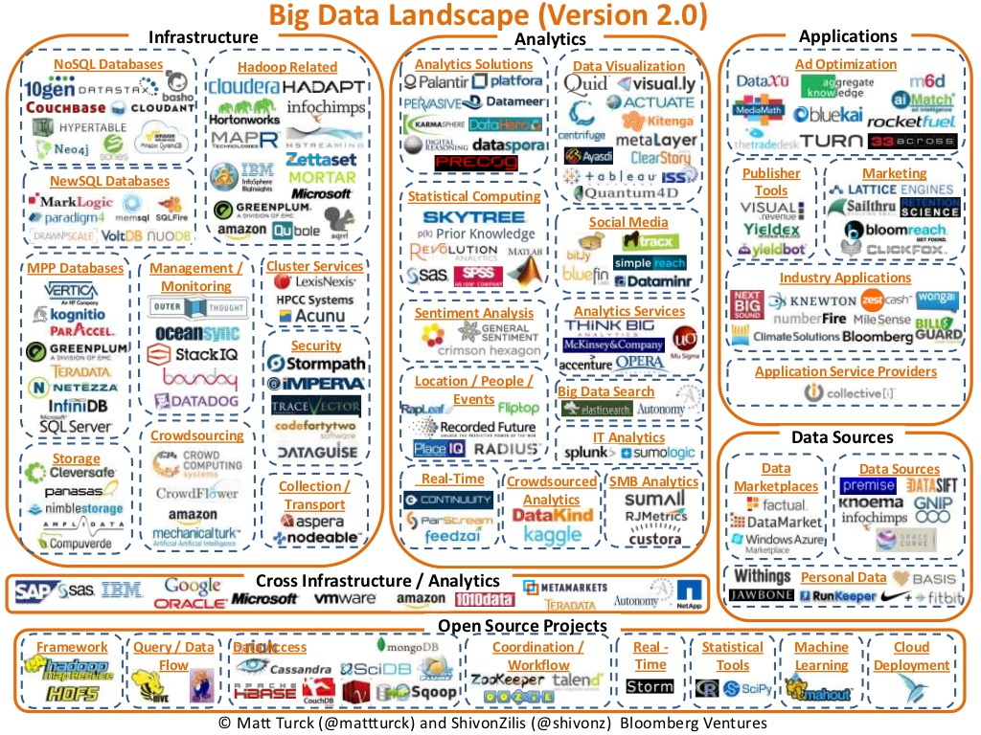
What’s Next?
You are here

Slide 27
Introducing Apache Calcite
Query parser, compiler, and planner framework
Enables Phoenix to get missing SQL support
ANSI compliant (ever argue SQL with Julian? :-) )
Pluggable cost-based optimizer framework
Sane way to model push down through rules
Interop with other Calcite adaptors
Not for free, but it becomes feasible
Already used by Drill, Hive, Kylin, Samza
Supports any JDBC source (i.e. RDBMS - remember them :-) )
One cost-model to rule them all

Slide 28
Calcite Integration
How does Phoenix plug in?
Optimization rules
A query example from logical operators to Phoenix query plan
An interoperability example

Slide 29
How does Phoenix plug in?
JDBC Client
SQL + Phoenix specific grammar
Calcite Parser & Validator
Built-in rules
+ Phoenix specific rules
Calcite Query Optimizer
Phoenix Query Plan Generator
Phoenix Runtime
Phoenix Tables over HBase

Slide 30
Optimization Rules
AggregateRemoveRule
FilterAggregateTransposeRule
FilterJoinRule
FilterMergeRule
JoinCommuteRule
PhoenixFilterScanMergeRule
PhoenixJoinSingleAggregateMergeRule
…

Slide 31
Query Example (filter push-down and smart join algorithm)
LogicalProject
projects: $0, $5
Optimizer
(with RelOptRules & ConvertRules)
PhoenixServerProject
projects: $2, $0
LogicalFilter
filter: $0 = ‘x’
PhoenixServerJoin
type: inner
cond: $3 = $1
LogicalJoin
type: inner
cond: $3 = $7
PhoenixServerProject
projects: $0, $3
PhoenixServerProject
projects: $0, $2
LogicalTableScan
table: A
LogicalTableScan
table: B
PhoenixTableScan
table: ‘a’
filter: $0 = ‘x’
PhoenixTableScan
table: ‘b’

Slide 32
Query Example (filter push-down and smart join algorithm)
PhoenixServerProject
projects: $2, $0
Phoenix
Implementor
HashJoinPlan
types {inner}
join-keys: {$1}
projects: $2, $0
PhoenixServerJoin
type: inner
cond: $3 = $1
Probe
PhoenixServerProject
projects: $0, $3
ScanPlan
table: ‘b’
projects: col0, col2
PhoenixServerProject
projects: $0, $2
Build
hash-key: $1
ScanPlan
table: ‘a’
skip-scan: pk0 = ‘x’
projects: pk0, c3
PhoenixTableScan
table: ‘a’
filter: $0 = ‘x’
PhoenixTableScan
table: ‘b’

Slide 33
Interoperibility Example
Joining data from Phoenix and mySQL
EnumerableJoin
JdbcTableScan
PhoenixTableScan
Phoenix Tables over HBase
mySQL Database

Slide 34
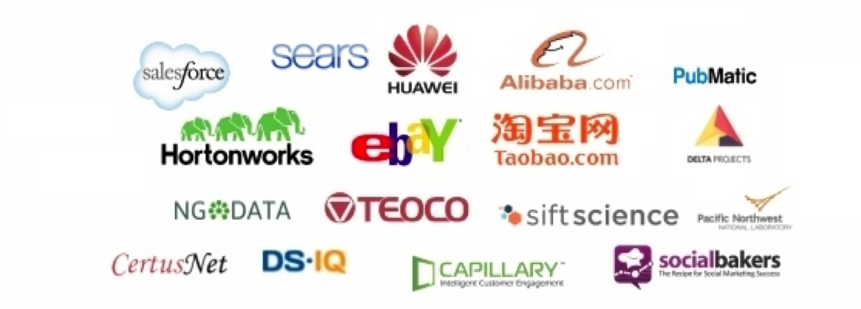

Thank you! Questions?
* who uses Phoenix

