Slide 1

Ohio’s New Learning Standards: K-12 English Language Arts
Center for Curriculum and Assessment
Notes:
How many of you have seen the current ELA Standards?
Rate your knowledge of them: Very well, average knowledge, very little, none.
Who knows when our current standards were adopted by the State BOE?
Rate your knowledge of CC Standards: very well, average, very little, none.
Who knows when the CCS were adopted by State BOE?

Slide 2
Session Objectives
Overview of Ohio’s New Learning Standards
Description of English Language Arts Model Curriculum
Update on future of Ohio’s assessment system

Slide 3
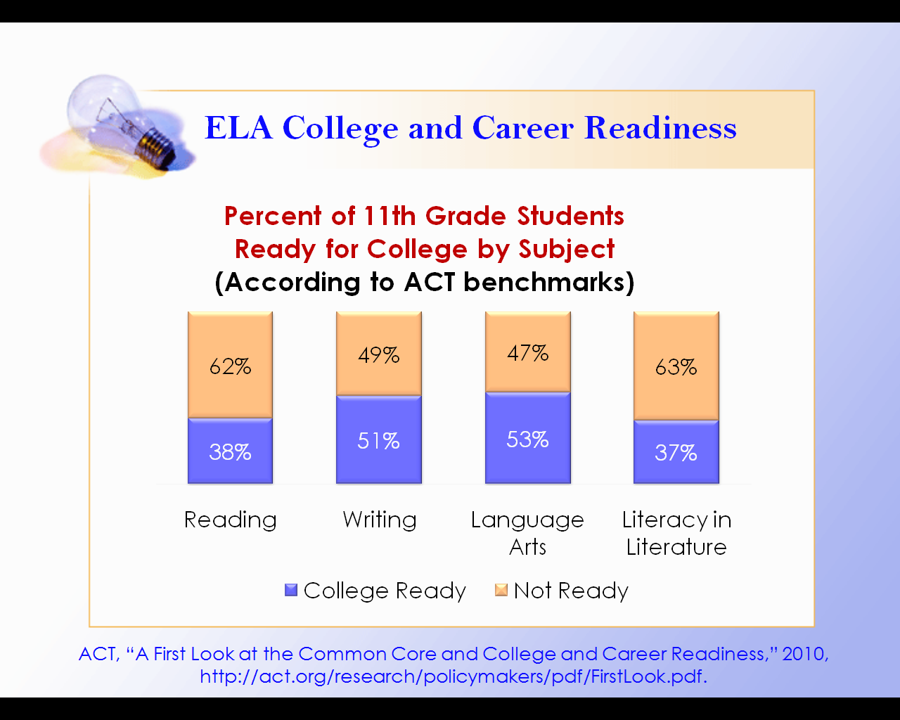
Notes:
One of the guiding factors behind adopting the new standards were the studies that showed that our students were not College and Career Ready after graduating from high school. This particular study is based on ACT benchmarks. It shows the percent of 11th grade students ready for college.

Slide 4
First Step: Revised Standards
Revised Academic Content Standards: June 2010
Model
Curricula:
March 2011
Aligned System
of Assessments:
2014
Notes:
The first step to revising Ohio’s comprehensive educational system addressed the revision of the academic content standards.

Slide 5
Standards Revision
Not later than June 30, 2010…
the state board of education shall adopt statewide academic standards with emphasis on coherence, focus, and rigor for each of grades kindergarten through twelve in English language arts, mathematics, science, and social studies.
– ORC §3301.079(A)(1)
Notes:
Why new standards? Based on legislative mandate.

Slide 6
ELA Standards Framework
Strands
The major areas or disciplines of study within each content area.
“What” students should know and be able to do at each grade level and band.
The main focus of the content within each strand.
Topics
Standard Statements by Grade Level
Standards Statements by Grade Level
Standards Statements by Grade Level
Notes:
Common Core State Standards are organized by:
Strands -major areas of study: reading, writing, listening/speaking and language.
Topics -organizational grouping of the standards
Standard Statements - essential knowledge and skills to be learned at each grade level or grade band
Reminder: This is the ELA common core format. Math’s format is different.

Slide 7
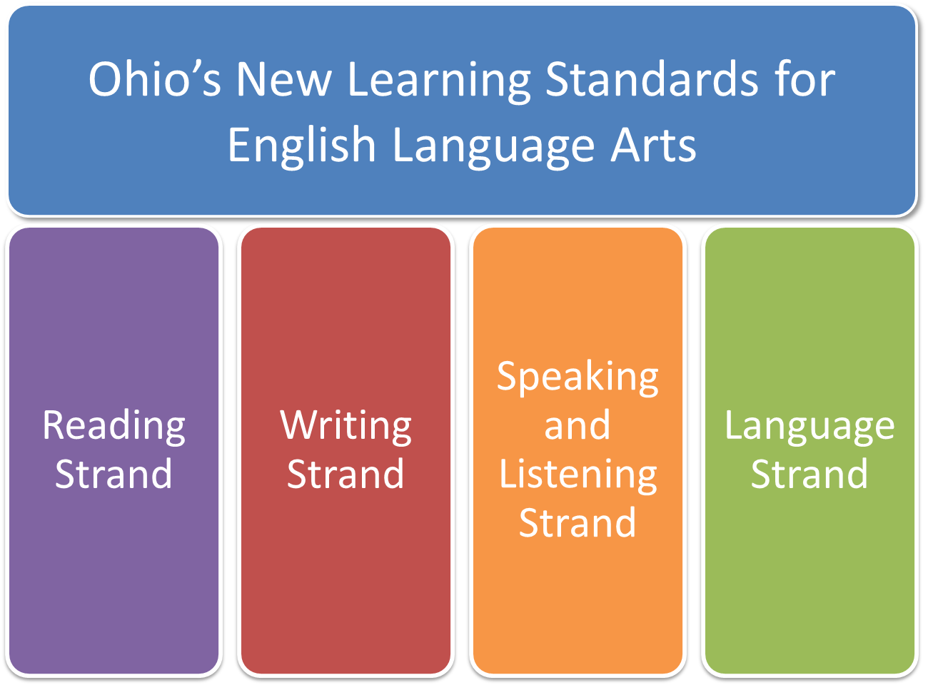
Notes:
At its most basic organizational view. There are four strands or disciplines within the ELA Common Core State Standards (CCSS). Reading, Writing, Speaking and Listening, and Language

Slide 8
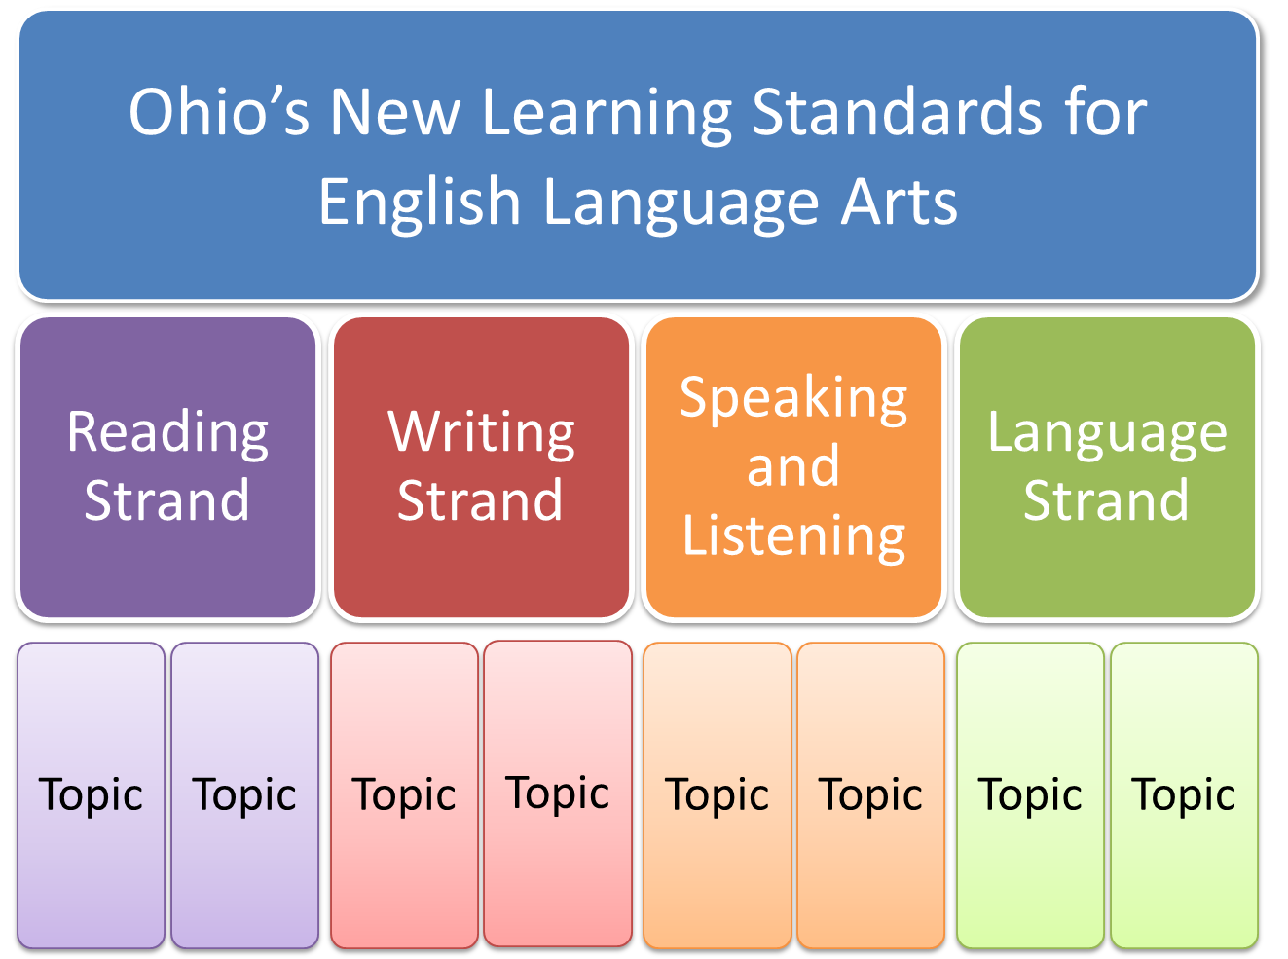
Notes:
Each strand is organized by topics within the strand. There are 4 topics in Reading and Writing, 2 topics in Speaking and Listening and 3 topics in Language. This graphic only reflects the organizational structure. It does not include the exact number of topics for each strand.

Slide 9
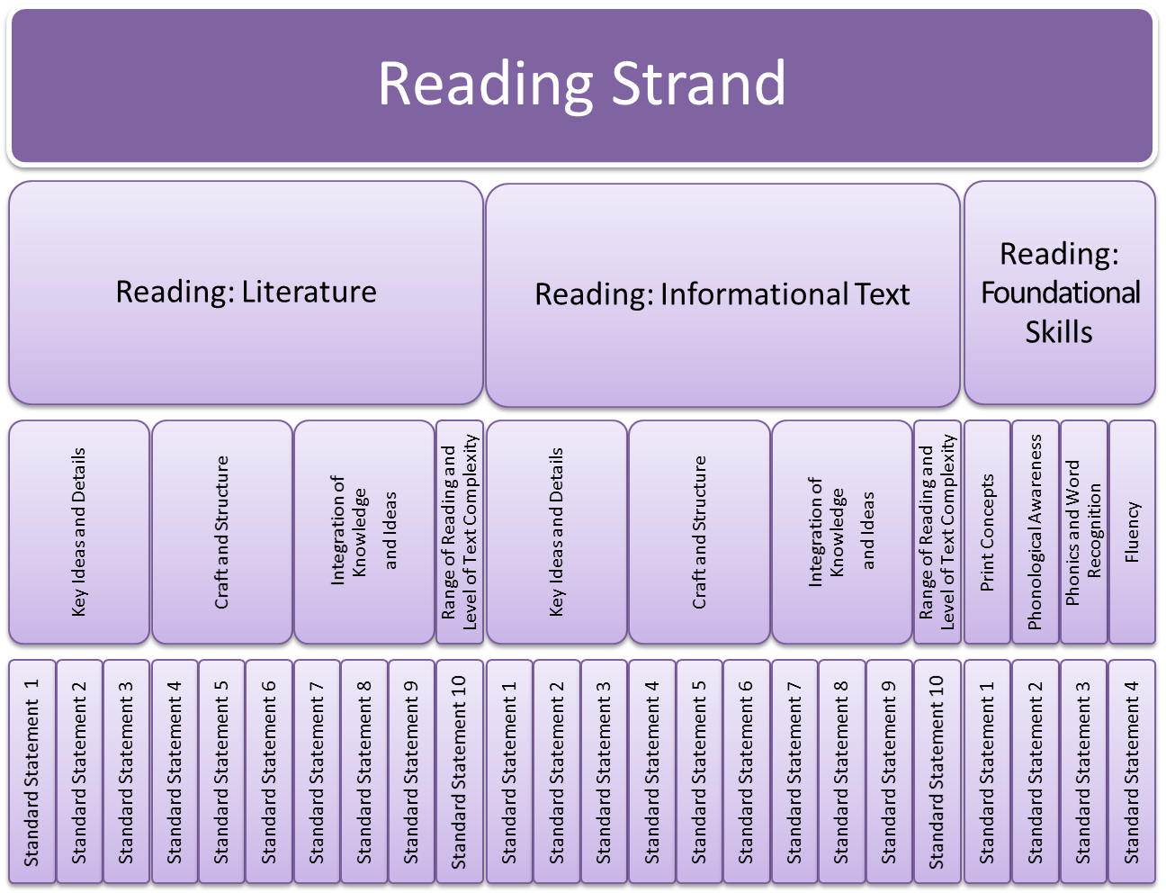
Notes:
The reading strand is the only strand that has “sub-strands” which include: Reading Literature, Reading Informational Text and Reading Foundations. This graphic represents the correct number of substrands, topics and standard statements within the reading strand. Note that the topics for Reading Literature and Reading Informational Text are exactly the same. Reading Foundational Skills applies only to grades K-5.

Slide 10
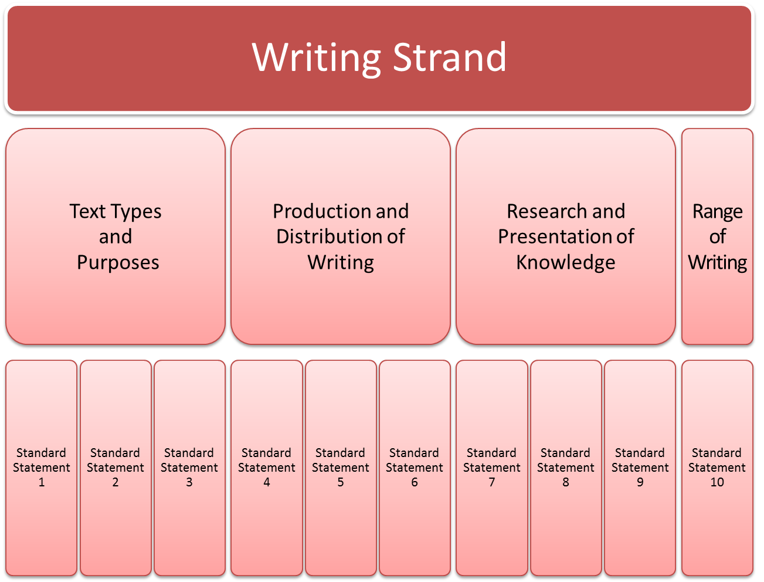
Notes:
The writing strand has 4 topics: 1)Text Types and Purposes 2)Production and Distribution of Writing 3)Research and Presentation of Knowledge 4) Range of Writing. Each topic includes 3 standard statements with the exception of Range of Writing which only has one standard (#10).

Slide 11
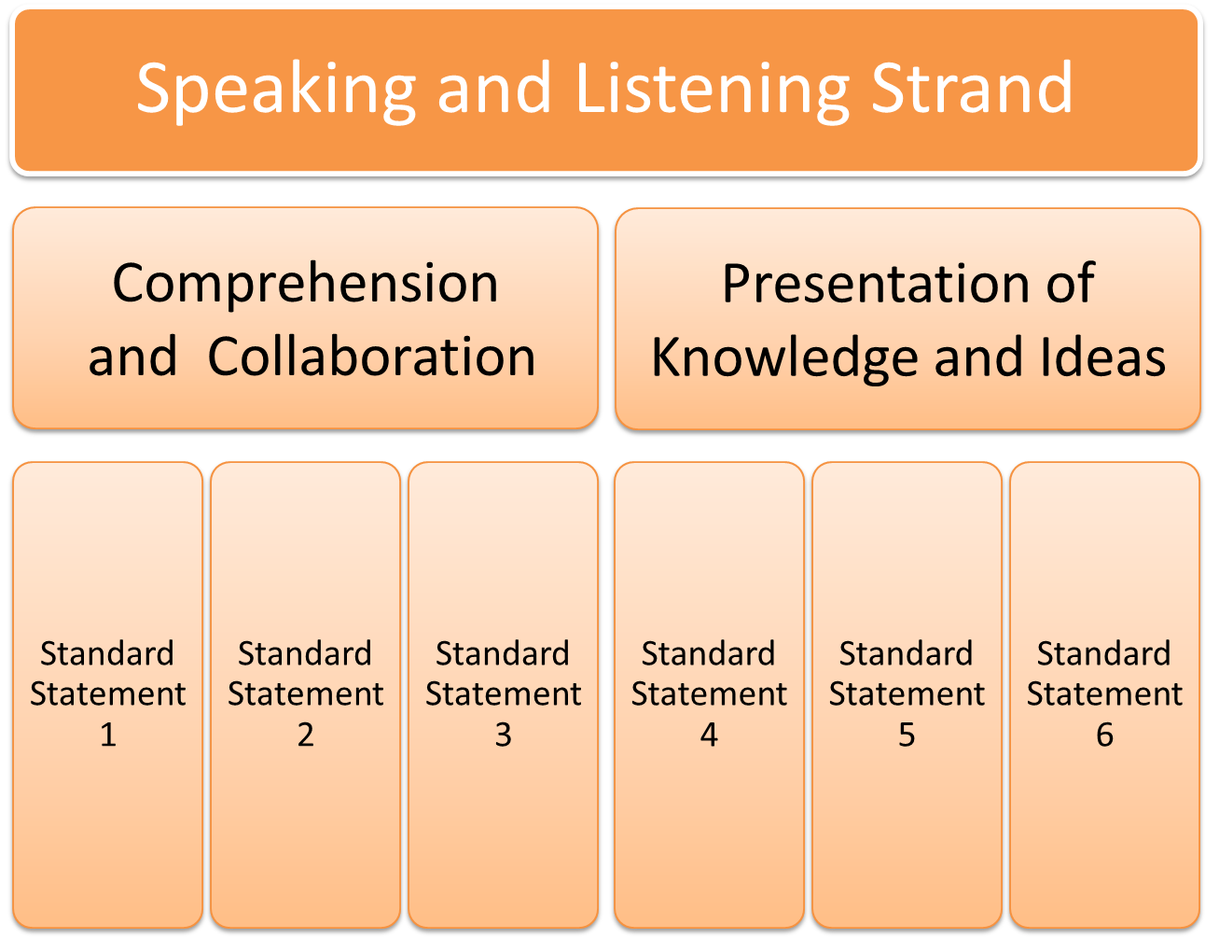
Notes:
The speaking and listening strand has two topics: 1)Comprehension and Collaboration 2)Presentation of Knowledge and Ideas. Both topics include 3 standard statements.

Slide 12
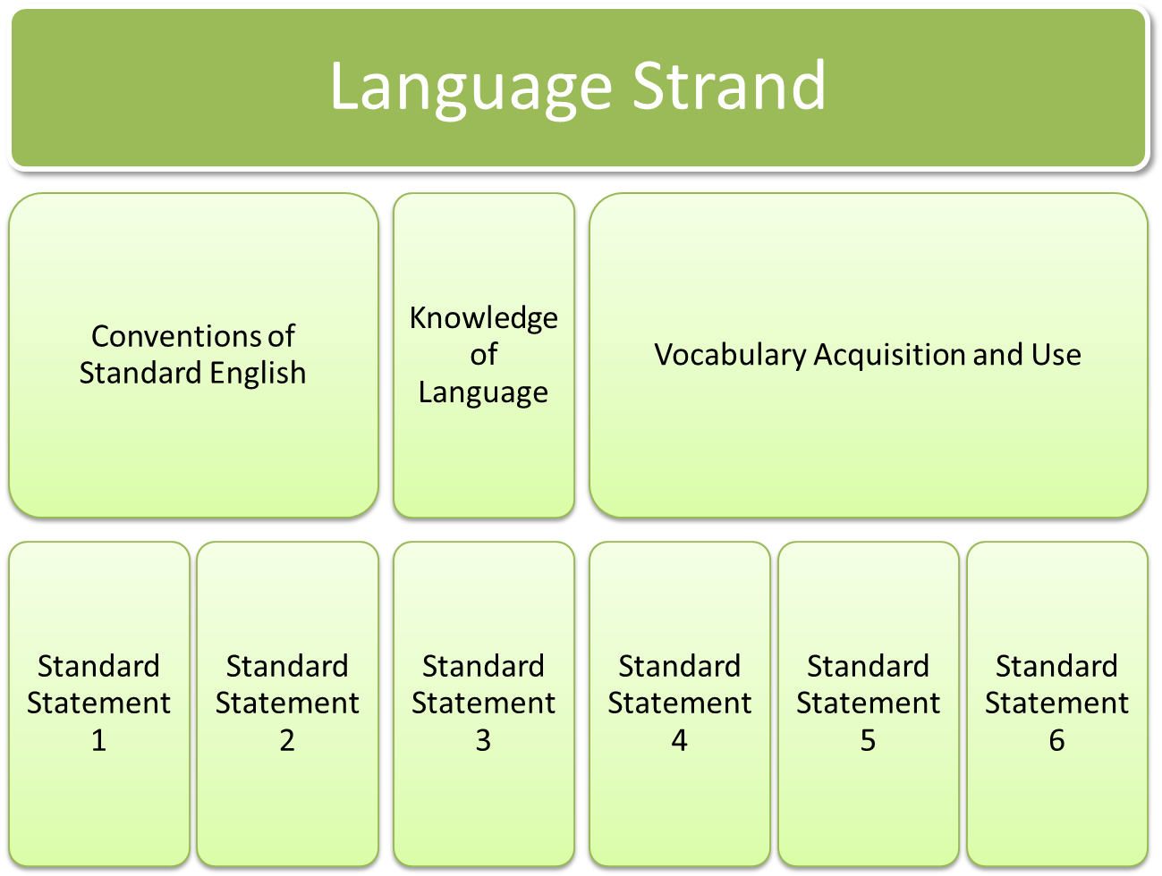
Notes:
The language strand has 3 topics: 1)Conventions of Standard English 2)Knowledge of Language 3) Vocabulary Acquisition and Use. Each topic has a different number of standards within it.

Slide 13
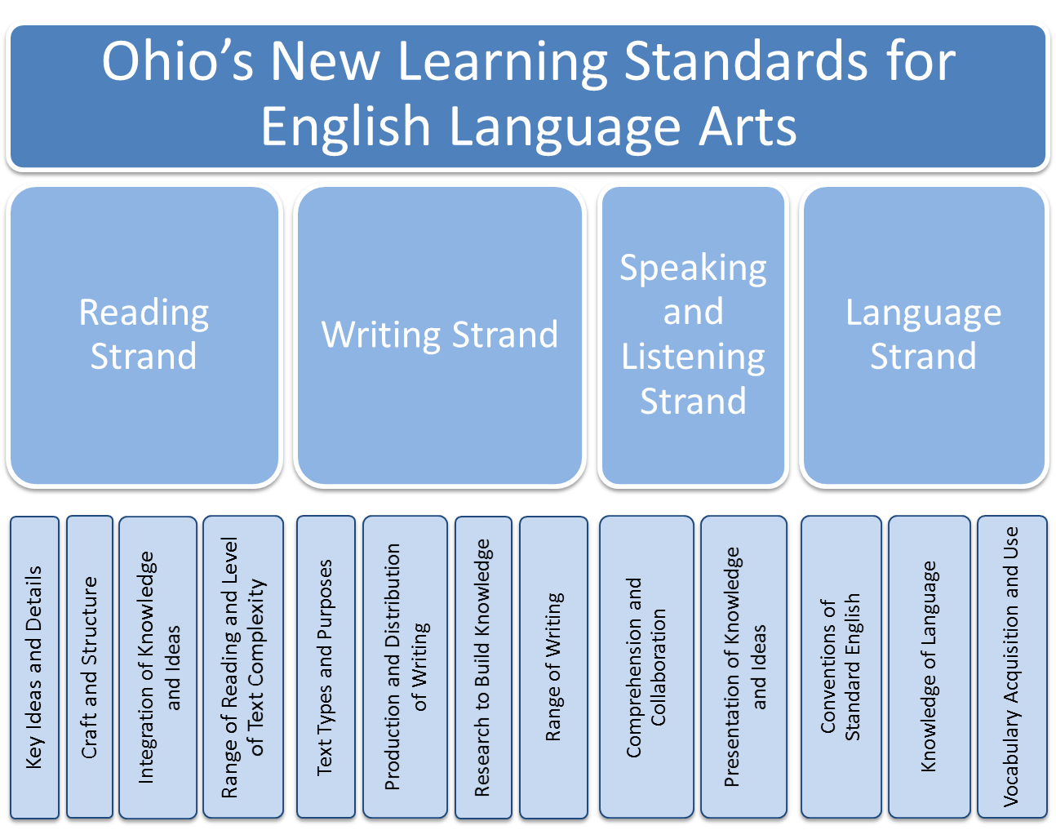
Notes:
Here are the four strands and their corresponding topics.

Slide 14
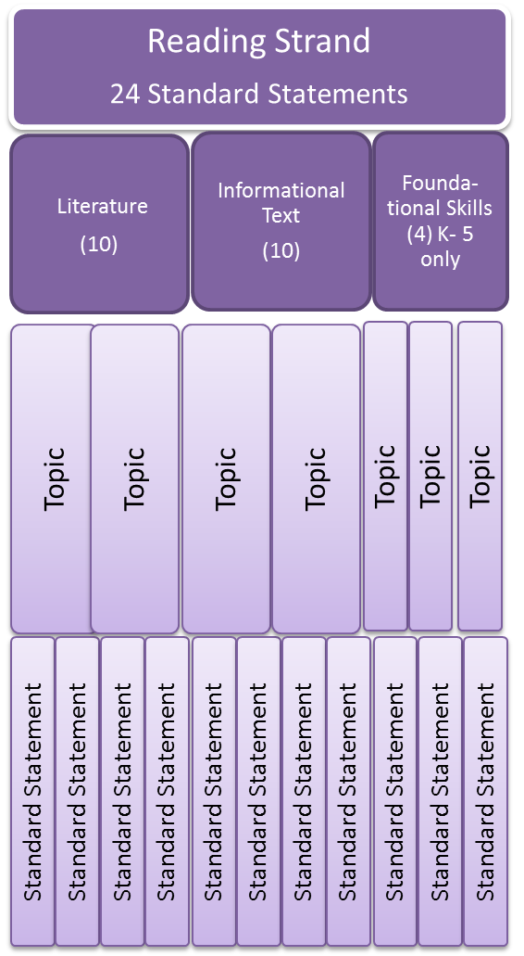
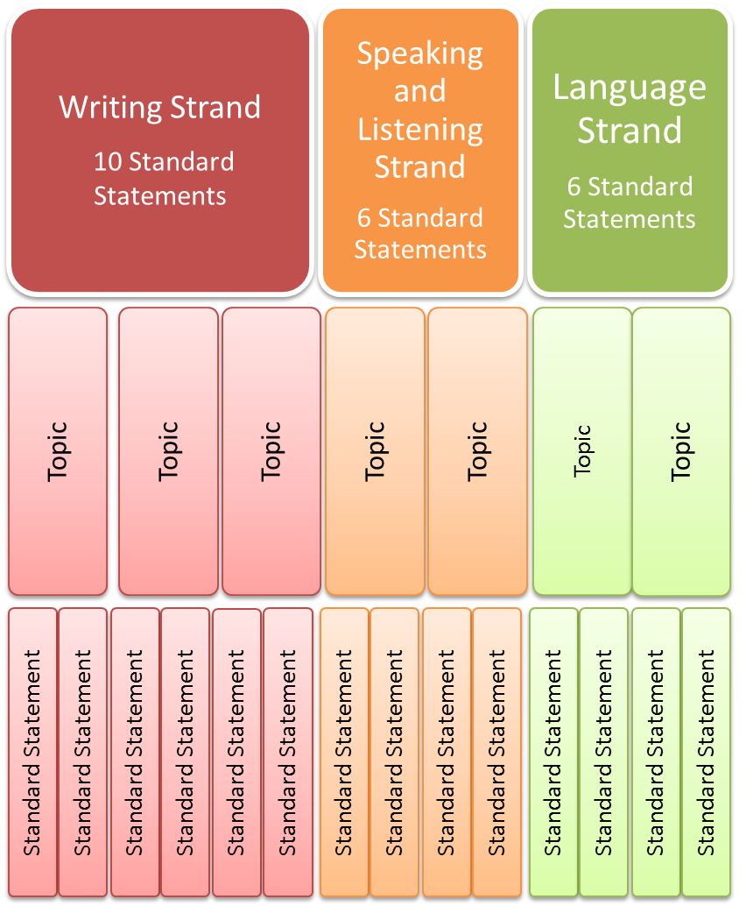
Notes:
Here is a graphic representation of the strands, topics and standard statements. Note: the number of topics and standard statements is not exact in this illustration.

Slide 15
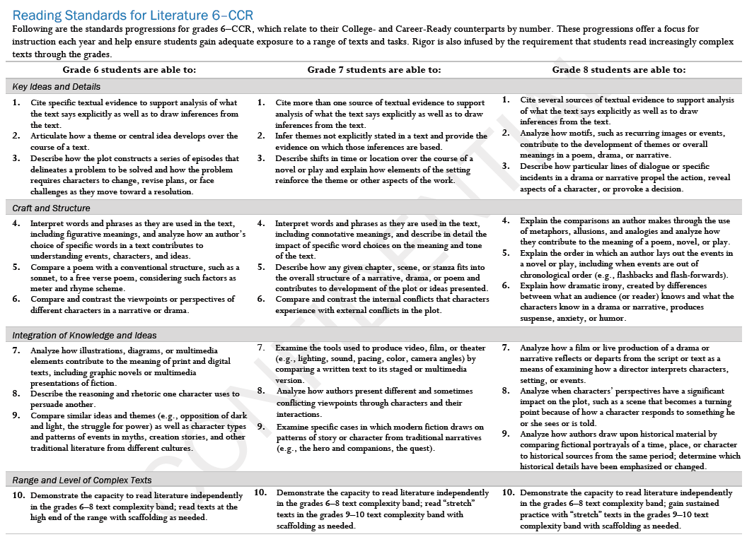



ELA Standards Format
Strands
Topics
Standard Statement
Notes:
Here’s a look at one page from the CCSS standards. It is broken up into three parts: The strand, the topics and the standard statements.

Slide 16
ELA Standards Coding
RL = Reading for Literature
RI = Reading for Information
RF = Reading Foundations
W = Writing
SL = Speaking and Listening
L = Language
Notes:
The CCSS have a coding system that will be used by all states.

Slide 17
Sample Code
Reading Literature
Standard 2
RL.1.2
Grade 1
Notes:
The code includes the strand RL(Reading Literature), the grade (1), and the standard #( 2).

Slide 18
ELA Standards Coding Quiz
W.4.3
Writing, Grade 4, Standard 3
RF.2.4
Reading Foundations, Grade 2, Standard 4
L.10.3a
Language, Grade 10, Standard 3a
Notes:
Let’s see if you can decode these standards references.

Slide 19
Additional Components of the Learning Standards for ELA
Anchor standards (K-12)
Literacy standards for History/Social Studies, Science and other Technical Subjects (Grades 6-12)
Appendix A
  Text complexity
Appendix B
  Illustrative texts
Appendix C
  Student writing exemplars
Language Progressive Skills (Grades 3-12)
Notes:
The CCSS include anchor standards which can be found at the beginning of each strand. Because there are 10 standards for reading, there are 10 anchor standards. In addition to the anchor standards, there are three appendices that can further assist teachers. The Common Core also includes the literacy standards for History, Science, and other Technical Subjects for grades 6-12.
Appendix A – an excellent resource for understanding the topic of text complexity.
Appendix B – provides examples of grade appropriate text for each grade level. Caution: These titles are not to be used as a reading list. They are examples of text complexity appropriate for each grade. Appendix B also provides examples of performance tasks related to the exemplar texts for each grade level.
Appendix C – provides student writing exemplars for each grade level.

Slide 20
Three Key Shifts
Building knowledge through content-rich nonfiction
Reading, writing and speaking grounded in evidence from text, both literary and informational
Regular practice with complex text and its academic language
Notes:
Educators are responsible for making sure that students are exposed to grade level text complexity regardless of their reading ability. In addition, we must make sure that students are exposed to a wide range of text types including informational text.
The focus of the revised standards is to read shorter texts but with much closer attention. Rereading and looking for evidence to support conclusions drawn from the text is critical to becoming an effective reader.
Writing prompts should be tied to texts. In other words, to complete a “writing to source” assignment, the student must have read and analyzed a text to respond to the prompt. For example, a typical writing prompt for students after reading Martin Luther King’s “Letter from a Birmingham Jail” might ask students to discuss the idea of freedom and what it means to her/him (the student). However, a “writing to sources” assignment would be: What does freedom mean to the author? How does the author define freedom? In this assignment students cannot answer the question without having read and analyzed the text and used evidence from it to support his/her conclusion.
Research should not be a once a year event. Short research projects should be included in every unit of study and occur throughout the year.

Slide 21
Ten Guiding Principles
Make close reading of texts central to lesson
Structure majority of instruction so all students read grade-level complex texts
Emphasize informational texts from early grades on
Provide scaffolding that does not preempt or replace text
Ask text-dependent questions
Notes:
Close reading of short texts with deep analysis. Good questions linger over specific phrases and sentences.
All students deserve the opportunity to grapple with grade level text. Deficiencies are not equal opportunity.
See the chart in the standards on page 5 of the Introduction which shows the amount of daily classroom time that should be spent at each grade level with informational text. (Grade 4 = 50%, Grade 8 = 55%, Grade 12 =70%)
Instead of replacing a grade level text that is above a student’s reading ability with an easier one, scaffold the lesson so that all students are exposed to grade level text.
Structure questions so that they require students to have read and analyzed the text in order to answer. Less writing to decontextualized prompts.

Slide 22
Ten Guiding Principles
Provide extensive research and writing opportunities (claims and evidence)
Offer regular opportunities for students to share ideas, evidence and research
Offer systematic instruction in vocabulary
Provide explicit instruction in grammar and conventions
Cultivate students’ independence
Notes:
6. Short research projects should be ongoing and frequent. Inquiry-based learning.
7. Students must have opportunities to share their ideas, evidence and research. This is a 21st century skill which will be critical in their careers. Presentations, discussions, project sharing, debates, etc.
8. Empower students with the strategies to tackle new vocabulary both in writing and reading. Spend time on the power of each word. Isabel Beck’s Bringing Words to Life
9. Every content area has its domain-specific vocabulary and concepts. The knowledge of grammar and conventions is critical and must be explicitly taught.
10. Help students become independent learners who have choices in their study.

Slide 23

Transitioning to Ohio’s New Learning Standards
Familiarize yourself with structure and content of new standards
Understand commonalities and differences between current and revised standards
Discuss implications for instruction and assessment
Utilize the resources and the tools created by ODE for alignment

Slide 24
Intentional Design Limitations
What Standards do NOT define:
How teachers should teach
All that can or should be taught
Nature of advanced work beyond core
Interventions needed for students well below grade level
Full range of support for English language learners and students with special needs
– Common Core Presentation 2010
Notes:
The CCSS are the “what.” Educators have many choices in deciding the “how” ( how to make the “what” accessible to ALL students.)

Slide 25
Frequently Asked Question
Q: Will the common core state standards keep local teachers from deciding what or how to teach?
A: No.
Common core standards are clear set of shared goals and expectations for what knowledge and skills will help students succeed
Local teachers, principals, superintendents and others will decide how standards are met
Teachers continue to devise lesson plans and tailor instruction to individual needs of students in classrooms
Local teachers, principals, superintendents and school boards continue to make decisions about curriculum and how school systems are operated
– Common Core Presentation 2010

Slide 26
TOOLS AND RESOURCES

Slide 27
ELA Crosswalk
Aligns Ohio Academic Content ELA Standards to Ohio’s New Learning Standards for ELA (in broad way)
Available at education.ohio.gov
Updated February 2011 – please use new version
Notes:
The commonalities mentioned in the previous slide are making reference to the crosswalk that focuses on aligning current ELA standards to the New Common Core Standards. The newest version can be located on the ODE website on the English language arts landing page.

Slide 28
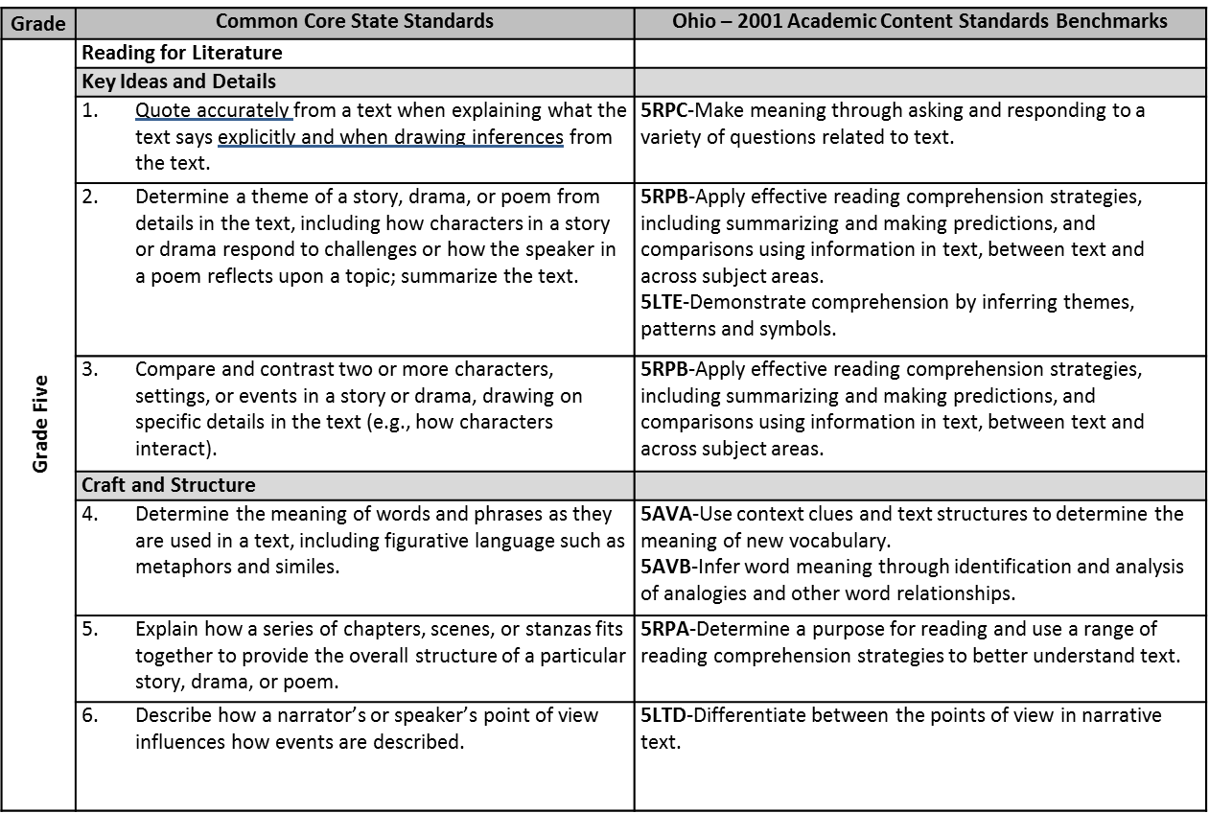

SAMPLE CROSSWALK
Not intended to be an exact match, rather to be used as a tool for orienting educators as they work on implementation.
Notes:
On the left side of the document are the CCSS. The right column shows where the same concepts and skills are found in the old standards.
Use of the Crosswalk is a good starting point but cannot be relied upon solely as there are really very few exact matches. Beware of thinking that you can check off the standards simply because they are shown in the Crosswalk to be aligned. ODE recommends use of the Comparative Analysis as a more effect document for alignment.
Optional comments: Most often it isn't the content that is different, but it is the level or specificity of the expectation. Note the difference in the 5th grade Common Core Standard #1 in reading and the Ohio ACS Reading Process C. The intent is similar, however the CCSS asks students to ‘quote accurately’ to explain literal and inferential information gathered from the text.
It is a starting point to start to look at how to start to research the standards
Note also that Skills and concepts addressed in the Reading Strand for the Common Core State Standards are often aligned to things that were not a part of the Literary Text/Informational Text Benchmarks and/or indicators. On this page specifically skills were aligned to expectations in our Reading Process, Literary Text and Acquisition of Vocabulary areas.

Slide 29
Comparative Analysis
A grade-level specific tool designed to help teachers understand the overall similarities and changes between the Ohio Academic Content Standards and Ohio’s New Learning Standards.
Will show:
  What is the same
  What is new
  What is no longer present

Slide 30
Comparative Analysis
Content that has been shifted or changed in grade band 9-10 | Content that appears in both documents | Content new to content area/grade level
The concepts and skills found in the Reading Process Standard of the Ohio Academic Content Standards are embedded in larger ideas within Reading, Writing, Speaking and Listening, and Language Strands of the Common Core State Standards | Reading for Literature Citing textual evidence Drawing inferences Identifying theme Analyzing character development Determining tone Analyzing point of view Determining meanings of words and phrases Analyzing diction Analyzing treatment, scope & organization of text. | Reading for Literature Analyzing a subject or key scene in different artistic mediums (RL.9-10.7) Analyzing how an author draws on and transforms source material (RL.9) Text complexity: the inherent difficulty of reading &comprehending a text combined with consideration of reader and text variables. (RL.9-10.10)
Notes:
The Comparative Analysis is a much more accurate way of looking at alignment which looks at the big ideas that have changed, are still highlighted, or are new to the CCSS.
This is an example of Grade 9 Reading.

Slide 31
Helpful Websites
www.corestandards.org
www.commoncore.org
(Curriculum maps linked to Common Core Standards)
www.education.ohio.gov
www.achievethecore.org
Notes:
Commoncore.org— a great resource, but does not cover all standards in the CCSS. The ELA landing page at the ODE website has many resources including vertical articulations of the CCSS, videos, handouts, etc.,

Slide 32
Additional Resources
James B. Hunt, Jr. Institute for Educational Leadership and Policy
  http://www.hunt-institute.org/
James B. Hunt, Jr. CCSS Articles
  http://www.hunt-institute.org/knowledge-library/articles/#articles-by-common-state-standards
Kansas Department of Education
  http://www.ksde.org/Default.aspx?tabid=4754
Notes:
This site includes videos that explain/expand the Common Core State Standards. (Scroll to bottom of page)
Also YouTube has a number of resources available using the key word Common Core State Standards.

Slide 33
Next Step: Model Curricula
Revised Academic Content Standards: June 2010
Model
Curricula:
March 2011
Aligned System
of Assessments:
2014
Notes:
The second part of Ohio’s comprehensive educational improvement system is the development of a model curricula which is aligned to the revised standards.

Slide 34
Why a Model Curriculum?
…the state board shall adopt a model curriculum…The model curriculum shall be aligned with the standards, to ensure that the academic content and skills specified for each grade level are taught to students, and shall demonstrate vertical articulation and emphasize coherence, focus, and rigor.
– ORC §3301.079(B)

Slide 35
What is the Model Curriculum?
Web-based tool, aligned to standards, that:
Presents information specific to content area by grade level, grade band and course
Provides curricular and instructional guidance
Includes instructional strategies and resources
Informs assessment development

Slide 36
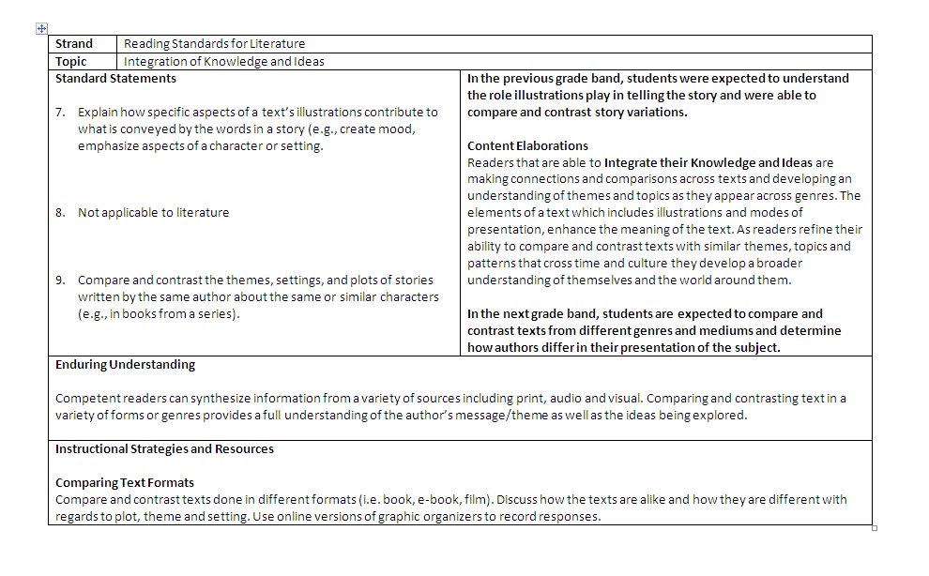
Model Curriculum Example
English Language Arts
Grade 3
Standards
Progressions
Content Elaborations
Enduring Understanding
Instructional Strategies and Resources
Notes:
This is an example of what you will see on the ODE website. The model curriculum is broken up into several sections. At the top there are the Standard Statements, to the right you will find bolded progressions that inform the teachers of the previous grades’ expectations and at the bottom it shows the expectations of the grades to follow. Under the progressions are the Content Elaborations which further explain the topic. The next block contains the Enduring Understanding which seeks to explain why these skills are important. Finally, below the enduring understanding are the Instructional Strategies and Resources. This section is meant to give teachers ideas and additional resources to help with instruction. This is not a lesson plan; it is only meant to be a tool to assist teachers design instruction.

Slide 37
Instructional Strategies and Resources
To be updated and expanded every year
Includes link to www.cast.org for plethora of resources and strategies for diverse learners

Slide 38
Helpful Websites
www.corestandards.org
(Use link at top of page, The Standards)
www.commoncore.org
(Curriculum maps linked to Common Core Standards)
www.education.ohio.gov
(Academic Content Standards>English Language Arts>Comparison of the K-12 Ohio Academic Content Standards and the Common Core Standards)

Slide 39
Another Powerful Resource
On ELA landing page, link to video clip entitled Bringing Common Core to Life
Presentation of model lesson by one of writers of Common Core, David Coleman
Demonstrates how to teach close reading of text

Slide 40
Ohio’s Comprehensive Educational System
Revised Academic Content Standards: June 2010
Model
Curricula:
March 2011
Aligned System
of Assessments:
2014
Notes:
The third part of Ohio’s comprehensive educational system involves new assessments.

Slide 41

Ohio’s Decision
Ohio had been a participating member of two consortia.
On November 15, 2011 the Ohio State Board of Education voted for Ohio to join PARCC as a governing member.
Notes:
PARCC = Partnership for Assessment of Readiness for College and Careers
This organization will develop Ohio’s assessments for English language arts and mathematics which will begin in 2014-2015.

Slide 42

Ohio’s New Assessments
PARCC Developed Assessments
State Developed Assessments
English language arts
grades 3 – 8 and high school
Mathematics
grades 3 – 8 and high school
Assess the Common Core Standards
Operational school year 2014-15
Science
grades 5 and 8 and high school
Social Studies
grades 4 and 6
Assess the revised Ohio standards
Operational school year 2014-15

Slide 43
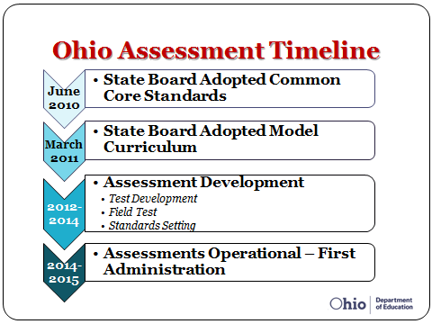

Slide 44

Follow PARCC Development
www.parcconline.org
See ELA Content Frameworks
http://www.parcconline.org/parcc-content-frameworks

Slide 45
Assessment Suspension
Assessments suspended:
  Writing, Grade 4 and 7, OAA
  Social Studies, Grade 5 and 8, OAA
  2009-2010 and 2010-2011 school years
All five OGT tests will still be administered

Slide 46
New Assessments
Field testing: 2012-2013
Standard setting: 2013-2014
New tests begin: 2014-2015

Slide 47
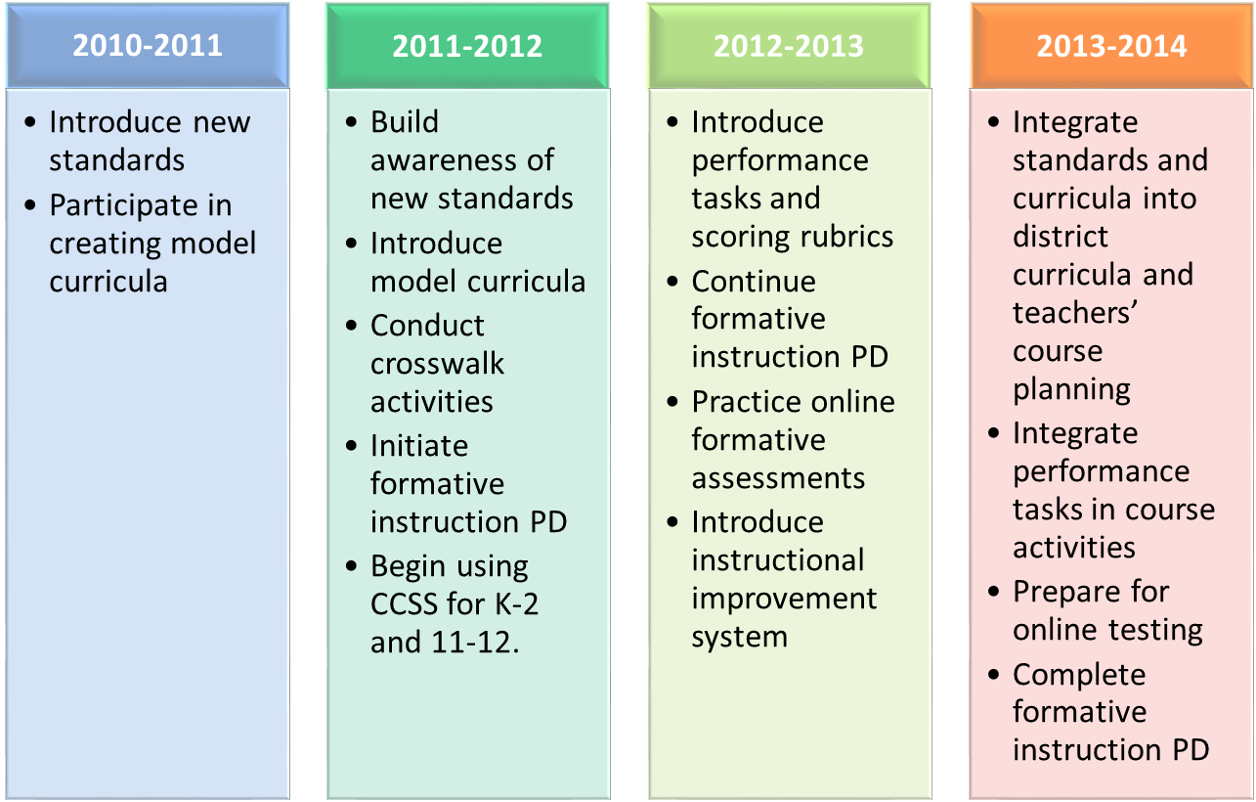
Preparation for New Standards
Tasks for Districts
Notes:
Year-by-year plan for district implementation of revised standards.

Slide 48
Have Questions?
Contact:
Elizabeth Bridges
English Language Arts & Assessment Development
Ohio Department of Education
Elizabeth.bridges@education.ohio.gov
Shantelle Hill
English Language Arts & Professional Development and Stakeholder Outreach Consultant
Ohio Department of Education
Shantelle.hill@education.ohio.gov

