Slide 1
Chapter 4: Data Cube Computation and Data Generalization
Efficient Computation of Data Cubes
High-Dimensional OLAP Query
Summary

Slide 2
Efficient Computation of Data Cubes
Preliminary cube computation tricks
Computing full/iceberg cubes:
  Top-Down: Multi-Way array aggregation
  Bottom-Up: Bottom-up computation: BUC
  Integrating Top-Down and Bottom-Up:
High-dimensional OLAP: A Minimal Cubing Approach.

Slide 3
Preliminary Tricks (Agarwal et al. VLDB’96)‏
Sorting, hashing, and grouping operations are applied to the dimension attributes in order to reorder and cluster related tuples
Aggregates may be computed from previously computed aggregates, rather than from the base fact table
  Smallest-child: computing a cuboid from the smallest, previously computed cuboid
  Cache-results: caching results of a cuboid from which other cuboids are computed to reduce disk I/Os
  Amortize-scans: computing as many as possible cuboids at the same time to amortize disk reads
  Share-sorts: sharing sorting costs cross multiple cuboids when sort-based method is used
  Share-partitions: sharing the partitioning cost across multiple cuboids when hash-based algorithms are used

Slide 4
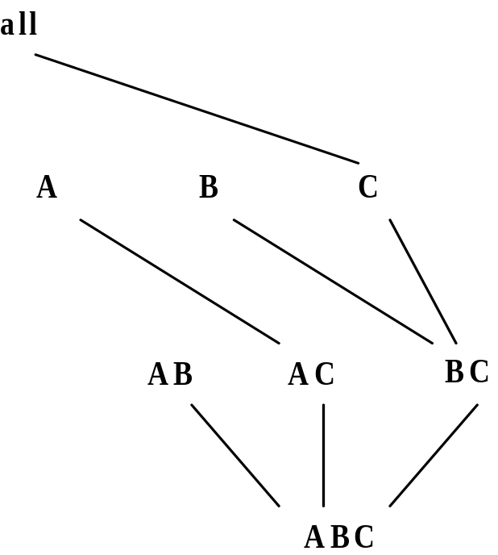
Multi-Way Array Aggregation
Array-based “bottom-up” algorithm
Using multi-dimensional chunks
No direct tuple comparisons
Simultaneous aggregation on multiple dimensions
Intermediate aggregate values are re-used for computing ancestor cuboids

Slide 5
Multi-way Array Aggregation for Cube Computation (MOLAP)‏
Partition arrays into chunks (a small subcube which fits in memory).
Compressed sparse array addressing: (chunk_id, offset)‏
Compute aggregates in “multiway” by visiting cube cells in the order which minimizes the # of times to visit each cell, and reduces memory access and storage cost.
C
c3
61
62
63
64
c2
45
46
47
48
c1
29
30
31
32
What is the best traversing order to do multi-way aggregation?
c 0
B
60
b3
13
14
15
16
44
9
28
56
b2
B
40
5
24
52
b1
36
20
b0
1
2
3
4
a0
a1
a2
a3
A

Slide 6
Multi-way Array Aggregation for Cube Computation
C
c3
61
62
63
64
c2
45
46
47
48
c1
29
30
31
32
c 0
B
60
b3
13
14
15
16
44
B
9
28
56
b2
40
5
24
52
b1
36
20
b0
1
2
3
4
a0
a1
a2
a3
A

Slide 7
Multi-way Array Aggregation for Cube Computation
C
c3
61
62
63
64
c2
45
46
47
48
c1
29
30
31
32
c 0
B
60
b3
13
14
15
16
44
B
9
28
56
b2
40
5
24
52
b1
36
20
b0
1
2
3
4
a0
a1
a2
a3
A

Slide 8
Multi-Way Array Aggregation for Cube Computation (Cont.)‏
Method: the planes should be sorted and computed according to their size in ascending order
  Idea: keep the smallest plane in the main memory, fetch and compute only one chunk at a time for the largest plane
Limitation of the method: computing well only for a small number of dimensions
  If there are a large number of dimensions, “top-down” computation and iceberg cube computation methods can be explored

Slide 9
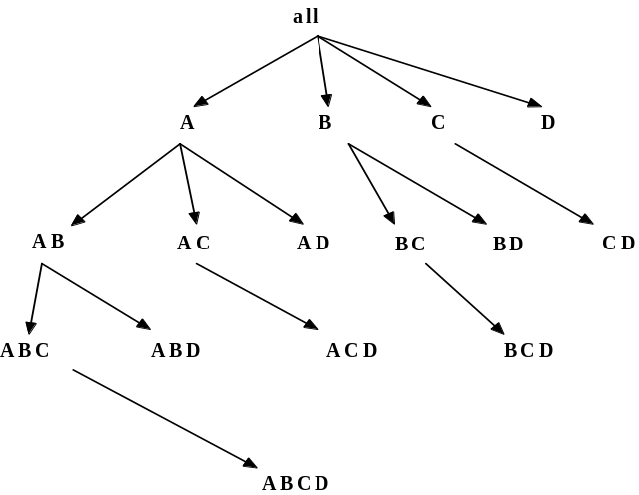
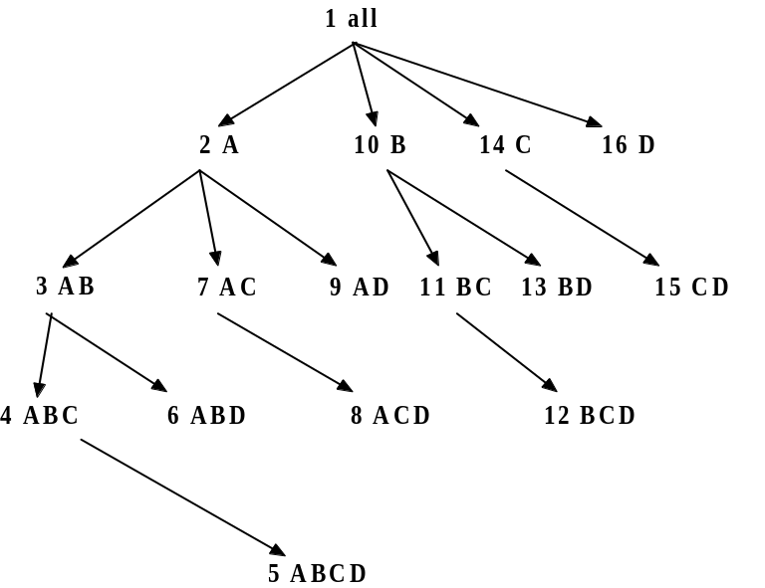
Bottom-Up Computation (BUC)‏
Divides dimensions into segments and facilitates iceberg pruning
  If a partition does not satisfy min_sup, its descendants can be pruned,
  If minsup = 1 ⇒ compute full CUBE!
No simultaneous aggregation

Slide 10

BUC: Partitioning
Usually, entire data set can’t fit in main memory
Sort distinct values, partition into blocks that fit
Continue processing
Optimizations
  Partitioning
    External Sorting, Hashing, Counting Sort
  Ordering dimensions to encourage pruning
    Cardinality, Skew, Correlation
  Collapsing duplicates
    Can’t do holistic aggregates anymore!

Slide 11
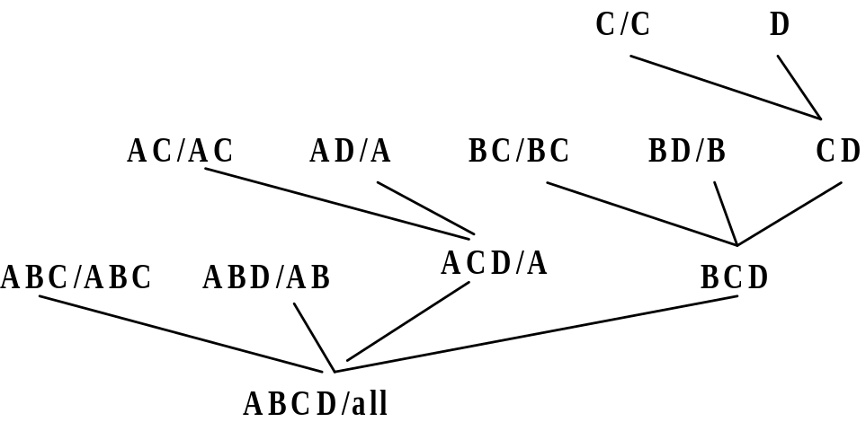
Star-Cubing: An Integrating Method
Integrate the top-down and bottom-up methods
Explore shared dimensions
  E.g., dimension A is the shared dimension of ACD and AD
  ABD/AB means cuboid ABD has shared dimensions AB
Allows for shared computations
  e.g., cuboid AB is computed simultaneously as ABD
Aggregate in a top-down manner but with the bottom-up sub-layer underneath which will allow Apriori pruning
Shared dimensions grow in bottom-up fashion

Slide 12
Iceberg Pruning in Shared Dimensions
Anti-monotonic property of shared dimensions
  If the measure is anti-monotonic, and if the aggregate value on a shared dimension does not satisfy the iceberg condition, then all the cells extended from this shared dimension cannot satisfy the condition either
Intuition: if we can compute the shared dimensions before the actual cuboid, we can use them to do Apriori pruning
Problem: how to prune while still aggregate simultaneously on multiple dimensions?

Slide 13
Star Attributes and Star Nodes
Intuition: If a single-dimensional aggregate on an attribute value p does not satisfy the iceberg condition, it is useless to distinguish them during the iceberg computation
  E.g., b₂, b₃, b₄, c₁, c₂, c₄, d₁, d₂, d₃
Solution: Replace such attributes by a *. Such attributes are star attributes, and the corresponding nodes in the cell tree are star nodes
A | B | C | D | Count
a1 | b1 | c1 | d1 | 1
a1 | b1 | c4 | d3 | 1
a1 | b2 | c2 | d2 | 1
a2 | b3 | c3 | d4 | 1
a2 | b4 | c3 | d4 | 1

Slide 14
Example: Star Reduction
Suppose minsup = 2
Perform one-dimensional aggregation. Replace attribute values whose count < 2 with *. And collapse all *’s together
Resulting table has all such attributes replaced with the star-attribute
With regards to the iceberg computation, this new table is a loseless compression of the original table
A | B | C | D | Count
a1 | b1 | * | * | 1
a1 | b1 | * | * | 1
a1 | * | * | * | 1
a2 | * | c3 | d4 | 1
a2 | * | c3 | d4 | 1
A | B | C | D | Count
a1 | b1 | * | * | 2
a1 | * | * | * | 1
a2 | * | c3 | d4 | 2

Slide 15
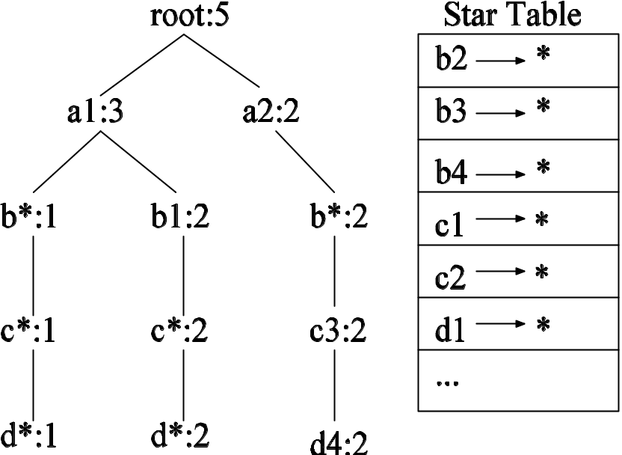
Star Tree
Given the new compressed table, it is possible to construct the corresponding cell tree—called star tree
Keep a star table at the side for easy lookup of star attributes
The star tree is a loseless compression of the original cell tree

Slide 16
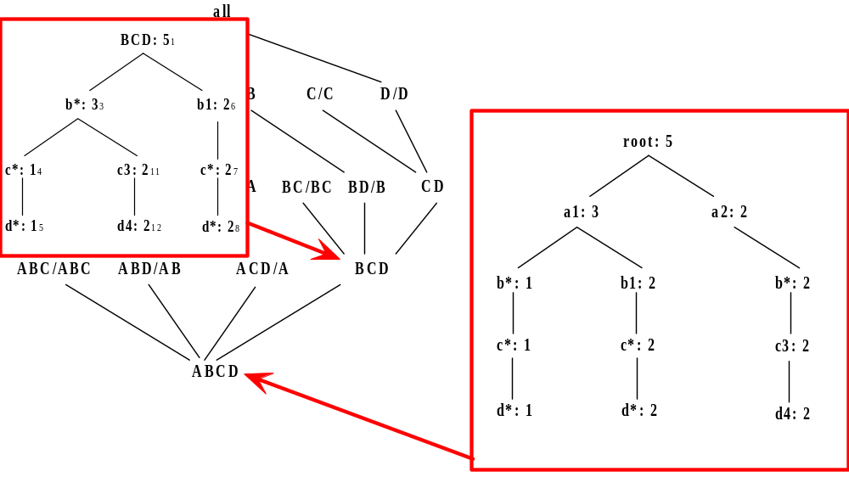
Star-Cubing Algorithm—DFS on Lattice Tree

Slide 17
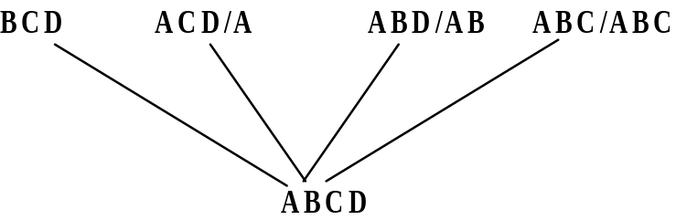
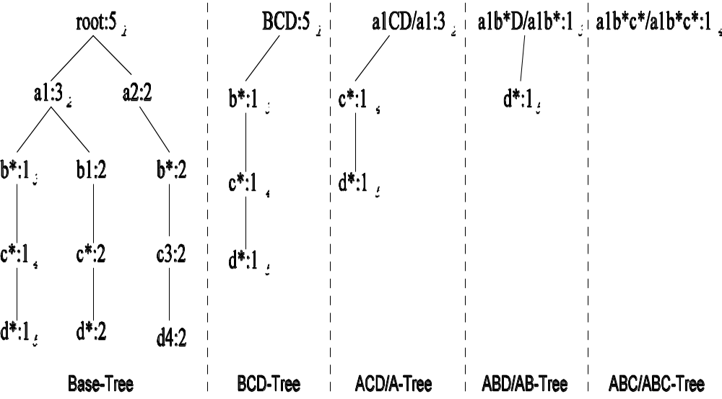
Multi-Way Aggregation

Slide 18
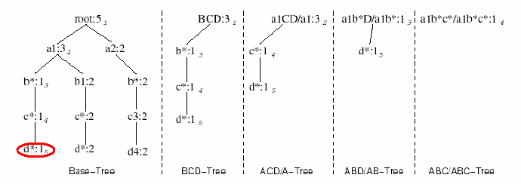
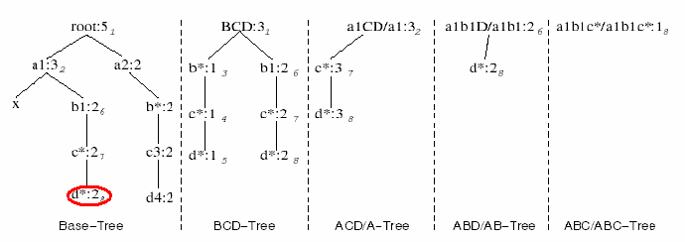
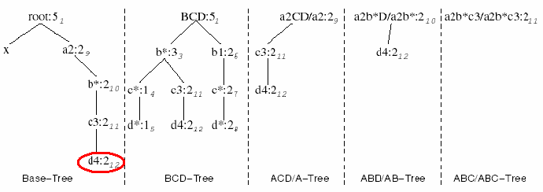
Star-Cubing Algorithm—DFS on Star-Tree

Slide 19
Multi-Way Star-Tree Aggregation
Start depth-first search at the root of the base star tree
At each new node in the DFS, create corresponding star tree that are descendents of the current tree according to the integrated traversal ordering
  E.g., in the base tree, when DFS reaches a1, the ACD/A tree is created
  When DFS reaches b*, the ABD/AD tree is created
The counts in the base tree are carried over to the new trees
Notes:
Refer to the aggregation diagram.

Slide 20
Multi-Way Aggregation (2)
When DFS reaches a leaf node (e.g., d*), start backtracking
On every backtracking branch, the count in the corresponding trees are output, the tree is destroyed, and the node in the base tree is destroyed
Example
  When traversing from d* back to c*, the a1b*c*/a1b*c* tree is output and destroyed
  When traversing from c* back to b*, the a1b*D/a1b* tree is output and destroyed
  When at b*, jump to b1 and repeat similar process

Slide 21
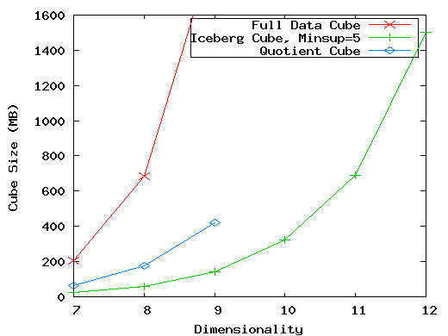
The Curse of Dimensionality
None of the previous cubing method can handle high dimensionality!
A database of 600k tuples. Each dimension has cardinality of 100 and zipf of 2.

Slide 22
Motivation of High-D OLAP
Challenge to current cubing methods:
  The “curse of dimensionality’’ problem
  Iceberg cube and compressed cubes: only delay the inevitable explosion
  Full materialization: still significant overhead in accessing results on disk
High-D OLAP is needed in applications
  Science and engineering analysis
  Bio-data analysis: thousands of genes
  Statistical surveys: hundreds of variables

Slide 23
Fast High-D OLAP with Minimal Cubing
Observation: OLAP occurs only on a small subset of dimensions at a time
Semi-Online Computational Model
  Partition the set of dimensions into shell fragments
  Compute data cubes for each shell fragment while retaining inverted indices or value-list indices
  Given the pre-computed fragment cubes, dynamically compute cube cells of the high-dimensional data cube online

Slide 24
Properties of Proposed Method
Partitions the data vertically
Reduces high-dimensional cube into a set of lower dimensional cubes
Online re-construction of original high-dimensional space
Lossless reduction
Offers tradeoffs between the amount of pre-processing and the speed of online computation

Slide 25
Example Computation
Let the cube aggregation function be count
Divide the 5 dimensions into 2 shell fragments:
  (A, B, C) and (D, E)‏
tid
A
B
C
D
E
1
a1
b1
c1
d1
e1
2
a1
b2
c1
d2
e1
3
a1
b2
c1
d1
e2
4
a2
b1
c1
d1
e2
5
a2
b1
c1
d1
e3

Slide 26
1-D Inverted Indices
Build traditional invert index or RID list
Attribute Value
TID List
List Size
a1
1 2 3
3
a2
4 5
2
b1
1 4 5
3
b2
2 3
2
c1
1 2 3 4 5
5
d1
1 3 4 5
4
d2
2
1
e1
1 2
2
e2
3 4
2
e3
5
1

Slide 27


Shell Fragment Cubes
Generalize the 1-D inverted indices to multi-dimensional ones in the data cube sense
Cell | Intersection | TID List | List Size
a1 b1 | 1 2 3 1 4 5 | 1 | 1
a1 b2 | 1 2 3 2 3 | 2 3 | 2
a2 b1 | 4 5 1 4 5 | 4 5 | 2
a2 b2 | 4 5 2 3 |  | 0

Slide 28
Shell Fragment Cubes (2)‏
Compute all cuboids for data cubes ABC and DE while retaining the inverted indices
For example, shell fragment cube ABC contains 7 cuboids:
  A, B, C
  AB, AC, BC
  ABC
This completes the offline computation stage

Slide 29
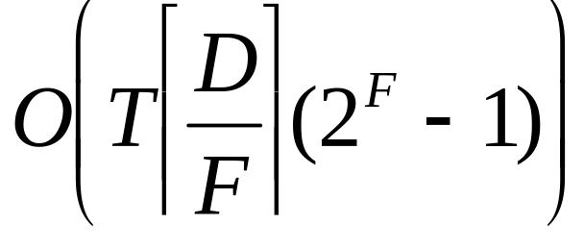
Shell Fragment Cubes (3)
Given a database of T tuples, D dimensions, and F shell fragment size, the fragment cubes’ space requirement is:
For F < 5, the growth is sub-linear.

Slide 30
Shell Fragment Cubes (4)‏
Shell fragments do not have to be disjoint
Fragment groupings can be arbitrary to allow for maximum online performance
  Known common combinations (e.g.,<city, state>) should be grouped together.
Shell fragment sizes can be adjusted for optimal balance between offline and online computation

Slide 31
ID_Measure Table
If measures other than count are present, store in ID_measure table separate from the shell fragments
tid
count
sum
1
5
70
2
3
10
3
8
20
4
5
40
5
2
30

Slide 32
The Frag-Shells Algorithm
Partition set of dimension (A₁,…,A_{n}) into a set of k fragments (P₁,…,P_{k}).
Scan base table once and do the following
insert <tid, measure> into ID_measure table.
for each attribute value a_{i} of each dimension A_{i}
build inverted index entry <a_{i}, tidlist>
For each fragment partition P_{i}
build local fragment cube S_{i} by intersecting tid-lists in bottom-up fashion.

Slide 33
Frag-Shells (2)‏
Dimensions
D Cuboid
EF Cuboid
A
B
C
D
E
F
…
DE Cuboid
Cell
Tuple-ID List
d1 e1
{1, 3, 8, 9}
d1 e2
{2, 4, 6, 7}
d2 e1
{5, 10}
…
…
ABC
Cube
DEF
Cube

Slide 34


Online Query Computation
A query has the general form
Each a_{i} has 3 possible values
  Instantiated value
  Aggregate * function
  Inquire ? function
For example, returns a 2-D data cube.

Slide 35
Online Query Computation (2)‏
Given the fragment cubes, process a query as follows
  Divide the query into fragment, same as the shell
  Fetch the corresponding TID list for each fragment from the fragment cube
  Intersect the TID lists from each fragment to construct instantiated base table
  Compute the data cube using the base table with any cubing algorithm

Slide 36
Online Query Computation (3)‏
A
B
C
D
E
F
G
H
I
J
K
L
M
N
…
Instantiated
Base Table
Online
Cube

Slide 37
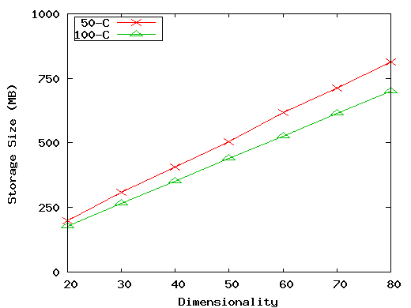
Experiment: Size vs. Dimensionality (50 and 100 cardinality)‏
(50-C): 10⁶ tuples, 0 skew, 50 cardinality, fragment size 3.
(100-C): 10⁶ tuples, 2 skew, 100 cardinality, fragment size 2.

Slide 38
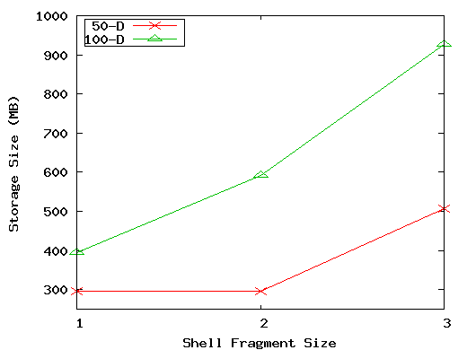
Experiment: Size vs. Shell-Fragment Size
(50-D): 10⁶ tuples, 50 dimensions, 0 skew, 50 cardinality.
(100-D): 10⁶ tuples, 100 dimensions, 2 skew, 25 cardinality.

Slide 39
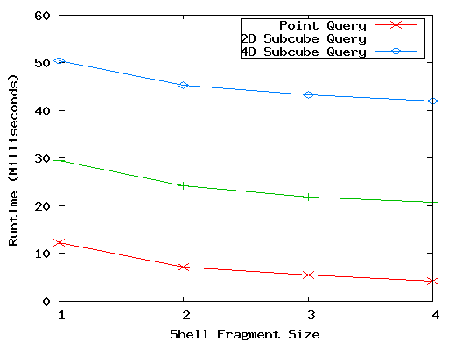
Experiment: Run-time vs. Shell-Fragment Size
10⁶ tuples, 20 dimensions, 10 cardinality, skew 1, fragment size 3, 3 instantiated dimensions.

Slide 40
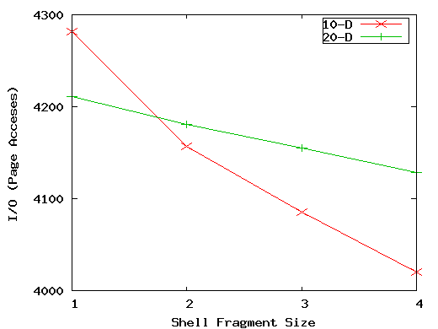
Experiment: I/O vs. Shell-Fragment Size
(10-D): 10⁶ tuples, 10 dimensions, 10 cardinalty, 0 skew, 4 inst., 4 query.
(20-D): 10⁶ tuples, 20 dimensions, 10 cardinalty, 1 skew, 3 inst., 4 query.

Slide 41
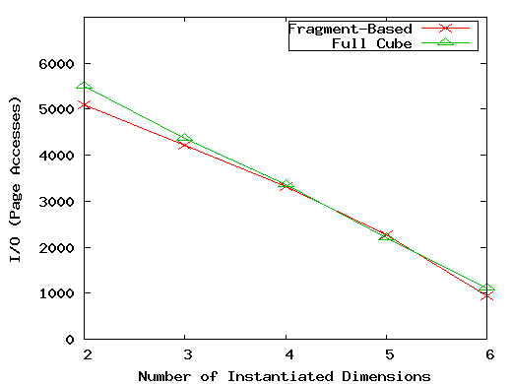
Experiment: I/O vs. # of Instantiated Dimensions
10⁶ tuples, 10 dimensions, 10 cardinalty, 0 skew, fragment size 1, 7 total relevant dimensions.

Slide 42
Summary
Efficient algorithms for computing data cubes
  Multiway array aggregation
  BUC
  Star-cubing
  High-D OLAP by minimal cubing

Slide 43
References (I)‏
S. Agarwal, R. Agrawal, P. M. Deshpande, A. Gupta, J. F. Naughton, R. Ramakrishnan, and S. Sarawagi. On the computation of multidimensional aggregates. VLDB’96
D. Agrawal, A. E. Abbadi, A. Singh, and T. Yurek. Efficient view maintenance in data warehouses. SIGMOD’97
R. Agrawal, A. Gupta, and S. Sarawagi. Modeling multidimensional databases. ICDE’97
K. Beyer and R. Ramakrishnan. Bottom-Up Computation of Sparse and Iceberg CUBEs.. SIGMOD’99
Y. Chen, G. Dong, J. Han, B. W. Wah, and J. Wang, Multi-Dimensional Regression Analysis of Time-Series Data Streams, VLDB'02
G. Dong, J. Han, J. Lam, J. Pei, K. Wang. Mining Multi-dimensional Constrained Gradients in Data Cubes. VLDB’ 01
J. Han, Y. Cai and N. Cercone, Knowledge Discovery in Databases: An Attribute-Oriented Approach, VLDB'92
J. Han, J. Pei, G. Dong, K. Wang. Efficient Computation of Iceberg Cubes With Complex Measures. SIGMOD’01

Slide 44
References (II)‏
L. V. S. Lakshmanan, J. Pei, and J. Han, Quotient Cube: How to Summarize the Semantics of a Data Cube, VLDB'02
X. Li, J. Han, and H. Gonzalez, High-Dimensional OLAP: A Minimal Cubing Approach, VLDB'04
K. Ross and D. Srivastava. Fast computation of sparse datacubes. VLDB’97
K. A. Ross, D. Srivastava, and D. Chatziantoniou. Complex aggregation at multiple granularities. EDBT'98
S. Sarawagi, R. Agrawal, and N. Megiddo. Discovery-driven exploration of OLAP data cubes. EDBT'98
G. Sathe and S. Sarawagi. Intelligent Rollups in Multidimensional OLAP Data. VLDB'01
D. Xin, J. Han, X. Li, B. W. Wah, Star-Cubing: Computing Iceberg Cubes by Top-Down and Bottom-Up Integration, VLDB'03
D. Xin, J. Han, Z. Shao, H. Liu, C-Cubing: Efficient Computation of Closed Cubes by Aggregation-Based Checking, ICDE'06
W. Wang, H. Lu, J. Feng, J. X. Yu, Condensed Cube: An Effective Approach to Reducing Data Cube Size. ICDE’02
Y. Zhao, P. M. Deshpande, and J. F. Naughton. An array-based algorithm for simultaneous multidimensional aggregates. SIGMOD’97

