Slide 1
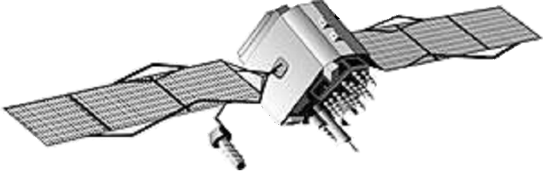

Global Positioning System
Space Segment
Broadcast of:
Navigation Data
Spread-spectrum ranging signals
Uplink of:
- Ephemeris
- Clock Data
Control Segment
User Segment
Five Monitor Stations & Four Upload
Stations Spread Around the Equator

Slide 2

Requirements For Aviation
Standalone GPS does not meet the requirements for precision approach (vertical accuracy insufficient; integrity not guaranteed).
To meet the requirements, GPS is augmented by additional ground-based equipment.
Notes:
We can navigate using GPS. Why is LAAS necessary to land airplanes?
Stand-alone GPS accuracy ~ 10 m (S/A off).
For aircraft autoland, 10m is OK laterally, but not vertically.
Dominant error sources are iono and tropo. LAAS/ DGPS corrects both ==> typical accuracy better than about ~1 m (S/A on or off).

Slide 3

Local Area Augmentation System
Atmosphere
Atmosphere
Atmosphere
Correction
Airport Reference Station
Benefits of augmentation system + SQM:
Improved position accuracy, service availability
Tighter error bounds
Continuous monitoring of satellites
Some architectures also improve geometry
SQM
Signal Quality Monitor
Received:
E: 122°30’08”
N: 37°24’11”
U: 528m
Known: Received:
E: 122°47’25” E: 122°
N: 37° 10’39” N: 37°
U: 22.57m U: 31m
Notes:
1) Step through the logic:
Surveyed known position at airport;
Compute corrections;
Broadcast to user.
2) What problems affect LAAS? How are they solved?
Non-common mode errors (thermal noise, multipath). Better RF hardware, shielding improves noise performance; Better antenna, siting, signal processing improves multipath resistance.
IONO: Ground receiver may have dual-frequency capability to estimate iono delay (WAAS already does this). User is typically single-frequency; GRS broadcasts corrections.
Common-mode errors that are difficult to detect (SV faults).
3) For all these reasons, LAAS has Signal Quality monitoring (SQM)

Slide 4
GPS Signal Structure
Carrier
1575.42 MHz (L₁)
1227.60 MHz (L₂)
19 cm (L₁)
Code
1.023 Mcps (C/A),
period = 1 msec
10.23 Mcps (P(Y)),
period = 1 week
300 m (CA)
Navigation data
50 bits/second
6000 km
Notes:
C/A code is a common thread that runs throughout this presentation. It is one of the basic building blocks of SQM.
SV19 code traces;
MEW built on top of C/A chips;
Δ on nominal SVs is @ edges of C/A chips

Slide 5
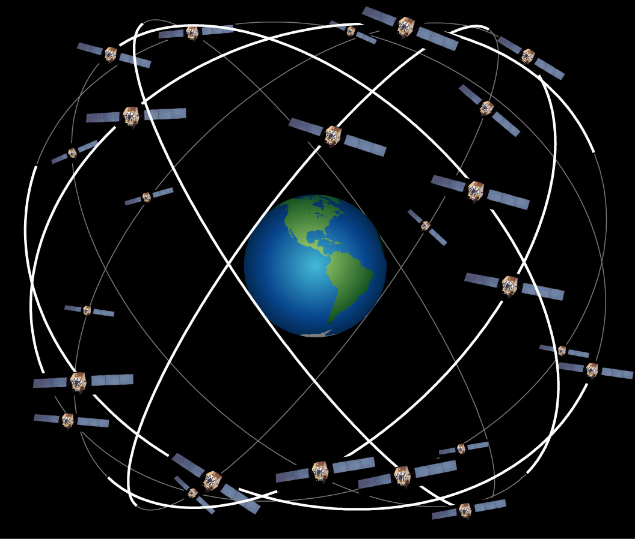
The GPS Constellation
GPS Block I
  02/78 – 10/85
  0 of 10 still on orbit
  Prototypes for testing
GPS Block II
  02/89 – 10/90
  3 of 9 still on orbit
GPS Block IIA
  11/90 – 11/97
  17 of 19 still on orbit
GPS Block IIR
  01/97 – present
  8 of 8 still on orbit
GPS Block I
  02/78 – 10/85
  0 of 10 still on orbit
  Prototypes for testing
GPS Block II
  02/89 – 10/90
  3 of 9 still on orbit
GPS Block IIA
  11/90 – 11/97
  17 of 19 still on orbit
GPS Block IIR
  01/97 – present
  8 of 8 still on orbit
Courtesy Dr. Todd Walter

Slide 6
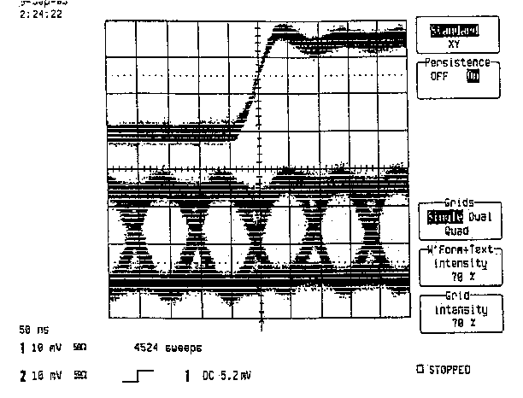
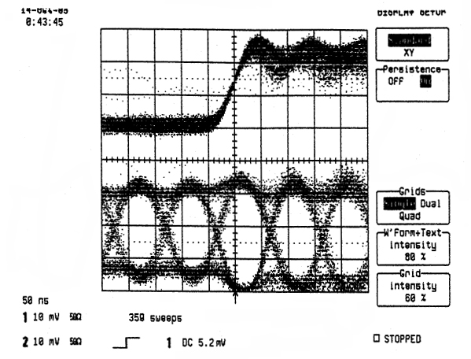
SV19 Signal (Time Domain)
SV26
SV19
5 nsec
33 nsec
C/A code edges on healthy SV aligned to within 3-6 nsec*.
*equipment measurement accuracy
C/A code edges on SV19 mis-aligned by ~ 28-33 nsec with respect to P code edges.

Slide 7
Contributions
Geometric Analysis Of Original SV 19 Observations
  Observed results (Oshkosh, WI) and waveforms (Camp Parks, CA)
  Sensitivity of vertical error to PR error on SV 19
Evil Waveforms
  Theoretical analysis for “most evil” (worst) case [NTM 1999]
  Simplified ICAO threat space
Characterization of operational GPS Satellites
  Spectral domain (SV19 revisited)
  Correlation Domain (simulation using Arbitrary GPS Generator)
  Time Domain [ION 2002, RTCA 2003]
Tools for SQM Analysis
  Arbitrary GPS Waveform Generator [ION 2000 Best-of-Session; Navigation]
  Real-Time 48-Correlator Monitor Code [ION 2000]

Slide 8
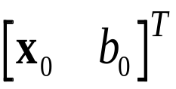
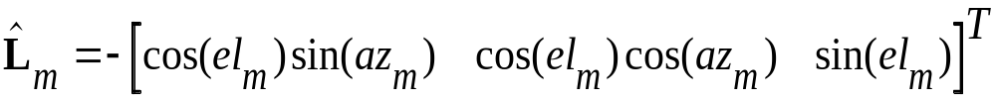
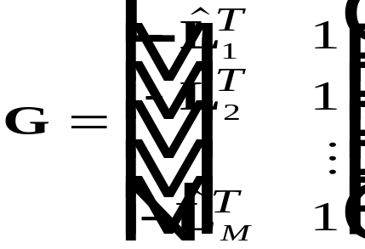
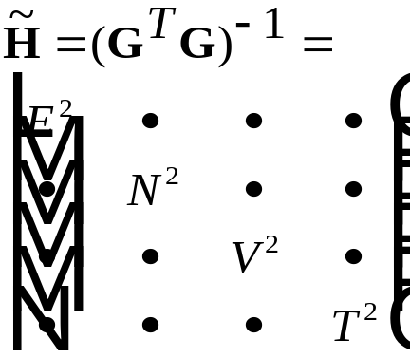
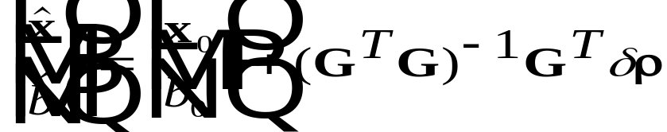
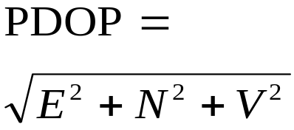
Position Solution and DOP
Initial user position and clock:
ρ₃
Initial user position and clock:
ρ_{m}
ρ₂
Line-of-sight (LOS) vector user → SVs:
ρ₁
The geometry matrix:
Finding DOP:
Iterative least-squares position solution:

Slide 9
Geometric Analysis
Location -
Oshkosh, WI 43°59’45” N
88°33’10” W
Almanac
GPS Week 704
(July 4→10, 1993)

Slide 10


What a Receiver Really “Sees”
Receiver #1
Receiver #2
Receiver #3
(true code phase)
(estimated code phase based on one sample pair)
A receiver generally has no information about the complete structure of the underlying peak -- only the values of its correlator samples. (Here, all three receivers’ correlator pairs make the same code phase estimate.)
Notes:
So what does a receiver really see? Of course it does not see the triangular peak shown on the previous slide, but under ideal conditions a complete knowledge of the peak can be obtained by knowing only a few points.
Historically +/-0.5 chip spacing was always used. Later, narrow correlator technology demonstrated benefits against multipath and noise. RESULT: currently deployed receivers use all sorts of spacings.
Here is an example of an ideal correlation peak. In this case, all three correlators compute the same (and correct) estimate of the underlying code phase.
Furthermore, the symmetry of the peak guarantees that any correlator spacing will result in the same estimate of code phase. This idea suggests some possible fault modes.

Slide 11
Distorted Code ⇒ Distorted Peak
Signal from
satellite
Local replica
(late)
late
Average
Local replica
(prompt)
Average
Local replica
(early)
Average
-
early
Code
Generator
Loop
Filter
DLL Error
Function
Notes:
Transition: how might these errors get into the system?
Peak can be distorted due to MP, interference, C/A code generator, etc.

Slide 12


Differential Error
What happens when the peak is distorted?
(differential error due
to distorted peak)
(reference)
(user)
• Disagreement in code phase estimate between reference (ground station) and roving user is mapped onto a position error as a function of satellite geometry. Errors common to all SVs are mapped onto user clock error and corrected.
Notes:
Recall that the base of the triangle is 300 meters -- thanks to the speed of light, these errors can really add up!
The scenario described above is not necessarily the case in general, however, and often there are situations in which a narrow correlator might detect a fault that the wide one would miss, and vice-versa.
Let’s think about how that might happen.

Slide 13


A Troublesome Example
Given one or more monitors, what errors can get through undetected?
(differential error)
(ground
reference)
(aircraft)
(ground
monitor)
but
• To the ground, this badly distorted peak is indistinguishable from the nominal correlation peak shown on the earlier slide!
Notes:
Note that in this case, neither the wide nor the narrow correlator catches the signal fault, so regardless of what kind of receiver you were using you’d still be in trouble at the air spacing indicated.
Recall that the base of the triangle is 300 meters -- thanks to the speed of light, these errors can really add up!
The scenario described above is not necessarily the case in general, however, and often there are situations in which a narrow correlator might detect a fault that the wide one would miss, and vice-versa. Let’s think about how that might happen.

Slide 14





Generalized Fault Model
In general, a distorted GPS signal can be written as the sum of the nominal signal and a distortion term:
Starting with this model, we can derive an explicit worst-case waveform, , as a function of the system parameters:
  Number of monitor pairs and their spacings,
  Ground filter bandwidth and shape,
  Aircraft spacing,
  Aircraft filter bandwidth and shape,

Slide 15
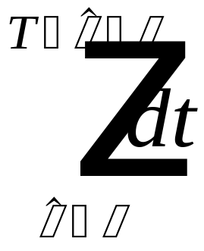

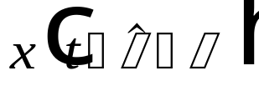
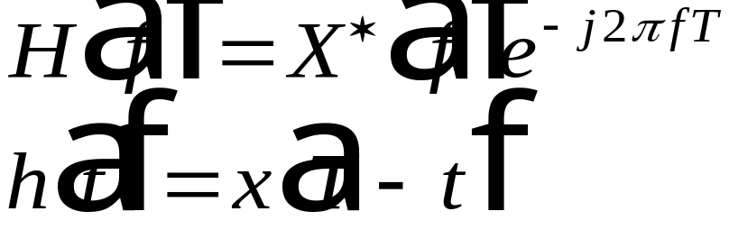
Generalized Model: First Principles
A single correlator sample …
… and its frequency-domain equivalent
Notes:
Intuitive way to understand matched filter:
multiplication in time == convolution in frequency
to get frequency responses to match maximally, *reverse* the replica -- this generates a complex conjugate in the frequency domain, and we get a magnitude-squared response (which is maximum because the phasors are aligned).

Slide 16







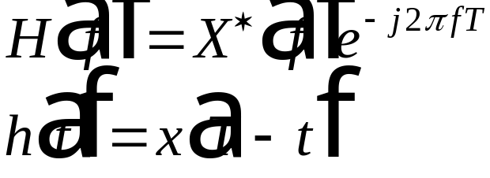


Generalized Model: Correlator Pair
Late
E
L
Early

Slide 17









Generalized Model: Basic LAAS (M=0)
Ground processing
Aircraft processing
The most evil waveform for M=0, , maximizes and is matched to the overall transfer function.
We can find the explicit form of using Gram-Schmidt orthogonalization and the Schwartz inequality.

Slide 18












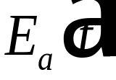
Generalized Model: Full LAAS (M≥1)
SQM Algorithms
(Algebraic
functions of
monitor inputs)
Ground processing
Aircraft processing

Slide 19

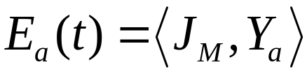
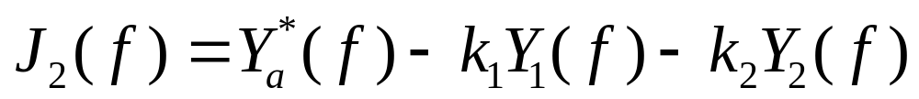
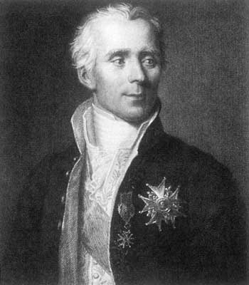
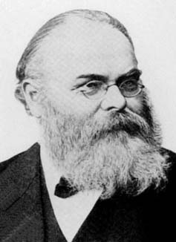
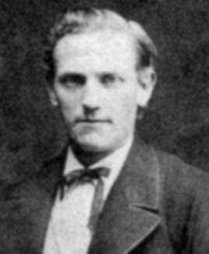
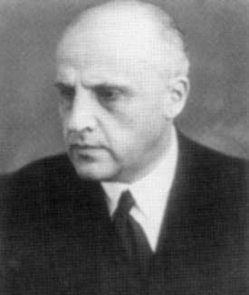
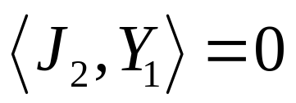
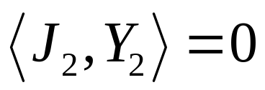
The Most Evil Waveform (1)
The most evil waveform for M monitors, J_{M} , lies in the null space of
and maximizes . We can construct such a function using the Schwartz inequality and Gram-Schmidt orthogonalization.
For example, the M=2 case is:
With
and

Slide 20
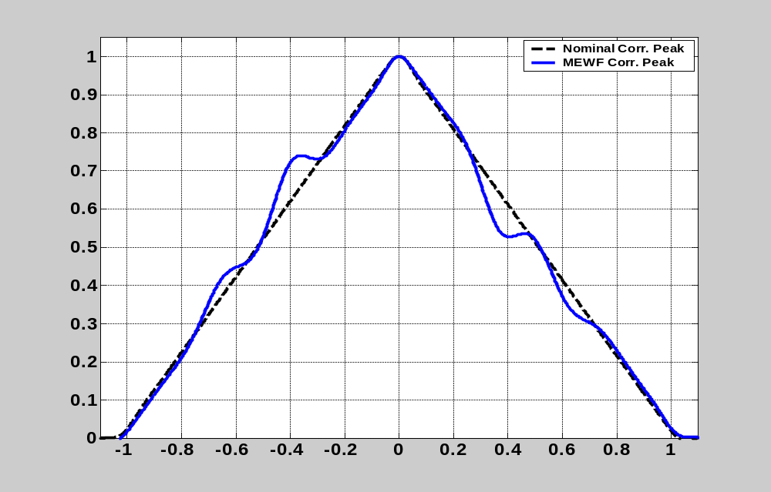
The Most Evil Waveform (3)
α_{Ref} = 0.1, α_{Mons} = { 0.5, 1.0 }, α_{Air} = 0.75 16MHz BPFs S/J = +6dB
Normalized amplitude
Undetected Pseudorange
Error ≈ 21.3 meters
Spacing (chips)

Slide 21
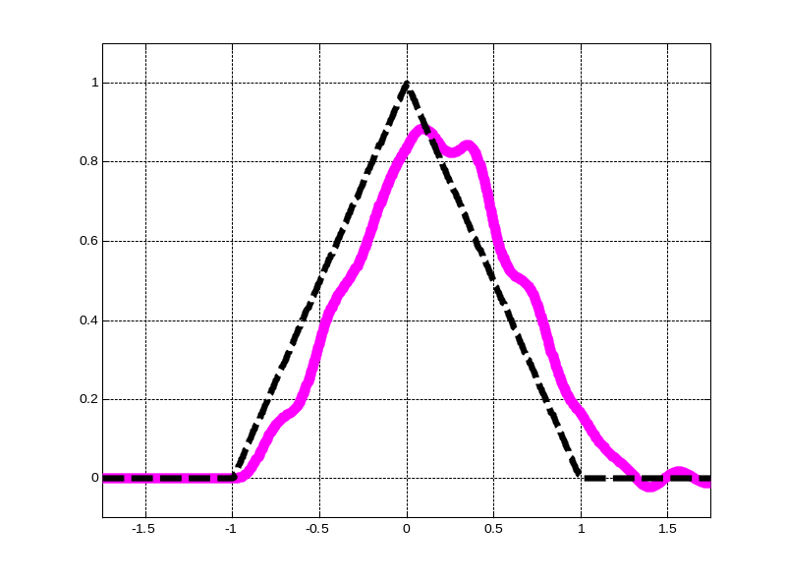
ICAO Threat Model (1)
2.5
σ
Δ
2
1.5
1
Normalized amplitude
Normalized amplitude
0.5
0
-0.5
-1
1/f_{d}
-1.5
-2
-2.5
0
1
2
3
4
5
6
Time (chips)
Code Offset (chips)
“Analog” failure component
  Two-pole linear system (LHP)
  Completely described by σ and f_{d}
Encapsulates essential pathologies hypothesized for SV19
  side-to-side asymmetry
  false peaks
  flat top
Consistent with empirical evidence (ringing, edge lag)
Bounded and physically realizable
“Digital” failure component
  Delay/advance in falling (or rising) edges only
  Completely described by Δ

Slide 22
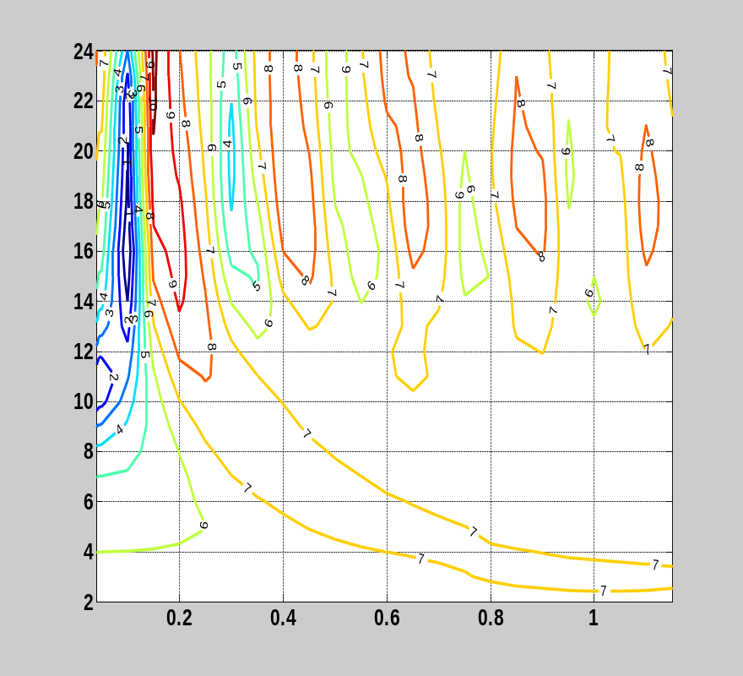
ICAO Threat Model (2)
Specifies a class of signal anomalies which could lead to hazardously misleading information (HMI)
Implies a dominant error source
(single complex pole pair)
Defines a three-dimensional threat space
  Extensively analyzed by Phelts et. al. (2001)
  Maximum vertical error for a particular correlator spacing and front-end BW is found by exploring this space
Bandwidth (MHz)
Air Spacing (chips)
Notes:
In general, GPS satellites are very complicated systems.
The 2OS model is particularly useful in the case where a single physical
mechanism is the dominant source of signal anomaly.
It was adopted by ICAO as a broad description of what might plausibly
go wrong on a satellite. See discussion in Phelts’ dissertation, pp. 41-42
(More complex systems, involving an arbitrary number of poles and zeros,
were considered and rejected for reasons of physical plausibility. Some,
for example, yielded non-causal step responses).
XXX Check with Prof. Enge for how to best word this explanation. XXX

Slide 23
ICAO Model: Application (1)
This model is useful for detailed analysis of signal anomalies. For example, consider what it tells us about the troublesome spikes seen in the spectrum of SV19:
Δ > 0
Δ = 0
How does a non-zero Δ affect the spectrum? To see its effects, consider the difference waveform:
0
T_{c}
2T_{c}
3T_{c}
4T_{c}
nT_{c}
Periodic in T_{epoch} = 1 msec; exactly 256 Δ-wide pulses at nT_{chip}
Notes:
INTEGRITY: What is “hazardous?”
-- 1m to the left or right of the intended touchdown point is perfectly OK.
-- 50m behind (along-track) and you may find the landing gear parked in S.F. Bay. This may lead to customer service issues.
-- Name of the game (as concerns integrity) is not about nominal performance; rather, it is about making sure that “very unlikely” errors (which would be big enough to be hazardous) are sufficiently unlikely.
CONTINUITY:
-- Setting the thresholds too tight (conservatively) can lead to “the landing system that cries ‘wolf.’”
-- We need to know what a deviations from the ideal signal occur normally, on a healthy satellite.

Slide 24



ICAO Model: Application (2)
This is almost periodic in T_{chip}:
0
T_{c}
2T_{c}
3T_{c}
4T_{c}
nT_{c}
Compute the Fourier Series expansion starting with the fundamental frequency
and scaling the resulting coefficients by the factor
This gives us an explicit relationship between Δ and the amplitude of spectral spikes at (C/A nulls).
Notes:
INTEGRITY: What is “hazardous?”
-- 1m to the left or right of the intended touchdown point is perfectly OK.
-- 50m behind (along-track) and you may find the landing gear parked in S.F. Bay. This may lead to customer service issues.
-- Name of the game (as concerns integrity) is not about nominal performance; rather, it is about making sure that “very unlikely” errors (which would be big enough to be hazardous) are sufficiently unlikely.
CONTINUITY:
-- Setting the thresholds too tight (conservatively) can lead to “the landing system that cries ‘wolf.’”
-- We need to know what a deviations from the ideal signal occur normally, on a healthy satellite.

Slide 25
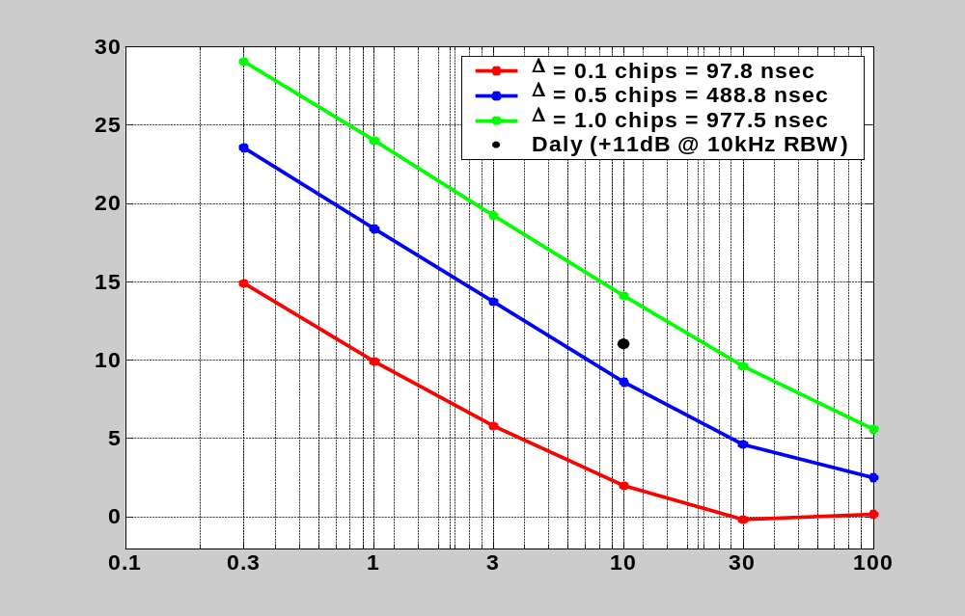
ICAO Model: Application (3)
Spike height above spectral peak (dB)
+11dB spike @ L₁ due to Δ alone
implies Δ ≈ 0.75 chips = 733 nsec
Resolution bandwidth (kHz)
Notes:
INTEGRITY: What is “hazardous?”
-- 1m to the left or right of the intended touchdown point is perfectly OK.
-- 50m behind (along-track) and you may find the landing gear parked in S.F. Bay. This may lead to customer service issues.
-- Name of the game (as concerns integrity) is not about nominal performance; rather, it is about making sure that “very unlikely” errors (which would be big enough to be hazardous) are sufficiently unlikely.
CONTINUITY:
-- Setting the thresholds too tight (conservatively) can lead to “the landing system that cries ‘wolf.’”
-- We need to know what a deviations from the ideal signal occur normally, on a healthy satellite.

Slide 26



Synchronous Sampling (1)
…
First sample in epoch
First sample in epoch
Start of epoch 1
Start of epoch N
Uncorrected errors (Doppler, LO, ADC clock) lead to sample “drift” with respect to underlying features
  47.5 MHz, 250 msec, 2 kHz Doppler (uncompensated) ⇒ Accumulated error = ≈ 15.08 samples ≈ 0.32 chips
Tight control of timebase required to avoid this error.

Slide 27
Vernier Sampling (1)
Given…
  An accurate local oscillator (Rb standard accurate to 1mHz at 10MHz);
  A method to reliably predict Doppler shift of a given satellite as seen from a known location at a given time (demonstrated as part of Oshkosh SV19 analysis);
  A/D converter with sample rate adjustable in fine steps (VSA specified to 1mHz nominally)
What happens when we reduce the sample rate?
Epoch #1
Epoch #2
Epoch #n

Slide 28
Vernier Sampling (1)
Given…
  An accurate local oscillator (Rb standard accurate to 1mHz at 10MHz);
  A method to reliably predict Doppler shift of a given satellite as seen from a known location at a given time (demonstrated as part of Oshkosh SV19 analysis);
  A/D converter with sample rate adjustable in fine steps (VSA specified to 1mHz nominally)
What happens when we reduce the sample rate?
We can increase the effective sample rate by a factor of n over the maximum instrument sample rate
  This occurs at the expense of noise averaging
  Affords improved time resolution provided data set is long enough
Aggregate Epoch

Slide 29
Measuring Digital Distortion (1)
Ideal C/A Code
+1
2T_{c}
2T_{c}
0
3T_{c}
T_{c}
T_{c}
-1
C/A Code with Digital Distortion
+1
2T_{c}-Δ
2T_{c}-Δ
0
3T_{c}+Δ
T_{c}+Δ
T_{c}+Δ
-1
0 1 2 3 4 5
Chip Transition #

Slide 30
Summary of Aviation Requirements
Phase of
Accuracy
Integrity
Continuity
Availability
Flight
(95%
Time to
Alert
Pr(MI)
Pr(loss of
Threshold
Objective
SPS/RAIM + INS
Error)
Alert
Limit
navigation)
Oceanic
H: 12.4
2 min
H: 12.4 nmi
10
-
7
/ hour
10
-
5
/ hour
0.99
0.999
–
Enroute
nmi
0.99999
Domestic
H: 2.0 nmi
1 min
H: 2.0 nmi
10
-
7
/ hour
10
-
6
/ hour
0.99
0.99999
Enr
oute
Terminal
H: 0.4 nmi
30 sec
H: 1.0 nmi
10
-
7
/ hour
10
-
6
/ hour
0.99
0.99999
WAAS
Area
Non
-
prec.
H: 220 m
10 sec
H: 556 m
10
-
7
/ hour
10
-
5
/ hour
0.99
0.99999
Approach
LNAV/
H: 220 m
10
sec
H: 556 m
10
-
7
/ hour
5
.5
× 10
-
5
/
0.99
0.99999
VNAV
V: 50 m
approach
LPV (APV
H: 16 m
10
sec
H: 40 m
2 × 10
-
7
/
5
.5
× 10
-
5
/
0.99
0.99999
LAAS (satisfies WAAS reqmts. within VDB coverage)
1.5)
V:
20
m
V: 50 m
approach
approach
APV
-
2
H: 16 m
6 sec
H: 40 m
2 × 10
-
7
/
5
.5
× 10
-
5
/
0.99
0.99999
V: 7.6 m
V: 20 m
approach
approach
Cat. I Prec.
H: 16 m
6 sec
L: 40 m
2 × 10
-
7
/
5
.5
× 10
-
5
/
0.99
0.99999
Appch.
V: 4
?
7.6 m
V: 10
?
12 m
approac
h
approach
Cat. II Prec.
H: 6.9 m
2 sec
L: 17.3 m
2 × 10
-
9
/
4 × 10
-
6
/ 15
0.99
0.99999
Being reconsi-dered by RTCA
Appch.
V: 2.0 m
V: 5.3 m
approach
sec
Cat. III
H: 6.1 m
1
–
2
L: 15.5 m
2 × 10
-
9
/
L: 2 × 10
-
6
/
0.99
0.99999
Precision
V: 2.0 m
s
ec
V: 5.3
m
approach
30 sec
Appch.
V: 2 × 10
-
6
/
15 sec
Original Source: GPS Risk Assessment Study: Final Report. Johns Hopkins University Applied Physics Laboratory, VS-99-007, January 1999. http://www.jhuapl.edu/transportation/aviation/gps/

