Slide 1
Obliterate
or
Let's Pretend I Didn't Do That
Julian Foad
WANdisco

Slide 2
Overview
Why obliterate?
  Reasons fall into three categories
How to obliterate?
  Delete files or undo changes
Alternatives
  How it's done in CVS and P4
  How it's done in Svn now

Slide 3
Why?
Requested...
  since pre-1.0
  by many on mailing list over the years
  by big companies & organisations
Reasons stated...
  hide secrets
  undo accidental large additions
  remove old data to reduce repos size
  work flow needs only recent version(s)

Slide 4
Why?
Alternatives...
  can do in CVS (crudely)
  Perforce has “p4 obliterate”
  Use authz to hide files
Counter-arguments...
  is not pure version control (find other ways)
  “dangerous” if mis-used (audit trail)

Slide 5
Why? Hide a Secret
What happened?
  committed a customer's private data in a company-wide repository,
  committed copyrighted material to a public repository.
What's needed?
  Hide that file first,
  (may require swift action),
  then plan the permanent fix.

Slide 6
Why? Recover Space
What happened?
  added large, generated files,
  imported to wrong repository,
  split the repos,
  a large project became redundant.
What's needed?
  Reclaim server disk space.
  Can be a planned event.
Notes:
Even when correcting a mistake just made, can't assume that it's sufficient to delete just the most recent N revs of the whole repository, because the need arises most commonly in a busy repository.

Slide 7
Why? Latest Version
Project structure:
  moduleA/
    src/...
    obj/...
  moduleB/...
  moduleC/...
test
commit
A/src
A/obj
work on A
update
B/src
B/obj
C/src
C/obj
build
Doesn't
need to
build
B/obj
or
C/obj

Slide 8
Why? Latest Version
What's happening?
  frequently revising a large file
  never need old versions of it
What's needed?
  configure to store only latest version
  make “update” work without deltas
Why?
  convenience (could do outside svn)

Slide 9
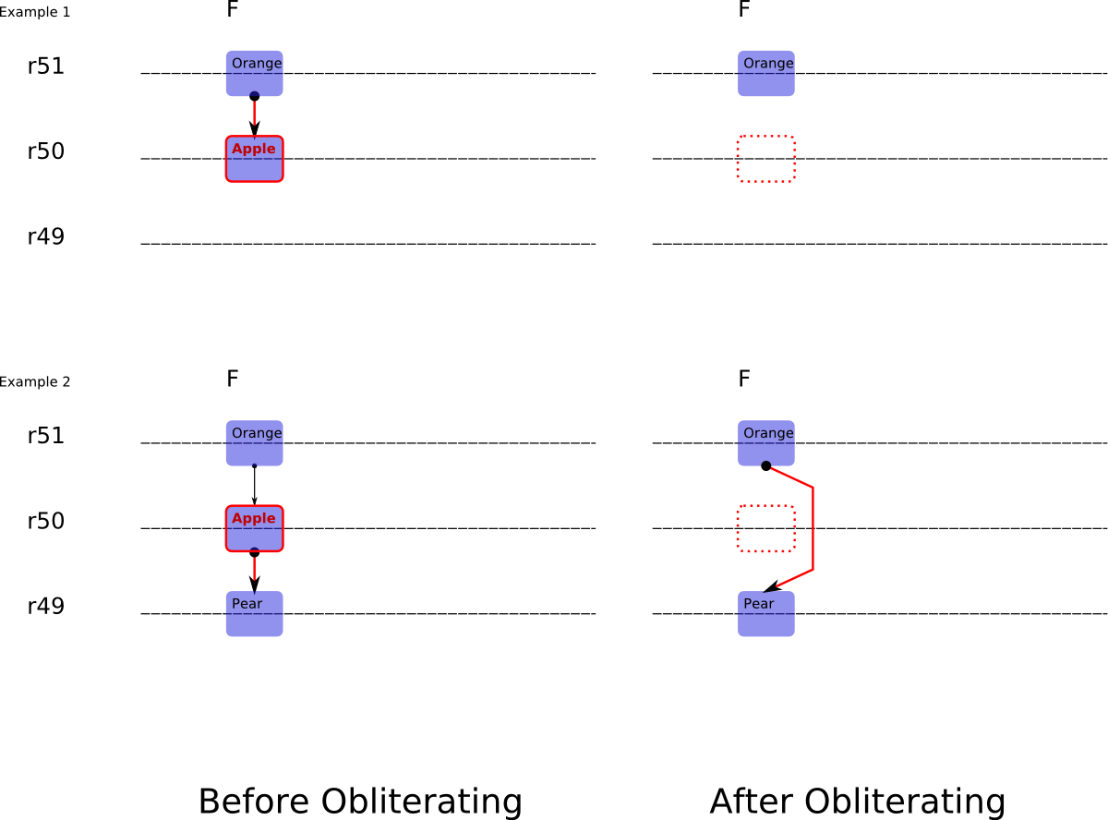
How? Delete Files
Notes:
There are many possible ways in which history could be changed. This is one way, and on the next slide is another way. Both of these ways satisfy all of the use cases.
This scheme, here labelled “delete files”, is in fact illustrating deletion of an individual node-rev. The user can obliterate individual files (or directory trees) from individual revisions (or ranges of revisions).
This scheme shows history being re-connected from F@51 to F@49, whereas another option is not to re-connect the history in this way.
See <notes/obliterate/fspec-dd1/> in the source tree for details of this scheme.

Slide 10
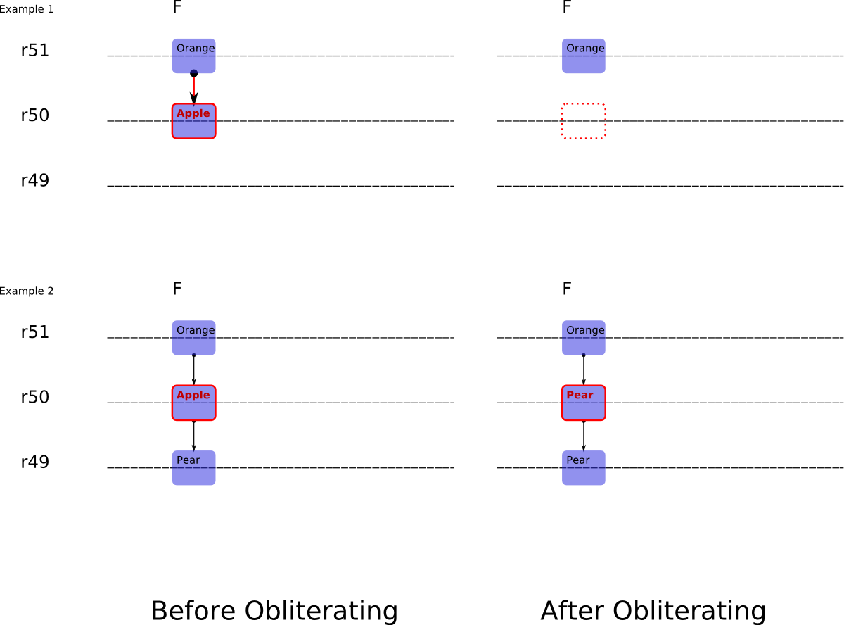
How? Undo Changes
Notes:
This scheme, here labelled “undo changes”, differs from the “delete files” scheme in that it replaces an individual node-rev with the previous revision of that node, or deletes it if it did not exist in the previous revision.
See <notes/obliterate/fspec-cc1/> in the source tree for details of this scheme.

Slide 11
What CVS/P4 Users Do
CVS: Delete the “,v” file
Perforce: “p4 protect”
Perforce: “p4 obliterate”
Perforce: “p4 filetype” for latest N revs
Notes:
CVS administrators can remove an archive “,v” file to effectively delete the whole history of a particular file. (Recall that in CVS each file has its own history, version numbers and log messages.) It is not so easy to remove selected revisions or changes from a CVS archive.
Perforce administrators can hide files with “p4 protect”, delete file-revisions with “p4 obliterate”, and enable “last N versions only” on selected files with a “p4 filetype” setting.

Slide 12
What Svn Users Do
dump | svndumpfilter | load
authz can hide paths
Notes:
Subversion administrators can dump, filter and load a repository. Functionally, that satisfies most needs, but on a large repository it is much too slow for anything except a planned space-recovery.
Authorization settings can be used to hide specific paths. (But not at specific revs? Need to check.)

Slide 13
Non-reasons
These possible reasons to obliterate are not goals
  to undo (roll back) a recent commit
  to tidy up history after an unwanted change has been done and undone
Documentation should steer users to best practices for these tasks

