Slide 1



Obliterating
History
in
Subversion
Julian Foad
October 2009

Slide 2
Who am I?
Julian Foad
WANdisco
  Subversion: obliterate
CollabNet
  Subversion: tree conflicts
Embedded software engineer
  user & administrator of version control
Subversion
  volunteer: many small features & fixes
Notes:
WANdisco since 2009
CollabNet since 2008
Embedded: Heating controllers, mobile radios. Needing source control.
Subversion since 2003

Slide 3
Purpose
Tell you about this feature
Find out what you want it to do
Notes:
Why am I standing here?
Tell you what I am designing and why.
Find out what you need. I'll ask you some questions.
I will alter my design.

Slide 4
Contents
Why?
How? - user's POV
Architecture - client/server
Client Issues - WC
Authorization
Audit Trail
Notes:
Why?
- Reasons fall into 3 groups
How?
- Hide or alter history?
- Delete files or undo changes?
- How it's done in Svn, CVS, P4, CC
Architecture
- svnadmin, svn
Client Issues
- How do we keep a Working Copy working?
Authorization
- Do we need more than Subversion's current authorization methods?
Audit Trail
- Does the server need to keep a record of obliterations?

Slide 5
Contents
Why?
How?
Architecture
Client Issues
Authorization
Audit Trail

Slide 6
Why?
Requested
  since pre-1.0
  by many on mailing list over the years
  by big companies & organisations
Reasons stated
  three groups of reasons
Notes:
Obliterate was first requested and discussed in 2001.
v1.0 was released in 2004.
We will examine the reasons in more detail.

Slide 7
Why?
Alternatives...
  can do in CVS (crudely), P4, CC, ...
  in Svn, authz can hide files
Counter-arguments...
  is not “pure” version control
    and “store only latest” is not VC at all
  is “dangerous” if mis-used (audit trail)
Notes:
Counter-argument “not pure VC”:
- Any change of history can cause a mismatch between a client's memory and the repository's memory of history, which can lead to client-side difficulties.
- Storing several recent versions can cause the memory-mismatch problems, and storing only the latest version is not VC at all, so do it outside Subversion.
Counter-argument “dangerous”:
- Some people rely on repository history as their audit trail, and the mere possibility of it being changed is a threat.
Both arguments are trumped by practical advantages and solved by pragmatic and responsible usage.

Slide 8
Why?
Why?
How?
Architecture
Client Issues
Authorization
Audit Trail
Hide data
Remove
  accidental large addition
  old, obsolete data
Need only latest version
Non-goals
Notes:
People mean different things when they think of “obliterating”.
We will look at three groups of reasons.
You may already have wanted one of these.

Slide 9
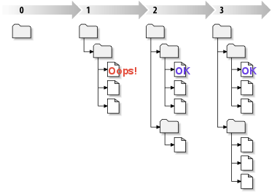
Why? Hide data
What happened?
  accidentally committed private data
    a customer's private data
    copyrighted material
  deleted it soon afterwards
What's needed?
  Hide that file first
    FILE or FILE@1
    may require swift action
  then plan the permanent fix.
Notes:
Here is an example of the first reason.
WHAT HAPPENED?
Customer's private details in a company-wide repository, or
Copyright material in a public repository.
The user adjusted the data soon afterwards, so there is no concern about the head revision of the repoistory.
WHAT'S NEEDED?
First, quickly, hide the unwanted data. Hide FILE at revision 1. If it is only possible to hide FILE (at all revisions), or all the content of revision 1, then do that.
Then plan to either obliterate the data, or implement a permanent change in access permissions.
MORE
This is one of the most important use cases.
Related scenarios:
Plan to make a repository more widely visible, but it contains some private data. Some data needs to be hidden, but not urgently.
There has also been talk of wanting to remove sensitive data from server-side database files, but that seems to be a much less common requirement.

Slide 10
Why? Recover Space
What happened?
  added large, generated files,
  imported to wrong repository,
  split the repos,
  a large project became redundant.
What's needed?
  Reclaim server disk space.
  Can be a planned event.
Notes:
Second reason: To recover space in the repository.
This is one of the most common and important use cases.
WHAT HAPPENED? ...
WHAT'S NEEDED? ...
NOTE
Even when correcting a mistake just made, we cannot assume that it's sufficient to delete just the most recent N revs of the whole repository, because the need arises most commonly in a busy repository.

Slide 11
Why? Latest Version
Project structure:
  moduleA/
    src/...
    obj/...
  moduleB/...
  moduleC/...
test
commit
A/src
A/obj
work on A
update
B/src
B/obj
C/src
C/obj
build
Doesn't
need to
build
B
or
C
Notes:
Third reason: only want to store the latest version.
Example of a developer's work flow:
- Assume Subversion is storing only the lastest version of the “obj/” directories.
- Developer working on module A updates, receiving both source and object code of B and C.
- This means A doesn't need to build modules B and C before continuing to work on A, thus saving time.
To debug an old version, the developer needs to build all the modules because the old “obj/” directories are no longer available.

Slide 12
Why? Latest Version
What's happening?
  frequently revising a large file
  never need old versions of it
What's needed?
  configure to store only latest version
  make “update” work without deltas
Why?
  convenience (could do outside svn)
test
commit
A/src
A/obj
work on A
update
B/src
B/obj
C/src
C/obj
build

Slide 13
Non-goals
Non-goals
  to undo (roll back) a recent commit
  to tidy up history after an unwanted change has been done and undone
Documentation should steer users to best practices for these tasks

Slide 14
Contents
Why?
How?
Architecture
Client Issues
Authorization
Audit Trail

Slide 15
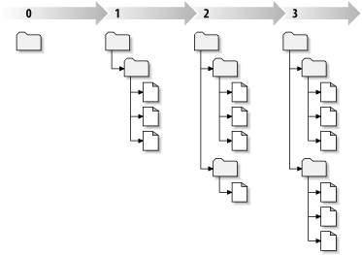
How? Granularity
One file (all revisions)
One revision (all changes)
One file in one revision
Some text within a file
Notes:
Granularity defines the smallest item that you can affect.
One file (all revision) and One revision (all changes): too big for most of the requirements.
One file in one revision: good.
Some text within a file: too small – unnecessarily complex.

Slide 16
How? Obliteration Set
svn oblit -r50:53
–trace-history
dir/bar.c@53
Client
Obliteration Set:
dir/foo.c @50
dir/foo.c @51
dir/foo.c @52
dir/bar.c @53
Library
Repository
Notes:
Lieven Govaerts defined “Obliteration Set”.

Slide 17
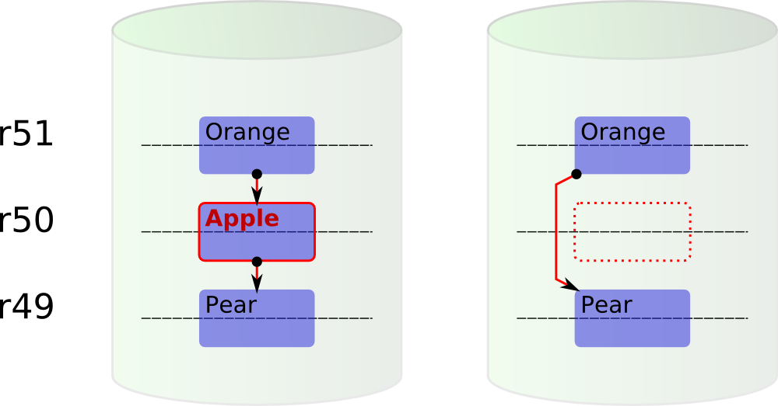
How? Delete Files
Obliterate file 'F' @ r50 – delete it
Notes:
There are many possible ways in which history could be changed. This is one way, and on the next slide is another way.
In this scheme, which I have called “delete files”, the user can obliterate individual files (or directory trees) from individual revisions.
The new history will show that the file was deleted in r50 and re-created in r51 (as a copy from r49).
---
See <notes/obliterate/fspec-dd1/> in the source tree for details of this scheme.

Slide 18
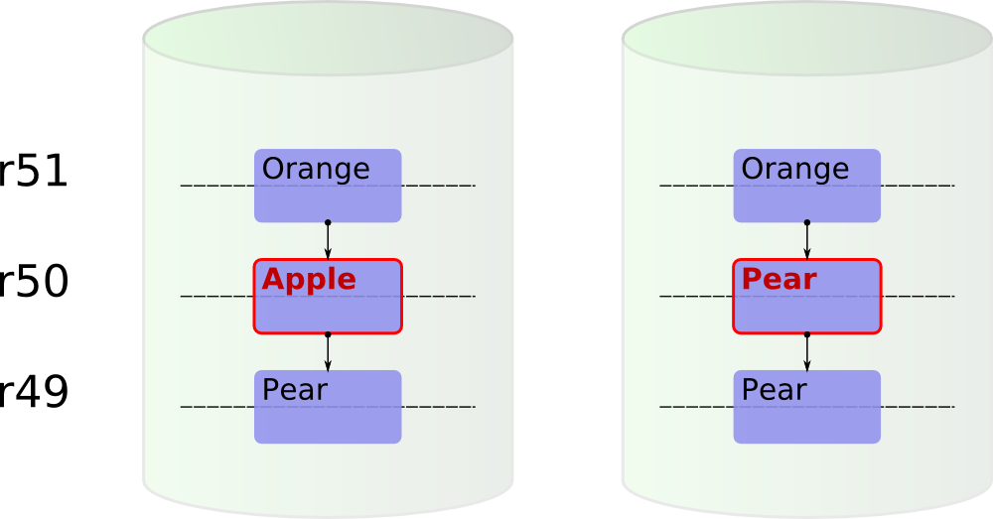
How? Undo Changes
Obliterate file 'F' @ r50 – undo changes
Notes:
This scheme, which I call “undo changes”, differs from the “delete files” scheme in that it replaces an individual node-rev with the previous revision of that node.
---
See <notes/obliterate/fspec-cc1/> in the source tree for details of this scheme.

Slide 19
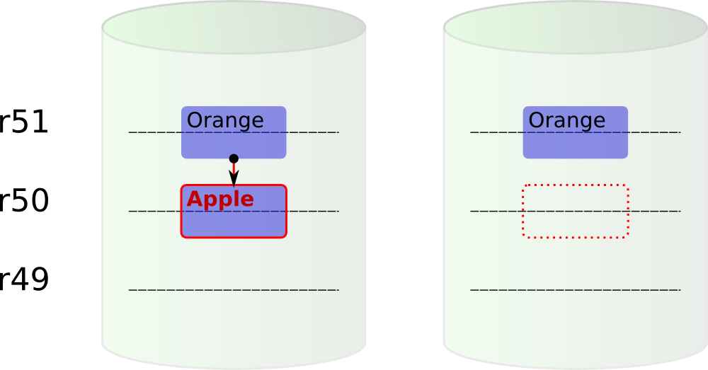
How?
Obliterate file 'F' @ r50 – if it was new
Notes:
If we obliterate a file in a revision where it was added, this works exactly the same in both schemes.
Both of the schemes can satisfy all of the use cases.

Slide 20
How? In other VCS
CVS
  Delete the “,v” file (delete a file)
Perforce
  “p4 protect” (can hide file-rev)
  “p4 obliterate” (delete file-rev)
  “p4 filetype” (latest N revs)
ClearCase
  “rmversion” (delete a node-rev)
  “rmelement” (delete a node)
Notes:
A CVS admin can remove an archive “,v” file to effectively delete the whole history of a particular file. (Recall that in CVS each file has its own history, with its own version numbers and log messages.) It is not so easy to remove selected revisions or changes from a CVS archive.
A Perforce admin can hide files with “p4 protect”, delete file-revisions with “p4 obliterate”, and enable “last N versions only” on selected files with a “p4 filetype” setting.
A ClearCase admin can remove a node-rev with “rmversion” or remove the whole history of a node with “rmelement”.

Slide 21
How? In Subversion
dump | svndumpfilter | load
authz can hide paths
Notes:
Subversion administrators can dump, filter and load a repository. Functionally, that satisfies most needs, but on a large repository it is much too slow for anything except a planned space-recovery.
Authorization settings can be used to hide specific paths, but not at specific revs.

Slide 22
Contents
Why?
How?
Architecture
Client Issues
Authorization
Audit Trail

Slide 23
Overview
Why?
How?
Architecture
Client Issues
Authorization
Audit Trail
Server or Client
Tell Server “Delete r50”?
FSFS or BDB

Slide 24
Server or Client
client
svnadmin
server
WC
repo

Slide 25
Server or Client
Client side (on-line)
client
svnadmin
server
WC
repo
svn obliterate ...
Notes:
Repo is on line.
MUST access repo through the running server
full potential for all use cases
extend the existing net protocols
could instead provide the server with a totally different interface, but doesn't seem sensible
extend the existing client(s)
could instead write a separate client, but doesn't seem sensible
Paranoia:
will likely want a server-side “obliterate on/off switch”, for when net authn/authz considered insufficient

Slide 26
Server or Client
Server side (off-line)
client
svnadmin
server
WC
repo
svnadmin obliterate ...
Notes:
Repo is off line
This solution is suitable for planned maintenance only.
Simpler design and implementation – no concurrency issues.

Slide 27
Server or Client
Local (off-line)
client
client
svnadmin
server
WC
repo
svn obliterate file://...
Notes:
Repo is off line.

Slide 28
Tell Server “Delete r50”?
Present client-server protocol
says “create a new HEAD revision”
cannot say “modify revision 50”
server doesn't know how to.

Slide 29
Tell Server “Delete r50”?
We need
new function in server libraries
  perform a “primitive” obliteration
new command in network protocol
  describe a “primitive” obliteration
new UI in client
  interpret what the user wants
  send obliteration commands

Slide 30
Contents
Why?
How?
Architecture
Client Issues
Authorization
Audit Trail

Slide 31
Client Issues
Coping with history changes
Aim: do something simple & friendly
  not totally automatic recovery
Support on server
  for helping clients to discover & recover

Slide 32
Contents
Why?
How?
Architecture
Client Issues
Authorization
Audit Trail

Slide 33
Authorization
Pre-obliterate hook
  Must be installed (like pre-revprop-change)
  otherwise obliteration is DISABLED
Inputs
  User
  Obliteration Set
Result
  Allow
  Deny (optional error message)

Slide 34
Contents
Why?
How?
Architecture
Client Issues
Authorization
Audit Trail

Slide 35
Audit Trail
Can still have an audit trail
Leave “breadcrumbs” where & when something was obliterated
  who, when, reason. [Bob Jenkins]
Put the info in
  rev-prop
  log file
If paths are sensitive, just say the changes were “within directory X”
Notes:
<http://svn.haxx.se/dev/archive-2008-04/0816.shtml>

Slide 36
End
svn obliterate
Any questions?

