Slide 1

Large-Scale Meta-Learning in SystemML
Arun Kumar
Mentor: Doug Burdick
Acknowledgments:
Amol, Berthold, Bhargav, Sekar, Shirish, Shiv, Vikas, Yuanyuan

Slide 2










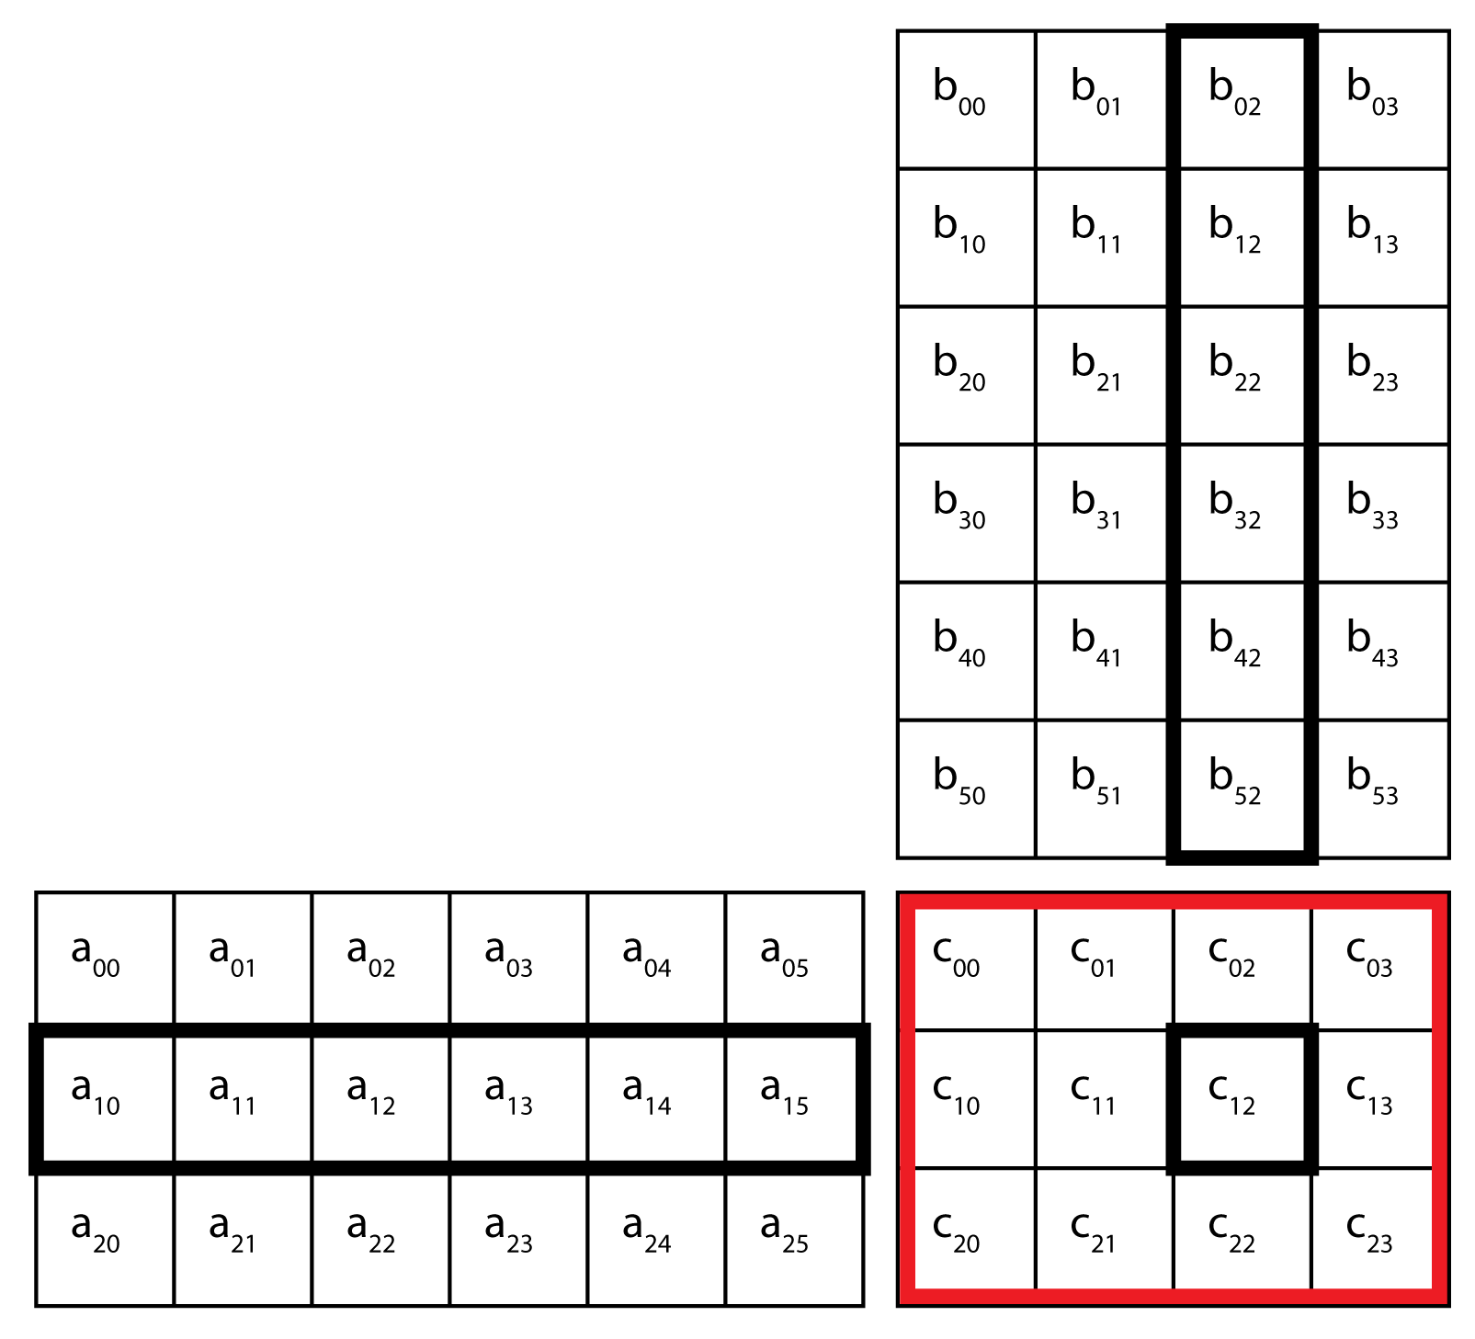
Large-Scale Machine Learning
Deluge of “Big Data” (TBytes – PBytes):
Recommendation
Systems
Web Search
Social Media
Blogs
Need to make sense of data:
    Patterns, Models, Predictions, Analytics
Pervasive need for:
  “Large-Scale Machine Learning”
Example:
  Topic modeling to analyze product reviews on blogs; Recommending new movies
  to Netflix users
Large
Matrix
Decomposition

Slide 3
SystemML
Declarative system for large-scale machine learning
Declarative high-level language, DML, to express ML algorithms
  Based on linear algebra, with R-like syntax
  Reduces LOC by orders of magnitude
Compiles DML into a logical plan of operators, optimizes it, and executes it in parallel over Hadoop/MapReduce
Cost-based optimization framework using data and system characteristics to choose most efficient execution plan
Large, sparse data (billions of non-zeros)

Slide 4
Example – Linear Regression
One of the most widely used ML algorithms
  Economics, finance, epidemiology, environmental science, etc.
Linear Regression in DML:
V = read("in/V", rows=1e8,cols=1e5);
b = read("in/b", rows=1e8, cols=1);
lambda = 1e-6;
r = -b ;
p = -r ;
norm_r2 = sum(r * r);
max_iteration = 20;
i = 0;
while(i < max_iteration) {
q = ((t(V) %*% (V %*% p)) + lambda * p)
alpha = norm_r2 / (t(p) %*% q);
w = w + alpha * p;
old_norm_r2 = norm_r2;
r = r + alpha * q;
beta = norm_r2 / old_norm_r2;
p = -r + beta * p;
i = i + 1;
}
write(w, "out/w");
Read in the data and labels
Matrix Multiplication
Write out the model (the regression coefficients)

Slide 5
Outline
Motivation and Background:
  SystemML
  Meta-Learning: Cross Validation and Ensemble Learning
Integrating Meta-Learning into SystemML
  Unified Abstractions and DML Constructs
  The PARTITION Operation
Experiments
Ongoing and Future Work
Conclusion
Notes:
- Use color to highlight Current- Remove Prior work
First we mentionThe appraoches And the chalgns
Then, we present
The language
Construct
Then we present
Solution to scalability
Mention that systemml already scales train and test for free! So, partition!
Reword the titles in the outline; maybe PARTITION --> SUBSET

Slide 6
Meta-Learning
Wide variety of machine learning models/algorithms for various tasks:
  Classification, regression, ranking, matrix factorization, etc.
General goal is to achieve high accuracy on unseen data
But, some 'meta' questions arise. For example:
  How do we know if a model is of good quality?
    Need to measure generalizability of model to unseen data
  What if a model is not powerful enough to fit the bill?
    Perhaps using multiple models can help on complex concepts
'Meta-learning' techniques (i.e., techniques that are mostly agnostic to the underlying ML algorithms) employed to solve such problems
  Cross Validation (CV)
  Ensemble Learning (EL)

Slide 7
Cross Validation (CV)
Basic idea is to split the available data, train the model on some parts, evaluate it on the others, and assess overall quality (error)
  Measures the generalizability of the model to unseen data
Widely used in the machine learning community:
  Prevent overfitting – model may learn noise in the data
  Model selection – selecting good models and parameters
  Feature selection – selecting most informative features
Several methods of CV have been proposed:
  Supervised: K-Fold, Holdout, Bootstrap, etc.
  Unsupervised: Gabriel split, Wold holdout, etc.

Slide 8
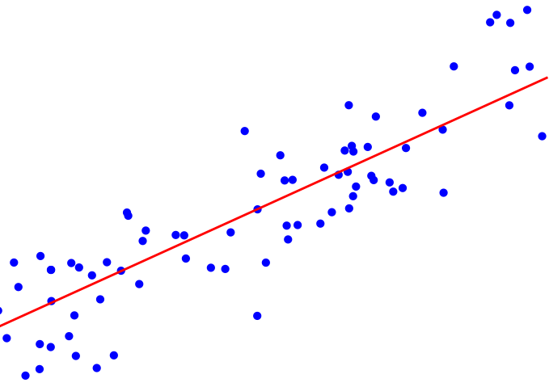
Example – K-fold CV
In supervised setting, data is partitioned into K equal-sized sets
Train fold is on union of K-1 sets, test on the remaining fold
Repeat for all K such combinations, and compute average error
E.g., Linear Regression with K-Fold CV (K = 3):
TRAIN
TEST
0.3
PARTITION
Result
TRAIN
TEST
Avg
0.1
0.2
AGGREGATE
Labeled
Data
TRAIN
TEST
0.2
Folds
Errors

Slide 9


Ensemble Learning (EL)
Basic idea is to build multiple models over the available data, and combine their predictions
Diversity can improve accuracy. Many ways to achieve diversity:
  Tweak the dataset
  Explicitly change model parameters
  Use different models altogether
Many ways to combine predictions – voting, averaging, etc.
Ensemble Learning methods used in several applications, e.g.:
  Recommendation systems, financial risk prediction, epidemiology and social sciences, face recognition, etc.

Slide 10
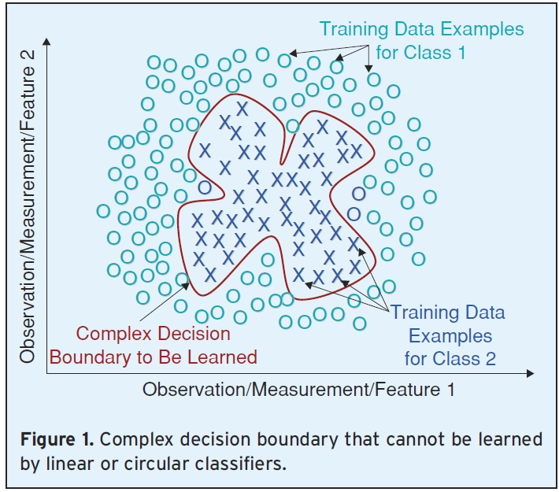
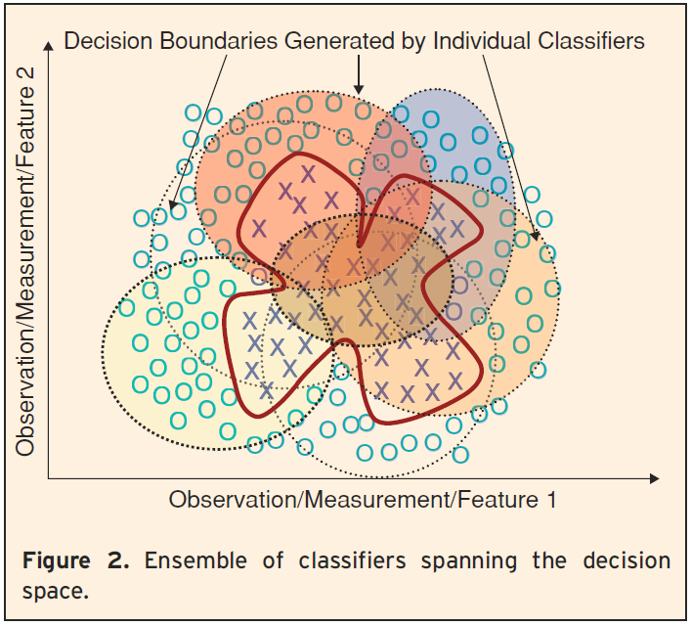
Ensemble Learning
Several methods of Ensemble Learning (mostly supervised)
  Bootstrap Aggregation (Bagging), Boosting, Random Subspace method (RSM), Stacked Generalization, etc.
Ensemble Learning is useful for many reasons:
  Decision surface is too complex
  Statistical reasons – better generalizability, error reduction
  Heterogeneous datasets; too much/little data
Figure from R. Polikar, “Ensemble Based Systems in Decision Making”, IEEE Circuits and Systems Magazine 6 (3): 21–45, 2006

Slide 11
Example – RSM EL
Random Subspace Method (RSM) samples data in the feature space to achieve diversity and obtain several folds
Train model on each subspace and save for future reuse
E.g., Linear Regression with RSM EL:
Building the Ensemble
Scoring with the Ensemble
PARTITION
TRAIN
0.4
0.2
Avg
0.3
TRAIN
Result
0.3
…
AGGREGATE
Labeled
Data
TRAIN
Outputs
…
…
…
Unlabeled
Data
Subspaces
Models

Slide 12
Outline
Motivation and Background:
  SystemML
  Meta-Learning: Cross Validation and Ensemble Learning
Integrating Meta-Learning into SystemML
  Unified Abstractions and DML Constructs
  The PARTITION Operation
Experiments
Ongoing and Future Work
Conclusion
Notes:
- Use color to highlight Current- Remove Prior work
First we mentionThe appraoches And the chalgns
Then, we present
The language
Construct
Then we present
Solution to scalability
Mention that systemml already scales train and test for free! So, partition!
Reword the titles in the outline; maybe PARTITION --> SUBSET

Slide 13
Meta-Learning in SystemML
Goal: Integrate the meta-learning operations of
CV and EL as first-class citizens in SystemML
Possible approaches to integrate meta-learning:
  R/Matlab-style approach:
    Implement model-specific packages, e.g. cv.glm() in R
    Not very generalizable; no reuse
  Generic Functions approach:
    Write separate functions that take in train/test routines
    Hard to parallelize; doesn't exploit optimization machinery
Our Approach: CV and EL as language constructs in DML

Slide 14
Challenges
As explained before, SystemML uses a declarative language, and is built for large-scale datasets
Thus, we face two key challenges in integrating meta-learning:
  Generic Abstractions:
    Identify unified abstractions for generic CV, generic EL
    Declarative constructs to capture most CV, EL methods
  Scalability:
    Very large sparse matrices; billions of non-zeros
    Construction and execution of several folds

Slide 15
Outline
Motivation and Background:
  SystemML
  Meta-Learning: Cross Validation and Ensemble Learning
Integrating Meta-Learning into SystemML
  Unified Abstractions and DML Constructs
  The PARTITION Operation
Experiments
Ongoing and Future Work
Conclusion
Notes:
- Use color to highlight Current- Remove Prior work
First we mentionThe appraoches And the chalgns
Then, we present
The language
Construct
Then we present
Solution to scalability
Mention that systemml already scales train and test for free! So, partition!
Reword the titles in the outline; maybe PARTITION --> SUBSET

Slide 16
General Operations in CV and EL
CV
TRAIN
TEST
0.3
PARTITION
TEST
Result
TRAIN
0.1
Avg
0.2
AGGREGATE
Labeled
Data
...
...
Folds
Construct the folds
Build Models
Use Models
Aggregate Results
EL
PARTITION
TRAIN
0.4
0.2
Avg
0.3
TRAIN
Result
0.3
TRAIN
…
AGGREGATE
Labeled
Data
…
Outputs
…
…
Unlabeled
Data
Subspaces
Models
Building the Ensemble
Scoring with the Ensemble

Slide 17
Unified Abstractions for Meta-Learning
Four basic steps in meta-learning; many similarities between CV and EL, but some differences exist
STEPS | CV | EL
PARTITION | Construct folds: train and test | Construct folds: only train
TRAIN | Train models on each fold | Train models on each fold
TEST | Evaluate models on test folds to get errors | Score (predict) on unlabeled data using models
AGGREGATE | Combine errors to final error result | Combine predictions to get final predictions
CV is a one-time process to compute error on a dataset
EL has a one-time building phase to learn the ensemble, and possibly several scoring phases on new data

Slide 18
DML Construct for Cross Validation
Example: Linear Regression with K-Fold CV
CROSSVAL USING (myData)
PARTITION (type='kfold', element='row', numfolds=10)
                as (trainFold, testFold)
TRAIN linearRegrTrain (trainFold) as (regCoeffs)
TEST linearRegrTest (regCoeffs, testFold) as (error)
AGGREGATE avg (error) as (outputError);
Labeled dataset matrix
Type of partitioning/
sampling
Train and Test
Functions
Elements to
partition upon
Not visible outside;
Intermediate outputs
Final error result
Error aggregation
Formal Construct:
CROSSVAL USING <dataset>
PARTITION ( type='kfold'|'holdout'|'bootstrap',
element='row'|'submatrix'|'cell',
<type-specific parameters> ) as <folds>
TRAIN trainFunction (<inputs>) as <models>
TEST testFunction (<inputs>) as <error>
AGGREGATE aggrFunction (<error>) as <output>;

Slide 19
DML Constructs for Ensemble Learning
Example: Linear Regression with Random Subspace Method (RSM) EL:
BUILD ENSEMBLE myEnsemble ON (myData)
PARTITION (method='rsm', numfolds=20, frac=0.4)
                as (myFolds)
TRAIN linearRegressionTrain (myFolds);
Persisted ensemble metadata file
EL method implicitly defines
partitioning type and element
New unlabeled data
Model implicit from ensemble file
USE ENSEMBLE myEnsemble
TEST linearRegressionPredict (newData, myEnsemble) as (myPredictions)
AGGREGATE avg (myPredictions) as (myResults);
Final output matrix
Output aggregation function

Slide 20
Outline
Motivation and Background:
  SystemML
  Meta-Learning: Cross Validation and Ensemble Learning
Integrating Meta-Learning into SystemML
  Unified Abstractions and DML Constructs
  The PARTITION Operation
Experiments
Ongoing and Future Work
Conclusion
Notes:
- Use color to highlight Current- Remove Prior work
First we mentionThe appraoches And the chalgns
Then, we present
The language
Construct
Then we present
Solution to scalability
Mention that systemml already scales train and test for free! So, partition!
Reword the titles in the outline; maybe PARTITION --> SUBSET

Slide 21
PARTITION – The Common Operation
Both CV and EL require various methods of sampling / partitioning (together called PARTITION) the input dataset
The splits of the dataset are then used to train / test models
Type \ Element | Row | Column | Submatrix | Cell
K-Fold | K-Fold CV |  | Gabriel CV
Bootstrap | Bootstrap CV, Bagging EL
Holdout | Holdout CV, Holdout EL | RSM EL |  | Wold CV
Notes:
Verbally state focus; sttae that cell/submatrix are spl cases for unsup cv
We can simply state its in paper, and skip it;
If any qns, offlines

Slide 22
Sampling Methods in PARTITION
Sampling – selecting portions of the data for a fold
Without Replacement
(Holdout; also K-fold)
With Replacement
(Bootstrap)
Fraction = 0.5
Fraction = 0.5
1
3
1
4
4
2
1
2
1
3
4
3
4
4
4
6
4
4
6
5
5
6
6
7
7
8
8
We discuss 3 ways of implementing PARTITION:
  Reblock-Based Method (RB)
  Using Joins:
    HashMap Method (HM) and Join-and-Reblock Method (JR)
Only Without Replacement
Both With / Without Replacement

Slide 23
Challenges for PARTITION
Blocked representation of matrices (inputs and outputs)
  Only a portion of a row is available in a block
E.g., 9x9 matrix with 3x3 blocks
Totally, 9 blocks with IDs: (0,0) to (2,2)
Matrix is physically stored as an HDFS SequenceFile
with block IDs as keys and contents as values
  Operations with block-format are more efficient
Scale to large matrices, for any number of folds
  Millions of rows/columns, billions of non-zeros
Sampling with replacement non-trivial to parallelize
  Needed for Bootstrap CV and Bagging EL

Slide 24
ReBlock-Based Method (RB)
Baseline solution; works for sampling with replacement
Uses SystemML's ReBlock() operation
ReBlock II
ReBlock I
Produce Folds
Fold 1
Reblocked Fold 1
Input Matrix
Reblocked Input
Fold 2
Reblocked Fold 2
Intermediate key:
(Fold ID)
...
...
E.g. Holdout:
On each row:
r = Rand(0,1)
If (r < Fraction)
Emit(fold)
Else
Ignore
Distributed PRNG
3 MapReduce jobs
For Bootstrap CV / Bagging EL, each row may appear in a fold multiple times, but it cannot independently decide that
Notes:
Verbally state why; and then segue into the next slide

Slide 25
PARTITION Using Joins
Tackles the problem of sampling with replacement
Basic idea is to write out the sampled row/column-ids into a file (IDTable) at a centralized location (control program)
  Do a join with input dataset over MapReduce
Can handle sampling without replacement as well
Tracking sampled column-ids needed for RSM EL
Join can be done at:
  The mapper-side → HashMap Method (HM)
  The reducer-side → Join-and-Reblock Method (JR)

Slide 26
PARTITION Using Joins
HashMap Method (HM)
Produce Folds:
Map-Side Join
Fold 1
1 MR job
Memory intensive
Mapper
reads the
IDTable into
memory
IDTable
Fold 2
Input
Intermediate key:
(Fold ID, Block ID)
...
Join-and-Reblock Method (JR)
Produce Folds:
Reduce-Side Join
Fold 1
ReBlock
Reblocked Fold 1
Input
Intermediate key:
(Fold ID, Row ID)
Fold 2
Reblocked Fold 2
...
IDTable
2 MapReduce jobs
Less memory required

Slide 27
Joins on the IDTable
IDTable : With
Replacement
Fraction = 0.4
Fold 1
Data 'Table'
Index | Fold1 IDs
1 | 2
2 | 7
3 | 3
4 | 2
Index | Attributes...
1 | 9.5 | ...
2 | 0
3 | 2.1
4 | 9.5
ID | Attributes...
1 | 1.3 | 0.2
2 | 9.5 | 6.6
3 | 2.1 | 4.0
4 | 3.7 | …
5 | 7.2
6 | 10
7 | 0
8 | 5.4
9 | 0
10 | 8.3
Join on Fold1's
Column of IDs
IDTable: Without
Replacement
Fraction = 0.4
ID | Fold1 Indices
1 | 1
2 | -
3 | 2
4 | -
5 | 3
6 | 4
Fold 1
Index | Attributes...
1 | 1.3 | ...
2 | 2.1
3 | 7.2
4 | 10
Join on ID
Column
Input Matrix
...

Slide 28
Cost Analysis
Notations:
m – No. of rows in input
n – No. of columns in input
k – No. of folds
P – No. of mappers
b – No. of rows per block
c – No. of columns per block
Input matrix size: 8mn bytes
IDTable size: 8mk bytes
HM:
Shuffle: 8mnk
...
I/O: 8mnk
I/O: 8mn + 8mkP
Distribution: 8mkP (Network and I/O)
JR:
Shuffle: 8mn + 8mk
Shuffle: 8mnk
...
I/O: 8mnk
I/O: 8mnk
I/O: 8mnk
I/O: 8mn + 8mk
RB:
Shuffle: 8mnk
Shuffle: 8mnk
Shuffle: 8mn
...
I/O: 8mn
I/O: 8mn
I/O: 8mn
I/O: 8mnk
I/O: 8mnk
I/O: 8mnk

Slide 29
Cost Analysis – Summary
 | RB | JR | HM
Number of MR Jobs | 3 | 2 | 1
I/O cost (bytes) | 16mn + 8mn(1 + k) + 16mnk | 8m(n + k + nk) + 16mnk | 8m(n + kP + nk) (+ 8mkP distribution)
Shuffle cost (bytes) | 8mn + 8mnk + 8mnk | 8m(n + k) + 8mnk | 8mnk (+ 8mkP distribution)
Shuffle: # KV pairs in MapReduce jobs | mn + mk + mnk | (mn + mk) + mnk | mnk
For large-scale inputs: m, n >> k, P; expected runtimes of RB > JR > HM
But, several other factors also affect these costs and runtimes:
  Fraction parameter, physical details, sparsity, CPU times, etc.
Cost-based optimization:
  No single method is consistently best for all cases; several data and system characteristics affect their runtimes
  Declarative system can choose best method based on costs; optimizer chooses HM if memory available; else use shuffle costs; if similar, use I/O

Slide 30
Outline
Motivation and Background:
  SystemML
  Meta-Learning: Cross Validation and Ensemble Learning
Integrating Meta-Learning into SystemML
  Unified Abstractions and DML Constructs
  The PARTITION Operation
Experiments
Ongoing and Future Work
Conclusion
Notes:
- Use color to highlight Current- Remove Prior work
First we mentionThe appraoches And the chalgns
Then, we present
The language
Construct
Then we present
Solution to scalability
Mention that systemml already scales train and test for free! So, partition!
Reword the titles in the outline; maybe PARTITION --> SUBSET

Slide 31
Experiments
Performance comparison of the three implementations:
RB vs HM vs JR, for various CV / EL methods
Runtime variation with input characteristics:
  Number of rows
  Number of columns
  Sparsity
Experimental setting:
  Synthetic datasets; same local sparsity in each block
  40-core cluster (5 nodes); each 32 GB memory, 2 TB disk
  No. of reducers 5; Replication 1; avail. memory controlled

Slide 32
Runtime vs Number of Rows (m)
K-fold CV and Bagging EL (/ Bootstrap CV)
Number of columns = 10k, Number of folds = 5, Sparsity = 0.1%, Fraction = 0.3
RB not
applicable
Memory
exhausted
Memory
exhausted
All methods scale linearly with m, and runtimes of RB > JR > HM
HM faster than JR and RB, but eventually exhausts memory

Slide 33
Runtime vs Number of Columns (n)
K-fold CV and RSM EL
Number of rows = 1 million, Number of folds = 5, Sparsity = 0.1%, Fraction = 0.3
RB not
applicable
All methods scale linearly with n, and HM is still fastest
RB and JR are comparable
Notes:
Is that an anomaly or noise?
On Fri – discn
With Doug;
Reg status of
Impl and expts;
And KT on code

Slide 34
Runtime vs Sparsity
HM and JR can exploit sparsity to reduce no. of KV pairs shuffled
Instead of all non-zero cells, send sub-rows as values in shuffle
1000x1000 blocks in SystemML; sub-rows better if sparsity >> 0.001
E.g., Holdout EL; No. of rows = 100k, No. of columns = 10k
RB, JR and HM scale linearly, since number of non-zero cells increases linearly
Shuffling sub-rows faster for both HM and JR, but more for HM, since drop in no. of KV pairs is steeper
Also, runtime increase linearly with number of folds

Slide 35
Discussion
The baseline RB is the slowest in most cases, with HM always being the fastest
HM fails when mapper does not not have sufficient memory, while JR continues to scale
Scope for cost-based optimization for execution path selection based on data and system characteristics
Hybrid of HM and JR possible by leveraging ideas from literature on parallel DBMS-inspired joins in MapReduce
  Partition the IDTable, and use range partitioning of the data
  Can bridge the gap between HM and JR, while overcoming the high memory requirements of HM

Slide 36
Outline
Motivation and Background:
  SystemML
  Meta-Learning: Cross Validation and Ensemble Learning
Integrating Meta-Learning into SystemML
  Unified Abstractions and DML Constructs
  The PARTITION Operation
Experiments
Ongoing and Future Work
Conclusion
Notes:
- Use color to highlight Current- Remove Prior work
First we mentionThe appraoches And the chalgns
Then, we present
The language
Construct
Then we present
Solution to scalability
Mention that systemml already scales train and test for free! So, partition!
Reword the titles in the outline; maybe PARTITION --> SUBSET

Slide 37
Ongoing and Future Work
Partition without replication
  Create one fold at a time to save disk space on cluster
Other popular ensemble methods – boosting (AdaBoost)
  Weighted sampling; sequential execution
Scoring with ensembles
  Persist metadata file; reuse to test on unlabeled data
Exploit class of linear models (for K-fold)
  Can reuse sufficient statistics of model from each fold

Slide 38
Conclusion
Integrated meta-learning as first-class citizens of SystemML
Identified common abstractions and created declarative language constructs for generic meta-learning techniques
Developed scalable generic methods of data partitioning and sampling, a common operation in meta-learning techniques
Cost-based optimization framework for execution path selection to achieve best performance under various cases

Slide 39
Thank You

Slide 40
Backup Slides

Slide 41
DML Constructs for Ensemble Learning
Formal Construct:
BUILD ENSEMBLE <ensemble> ON <dataset>
PARTITION ( method='bagging'|'rowholdout'|'rsm',
<method-specific parameters> ) as <splits>
TRAIN trainFunction (<inputs>) ;
USE ENSEMBLE <ensemble>
TEST predictFunction ( <inputs> ) as <predictions>
AGGREGATE aggrFunction( <predictions> ) as <result>;

Slide 42
EL Construct with Boosting (AdaBoost)
Boosting as a method (AdaBoost)
BUILD ENSEMBLE <ensemble> ON <dataset>
PARTITION ( method='bagging'|'rowholdout'|'rsm'|'adaboost',
<method-specific parameters> ) as <splits>
TRAIN trainFunction (<inputs>) [as <models>];
[TEST testFunction (<inputs>)];
Optional; not visible outside; outputs
of trainer handled internally by ensemble
Required only for boosting
Example: AdaBoost on Decision Trees
BUILD ENSEMBLE myEnsemble ON (myData)
PARTITION (method='adaboost', numfolds=20) as (myDataSplit)
TRAIN treeTrain (myDataSplit) as (myTree)
TEST treePredict (myTree, myData);

Slide 43
Overview of AdaBoost
Data
Data1
Data 2
Model1
Model2
…
Sampling
Train
Test Sampling
Train
Test Sampling

Slide 44
Data Flow in AdaBoost
Ex: Boosting (AdaBoost) with weighted sampling:
BUILD ENSEMBLE myEnsemble DATA D
PARTITION ( method='adaboost', numfolds=3, resample=T ) as Di
TRAIN Trainer ( Di ) as Zi
TEST Tester ( Zi, D );
function Trainer ( Matrix[Double] Data, Matrix[Double] Label) return Matrix/Object Model
function Tester ( Matrix/Object Model, Matrix[Double] Unlabeled) return Matrix[Double] Prediction
Initial
w
Persistent
Write
Wtd.
Row
Sample
myEnsemble
Write
D1
L1
Trainer
Z1
Transient
Write
Metadata
/hdfs/Z1, 0.14
/hdfs/Z2, 0.23
…
Transient
Writes
Tester
ImpFactor1
P1
Reweight
Updated
w
D
Z2
ImpFactor2
L
Wtd.
Row
Sample
…
D, L
Read
Z3
ImpFactor3
Persistent Writes

Slide 45
Data Flow in AdaBoost
Ex: Boosting (AdaBoost) without sampling (weight-aware training):
BUILD ENSEMBLE myEnsemble DATA D
PARTITION ( method='adaboost', numfolds=3, resample=F ) as Wi
TRAIN WtdTrainer ( D, Wi ) as Zi
TEST Tester ( Zi, D );
Weight matrix
function WtdTrainer ( Matrix Data, Matrix Label, Matrix Weight) return Matrix/Object Model
function Tester ( Matrix/Object Model, Matrix Unlabeled) return Matrix Prediction
W1
Persistent Write
Wtd
Trainer
myEnsemble
Write
Z1
Transient
Write
Tester
Metadata
/hdfs/Z1, 0.14
/hdfs/Z2, 0.23
…
ImpFactor1
P1
D
Reweight
L
W2
Z2
ImpFactor2
…
D, L
Read
Wtd
Trainer
Z3
ImpFactor3
Persistent Writes

Slide 46
Our Current Scope
Supervised Prediction (e.g., Classification, Regression) → Yes
Unsupervised / semi-supervised methods
Popular methods of Ensemble Learning:
Bagging (Bootstrap Aggregation) → Yes
Boosting – AdaBoost, LogitBoost, etc. → Yes (some)
Random Subspace Method (RSM) → Yes
Stacked Generalization, Mixture of Experts, etc.
Random Forest (only for Decision Trees)
Diversity achieved by:
Tweak the labeled dataset (sampling, projection, etc) → Yes
Varying the model parameters
Using different types of models
Arbitrary mixtures

Slide 47
Meta-Learning Operators
Generic meta-learning operators, one for CV, one for EL (only building)
Uniform input / output interfaces
Partitioning, training, cost-based optimizations, and other algorithm specifics handled internally by operator
External package invocation possible (e.g., Nimble/PMML)
Remove this
Slide; redundant
Parameters
Parameters
Set of
Models
Data
TrainFunc
CV
Error
Labeled Data
EL
TestFunc
Metadata
File
TrainFunc
Aggregator
Inputs
Outputs
Inputs
Outputs
The CV Operator
The EL Operator

Slide 48
Join-based Partitioning – K-fold
Train Fold 1
Test Fold 1
Move to backup
Data 'Table'
IDTable
Ix | Attrs...
1 | 1.3 | ...
2 | 9.5 | ...
3 | 3.7
4 | 10
5 | 5.4
6 | 0
Ix | Attrs...
1 | 2.1 | ...
2 | 7.2 | ...
3 | 0
ID | Attributes...
1 | 1.3 | 0.2
2 | 9.5 | …
3 | 2.1
4 | 3.7
5 | 7.2
6 | 10
7 | 0
8 | 5.4
9 | 0
ID | Fold1 | Index1 | F2 | I2 | F3 | I3
1 | Train(Tr) | 1 | Ts | 1 | Tr | 1
2 | Train | 2 | Tr | 1 | Ts | 1
3 | Test(Ts) | 1 | Tr | 2 | Tr | 2
4 | Train | 3 | Ts | 2 | Tr | 3
5 | Test | 2 | Tr | 3 | Tr | 4
6 | Train | 4 | Tr | 4 | Ts | 2
7 | Test | 3 | Tr | 5 | Tr | 5
8 | Train | 5 | Ts | 3 | Tr | 6
9 | Train | 6 | Tr | 6 | Ts | 3
Train Fold 2
Test Fold 2
Ix | Attrs...
1 | 9.5 | ...
2 | 2.1 | ...
3 | 7.2
4 | 10
5 | 0
6 | 0
Ix | Attrs...
1 | 1.3 | ...
2 | 3.7 | ...
3 | 5.4
Output folds
by Join on ID
Input Matrix
K = 3
…

Slide 49
Runtime vs Number of Folds (k)
Holdout CV: Sparsity = 0.1%, Fraction = 0.3
Number of rows = 100k, Number of columns = 10k
Reduce to a bullet, not sep slidr
All methods scale linearly with k, and runtimes of RB > JR > HM
HM faster than JR and RB, but can again exhaust memory

Slide 50
MapReduce Implementation of RB
Mapper:
Reducer

Slide 51
MapReduce Implementation of HM
Mapper:
Reducer

Slide 52
MapReduce Implementation of JR
Mapper:
Reducer

