Slide 1
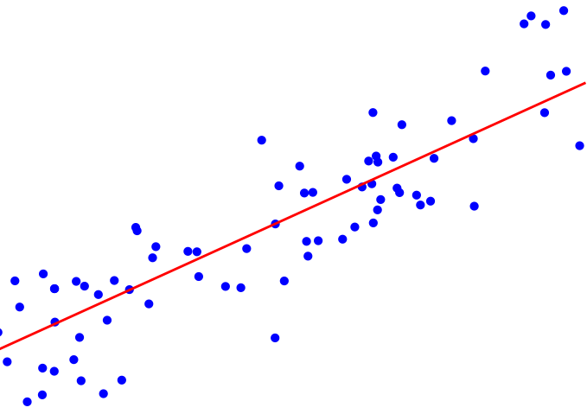
Build Ensemble
Use Ensemble
TEST
PARTITION
TRAIN
0.4
TEST
Avg
0.2
0.3
TRAIN
TEST
Result
0.3
…
AGGREGATE
Labeled
Data
TRAIN
Outputs
…
…
…
Unlabeled
Data
Splits
Models

