Slide 1
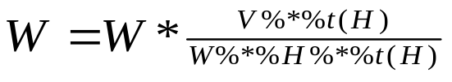

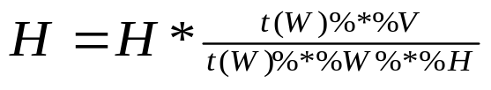
write
i
write
W
u(+)
b(*)
Live Variables Out
Matrix : W, H, V
Scalar : i, max_iteration
1.0
b(/)
W Assignment
read
i
a(+*)
a(+*)
a(+*)
r (T)
r(T)
Write
H
b(*)
b(/)
H Assignment
a(+*)
a(+*)
read
V
r(T)
a(+*)
read
H
r(T)
Live Variables In
Matrix : W, H, V
Scalar : i, max_iteration
read
W

Slide 2
write
i
write
W
u(+)
b(*)
1.0
b(/)
read
i
a(+*)
a(+*)
a(+*)
r (T)
r(T)
Write
H
b(*)
b(/)
a(+*)
a(+*)
read
V
r(T)
a(+*)
read
H
r(T)
read
W

