Slide 1
Tapestry Design Review
Thu Apr 4 2000
Notes:
Originally presented April 4 2000.
Updated since then due to changes in the framework.

Slide 2
Introduction
We’re still in the dark ages of web applications
We’re told:
  Receive a request
  Process it
  Send a reply
That’s a lie!
Notes:
Foxusing on Java Servlets and JavaServer Pages (JSPs)
Servlets API a step in the right direction; especially built-in session handling

Slide 3
Introduction
Web applications aren’t about requests
  They’re about interactivity
  Responding to user in a custom way
  Unifying behavior throughout application
Most solutions focus on the request alone
  ASP, JSP, WebMacro, XMLC, FreeMarker
  Scripting languages
  Unique, ugly, incompatible

Slide 4
Introduction
Scripting only helps for one part of interaction
  Each page includes “potentials” … links and forms with some behavior
  To build one page, you need to know how to invoke actions, some on other pages
  Tricky URLs to encode action, parameters, etc.
  Scripting only knows URLs, not actions
  Different developers, different approaches
Notes:
The URL has to encode (in a very abstract way):
A target object
An operation to perform
Parameters
For example, a URL for adding an item to a shopping cart could look like:
/servlet/add-to-cart&itemId=38271&qty=1
/servlet/add-to-cart is the operation (and, implicitly, the target).
itemId = 38271 and qty=1 are the parameters.
Of course, there are no hard-and-fast rules, so the URL could also look like:
/servlet/addcart/38271/1
Or any of other countless variations. This means that different developers on the same project must do a lot of exacting communication on even basic things.

Slide 5
Introduction
Scripting too weak
  Too many easy mistakes
  Too hard to debug
  Too much user-written code
  HTML full of “wierdness”
  Little possibility for re-use (non-static)
  Lots of plumbing for little effect
Notes:
Common mistakes:
“you say potatoh I say pohtahto” … minor naming mismatches that can’t be caught until runtime. “user-name” vs. “username” vs. “UserName” vs. “userName” vs. “user_name”, vs. …
Certain characters are invalid in URLs and must be encoded or escaped in various ways. Scattering the code that assembles URLs throughout the application leaves lots of weak points.
Code generating frameworks such as JSP mean that developers are debugging code written by and for machines, often without the benefit of source code.
HTML is one language. Java is another. They don’t look alike, nor should they. Combining them into one language, JSP, is a worst-case scenario since nothing quite fits together.

Slide 6
Introduction
CGI very procedural
Start here, do this, stop
APIs based on CGI very procedural
Time for objects!

Slide 7
Introduction
Thus, Tapestry!
Build app from component objects
Let framework do “the plumbing”
Reduce amount of code
Increase amount of interactivity
Eliminate bugs from ad-hoc solutions
Notes:
Plumbing:
Assembling URLs
Decomposing URLs
Navigation between pages
etc.
Under Tapestry, most code is directly related to the application. Nearly all the presentation logic is “programmed” in the HTML templates and specifications.
Tapestry enforces some rules and structure. It eliminates ad-hoc solutions and their bugs (example: invalid URLs generated if the product id contains punctuation).

Slide 8
Tapestry Goals
Portable code (JDK 1.1, Servlets 2.1)
Minimal HTML markup
Tapestry handles building/parsing URLs
Make difficult easy:
  Debugging
  Deployment
  Localization
  Reuse
  Monitoring / performance analysis
Robust exception support
Notes:
Debugging is easier for a number of reasons:
When exceptions are thrown, Tapestry has the component trace to identify exactly where they occurs.
All Tapestry exceptions support nested exceptions, allowing the developer to accurately trace back to initial problems.
Use of IBM RAS Toolkit for output.
All code is developer code or Tapestry framework; not generated Java code to debug.

Slide 9
Tapestry Goals
Reduce amount of Java code
Zero code generation
Work well for failover, load balancing
Good interfaces, simple implementations
  Grow Tapestry by creating new implementations
  Existing code works well into the future
Notes:
Currently, Tapestry tracks persistent page state in memory. Future enhancements will allow such data to be stored as HTTP Cookies or in a database … but that’s an implementation detail that existing and future components don’t need to worry about.

Slide 10
Overview
Components
Parameters
Pages
Applications
Application Servlet
Request Cycle
Application Services
Persistent Page State
Dynamic Page State

Slide 11
Components
Tapestry component
  Specification
  HTML template (optional)
  Java Class (usually, not always)
Component parameters
  Define data needed by component
  Ex: insert component has ‘value’
  Dynamic: based on JavaBeans properties
Notes:
Some useful components can be created simply through aggregation … combining existing components together in new ways. These will require little or no new Java code.
A Tapestry component is its specification … the Java class and HTML template (if used) are secondary.
Parameters are somewhat like JavaBeans properties. Instead of setting the value for a property (for example, setting the color of a button in a GUI editor), a Tapestry developer specifies a binding for a component parameter. The binding is a bridge that allows the component to access the source of the data, usually a property of some other object.

Slide 12
Components
Recursive
  Components contain other components
  Aggregation
  Part of the component specification
  Arbitrary depth
  Ex: ShoppingCartEditor contains form, textfield, insert, foreach, conditional, ...

Slide 13
Components
border : Border
navBar: NavBar
e: Foreach
insertPageName: Insert
pageLink: Action
insertPageTitle: Insert
ifShowNavigation: Conditional

Slide 14
Components
Re-usable
  Parameters to adapt component to page and application
  “Black box” design

Slide 15
Parameters
Parameters are “plugs” in the Component black-box
Mostly, data “pulled” into Component
  Insert: value to insert into HTML
  Conditional: value to evaluate
  Action: listener to notify if action triggered
  form components: initial value for form fields

Slide 16
Parameters
Sometimes, data “pushed” out from Component
  Foreach: current value
  form components: updated value when form submitted

Slide 17
Parameters
Bindings provide values for parameters
Specified in containing Component’s specification
Static bindings
  Fixed string value
  Often coerced to int or bool
  read-only

Slide 18
Parameters
Dynamic bindings
  Specifies JavaBeans property to get or set value
  Relative to containing Component
  read, write, read/write -- if Component implements accessors, mutators
  Can use property path
    Ex: page.application.specification.name

Slide 19
Parameters
home: HomePage
value: currentSelection
source: selectionOptions
e: Foreach
insertCurrentSelection: Insert
value: currentSelection

Slide 20
Pages
Specialization of Component
Point of interaction with application
Focus for persistence of server-side state
Contain other components
Specific Locale for localization
No parameters - no containing Component

Slide 21
Pages
home: HomePage
border: Border
border.navbar.e
navBar: NavBar
e: Foreach
insertPageName: Insert
pageLink: Action
e: Foreach
border.navbar.pageLink
changeSelection: Action
insertCurrentSelection: Insert

Slide 22
Applications
Provide support to everything else
  Page recorder for each page
  Page source: pool of reusable pages
  Application services (for building URLs)
  Runs the request cycle
  Access to templates & specifications
One instance for each client, stored in HttpSession

Slide 23
Applications
Central location for common values and logic
Serializable: may move to a different JVM because of failover or load balancing
Maps page names to page components
Provides framework for handling exceptions
Can provide new services

Slide 24
Application Servlet
Single servlet for entire application
Very little code: locates the Application object in the HttpSession, or creates it
Delegates everything else to the Application

Slide 25
Application Servlet
Servlet
:
:
: (Logical
: IApplication
Container
ApplicationServlet
RequestContext
View::javax::ser
1. doGet(HttpServletRequest, HttpServletResponse)
1.1. RequestContext(HttpServlet, HttpServletRequest, HttpServletResponse)
1.2. getApplication(RequestContext)
1.2.1. getSessionAttribute(String)
1.2.1.1. getValue(String)
1.3. service(RequestContext)

Slide 26
Request Cycle
Represents processing a single request and rendering a response HTML page
Tracks state of components
Knows ‘where on the page’ during renderring … needed to build URLs

Slide 27
Application Service
Builds URLs for components
Later, parses URL and kicks off request cycle
URLS:
  servlet path / service name / service info
  Each service defines its own service info
  Ex: Page service, info is name of page
Usually linked to a specific Component

Slide 28
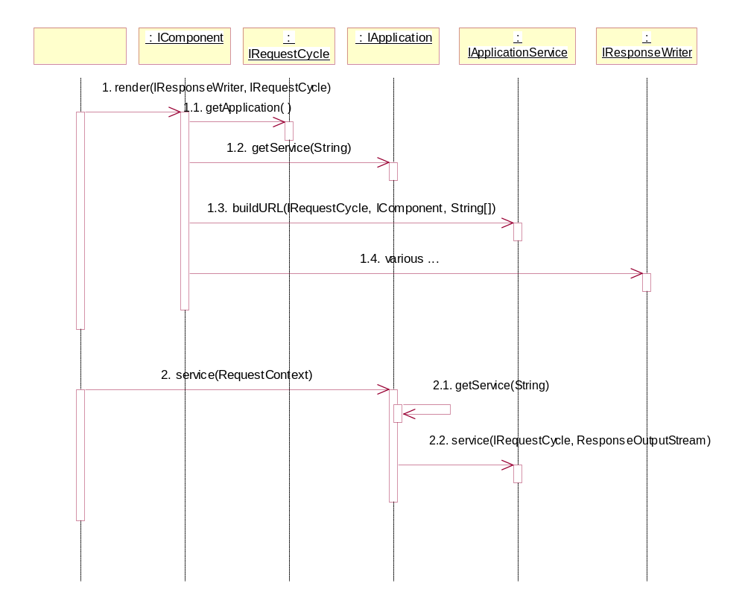
Application Service

Slide 29
Persistent Page State
Pages have server-side state
Data specific to state
Lifespan is same as session
Examples:
  Show / hide details
  Form data, or errors in submitted form
  Navigation through complicated data
  Handles of EJBs, database connections, etc.
Rich state for rich interaction

Slide 30
Persistent Page State
Traditionally (Servlets, JSPs)
  A lot of “plumbing”
  Stored as session attributes, cookies, hidden form fields, encoded URLs, etc.
  Lots of ‘ad-hoc’, buggy solutions
  Life span of data hard to control
Notes:
Life span - as a JSP application runs, its HttpSession gets cluttered with these attributes with no way to determine which ones are safe to delete.
Under Tapestry, a page may be ‘forgotten’ and all of its data is removed as a unit.

Slide 31
Persistent Page State
Stored in instance variables of page
Problem:
  Pages are complicated to build … whole tree of components, bindings, templates …
  Pages are pooled between requests
  Pooled pages shared between client sessions
  Need to separate page state from instances of pages

Slide 32
Persistent Page State
Page Recorders
Notified of changes to persistent properties
public void setActiveSelection(String value)
{
activeSelection = value;
fireObservedChange("activeSelection", value);
}
Can rollback a page to a prior state
Components can use their page’s recorder

Slide 33
Persistent Page State
Page Recorders have a version number
Incremented every request cycle if a property changes
Incorporated into URLs
Used to identify “stale links”

Slide 34
Dynamic Page State
State that changes during renderring a page
Examples:
  Iterating a list of line items in a shopping cart
  Building an option list of answers in a survey
Same components used multiple times in same render
Parameters different each time

Slide 35
Dynamic Page State
home: HomePage
value: currentSelection
source: selectionOptions
e: Foreach
insertCurrentSelection: Insert
value: currentSelection
changeSelection: Action
listener: listener
Problem: actions
  Knowing component id not enough
  What is dynamic state (ex: currentSelection)?

Slide 36
Dynamic Page State
Solution: encode in URL info needed to restore dynamic state
How?
  Allocate action ids during render
  Simple ascending sequence
  Automatically accounts for Foreach, Conditional, etc.

Slide 37
Dynamic Page State
Restoring page state:
  Roll back page state
  Re-render page, discarding output
  Action ids allocated again
  When current action id matches encoded action id, state has been restored
  Action component invokes actionTriggered() on its listener
  Called “rewind stage”

Slide 38
In Detail
Understanding the Request Cycle
Application Services
  page
  direct
  action
HTML Templates
Component Specification
Application Specification

Slide 39
Understanding the Request Cycle
Servlet Container invokes Application Servlet
Servlet locates/creates Application object, invokes service()
Application digs service out of URL
Application finds correct Application Service, invokes service()

Slide 40
Understanding the Request Cycle
Service runs rest of request cycle
Generally:
  Load page, restore its state
  Find component identified in URL
  Invoke component’s listener’s actionTriggered()
  Render a result page

Slide 41
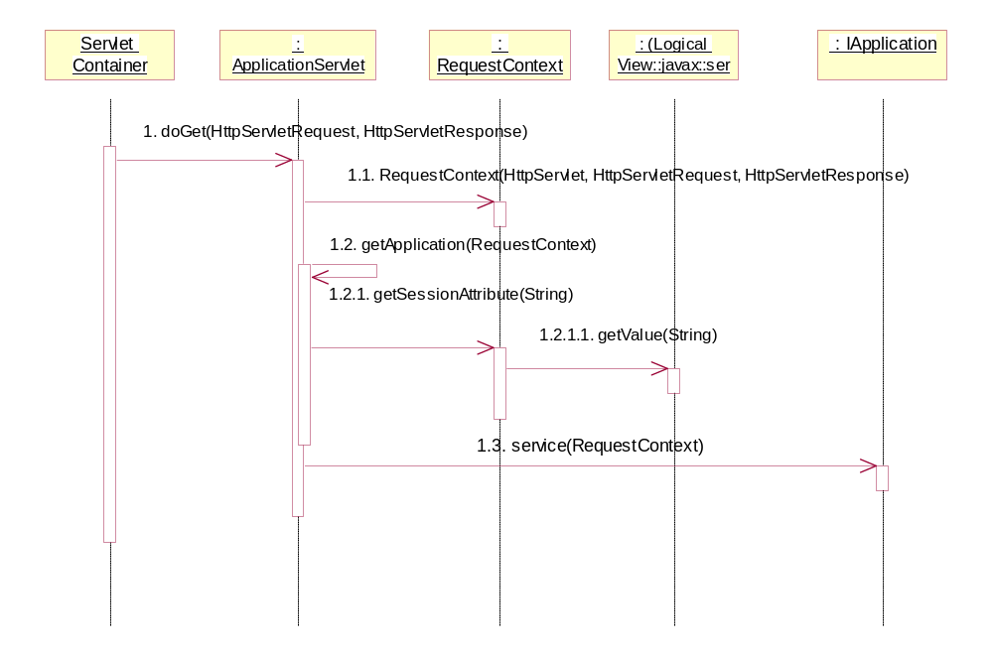
Understanding the Request Cycle

Slide 42
Application Service: page
Simple, used for basic navigation
URL:
servlet path / page / page name
Restores page’s persistent state
Doesn’t need to find component, just renders response page

Slide 43
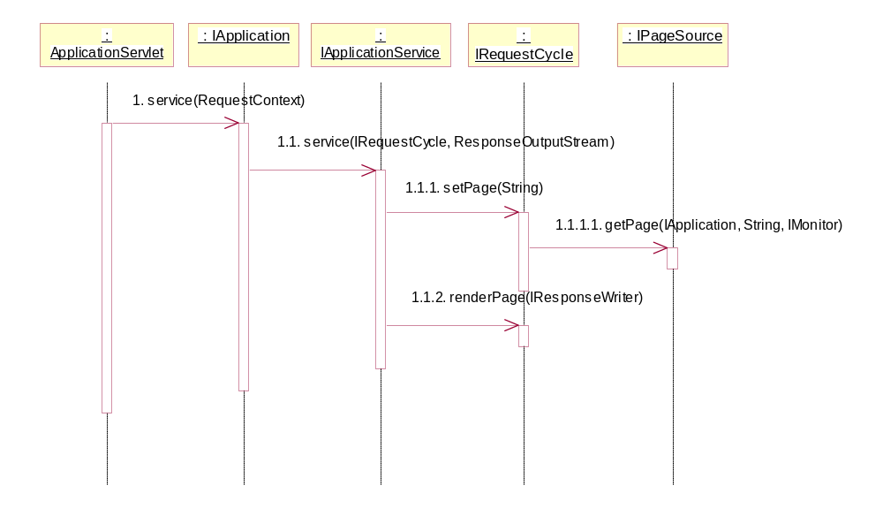
Application Service: page

Slide 44
Application Service: direct
For links & buttons on page that don’t rely on dynamic state of page
URL:
servlet path / direct / page name / page version / component id path / additional parameters
Invokes trigger() on the component
Component invokes actionTriggered() on its listener
Can carry additional parameters in URL

Slide 45
Application Service: direct
: IApplication
immediate :
:
: IPage
: IAction
:
:
IApplicationService
IRequestCycle
IActionListener
IPageRecorder
1. service(IRequestCycle, ResponseOutputStream)
1.1. getPage(String)
1.1.1. rollback(IPage)
1.2. getNestedComponent(String)
1.3. trigger(IRequestCycle, String[])
1.3.1. actionTriggered(IComponent, String[], IRequestCycle)
1.4. commit page changes
1.4.1. commit( )
1.4.2. setActive(boolean)
1.5. renderPage(IResponseWriter)
Ignore any changes while
the page is renderring.

Slide 46
Application Service: action
Used with forms and with actions sensitive to dynamic page state
URL:
servlet path / action / page name / page version / action id
Rolls the page back, then rewinds it
The action component invokes actionTriggered() on its listener

Slide 47
Application Service: action
action :
: IPage
: IComponent
:
:
IApplicationService
IRequestCycle
IActionListener
1. service(IRequestCycle, ResponseOutputStream)
1.1. setPage(String)
1.2. rewindPage(String)
1.2.1. renderPage(IResponseWriter, IRequestCycle)
1.2.1.1. render(IResponseWriter, IRequestCycle)
1.2.1.1.1. getNextActionId())
1.2.1.1.2. isRewound( )
1.2.1.1.3. actionTriggered(IAction, IRequestCycle)
RenderRewound-
Exception thrown after
invoking method.
1.3. commit page recorders
1.4. renderPage(IResponseWriter)
Notes:
This is out of date -- it reflects the old, slow, complicated method (using component traces), not the new, fast, streamlined action id method.

Slide 48
HTML Templates
Goals:
  Easy localization
  Minimal HTML markup
  Efficiency
Each component has a single template
Template may be chosen based on Locale
Templates are resources packaged in the JAR with classes and specifications
Notes:
Components are always part of a page, and a page has a specific Locale that never changes (once the Page is created).
When a Component looks for its template, it looks for variants based on its page’s Locale. Most of localization is simply translating HomePage.html into French and calling it HomePage_fr.html.
Ease of deployment: A Tapestry application is typically distributed as a single JAR file containing classes, specifications, HTML templates and even some private assets such as images and sounds. Other systems require an application to be expanded into directories of files making upgrades of the application that much more difficult.

Slide 49
HTML Templates
Templates are excerpts of standard HTML documents
Add a single element:
<jwc>
Java Web Component
Just a placeholder for the location of of the component

Slide 50
HTML Templates
Usage:
  <jwc id=“component id”> … </jwc>
  <jwc id=“component id”/>
Components may wrap static HTML and other components
Affects the order in which components are renderred (the component trace)

Slide 51
HTML Templates
HomePage.html
<p>Change it to:
<ul>
<jwc id="e">
<li><jwc id="changeSelection">
<jwc id="insertCurrentSelection"/>
</jwc>
</jwc>
</ul>
Notes:
Color coded extract from the demo HomePage
Blue is the enum component, which works through a list and renders its body multiple times.
Green is the action component, which generates an <a> tag
Purple is the insert component, which inserts some text into the HTML
Grey is static HTML that passes though to the rendered page unchanged

Slide 52
HTML Templates
Each component id in the template matches against a contained component in the specification
Pages have templates, but are not contained inside other components
Pages do contain other components
Notes:
So, if a component’s template contains <jwc id=“foo”>, then the component specification must contain a:
<component>
<id>foo</id> ….
</component>

Slide 53
Component Specification
Specifications are XML files
Stored with class in JAR file
Describe type of component
Describe parameters of component
Describe components contained within component

Slide 54
Component Specification
Structure:
<specification>
<class>class name</class>
parameters
components
assets
</specification>

Slide 55
Component Specification
Class is the Java Class to instantiate
Classes which use a template don’t specify the path to the template … it is assumed to be a neighbor of the specification (with the .jwc extension changed to .html).

Slide 56
Component Specification
Parameters
<allow-body>boolean</allow-body>
<allow-informal-parameters>boolean
</allow-informal-parameters>
<parameter>
<name>name</name>
<type>type</type>
<required>boolean</required>
</parameter>

Slide 57
Component Specification
<allow-body>
  Some components may not wrap other elements
  ex: textfield, insert
  Defaults to true if not specified

Slide 58
Component Specification
<allow-informal-parameters>
  Allows additional bindings beyond the defined parameters
  Each becomes one attribute of the tag created by the component
  Only makes sense when the component maps directly to a single HTML element
  Used for JavaScript, CSS
  Defaults to true if not specified

Slide 59
Component Specification
<parameter>
  One for each parameter
  Name should be a valid JavaBeans property name (alphanumeric)
  Type is a class, or omit for Object (I.e., match any)
  Required defaults to false; if true then binding must be specified

Slide 60
Component Specification
Embedded components:
<component>
<id>id</id>
<type>type</type>
bindings
</component>
Id must match <jwc> tag in template
Type is either a specification path, or a well known alias
Built in components all have aliases

Slide 61
Component Specification
Components have bindings that match their parameters
Three types:
  dynamic
  static
  inherited

Slide 62
Component Specification
Dynamic binding:
<binding>
<name>name</name>
<property-path>property path
</property-path>
</binding>
Property path is relative to containing component
May be read, write or read/write depending on component

Slide 63
Component Specification
Static binding:
<static-binding>
<name>name</name>
<value>value</value>
</static-binding>
Value will be the String value for the parameter
Read-only
Often coerced to int or boolean

Slide 64
Component Specification
Inherited binding:
<inherited-binding>
<name>name</name>
<parameter-name>parameter name
</parameter-name>
</inherited-binding>
Used often with aggregation
Contained component shares a parameter with its container

Slide 65
Component Specification
home: HomePage
title: ‘Home’
(static)
border: Border
value:
inherited
from title
insertPageTitle: Insert

Slide 66
Component Specification
Assets
  Allow images, sounds, etc. to be packaged with a component
  Supports re-use
  Described elsewhere

Slide 67
Application Specification
Another XML file
Specifies
  Name of application
  Map from page name to page component
  Short aliases for common components
    ex: ‘NavBar’ instead of ‘/tests/tapestry/NavBar.jwc’

Slide 68
Classes
IRender
render()
IComponent
getPage()
getId()
renderWrapped()
IPage
getApplication()
getLocale()
renderPage()

Slide 69
Classes
IApplication
IRequestCycle
getPageRecorder()
getPageSource()
getService()
getTemplateSource()
service()
getApplication()
getComponentTrace()
getPage()
getRequestContext()
isRewinding()
isRewound()
renderPage()
rewindPage()
setPage()
IApplicationService
buildURL()
service()

