Slide 1
Medicine and Health Care

Slide 2
A Look Ahead
What does sociology contribute to something as seemingly biological as health?
What is social epidemiology

Slide 3
Culture, Society, and Health: Definitions
Health: “state of complete physical, mental, and social well-being, and not merely the absence of disease and infirmity” (World Health Organization)
Health and diseases are rooted in the shared meanings of particular cultures
  Culture-bound syndrome: a disease or illness that cannot be understood apart from some specific social context

Slide 4
Culture, Society, and Health: Definitions
Epidemic
  A widespread outbreak of a contagious disease
Pandemic
  An outbreak of a contagious disease over a very large area or worldwide
Disease
  A pathology that disrupts the usual functions of the body
Health
  The capacity to satisfy role requirements

Slide 5
Illness and Social Order
Illness is a threat to social order; if too many people are sick at one time, it affects our ability to perform tasks necessary for continued operation of society
Sick role: societal expectations about attitudes and behavior of a person labeled as ill

Slide 6
Components of The U.S. Health Care Delivery System
Do we have a health care or an illness treatment System?
  Hospitals
  Physicians
  The Doctor-Patient Relationship
  Nurses
  Medical Schools
  Public Health systems at various levels
  Nursing Homes
  Pharmaceutical / Drug Companies
  Medical Device makers
  Insurance Companies

Slide 7
Health Care in the United States
Physicians, Nurses, and Patients
  Physicians (mostly male) have controlled interactions with patients and nurses (mostly female)
  Increasing numbers of physicians are women; may alter doctor–patient relationship
Alternatives to Traditional Health Care
  Growing interest in holistic medicine
  According to WHO, 80 percent of people who live in poorest countries use alternative medicine

Slide 8
Health Care in the United States
A Historical View
  By 1840s, health care largely unregulated
  American Medical Association institutionalized its authority through standardized programs of education and licensing
    Gave birth to medicalization of society
The Role of Government
  Medicare and Medicaid enacted in 1965

Slide 9
Medical Providers
Primary Roles
Physicians
  Have the authority to diagnose, prescribe treatment
  Certify death or competency
  Prestige results in many privileges
  Most are specialists today
Nurses
  Assist in medical settings under the supervision of a physician
  Have less education than physician
  Most are women

Slide 10
American Health Care Organizations
Hospitals
  Divided authorities
    Physicians
    Administrators
  Multihospital systems
    Hospitals managed by a company
HMO
  An insurance plan combined with a facility
  A “health maintenance organization”
    For a monthly fee, comprehensive health care is provided

Slide 11
Components of Health Care Delivery Systems
The American System
Rising Health Care Costs: Is Managed Care the Answer?
  What Accounts for the Rise in Costs?
  Competitive Health Services
  Managed Care
Health care is managed differently in different countries.
China, Great Britain, Kenya, Cuba and Canada have some type of national health care plans.
Go see the movie Sicko by Michael Moore for a somewhat biased view of the difference between American and other health plans

Slide 12
Power, Resources, and Health
Some compare status of medicine today to that of state religions in the past
The Medicalization of Society
  Growing role of medicine as a major institution of social control
  Medicine has greatly expanded its domain of expertise in recent decades
  Problems viewed using a medical model; makes it more difficult for common people to join discussion

Slide 13
Power, Resources, and Health
Inequities in Health Care
  Medical services concentrate where wealth is
  Brain drain: immigration to the U.S. and other industrialized nations of skilled workers, professionals, and technicians who are desperately needed in their home countries
  There are dramatic differences in infant mortality rates between developing countries and industrial nations

Slide 14
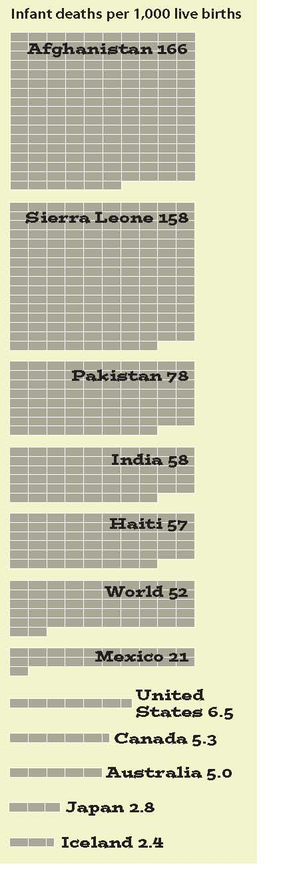
Infant Mortality Rates in
Selected Countries
Source: Haub 2007.

Slide 15
Power, Resources, and Health
Labeling and Power
  Power to label and power to oppress sometimes go hand in hand
  Policy makers slow to respond to AIDS crisis because those in high-risk groups were relatively powerless
  Disagreements continue in the medical community over whether a variety of life experiences are illnesses (e.g., PMS, PTSD, homosexuality)

Slide 16
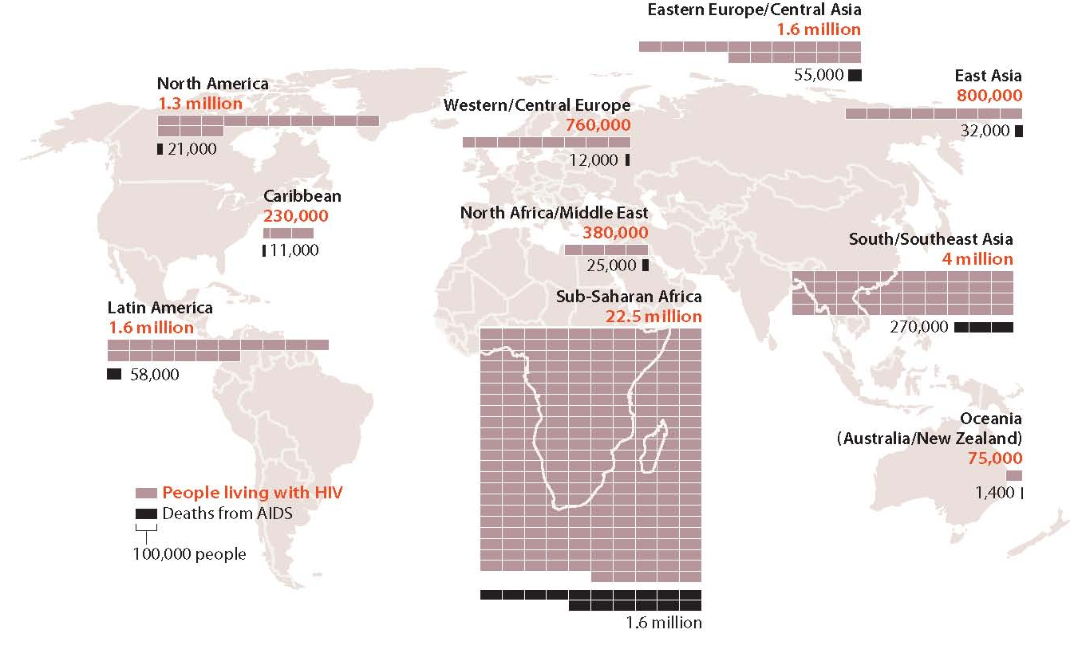
HIV/AIDS Cases, 2007
Note: Midpoint estimates for December 2007. Total number of adults and
children living with HIV, 33.2 million; total number of estimated adult and
child deaths during 2007, 2.1 million.
Source: Centers for Disease Control and Prevention 2007a; UNAIDS 2007.

Slide 17
Negotiating Cures
Physicians use cues to reinforce their prestige and power (e.g., white coat, stethoscope)
Patients are not passive; may play an active role in positive or negative health
Internet is transforming patient–physician encounters

Slide 18
Medicine
Social and Ethical issues surrounding death
  When does death occur?
  Do people have a right to die?
  What about mercy killing?
    Mercy killing is the common term for euthanasia, assisting in the death of a person suffering from an incurable disease.
The Medical Establishment.
  Medicine is a social institution concerned with combating disease and improving health.
  Holistic medicine is an approach to health care that emphasizes prevention of illness and takes account of the person’s entire physical and social environment. These are its foundations:
    Patients are people.
    Responsibility, not dependency.
    Personal treatment.

Slide 19
Medicine Paying for medical care
The United States. Ours is a direct-fee system or a medical care system in which patients pay directly for the services of physicians and hospitals.
  Medical bills are paid three ways:
    Private insurance programs (Indidual and employer/group plans)
    Public insurance programs, such as Medicare and Medicaid.
    Health Maintenance Organizations, organizations that provide comprehensive medical care to subscribers for a fixed fee.

Slide 20
Medicine Supply of Providers
Another issue in medical care is the shortage of some medical professionals in some parts of the United States
  Especially in disadvantaged parts of large cities and in Rural areas
    Nurses are in short supply in some place
    Some places do not have enough doctors
    some places have too many hospital beds and some not enough

Slide 21
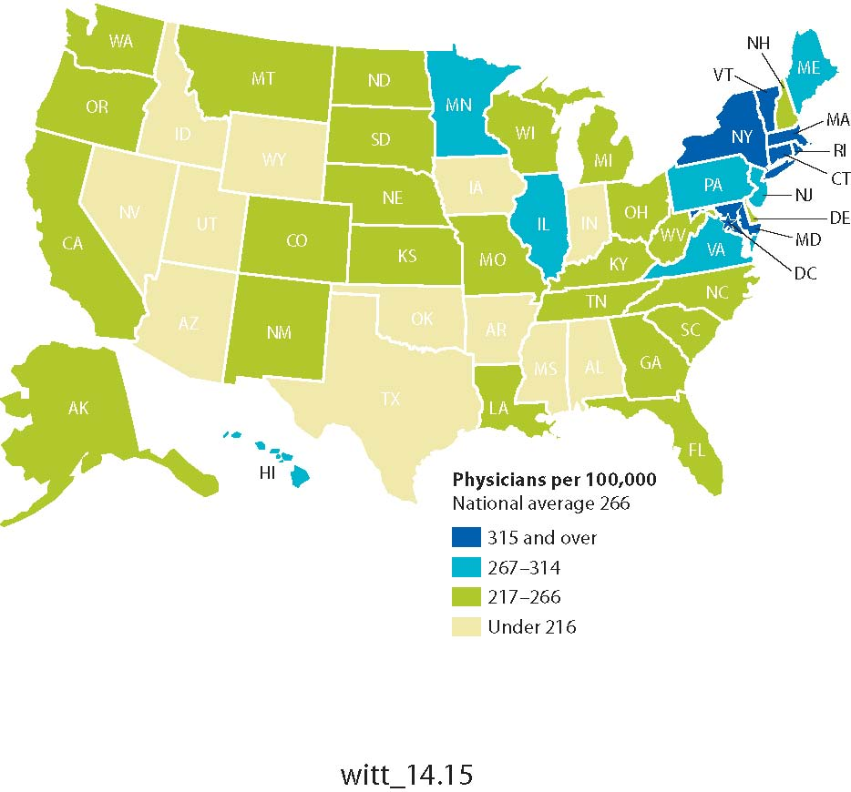
Availability of Physicians by
State, 2005
Source: Bureau of the Census 2007a: Table 154.

Slide 22
Medicine In other Cultures
Capitalist Societies:
  The Swedish system is often described as socialized medicine, a medical care system in which the government owns and operates most medical facilities and employs most physicians.
  Great Britain. The British created a “dual system” of medical service.
    The National Health Service pays 100% of medical costs
    The Private system is very expensive

Slide 23
Medicine In other Cultures
  Japan. Physicians in Japan have private practices, but a combination of government programs and private insurance pays medical costs.
  Canada. Canada has a “single payer” model of health care. But Canada also has a two-tiered system like Great Britain’s, with some physicians working outside the government-funded system and setting their own fees.

Slide 24
Medicine
Socialist Societies
  The People’s Republic of China. The government controls most health care. Traditional healing arts are still widely practiced in China. In addition, a holistic concern for the well-being of both mind and body characterizes the Chinese approach to health.
  The Russian Federation. Medical care is in transition. Nonetheless, the idea that everyone has a right to basic medical care remains widespread.

Slide 25
Theoretical Analysis of Medicine
Structural-functional analysis views illness as a social dysfunction.
  Talcott Parsons suggests that people often respond to illness by assuming the sick role, patterns of behavior defined as appropriate for people who are ill.
  The sick role has three characteristics:
    Illness exempts people from routine responsibilities.
    A sick person must want to be well.
    A sick person must seek competent help.
  The physician’s role. Parsons saw the doctor-patient relationship as hierarchical. Yet this pattern varies from society to society.
Critique: Parsons’s work links illness and medicine to the broader organization of society, but it also supports the idea that doctors, rather than patients, bear primary responsibility for health.

Slide 26
Theoretical analysis of Health Care
Symbolic-interaction analysis.
  The social construction of illness. How people define a medical situation may actually affect how they feel.
  The social construction of treatment. Understanding how people construct reality in the examination room is as important as mastering the medical skills required for treatment.
  Critique: This paradigm reveals the relativity of sickness and health, but seems to deny that there are any objective standards of well-being.
Social-conflict analysis.
  Access to care. The access problem is more serious in the United States than in other industrialized societies because our country has no universal medical care system.
  The profit motive. Some conflict analysts argue that the real problem is the character of capitalist medicine itself.
  Medicine as politics. Scientific medicine frequently takes sides on significant social issues.
  Critique : This perspective minimizes the improvements in health brought about by the present system.

Slide 27
Social Epidemiology
Social epidemiology: study of disease distribution, impairment, and general health status across a population
  Contemporary epidemiology concerned with epidemics, and also nonepidemic diseases, injuries, drug addiction and alcoholism, suicide, and mental illness
Incidence: number of new cases of a specific disorder that occur within a given population during a stated period, usually a year

Slide 28
Social Epidemiology
Prevalence: total number of cases of a specific disorder that exist at a given time
Morbidity rate: incidence of disease in a given population
Mortality rate: incidence of death in a given population

Slide 29
Social Class
Studies show people in lower classes have higher rates of mortality and disability
  Crowded living conditions
  Substandard housing
  Financial strain
  Poor diet
  Stress
  Inability to afford quality health care

Slide 30
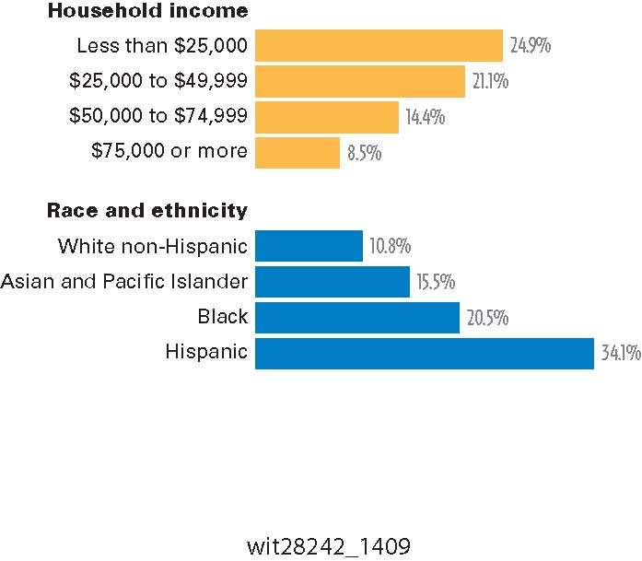
Percentage of People
Without Health Insurance, 2006
Source: DeNavas-Walt et al. 2007: 21.

Slide 31
Race and Ethnicity
Health profiles of racial and ethnic groups reflect social inequality in U.S.
  Poor economic and environmental conditions manifested in high morbidity and mortality rates
  African Americans, compared with Whites, have higher death rates from heart disease, pneumonia, diabetes, and cancer

Slide 32
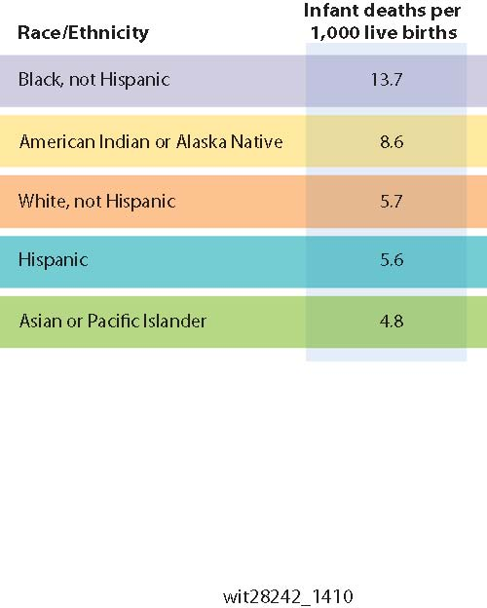
Infant Mortality Rates in the United States, 2002–2004
Source: National Center for Health Statistics 2007: 166–167.

Slide 33
Race and Ethnicity
Mexican Americans and other Latinos interpret illness according to curanderismo: Latino folk medicine, a form of holistic health care and healing
Latinos are likely to wait to receive treatment

Slide 34
Gender
When compared with men, women experience higher prevalence of many illnesses but they tend to live longer
  Lower rate of cigarette smoking
  Lower alcohol consumption
  Lower rate of employment in dangerous occupations
  Women more likely to seek treatment
    Vulnerable to medicalization of society

Slide 35
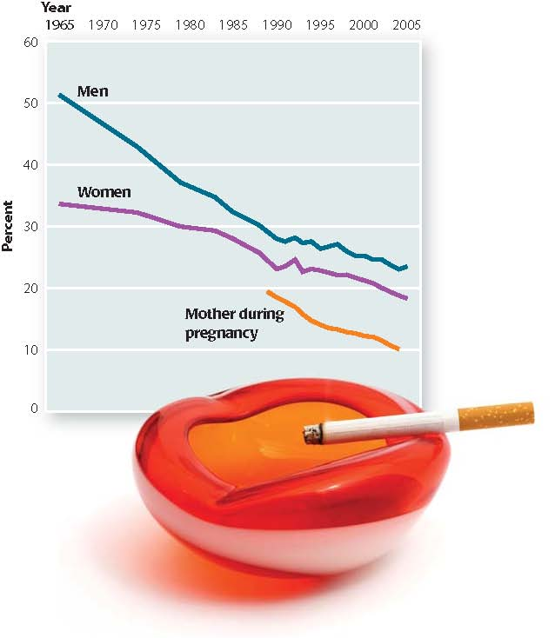
Smoking Rates by Gender,
1965–2005
Source: National Center for Health Statistics 2007.

Slide 36
Age
Health is overriding concern of the elderly
Most older people in U.S. have at least one chronic illness
  Older people vulnerable to certain types of mental health problems
  Older people use more health services than younger people

Slide 37
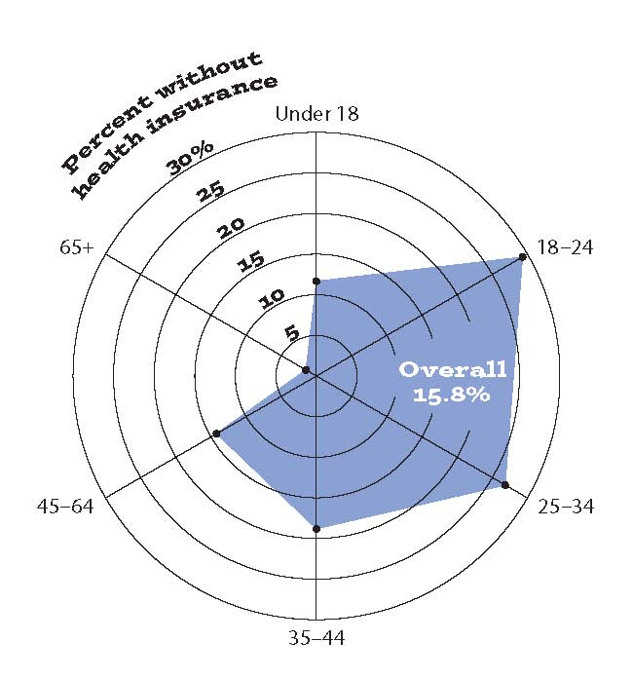
Health Insurance Rates by Age, 2006
Source: DeNavas-Walt et al. 2007: 21.

