Slide 1
Traffic Portal
The Guts

Slide 2
SPA
The Traffic Portal is a single page application (SPA) built using AngularJS
https://en.wikipedia.org/wiki/Single-page_application
A single-page application (SPA) is a web application or web site that interacts with the user by dynamically rewriting the current page rather than loading entire new pages from a server.
In an SPA, all necessary code – HTML, JavaScript, and CSS – is retrieved with a single page load.
Interaction with the single page application often involves dynamic communication with the web server behind the scenes.
Notes:
Show index.html
Location hash – HTML5 history api

Slide 3
Setup A DEV ENVIRONMENT
http://traffic-control-cdn.readthedocs.io/en/latest/development/traffic_portal.html
npm install
  fetches the application dependencies found in package.json and puts them in traffic_portal/node_modules
bower install
  fetches the client dependencies found in bower.json and puts them in traffic_portal/app/bower_components
grunt dev
  packages the application into traffic_portal/app/dist per Gruntfile.js
  starts a lightweight node.js web framework with a web server
    traffic_portal/conf/config.js
  starts a file watcher

Slide 4
Gruntfile.js – THE KEY TO STARTUP
grunt dev (or just grunt)
  build-dev
    clean <- cleans out dist directory
    copy:dev ← copies assets (css, fonts, images, js, html files, json files)
    string-replace ← adds query param for cache busting
    build-css-dev ← converts sass files to css
    build-js-dev ← converts html templates to javascript
    build-shared-libs-dev ← packages all client side dependencies into one file
  express:dev ← starts a lightweight node.js web framework with a web server
  watch ← recompiles source on source change

Slide 5
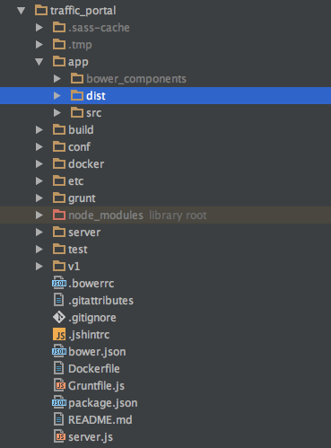
The dist directory
index.html
CSS
Fonts
Images
JS
traffic_portal_properties.json
traffic_portal_release.json

Slide 6
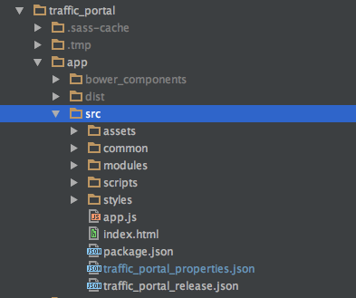
Source code structure
assets
common
  Common components designed for reuse through the system
modules
  Private ← auth required
  Public ← no auth required
scripts
styles
app.js
  all AngularJS modules are registered here

Slide 7
Core design aspects
Nested states
Nested views
View Controllers
Resolves

Slide 8
Nested states
  trafficPortal
    Defined in app.js
    Abstract: true
    Maps to /
  trafficPortal.public
    Abstract: true
    Maps to / + ‘ ’
  trafficPortal.public.login
    Abstract: false
    Maps to / + ’ ‘ + ‘ ‘
States map to URLs
URLs map to States

Slide 9
Nested states
  trafficPortal
    Defined in app.js
    Abstract: true
    Maps to /
  trafficPortal.public
    Abstract: true
    Maps to / + ‘ ’
  trafficPortal.public.login
    Abstract: false
    Maps to / + ’ ‘ + ‘ ‘
So if I navigate to
trafficportal.domain.com/#!/
Which state is being called?

Slide 10
Nested Views
The view for the state is built using one of 2 things:
  templateURL property
  views property

Slide 11
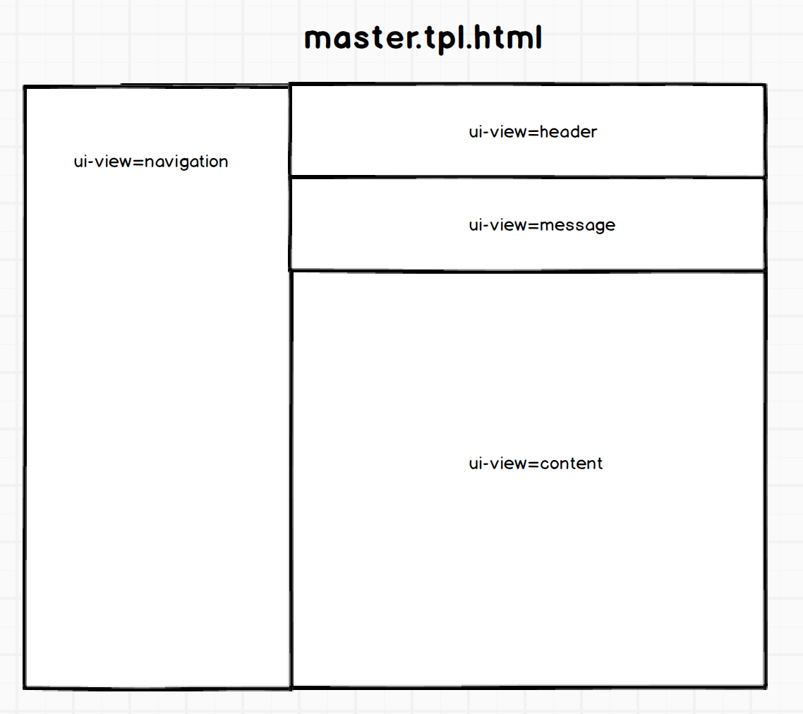
Nested Views
trafficPortal
  Abstract: true
  URL: ‘/’
  templateURL: master.tpl.html

Slide 12
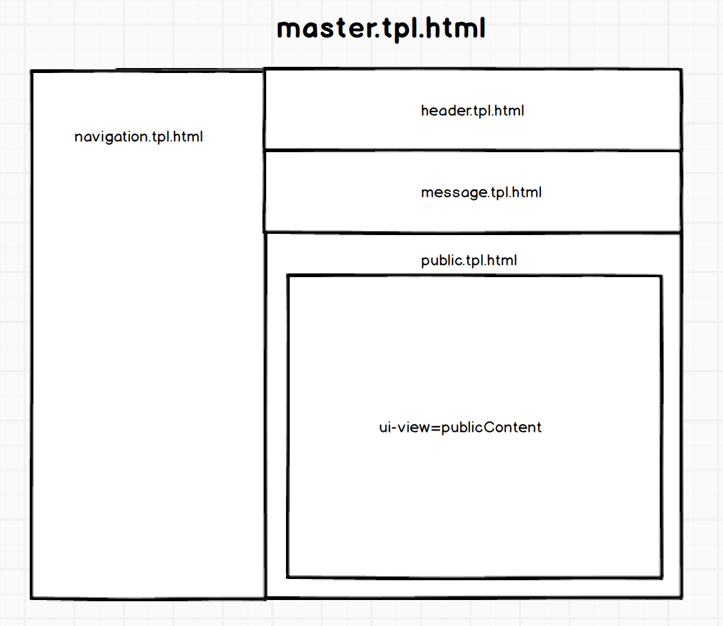
Nested Views
  trafficPortal.public
    Abstract: true
    URL: ‘/’ + ‘ ‘
    views
      navigation
      Header
      message
      content

Slide 13
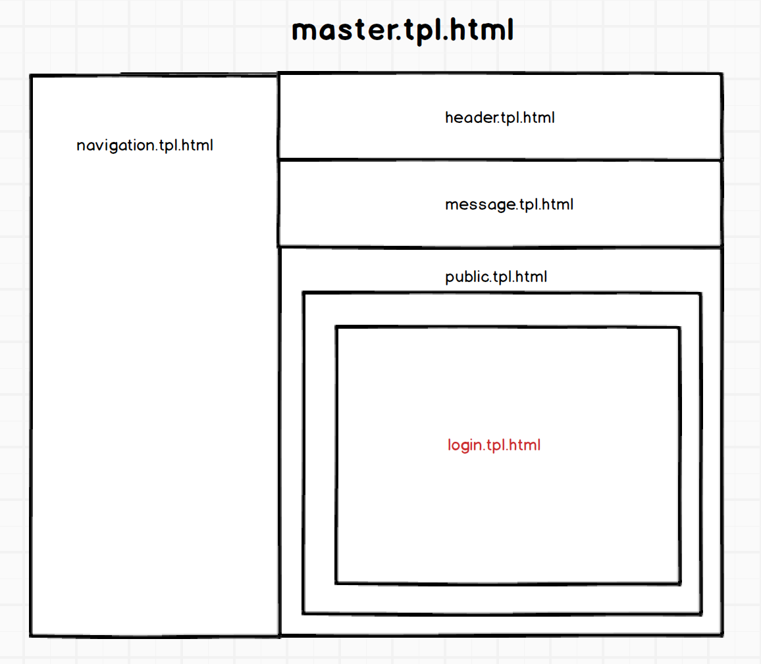
Nested Views
trafficPortal.public.login
  Abstract: false
  URL: ‘/’ + ‘ ‘ + ‘ ‘
  views
    publicContent

Slide 14
View controllers
Initialized when the state is called
Bound to the view through a variable called $scope
Can be injected with dependencies either through
  Dependency Injection
  Using resolves

Slide 15
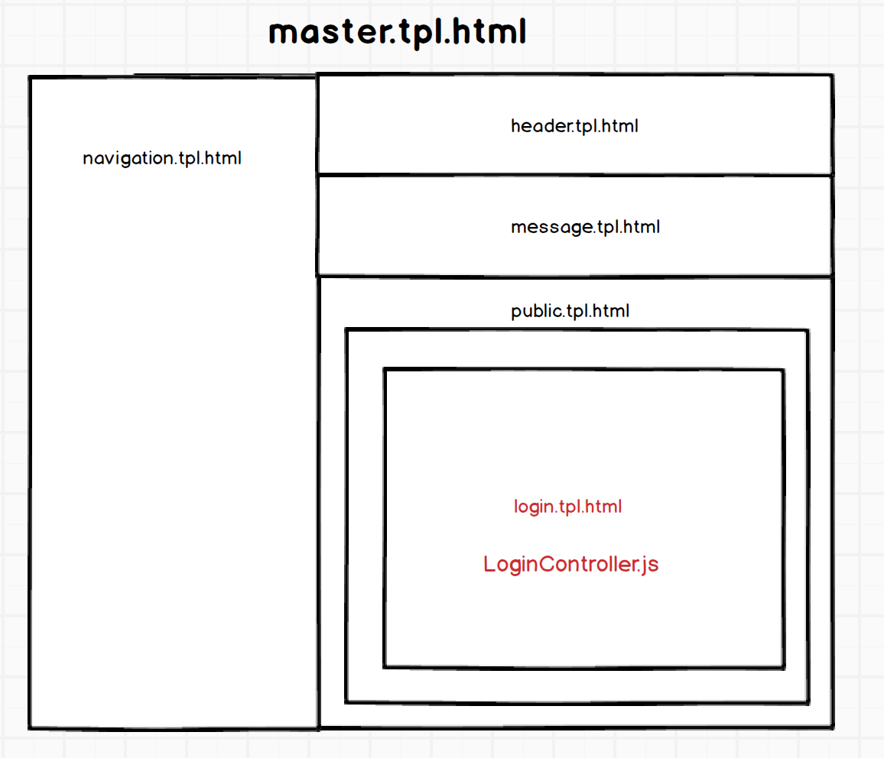
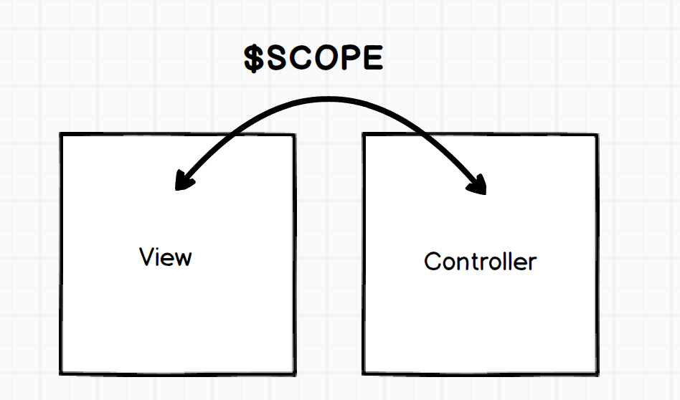
$scope
A variable namespace shared between a view and a controller
Enables data binding

Slide 16
Data binding
Data binding in is the synchronization between the model and the view

Slide 17
Dependency injection
Inject the following types of components into your controller
  Services
  Utils
  Models

Slide 18
resolves
Dependencies that must be resolved before the state is rendered
Defined in the state definition
trafficPortal
  Fetch traffic_portal_properties.json and load into PropertiesModel
trafficPortal.public
  No resolves
trafficPortal.public.login
  No resolves

Slide 19
resolves
Dependencies that must be resolved before the state is rendered
Defined in the state definition
trafficPortal
  Fetch traffic_portal_properties.json and load into PropertiesModel
trafficPortal.private
  Fetch currentUser if not loaded in userModel
  If you are not logged in, this will return a 401 which will send you back to the login page.

Slide 20
resolves
Dependencies that must be resolved before the state is rendered
Defined in the state definition
trafficPortal
  Fetch traffic_portal_properties.json and load into PropertiesModel
trafficPortal.private
  Fetch currentUser if not loaded in userModel
trafficPortal.private.cacheChecks
  Fetch cacheChecks and inject the result into the controller

Slide 21
Build a new state
Create a new state
Add a view template to the state
Register the state in app.js
Test the state
Add a controller with hard coded data
Test the state
Add a resolve that injects data from a service
Test the state
Call a real service
Test the state

Slide 22
installation
http://traffic-control-cdn.readthedocs.io/en/latest/admin/traffic_portal/installation.html

