Slide 1
Apache Traffic Server @ Comcast Evan Zelkowitz

Slide 2
Upgrading to ATS 7.x

Slide 3
Pitfalls
Logging changes (convert to lua format)
Traffic_line to traffic_ctl (use new command)
Cacheurl to cachekey (use new plugin)
Changed Parameters
Notes:
For logging changes had to add logic to traffic ops. If it sees a logging.config file then it will treat it as a lua format vs the old xml formatted logs_xml file. It still takes all the same parameters as the xml it just formats them into the new format
For traffic line, it has been deprecated officially in 7. traffic ctl has existed since 6 so it was safe at this point to just change all of ort to use ctl instead
Cacheurl being deprecated was a much bigger issue
Finally there were about 20 configuration parameters either removed or changed. I have linked to the ATS version 7 migration document at the end of this that details those

Slide 4
Logging Config Changes
Uses existing logs_xml.config conventions
TO now understands “logging.config”. This triggers TO to output a LUA formatted config file using the same parameters
Can use the same parameter values, assign to logging.config file

Slide 5
traffic_line to traffic_ctl
Traffic_line officially removed in 7.x
Ort will now use traffic_ctl. This exists in 6/5.x as well
This makes ort not backwards compatible past 5.x

Slide 6
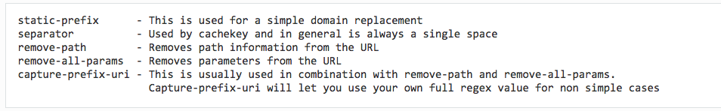
Cacheurl to Cachekey
Cacheurl is deprecated in 6.x, removed in 7.x
Cachekey in 6.x is usable though some patches are needed to support everything used in cacheurl (included in migration doc)
Change from single regex to parameter usages
Can create compatible Cachekeys that match Cacheurl regex keys (Thanks to Gancho Tenev)

Slide 7
Cachekey examples
http://example.net/(.*) http://example-cdn.net/$1
Simple host replacement
http://([^?]+)(?:?|$) http://example-cdn.net/$1
Special case that includes the original host in the key, i.e. http://example-cdn.net/example.net/...(path)..
Also note the s?, both http/https will use the same key
http://example.net/([^?]+)(?:\?|$) http://example-cdn.net/$1
Strips off params but leaves the path
@plugin=cachekey.so @pparam=--separator= @pparam=--static-prefix=http://example-cdn.net/
@plugin=cachekey.so @pparam=--separator= @pparam=--remove-all-params=true @pparam=--remove-path=true @pparam=--capture-prefix-uri=/https?:\/\/([^?]*)/http:\/\/example-cdn.net\/$1/
@plugin=cachekey.so @pparam=--remove-all-params=true @pparam=--separator= @pparam=--static-prefix=http://example-cdn.net/

Slide 8
Highly recommended to test with the ATS xdebug plugin to ensure you are matching your new cachekeys to your old cacheurl values “-H 'X-Debug: X-Cache-Key’”

Slide 9
ATS Enhancements

Slide 10
Traffic_ctl parent usage (John Rushford and Vijay Mamidi Next Hop)
Parent caches are defined in parent.config by delivery service
Parent state (up/down) is per line or delivery service in parent.config
The http state machine marks down a parent due to connection errors or timeouts. Parent selection will return a parent for retry once the retry window has elapsed and the parent is marked up if a retry is successful.
There is no way to manually control the state of parents. Today parents are removed from parent.config when maintenance must occur.
Notes:
We brought in support that John Rushford added to the ATS master branch where now you can mark parents up or down via traffic_ctl

Slide 11
# traffic_ctl host status odol-atsmid-den-07.denver.comcast.net
host_status.odol-atsmid-den-07.denver.comcast.net 0
# traffic_ctl host up odol-atsmid-den-07.denver.comcast.net
# traffic_ctl host status odol-atsmid-den-07.denver.comcast.net
host_status.odol-atsmid-den-07.denver.comcast.net 1
# traffic_ctl host down odol-atsmid-den-07.denver.comcast.net
There can be a slight delay between changing states as it propagates through ATS
Using traffic_ctl to mark down a parent is global across all remaps. Parent selection will not choose that parent again until you mark it back up
States appear in the stats_over_http. Lists all parents up/down states
Also available from traffic_ctl, /opt/trafficserver/bin/traffic_ctl metric match host_status
Can do multiple hosts on a single command as well
On master branch of ATS but pick-able back to 7.x

Slide 12
Jemalloc (Thanks to Kit Chan)
Current tools are slow (10x to 20x degradation). Not really possible to use in production
Some need recompilation
Hard to debug on large scale, can take days-weeks for a problem to show up

Slide 13
Simple Script to do a preload with the jemalloc library:
#!/bin/sh
prefix=/usr
exec_prefix=/usr
libdir=/usr/lib64
MALLOC_CONF="prof:true,prof_prefix:/tmp/jeprof.out,lg_prof_interval:33,lg_prof_sample:20"
LD_PRELOAD=${libdir}/libjemalloc.so.2
export LD_PRELOAD
export MALLOC_CONF
/opt/trafficserver/bin/traffic_server $@
This samples every 2^20 – 1mb, Does file dumps ~2^32 – 4GB
Change proxy.config.proxy_binary to match the script name
We setup a cronjob to clean up any dumps older than 2 weeks
Most dumps ~150-200k, we usually see them every few hours during normal usage
Can use dot to generate a pdf

Slide 14
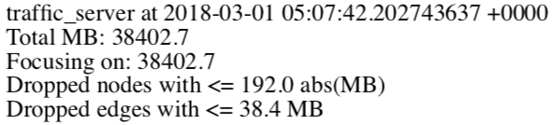
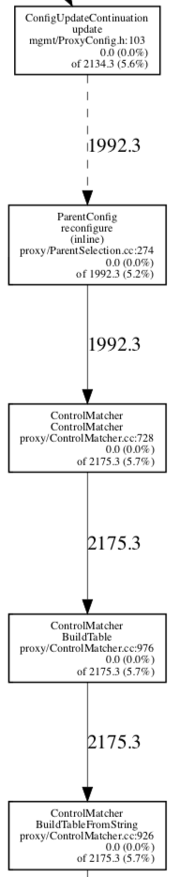
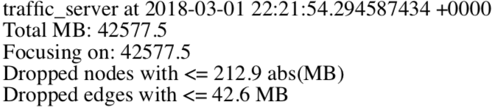
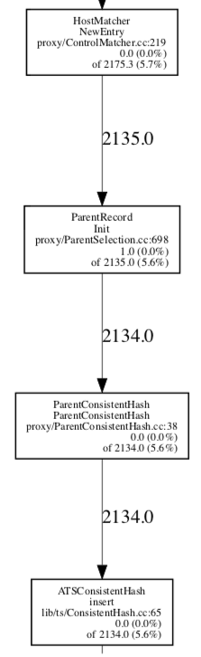
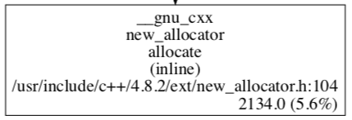
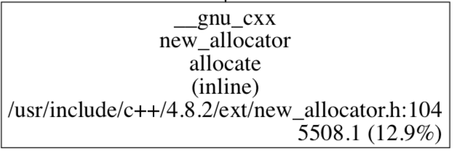
Jemalloc memory tracking
Notes:
Here we have a side by side of the graphical jemalloc output. You can see memory use values by largest hitters. So here we lost 5gb in ~20hrs. You cant really see the full tree but those inline allocations if you follow them up came from a parent config reconfigure call. So this helped us pinpoint fairly quickly that there was something not being free'd whenever we would do a reconfig of the parents or even just touch the parent.config file.
This helped us find the issue fairly quick and has since been sent upstream in to both the 6.x, 7.x, and master branches of ATS.

Slide 15
Very helpful in finding plugin memory issues
Can help in other areas as shown
Freelist can be problematic. Jemalloc does not understand the freelist so you can see it marks all the ‘memalign’ as lost memory when its just being held in the freelist
Similar syntax to gperftools

Slide 16
Jemalloc ATS presentation:
https://cwiki.apache.org/confluence/download/attachments/70255385/ATSSummit_jemalloc.pptx?version=1&modificationDate=1508884895000&api=v2
Traffic Control Migration Doc:
http://traffic-control-cdn.readthedocs.io/en/latest/admin/traffic_ops/migration_from_20_to_22.html
ATS Cachekey Documentation:
https://docs.trafficserver.apache.org/en/latest/admin-guide/plugins/cachekey.en.html
ATS v7 Upgrade Notes:
https://cwiki.apache.org/confluence/display/TS/Upgrading+to+v7.0

Slide 17
Questions?

