Slide 1

Traffic ops Crud Framework
Dylan Volz
TC Summit - Boxborough, MA

Slide 2
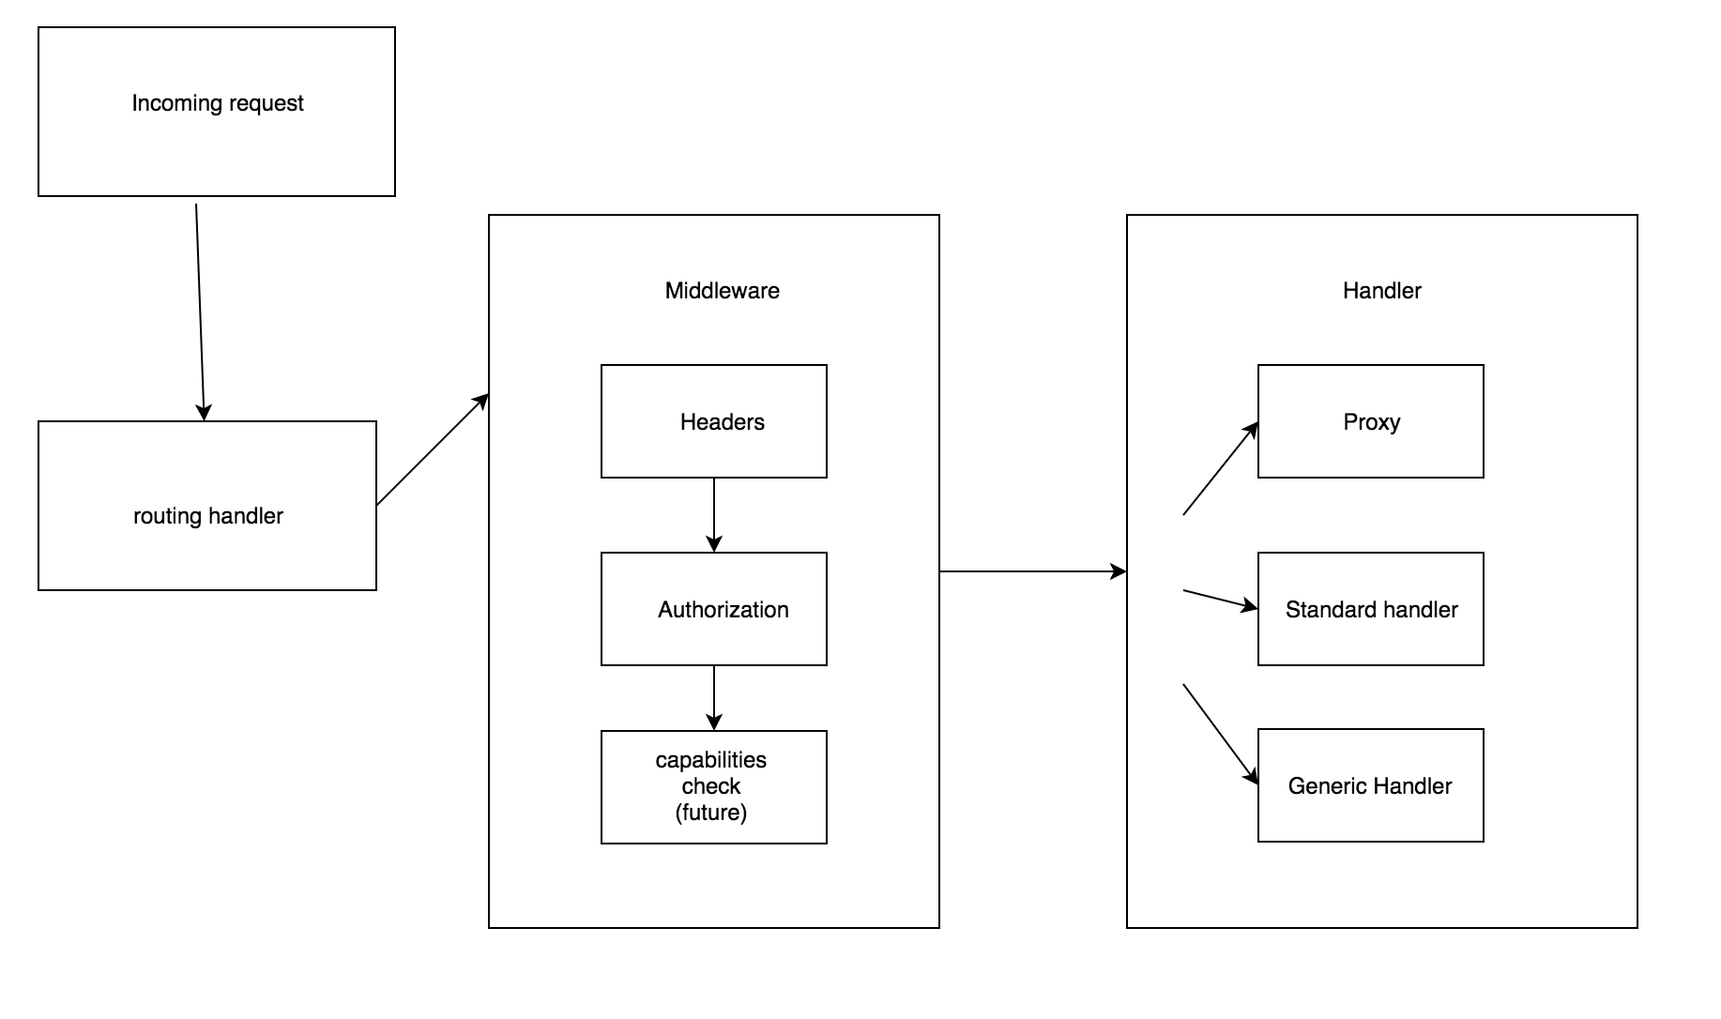

Slide 3
Routing basics
The routes are compiled and registered with the base handler
They are processed in the order they appear in the file
Regexes are used for path matching
Future considerations:
Processing a list for regex matches may have performance implications

Slide 4
Middleware
A set of optional request/response modifiers
Headers (Access-Control-Allow-*, Whole-Content-SHA512)
User Authorization (optionally applied based on the authentication field of the route)
Capabilities (Future)

Slide 5
Handler
Three main types currently:
Proxy passthrough handler -> routes request to Mojolicious server
We currently don’t use the headers or authorization middleware since mojo handles it
Standard handler -> accepts the request body and responds
Needs to unmarshal the JSON body, collect the parameters and user info from the context, check tenancy, handle the request, changelog entry, build a response body and set the content type
ping
Generic CRUD handler -> Normalizes the steps above around a Create, Read, Update, or Delete operation on a struct.

Slide 6
Generic Handlers
Implemented using interfaces
Identifier
Information about how to represent the struct
Tenatable
optional
Validator
Used to validate the request body after decoding
CRUD interfaces
Very similar code in each implementation
Flexibility versus verbosity

Slide 7
Recent and future changes
Id based -> definable key set
Remove sqlx.DB from interface definitions
Decouples implementation – greater flexibility
Replace type reference with singleton
Removes concurrency bug on delete

