Slide 1
Log Aggregation with Kafka Streams
Traffic Control Summit 2017
Steve Malenfant
Anadi Jaggia

Slide 2
Current State
Traffic Stats provides useful metrics
Global status codes (4xx, 5xx) associated to Delivery Services
Can provide Cache Hit Statistics
Bandwidth
Output to InfluxDB
Great for alarming (kapacitor)

Slide 3
More granular metrics
Few things can be enhanced like…
Status Codes (500 vs 502)
Cache Hit Ratio analysis
Few issues here
Sum of Bytes
Keyed Aggregation on
DS, Cache, Cachegroup, CDN

Slide 4
Other tried simple solution
Splunk – Can we say too expensive?
Elastic – How many racks do I need?
It might still be a viable solution
Need to solve the indexing rate scaling issues

Slide 5
Proof of Concept - Kafka Stream
Kafka has this concept of “Stream” since 0.10.0.0
Input and Output data are stored in the cluster
Supposed to be scalable and fault-tolerant
Process and transforms incoming stream
Aggregating
Windowing
Joining
Output to InfluxDB
Leverage Continuous query to down sample even more

Slide 6
Initial proof of concept

Slide 7
Second attempt

Slide 8
Kafka pitfalls
We learned a lot about Kafka during development
Retention policies on topics
default is delete and set to 168 hours
We ran out of disk fast!
Compacting to the rescue
KStream consist of a Key/Value Store and value are not overwritten but appended (to recreate the stream)
Compaction removes duplicates on a schedule basis (free up disk space)
Application can also use cache and compact before committing to Kafka
Has to be manually set (so far)
Partitions
If you don’t have enough, parallelism is reduced.

Slide 9
Performance
At first, the streaming, parsing and aggregation of the log statistics were all done in one giant java app. This was obviously memory and CPU intensive.
To fix this, we split the app up into two parts :
Kafka Consumer and Aggregator
InfluxDB writer
In early testing, it looks like this will speed up our performance greatly.

Slide 10
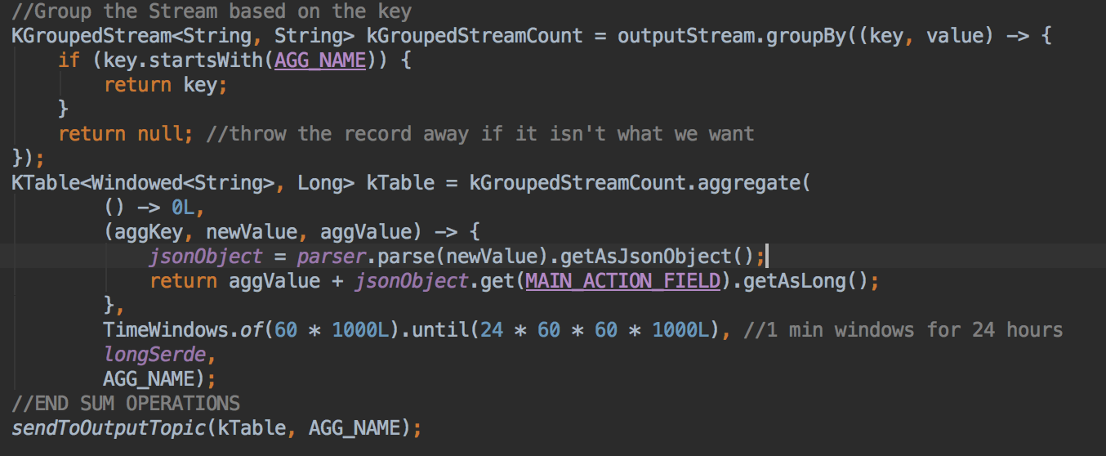
Code Snippets
Key Sample : sum_b,phn=dukecdedge06.rd.at.cox.net,shn=op-tve-ipvod-cox-origin-g.comcast.net,cachegroup=us-ga-atlanta-tve,cdn=tve value=63332304 1508160900000000000
Aggregation Code :

Slide 11
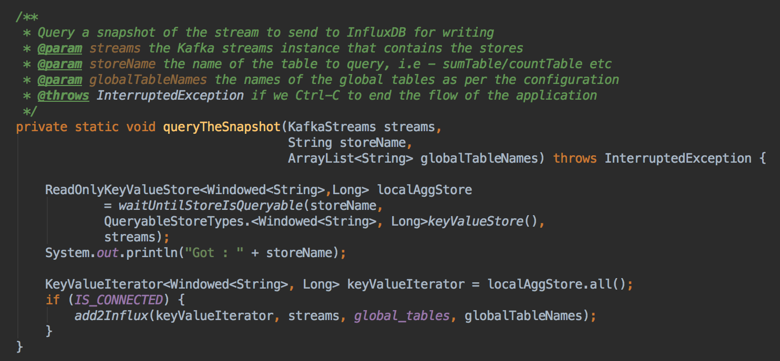
Code Snippets
Querying the a live snapshot of the stream and writing to influxDB.

Slide 12
Future Work
Enable multiple instance Kafka aggregator to work in parallel
Verify data is still aggregated accurately upon scaling
Add metrics to the application
Does it is satisfy performance requirement
A million Requests/sec?

Slide 13
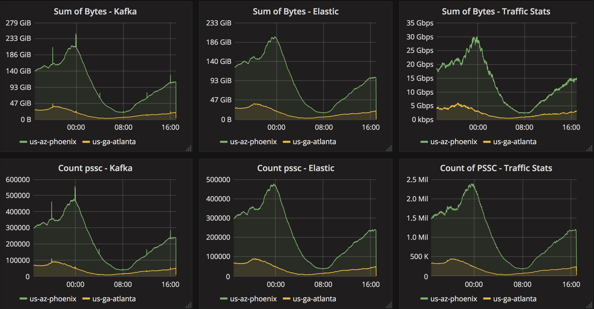
Comparing results

Slide 14
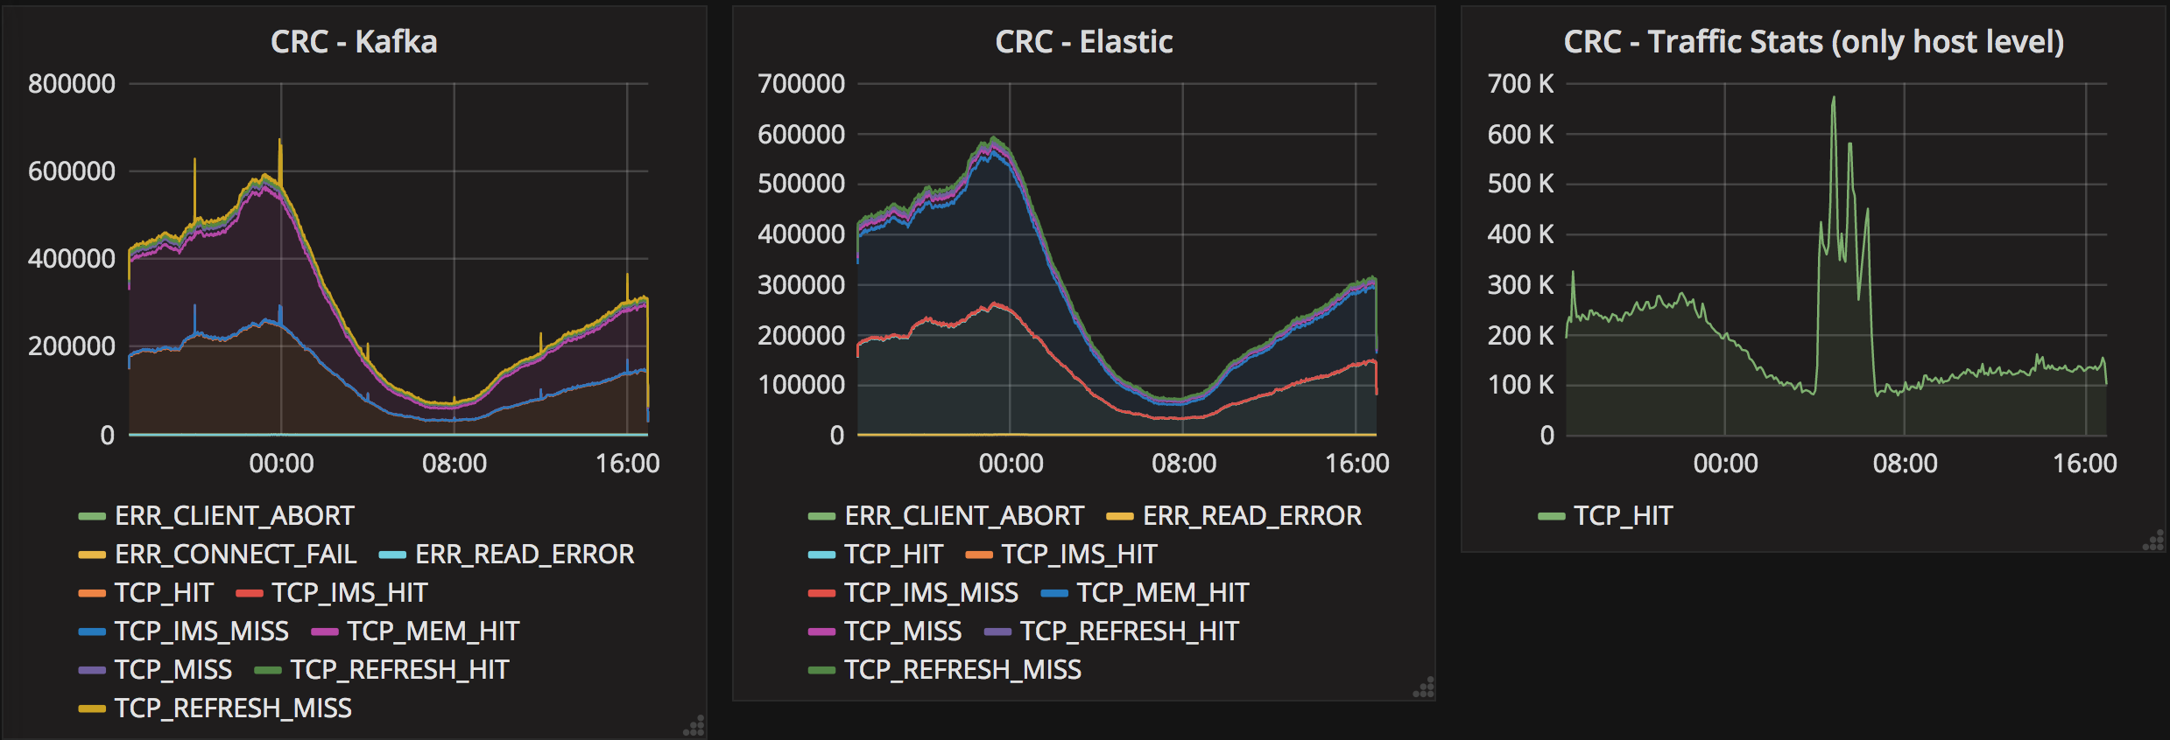
Cache Hit Ratio example – Shortcoming of TS

Slide 15
The End
Demo
Questions?

