Slide 1
OMD Content Prepositioning

Slide 2
Motivation
Customers have existing systems w/ prepositioning and want to maintain functionality
More reliable latency, protects against unreliable, slow or bw limited origins

Slide 3
Feature Goals
Protocol: Only support HTTP(s)
Header/Cookie Authentication: When sending request to OS, customized headers and/or cookie could be configured for authentication purpose.
Optionally use HTTP Proxy to access Manifest file
Policy Based Ingest: Content will be ingested based on ingest manifest file.
The ingest file will include the follow items:
Explicit List: list of individual files
Directory: recursively crawl all files under the directory
ABR Manifest: Generate ingest manifest from HLS/HSS/DASH Manifest
Content will be evicted if items removed
Each item could define a retry time and interval for failure
QoS Knobs
Scheduled Time of Day
Rate Limiting

Slide 4
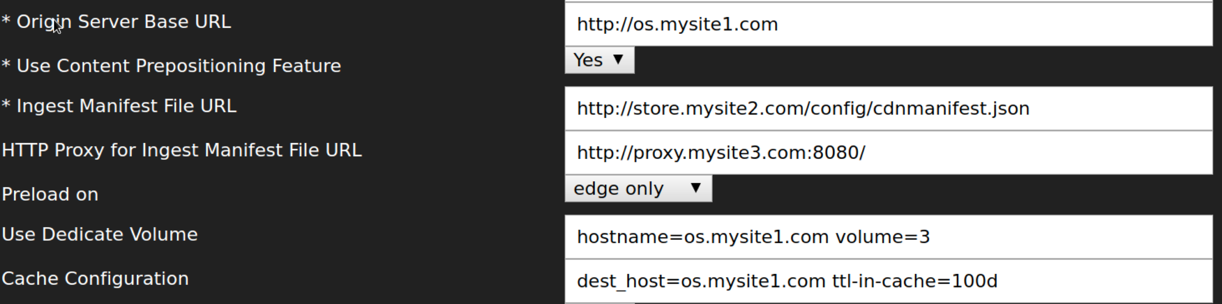
GUI Mockup

Slide 5
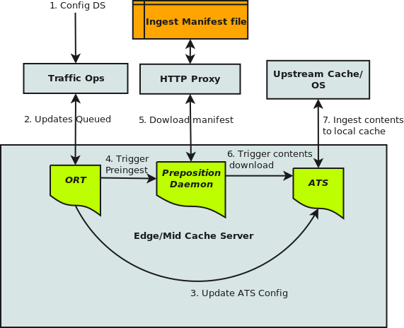
Architectural Overview

Slide 6
Manifest Example
{
"headers": "X-Auth-Key: mysecretkey",
"preload" : [
{
"items": [
"/content1/someone.jpg",
"/content1/animals.mov"
],
"retry": {
"count": 2,
"delay": 5
},
"schedule": {
"start": "2016-06-25 08:25:25",
"interval": "5d12h"
},
},
{
"crawl": [
{
"prefix": "/football/",
"depth": 5,
"acceptRegex": "\\.mov"
}
],
"abr": [
{
"manifest": "/nature/butterfly.m3u8",
},
{
"manifest": "/nature/butterfly/Manifest",
}
],
"schedule": {
"start": "2016-06-26 08:30:10",
"interval": "2h30m"
}
}
]
}

Slide 7
Persistent Content
ATS use the content area in a strip as a circular buffer where new objects overwrite the least recently cached objects.
To prevent content from being overwritten, "pin-in-cache" could be configured in "cache.config" of ATS.
If the update frequency and total size of preposition contents are fully under control, it is highly recommended to configure a dedicate volume for preposition contents.

Slide 8
Further Discuss
Rate Limiting
Consistent Hashing to Spread the content
Inspect pinned contents in ATS cache

