Slide 1
Apache Tuscany
Tutorial

Slide 2
The Rise of a Fruit Business
The Fruit Store
The Fruit&Vegetable Store
The Fruit&Vegetable Store using a database
The Fruit&Vegetable Store as Supplier
The Fruit&Vegetable Store Solution Provider
The Fruit&Vegetable Store in the enterprise
See the “README” file in this directory for run instructions

Slide 3
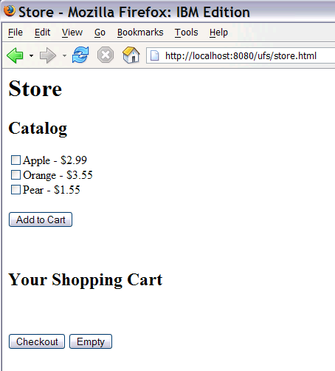
1 - The Fruit Store
Creating an Online Business (store)
store
Collection
atom
ShoppingCart
Store
jsonrpc
Total
currencyCode=USD
http
Catalog
Currency
Converter
jsonrpc
Notes:
The fruit stand goes online
constructing assets
- multiple languages
assembling/composing assets
- configuring and wiring assets
- binding via various protocols
- end to end: from ui via business logic to data
deployment
- multiple heterogeneous containers

Slide 4
2 - The Fruit&Vegetable Store
Merger or Acquisition (store-merger +
store
Collection
atom
ShoppingCart
Currency
Converter
Store
jsonrpc
Total
currencyCode=USD
Fruit
Catalog
http
Catalog
jsonrpc
Vegetable
Catalog
ws
Notes:
Acquiring a vegetable store
Integrating the vegetable catalog

Slide 5
3 - The Fruit&Vegetable Store
Using a DB in the ShoppingCart Implementation
store
database
Collection
atom
ShoppingCart
Currency
Converter
Store
jsonrpc
Total
currencyCode=USD
Fruit
Catalog
http
Catalog
jsonrpc
Vegetable
Catalog
ws

Slide 6
4 - The Fruit&Vegetable Store as Supplier
Being a Supplier for other Online Stores
database
store
Collection
atom
ShoppingCart
Currency
Converter
Store
jsonrpc
Total
jsonrpc
currencyCode=USD
Fruit
Catalog
http
Catalog
ws
Vegetable
Catalog
ws
AllAroundFoods.com
Notes:
Becoming a supplier for other online stores
Offering the catalog service via binding.ws and the shoppingcart service via binding.atom
AllAroundFoods.com is a user of these services

Slide 7

5 - The Fruit&Vegetable Store Solution Provider
Providing a Store Solution in another Geography
eustore
Collection
database
atom
ShoppingCart
Store
Currency
Converter
jsonrpc
Total
currencyCode=EUR
Fruit
Catalog
http
Catalog
ws
jsonrpc
ws
Vegetable
Catalog
ws
Notes:
The Fruit&Vegetable Store Solution provider
This can be on site or hosted
The 1st solution we saw evolve before
The 2nd solution that reuses most of the same assets we see here
- this customer solution uses a currency and fruit catalog service from the net
- the ui needs to reflect the corporate identity of the customer

Slide 8
6 - The Fruit&Vegetable Store in the Enterprise
Reaching out to other technologies
warehouse
Warehouse
http
jsonrpc
Wharehouse
JMS
Spring
store
Collection
ShoppingCart
Currency
Converter
Store
Java
http
jsonrpc
Java
Total
currencyCode=USD
Catalog
Fruit
Catalog
jsonrpc
Java
Vegetable
Catalog
Java
ws
Notes:
Acquiring a vegetable store
Integrating the vegetable catalog

