Slide 1

IBM Software Group
Tuscany Data Binding Framework
Raymond Feng (rfeng@apache.org)
Apache Tuscany: http://incubator.apache.org/tuscany/
IBM CONFIDENTIAL
© 2006 IBM Corporation

Slide 2
Overview

Slide 3
Background
Business data are represented in different ways
  SDO
  JAXB
  JavaBeans
  DOM
Different Web Service stacks use different data representations
  Axis1 uses DOM
  Axis2 uses AXIOM
  JAX-WS uses JAXB
Application developers should have the freedom to choose their preferred data representation and components with compatible data should be able to interoperate without the intervention of the business logic

Slide 4
Data bindings
What’s a databinding?
  A databinding represents a specific data format in the Tuscany runtime
  Each databinding has a unique name which identifies the data format
  Typical databindings
    XML/Java databinding frameworks
      SDO
      JAXB
      XMLBeans
      Castor
      Axiom
      JavaBeans
    XML Parsing Technologies
      SAX (InputSource, ContentHandler)
      DOM (Node)
      StAX (XMLStreamReader/XMLStreamWriter/XMLEventReader/XMLEventWriter)
    I/O
      InputStream/OutputStream
      Reader/Writer

Slide 5
Usage Scenarios

Slide 6
Data transformation between SCA components
Data transformation can be performed on wire for mappable and remotable interfaces
Data transformation can happen between interfaces defined using different IDLs such as Java or WSDL.
Source
Target
DataBinding Interceptor

Slide 7
Data transformation for composite services
<interface.xxx> defines the outbound service contract (SC2) which can be wired to a target component, reference or service (SC3).
<binding.xxx> can optionally hint a service contract for the inbound data from the binding protocol layer.
Binding
Protocols
(SOAP/HTTP,
RMI,
RMI/IIOP,
or JMS)
Service
Target
(component,
reference
or service)
DataBinding Interceptor
SC1
SC2
SC3

Slide 8
Data transformation for composite references
<interface.xxx> defines the inbound service contract (SC2) which can be wired from a source component, reference or service (SC1).
<binding.xxx> can optionally hint a service contract (SC3) for the outbound data to the binding protocol layer.
Source
(component,
reference
or service)
Reference
Binding
Protocols
(SOAP/HTTP,
RMI,
RMI/IIOP,
or JMS)
DataBinding Interceptor
SC1
SC2
SC3

Slide 9
Data transformation for property values
Property values are loaded from SCDLs as DOM documents
The DOM Document can be transformed into a java object under a databinding, such as SDO, JAXB so that the component implementation code can work with the databinding directly instead of DOM.
Data
Transformer
SDO
<property name=“p1”>
…
</property>
DOM
Component
Composite

Slide 10
Data Transformations

Slide 11
How to transform data across databindings
A databinding is a terminal for the data transformation
Three types of databindings depending on how the data is represented by the databinding
  Some databindings can feed the data for consumption
  Some databindings serve a sink to receive data
  Some databindings can bridge the sink so that data coming into the sink can be consumed by others

Slide 12
Scenario 1: Source → Source
SDO
DOM
Node
JAXB
XMLBeans
StAX
XMLStreamReader
SDO

Slide 13
Scenario 2: Source → Sink
OutputStream
SDO
SAX
ContentHandler
Writer

Slide 14
Scenario 3: Sink → Source (Pipe)
ByteArray
OutputStream
byte[]
ByteArrayInputStream
String
SDO
SAX
ContentHandler

Slide 15
How to use databindings?

Slide 16
Declare the data binding for the interfaces
Data Binding requirement can be expressed as:
  SCDL extension
<interface.wsdl …>
<db:databinding xmlns:db=“http://tuscany.apache.org/xmlns/sca/databinding/1.0” name=“commonj.sdo.DataObject”>
</interface.wsdl>

Slide 17
Java annotations for a remotable interface
@DataType can be applied to remotable interfaces at type and method level
  @Remotable
  @DataType(name="org.w3c.dom.Node")
  public interface Interface2 {
  Node call(Node msg);
  @DataType(name="javax.xml.stream.XMLStreamReader")
  XMLStreamReader call1(XMLStreamReader msg);
  }

Slide 18
What’s behind the magic?

Slide 19
Load and build the data binding metadata
The XML or annotation is loaded/processed as the DataBindingDefinition model object
The builder will resolve the DataBindingDefinition and create DataBinding as the runtime context for transformation
SCDL
Extension
Java
Annotation
DataBinding
Loader
DataBinding
Annotation Processor
DataBinding
Definition
Builder
DataBinding

Slide 20
Databinding transformer graph
Binding2
30
Binding3
10
10
10
10
10
Binding1
Binding4
20
20
10
10
10
10
20
Binding5
Binding6
Binding7
Binding8
20

Slide 21
The algorithm to calculate the transformation path
The transformers are registered and selected using the following algorithm.
  The data transformation capabilities for various databindings can be nicely modeled as a weighted, directed graph with the following rules. (Illustrated in the attached diagram).
  Each databinding is mapped to a vertex.
  If databinding A can be transformed to databinding B, then an edge will be added from vertex A to vertex B.
  The weight of the edge is the cost of the transformation from the source to the sink.
In the data interceptor on the wire, if we find out that the data needs to be transformed from databinding A to databinding E. Then we can apply Dijkstra's Shortest Path Algorithm to the graph and figure the most performed path. It can be A-->E, or A-->C-->E depending on the weights. If no path can be found, then the data cannot be mediated.

Slide 22
Transform data
Direct transformation
Multi-hop transformation
Source
DataBinding
Target
DataBinding
Source Data
Target Data
Transformer
Source
DataBinding
Intermediate
DataBinding
Target
DataBinding
Source Data
Intermediate
Data
Target Data
Transformer 1
Transformer 2

Slide 23
Deal with different IDLs

Slide 24
Dealing with WSDL/XSD based IDLs
SCA allows the interfaces to be defined using various IDLs, for example, java interface or WSDL portType
IDLs may have different ways to represent the input/output/fault data
The databinding framework is designed to support the transformation across IDLs
Some special databindings are internally used for this purpose:
  idl:input
  idl:ouput

Slide 25
Dealing with WSDL/XSD based IDLs
WrapperHandler
  Provide WrapperStyle WSDL wrapping/unwrapping support
SimpleTypeMapper: convert data between XSD simple types (by the databinding, for example, OMElement with an OMText child) and java objects
Wrapper
Arg1
Arg2
Arg3
C1
C2
C3

Slide 26
Extend the databinding framework

Slide 27
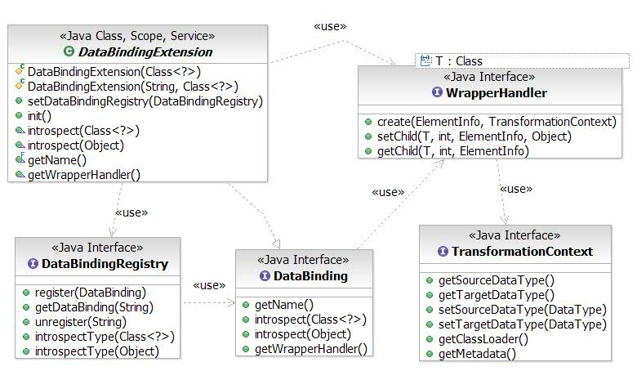
DataBinding Class Diagram

Slide 28
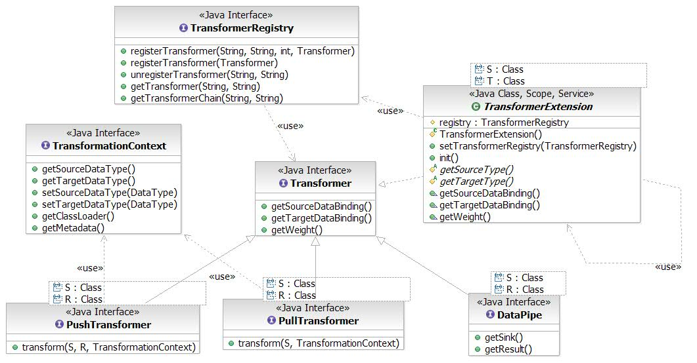
Transformers Class Diagram

Slide 29
How to contribute a new databinding?
It follows the Tuscany extensibility story
Optionally implement the DataBinding interface
Provide a set of Transformers which can transform data from/to this databinding
Register your databinding and transformers are system components in the extension SCDL

Slide 30
The DataBinding SPI
public interface DataBinding {
/**
* The name of a databinding should be case-insensitive and unique
* @return The name of the databinding
*/
String getName();
/**
* Introspect a java class or interface to create a DataType model
* @param javaType The java class or interface to be introspected
* @return The DataType or null if the java type is not supported by this databinding
*/
DataType introspect(Class<?> javaType);
/**
* Introspect the data to figure out the corresponding data type
* @param value The object to be checked
* @return The DataType or null if the java type is not supported by this databinding
*/
DataType introspect(Object value);
/**
* Provide a WrapperHandler for this databinding
* @return A wrapper handler which can handle wrapping/wrapping for this databinding
*/
WrapperHandler getWrapperHandler();
}

Slide 31
Register a databinding and transformers
<composite xmlns="http://www.osoa.org/xmlns/sca/1.0"
xmlns:system="http://tuscany.apache.org/xmlns/system/1.0-SNAPSHOT"
name="org.apache.tuscany.databinding.sdo">
<component name="databinding.sdo">
<system:implementation.system class="org.apache.tuscany.databinding.sdo.SDODataBinding" />
</component>
<component name="transformer.DataObject2String">
<system:implementation.system class="org.apache.tuscany.databinding.sdo.DataObject2String"/>
</component>
<component name="transformer.String2DataObject">
<system:implementation.system class="org.apache.tuscany.databinding.sdo.String2DataObject"/>
</component>
...
</composite>

