Slide 1
UIMA V3
Programmer’s Solutions
https://uima.apache.org

Slide 2
What does this cover?
New features of UIMA v3
Fixes for decades-old problems
From the programmers’ perspective
Doesn’t cover all the new features
More here: https://uima.apache.org/d/uimaj-3.0.0-beta/version_3_users_guide.pdf

Slide 3

Complaints!
Data in the CAS seems far away from Java code
Sometimes I get surprised by what happens
- not what I expected.
Annoyance - Sometimes I have a CAS, sometimes a JCas, why should I need to convert between these?
Big picture – I’d rather work with normal Java objects, and get advantages like GC, normal Java idioms, and type inferencing

Slide 4


Fixing the complaints!
Data stored as Feature Structures (FSs)
instances of JCas classes
Normal Java objects, GC works !
API: select
general way to get data from CAS/JCas and hook to common Java idioms
Access by Cas or JCas
UIMA objects integrated into Java idioms, with generic types supporting type inferencing
You, pulling
FSs out of Cas
FSs in the Cas

Slide 5
Fixing surprises - ConcurrentModificationException
While iterating with UIMA Feature Structure iterators, sometimes you get a ConcurrentModificationException
Maybe you remove a no-longer-needed FS
Or maybe you add a new FS
Maybe you modify a feature
And it turns out (unbeknownst to you) it was used in some index somewhere else
Eliminated in V3!
OK to modify index while iterating over it
Iteration continues with pre-modified version
(efficient)
Loop
Test
Action
Concurrent Modification Exception!

Slide 6
Example: modifying FS and indexes while iterating
Mr. Smith was looking for a gift for Mrs. Smith.
Combine into single tokens
FSIterator<Token> it = cas.getAnnotationIndex(Token.class).iterator(); while (it.hasNext()) {
Token token = it.next();
if (is_Mr_Mrs_Dr_Sir(token)) {
token.removeFromIndexes(); // delete this token (from indexes)
// combine this token and the next into one token with span covering both
Token followingToken = it.next();
followingToken.prefix = token.getCoveredText();
followingToken.setBegin(token.getBegin());
} }
Causes under-the-covers remove and add-back

Slide 7
Fixing Surprises – Subiterators
Get a subiterator over aa, begin = 10, end = 20
Lots of annotations there
But subiterator is sometimes empty !
Due to unexpected type priority ordering done elsewhere
Fixed in V3 – select doesn’t let type priorities do this
cas.select(myX).coveredBy(aa)
Where are the x’s?
x1
x2
x3
aa

Slide 8
Selecting FSs by type
Select framework
Credit: many ideas from uimaFIT
Using a sorted index
cas.select(MyType.class). …
jcas.select(MyType.class)
If you don’t have a JCas class for the type:
cas.select(myUimaType). …
cas.getAnnotationIndex().select()
Both
cas.getAnnotationIndex().select(MyType.class))

Slide 9
Actions following select
iterate
stream
for (x : y) { … }
No casting
required
for (MyType a : cas.select(MyType.class)) { ... }
cas.select(Annotation.class) // already is a stream .anyMatch(fs -> isOK(fs, outsideParam1))
Fast Iterators (Unsorted)

Slide 10
Special kinds of select: getting FSs within bounds of another
myBoundingAnnotation
x1
x
x
x2
x
x3
aa
select(MyXclass.class).coveredBy(myBoundingAnnotation)
By default: typePriority ordering is ignored ☺
nonOverlapping()
includeAnnotationsWithEndBeyondBounds()
These are “builder” methods: xxx.select().nonoverlapping()…

Slide 11
The opposite: getting FSs covering (spanning) a particular spot
span
x1
x2
select(myXtype).covering(span)

Slide 12
Getting FSs “at” a particular spot
x1
x2
x3
aa
select(Annotation.class).at(aa). …
Gets x1, x2, x3
select(Annotation.class).at(aBegin, anEnd). …
By default: typePriority ordering is ignored ☺

Slide 13
Getting the first item
Getting a single FS
Getting the third item
select(MyType.class).get()
select(MyType.class).get(3)
Getting a single item
select(MyType.class).single()

Slide 14
Select: starting at a position
select(MyType.class).startAt(thisFeatureStructure). …
select(Annotation.class).startAt(begin, end). …
select().startAt(thisFeatureStructure, shiftedByThisOffset). …
Following / preceding
select(MyType.class).following(thisFeatureStructure). …
select(Annotation.class).preceding(position). …
select().preceding(thisFeatureStructure, shiftedByThisOffset). …

Slide 15
Arbitrary Java objects in the CAS (!)
Can now be done ☺
Basic idea: Design a custom JCas class for this, which has both
the Java Object (as a normal Java field, with whatever custom accessors you want
A representation as normal CAS data objects, as internal features, for transporting
Implement conversion code between these two
Automatically Called by the UIMA framework when needed (serializing/deserializing, etc.)
There’s a whole chapter with detailed instructions describing this, in the v3 user’s guide

Slide 16

Some new (semi-)built-in types
Built using this new capability
To use: enable by adding to your type system descriptor: <import name="org.apache.uima.semibuiltins"/>
FSArrayList
FSHashSet, FSLinkedHashSet
IntegerArrayList
Int2FS (map)
Extremely lazy

Slide 17
A feature which is an adjustable array
Problem: you want to have feature holding an “efficient” collection of Feature Structures,
but don’t know how many there are, ahead of time
so can’t use the built-in FSArray type
Solution: use a new (semi-)built-in type: FSArrayList
Like an array, but you can add things to it
Implements the Java ArrayList API

Slide 18
Feature holding a set of Feature Structures
A feature which holds a set of Feature Structures.
Use the new (semi)built-in type
FSHashSet, or FSLinkedHashSet
Like Java HashSet, for holding Feature Structures
Implements the Java “Set” interface

Slide 19
Mapping from int(s) to Feature Structures
Some users like to keep a table of ints, and associate these to particular Feature Structure instances.
Int2FS is a new (semi)built-in type supporting this
Keys are int(s), Values are Feature Structures
Works like a HashMap (except for int keys, not Integer keys)
Includes “iterator()” returning an Iterator<IntEntry>
IntEntry<T> is like Entry, but the getKey() returns an int.

Slide 20
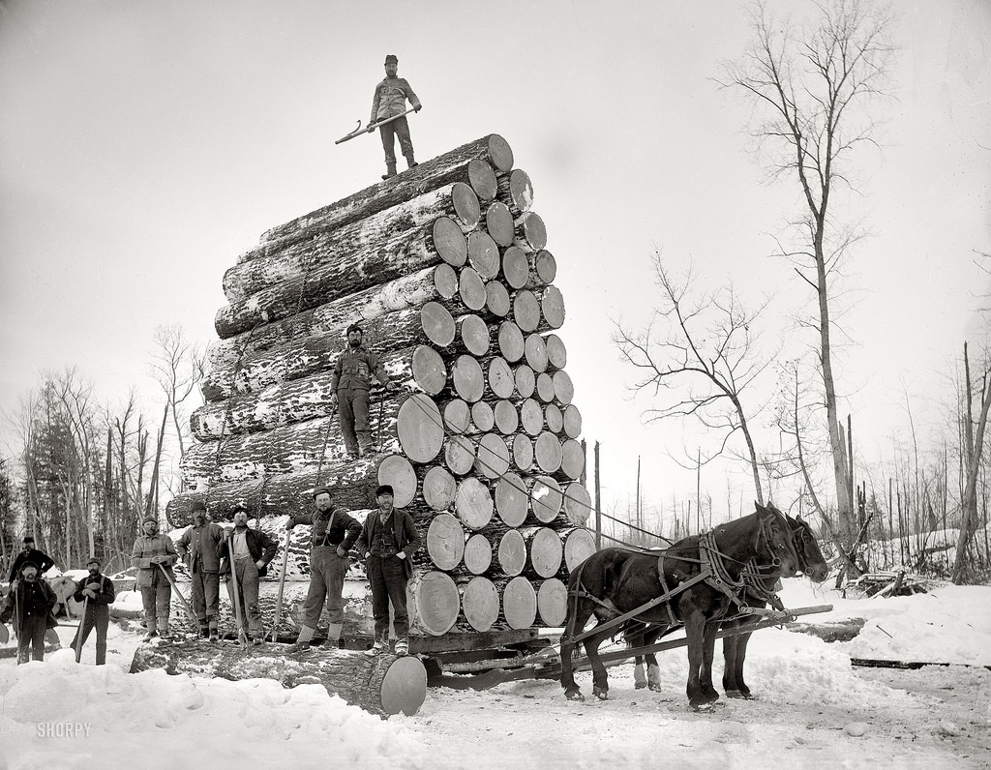
UIMA Logger complaints
Hard to write efficient log statements
New and old style of message embedding syntax
No support for cross-cutting filtering/ triggering per log message
Important for fixing problems in production systems
No support for run-time configurable context info augmentation
Important for fixing problems in production systems
Need to merge with other logging systems when UIMA is embedded

Slide 21
UIMA logger too old-fashioned to easily use efficiently
Problem : Need to write “guard” code to avoid computation when logger is “off”, e.g.
logger.log(Level.WARN, message, featureStructure.toString())
Otherwise, the argument computation evaluation is done even when not logging!
Solution: use the new logging APIs that exploit Java 8 lambdas:
logger.warn(message, () -> featureStructure.toString());
Message embedding syntax change coupled to logger invoking form
New form: logger.xxx (…) // xxx = info, warn, etc.
Old form: logger.log(Level.XXX, …) // XXX = INFO, WARN, etc., backward compatible
New forms use new modern-logger {} convention for substitutable items
vs. old form which used {1}, {2}, etc.
if (logger.isLoggable(Level.WARN))
toString may be expensive to compute

Slide 22
V2 UIMA logger: missing “marker” support
Problem : Want to use Markers on individual log messages
Configurable in production for debugging
Can trigger actions (send an email to the admin when this happens)
Can have cross-cutting filtering control (log things related to DB access)
Solution: UIMA’s new logging APIs support new standard “Markers”
logger.warn(aMarker, message, …)
https://logging.apache.org/log4j/2.0/manual/markers.html

Slide 23
UIMA logger: context information
Problem : Want to add context info (by thread)
Following modern logging standards, using MDC (Mapped Diagnostic Context)
Context information gets insert into log messages
Via run-time configuration of appenders/ handlers
Solution: UIMA logging backends log4j and logback support these
Older java.util.logging backend does not.
Contexts:
what pipeline is running, what annotator in the pipeline is running
What CAS is being used

Slide 24
UIMA “living” with other loggers
Problem : Embedding a UIMA pipeline inside another application
Which is already set up to use another logging system (e.g. log4j)
Solution: UIMA loggers are now built on top of slf4j, allowing:
Runtime determination of what logging framework is in use
Adapting UIMA logging to that framework
Defaults to v2 back-end logger: Java’s own built-in java.util.logging

Slide 25
FSArrays, StringArrays, etc. too hard to use
Problem: want to use normal Java idioms like streams, enhanced-for-loops
Solution – normal Java idioms now supported:
for (TOP item : myFSArray){…}
myFSArray.stream(). …

Slide 26
FSArrays and generic typing
Problem: want to use normal Java idioms with type inferencing
Solution: FSArray supports generic typing arguments
FSArray<MyType> fsa = new FSArray<>(jcas, 10);
… // other computation populating the array
for (MyType item : fsa){…}
No casting needed

Slide 27
UIMA Lists too hard to use
Lots of new convenience APIs for lists
Example: want to build a list from the end
Solution:
list = cas.emptyXXXlist(); // the tail
// Loop or stream over things to add
… loop not shown …
list = list.push(newItem); // push onto front
Another Example: list walker takes functional arguments, handles loops
list.walkList(…)

Slide 28
Common operations on UIMA lists and arrays
emptyXXX, empty(XxxList.class)
On Cas, JCas,
Shared object (why this is important)
Stream, Iterator, enhanced For
Special versions to avoid boxing
for (int i : myIntegerList) …

Slide 29
How about speed?
Speedups accrue from two sources
Converting to V3 (with no rewrites)
Exploiting V3
V3 puts smaller demand on memory caches
More cache space is left for application code
With just conversion, have seen 10-15 % speedups in overall application speed
Highly dependent on exact situations
V3 internals reworked for better locality of reference, much less copying of data

Slide 30






V3 summary
Faster!
GC works for feature structures
Integrate with Java 8 idioms
Using type inferencing
Java objects in the CAS
select
Surprises gone
No more ConcurrentModificationExceptions
Select style iterators not fooled by type priorities
Efficient Logging simplified
Backwards compatible*

Slide 31
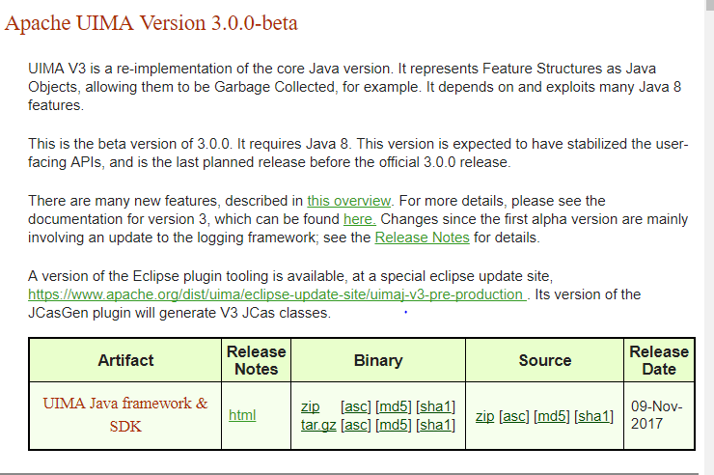
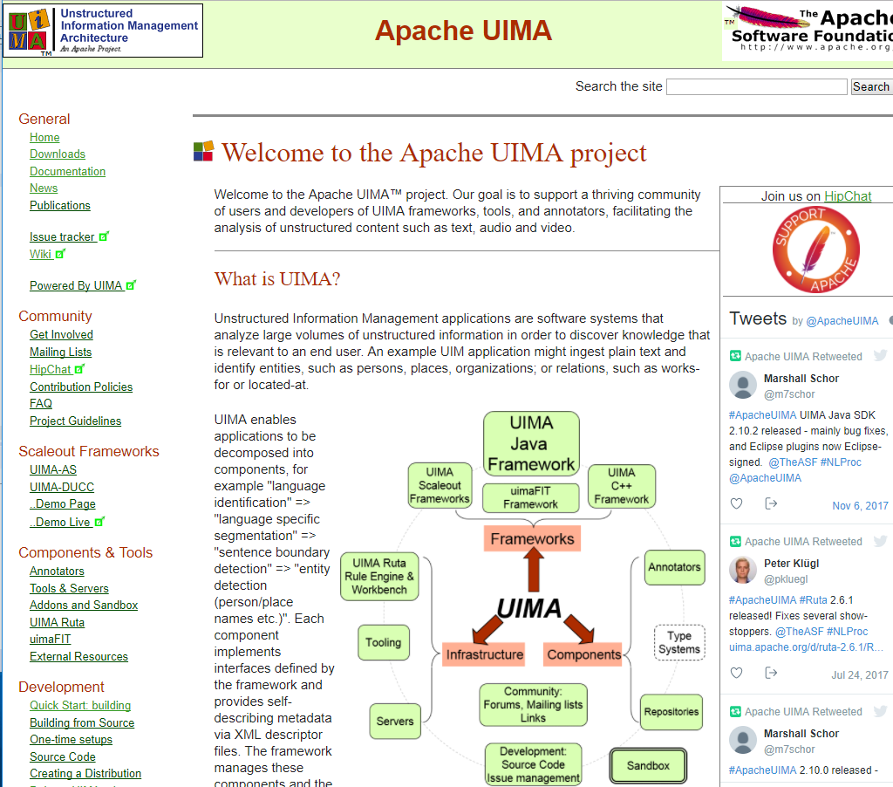
Get UIMA V3 from Apache UIMA
https://uima.apache.org

