Slide 1

CSE Framework: A UIMA-based Distributed System for Configuration Space Exploration
Elmer Garduno², Zi Yang¹, Yan Fang³, Avner Maiberg¹, Collin McCormack⁴, Eric Nyberg¹
¹⁾ Carnegie Mellon University {ziy, amaiberg, ehn}@cs.cmu.edu
²⁾ Sinnia elmerg@sinnia.com
³⁾ Oracle Corporation yan.fang@oracle.com
⁴⁾ The Boeing Company collin.w.mccormack@boeing.com

Slide 2
Motivation
Document ID | Rank
FBIS3-58 (relevant) | 1
AP880603-0268 | 2
WSJ920110-0013 | 3
FBIS3-45320 (relevant) | 4
FT942-2016 | 5
Answer candidates | Score | Document extracted
Beijing | 0.7 | AP880603-0268
Hong Kong | 0.65 | WSJ920110-0013
Shanghai | 0.64 | FBIS3-58
Taiwan | 0.5 | FT942-2016
Shanghai | 0.4 | FBIS3-45320
Typical QA Pipeline
Which city in China has the largest number of foreign financial companies?
Keywords: China largest foreign financial company
Answer type: location (city)
Question
Keywords
Docs
Answer
candidates
Question
Analysis
Document
Retrieval
Answer
Extraction
Answer Selection
Corpus
Answer
Shanghai

Slide 3
CURRENT RESEARCH IN QA

Slide 4
What did we learn from Watson?
QA systems can be fast enough, accurate enough, and confident enough to perform in the real world
Key factors:
Scalable, parallel architecture
Agile, open advancement process
Next big challenge: rapid domain adaptation

Slide 5
Automatic Optimization of QA for TREC Genomics Questions

Slide 6
Results of Automatic Optimization
[ Yang, Z., Garduno, E., Fang, Y., Maiberg, A., McCormack, C. and Nyberg, E. (2013). “Building Optimal Information Systems Automatically: Configuration Space Exploration for Biomedical Information Systems”, Proceedings of the ACM Conference on Information and Knowledge Management ]

Slide 7









Automatically Building an Information System by Another Meta-System?

Slide 8
Building an Information System Automatically
CSE framework
Notes:
Engage audiences. Benchmarks
Where we are.
Why do we need CSE? Expedite the process.

Slide 9
The benefit of CSE framework
Accelerate the system development cycle by automating the component selection and tuning!
Save cost!
It requires
Identify the tool, knowledge base, task algorithm candidates
Provide information needs with known outcomes, e.g. answers to questions in the domain.
Notes:
Engage audiences. Benchmarks
Where we are.
Why do we need CSE? Expedite the process.

Slide 10
CSE - Framework

Slide 11

Definition: Phase
An information system
Phase t
The processing unit as the t-th step in a process

Slide 12


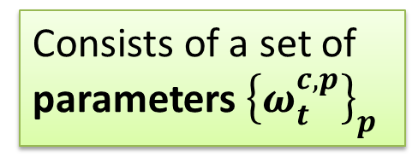
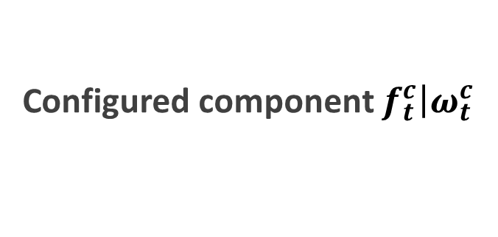
Definition: Component, Configuration
Inside phase t
Component $f_{t}^{c}$
Configuration $ω_{t}^{c}$
An instantiated processing unit in phase t
Consists of a set of parameters ${\left\{ω_{t}^{c,p}\right\}}_{p}$
Configured component $f_{t}^{c}\left|ω_{t}^{c}\right.$

Slide 13

Definition: Trace
Trace $f^{c}|ω^{c}= \left(f_{1}^{c_{1}}\left|ω_{1}^{c_{1}}\right.,f_{2}^{c_{2}}\left|ω_{2}^{c_{2}}\right., …,f_{n}^{c_{n}}\left|ω_{n}^{c_{n}}\right.\right)$
An execution path that involves a single configured component for each phase

Slide 14
Exponential problem
The number of traces grows exponentially with the phases and the number of components.
Space should be pruned when possible to keep the space bounded.

Slide 15
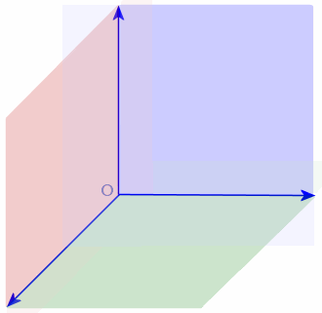
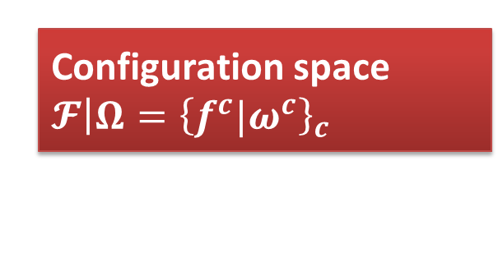
Definition: Configuration space
Pipeline
Phase 3
Configuration space $𝓕\left|Ω\right.={\left\{f^{c}|ω^{c}\right\}}_{c}$
Phase 1
Set of all configured components
Phase 2

Slide 16
UIMA - Extended Configuration Descriptor

Slide 17
Extended Configuration Descriptor
YAML format
A simple yet complete configuration descriptor
configuration:
name: testqa-ziy-test
author: ziy
persistence-provider:
inherit: jdbc.db.persistence-provider
collection-reader:
inherit: jdbc.db.collection-reader
dataset: BIO-COMBINED
sequence-start: 160
sequence-end: 187

Slide 18
Extended Configuration Descriptor
Phases and components inherit configuration properties or are declared as classes.
pipeline:
- inherit: jdbc.cse.phase
name: keyterm-extractor
options: |
- inherit: default.keyterm.default
- inherit: default.keyterm.faster
- inherit: jdbc.cse.phase
name: retrieval-stategist
options: |
- inherit: default.retrieval.default
- inherit: default.retrieval.better
- inherit: jdbc.cse.phase
name: passage-extractor
options: |
- class: cmu.edu.default.ie.Default

Slide 19
Component configuration
class: edu.cmu.lti.oaqa.ecd.example.FirstPhaseAnnotatorA1
extract: true
cross-opts
param-a: [value100,value200]
param-b: [value300,value400]
This evaluates to the following Object[] param lists.
[extract: true, param-a: value100, param-b: value300]
[extract: true, param-a: value200, param-b: value300]
[extract: true, param-a: value100, param-b: value400]
[extract: true, param-a: value200, param-b: value400]

Slide 20
Extended Configuration Descriptor
Evaluation metrics are pluggable, and can be specified at the local or global level.
- inherit: jdbc.eval.cse-retrieval-aggregator-consumer
- inherit: bioqa.eval.cse-passage-map-aggregator-consumer
post-process:
- inherit: jdbc.eval.cse-retrieval-evaluator-consumer
- inherit: report.csv-report-generator
builders: |
- inherit: jdbc.report.f-measure-report-component
- inherit: bioqa.eval.cse-passage-map-evaluator-consumer
- inherit: report.csv-report-generator
builders: |
- inherit: bioqa.report.map-report-component

Slide 21
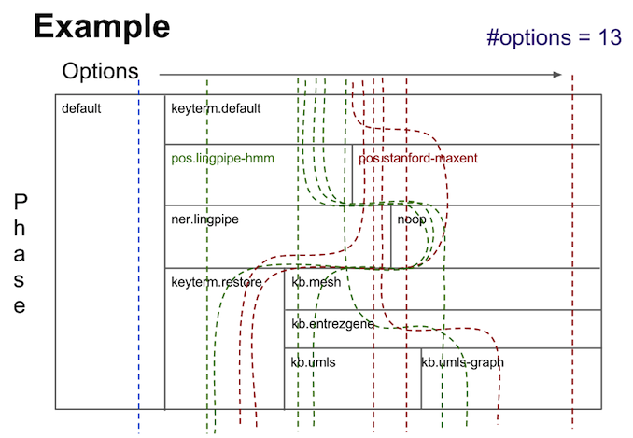
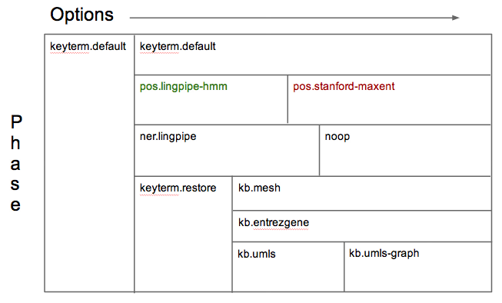
In-phase pipelines

Slide 22
Implementation

Slide 23
Implementation details
Built on top of uimaFIT
Combinatorial features are implemented using CAS Multiplier.
CASes are persisted as compressed XMI
Once per trace at each phase.
Experiments can be restarted at any arbitrary point.
Experimentation specific Type System
Use UIMA-AS for external resources.

Slide 24
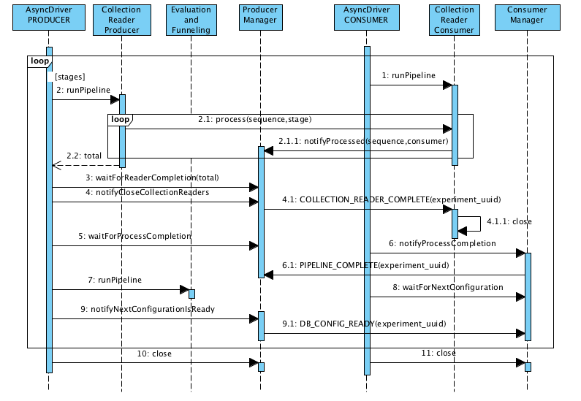
Distributed execution

Slide 25
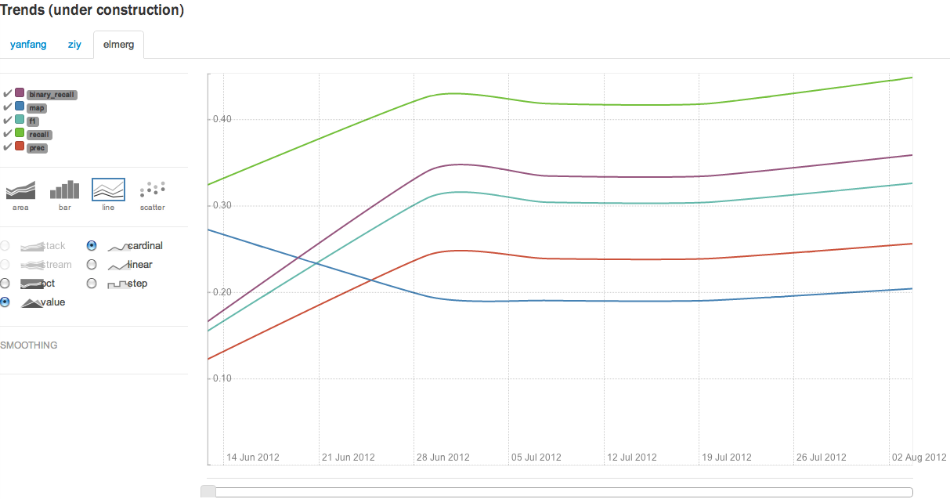
Incremental improvement

Slide 26
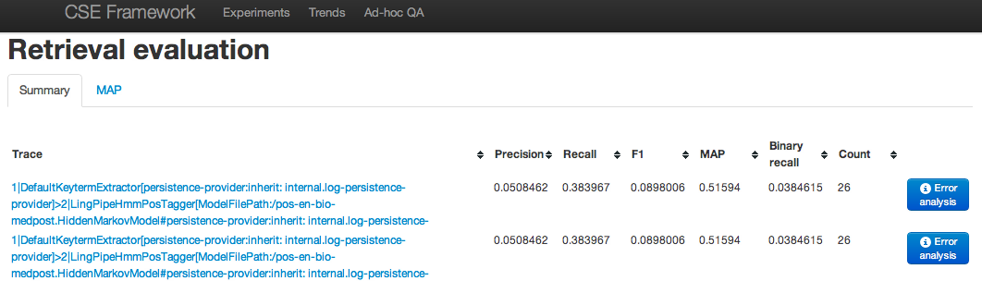
Per trace visibility

Slide 27
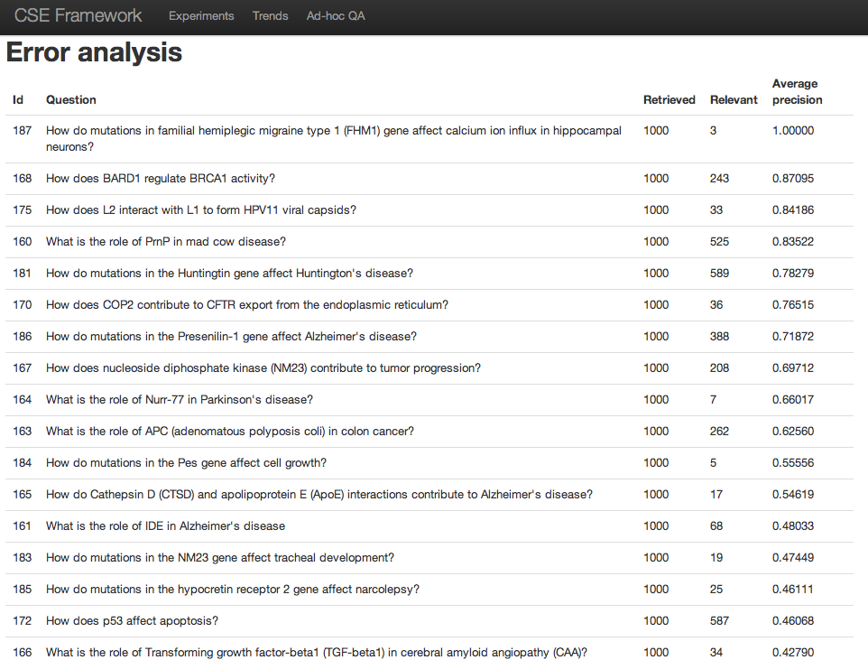
Error analysis

Slide 28
Other domains:QA4MRE
Question Answering for Machine Reading
Configuration space:
12 UIMA components were first developed
Replace UIMA descriptors with ECD
CSE
46 configurations
1,040 combinations
1,322 executions
The best trace identified by CSE achieved 59.6% performance gain over the original pipeline.
[Building Optimal Question Answering System Automatically using Configuration
Space Exploration (CSE) for QA4MRE 2013 Tasks Alkesh Patel, Zi Yang, Eric Nyberg
and Teruko Mitamura]

Slide 29
Future Work and Collaboration

Slide 30
Future work
Advanced Configuration Space exploration and pruning (Bagpipes Framework).
Run arbitrary UIMA pipelines on top of industry grade distributed systems (Spark, Mesos, HDFS).
Further investigation on space, time, resources constraining.
Use differential CAS storage.

Slide 31
Collaboration
http://oaqa.github.io

Slide 32

Thanks!

