Slide 1
Apache Wookie (Incubating)
Creating your first widget
wookie-dev@incubator.apache.org
http://incubator.apache.org/wookie

Slide 2
Objective focussed outline
Creating a widget from the template
Running in developer mode
Modify the widget

Slide 3
Task focussed outline
Create a real widget with geo-lookup
Display map of current location
Store settings
Package widget as .wgt

Slide 4
Development Environment

Slide 5
Create Development Environment
What you need:
  Wookie source code
  Ant + Ivy
  JDK
  Your favourite editor
    Javascript, HTML, CSS
    Java (if you want to hack on the server)

Slide 6
Using the Workshop CD
Copy the “wookie” folder to your preferred project location
Copy “apache-ant” into your preferred applications application directory
Install JDK from “java” folder
Configure your environment
  Set ANT_HOME
  Add $ANT_HOME/bin to your $PATH

Slide 7
Your first widget
Hello World!

Slide 8
Create a Hello World Widget
Wookie comes with a skeleton widget template:
Answer some questions about your widget
  Widget type: basic
  Short Name: part1
  Description: Code from first practical session of Wookie training day
  Default height: 320
  Default width: 200
You now have a widget in $WOOKIE_HOME/widgets/[SHORT_NAME]
cd $WOOKIE_HOME/widgets
ant seed-widget

Slide 9
Widget template types
Basic
  The one used here
  A basic HTML widget
  No special features included
Wave
  An widget with Wave feature
  Allows shared state between users

Slide 10
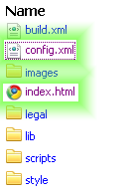
Widget File Structure

Slide 11
config.xml
<widget xmlns="http://www.w3.org/ns/widgets"
id="http://wookie.apache.org/widgets/part1"
Version="0.1"
Width="200" height="320">
<name>part1</name>
<description>Code from first practical session of Wookie training day</description>
<content src="index.html"/>
<icon src="images/icon.png"/>
<author>Apache Wookie (Incubating) Team</author>
<licence>...</licence>
</widget>

Slide 12
index.html - <head>
<meta
http-equiv="pragma"
content="no-cache"/>
<meta http-equiv="Content-Type"
content="text/html; charset=UTF-8" />
<link rel="stylesheet"
type="text/css"
href="style/screen.css" />

Slide 13
index.html - <head>
<script type="text/javascript"
src="scripts/ui.js"
charset="utf-8"></script>
<script type="text/javascript"
src="scripts/properties.js"
charset="utf-8"></script>
ui.js : for managing the user interface
properties.js : for managing widget properties

Slide 14
index.html - <body>
<div id="wookie-widget">
...
</div>
Widget content is enclosed in a div

Slide 15
index.html - <body> - decoration
<div id="wookie-toolbar">
<img id="wookie-widget-icon"
src="images/icon_16x16.png"
onclick="wookieShowSettings()"
alt="part1 Icon"/>
Part1
</div>
...
<div id="wookie-footer">Powered by Apache Wookie (Incubating)</div>
Header gives access to settings page

Slide 16
index.html - <body> - settings
<div id="wookie-settings">
<p>Frontpage content</p>
<textarea rows="6" cols="20"
id="wookie-template-property-content">
</textarea>
<p><input type="submit"
class="wookie-form-button"
value="Save"
onclick="saveProperties()"/>
</div>
wookie-settings page is hidden by default
  Displayed by calling wookieShowSettings()

Slide 17
index.html - <body> - content
<div id="wookie-content">
<h2>part1</h2>
<p>Code from first practical session of Wookie training day</p>
</div>
wookie-content is the main page
Displayed when widget is loaded
Hidden when wookieShowSettings() is called
  Show again with wookieShowMain()

Slide 18
Running Wookie in Developer Mode
Developer mode allows easy building and testing of widgets

Slide 19
Developer Mode
Building Wookie auto deploys all widgets in the $WOOKIE_HOME/widgets directory
We can run in development mode with:
Visit http://localhost:8080/wookie
[ASIDE] To run in debug mode
cd ..
ant run
ant -Djvmargs="-Xdebug -Xrunjdwp:transport=dt_socket,address=8000,server=y,suspend=n" run

Slide 20
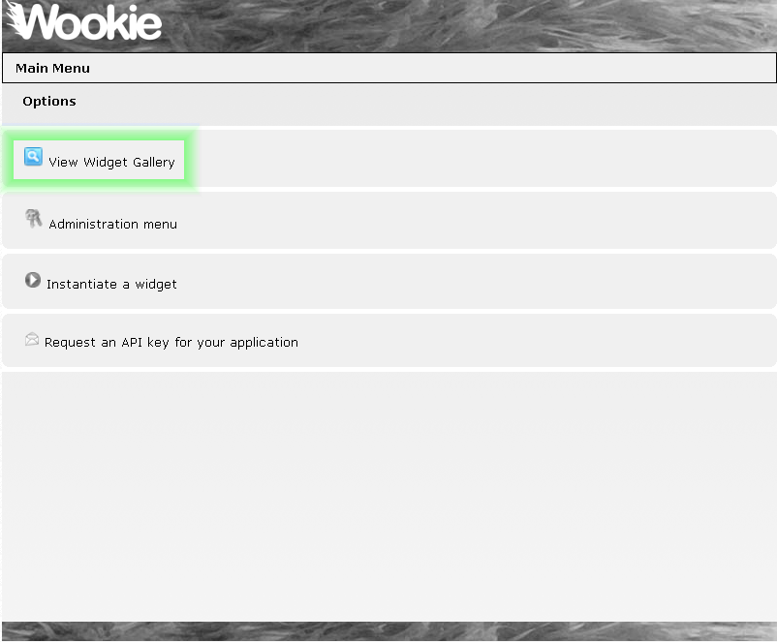

Slide 21
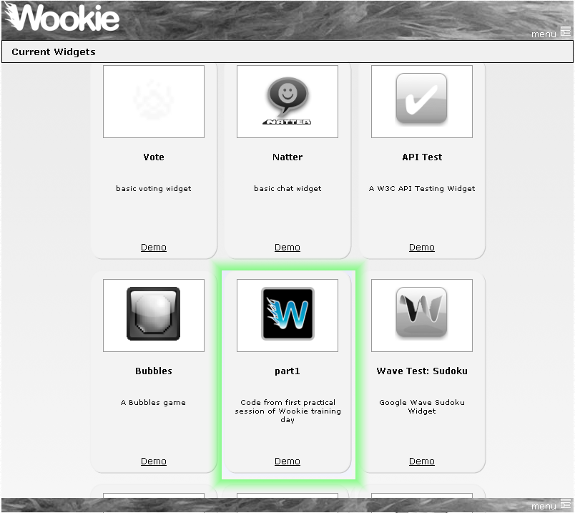

Slide 22
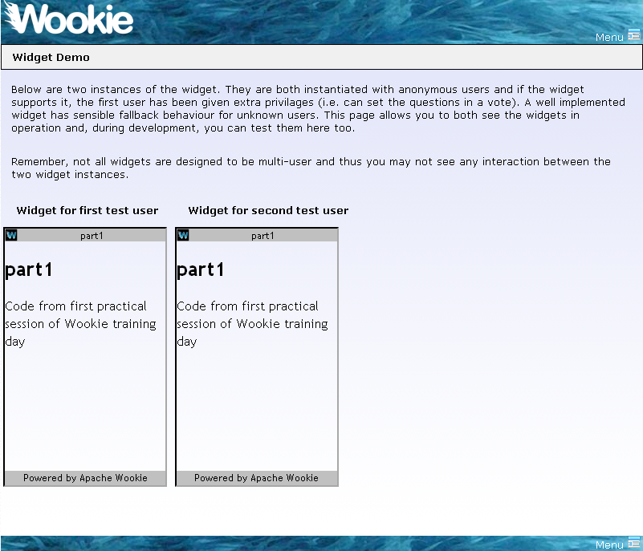

Slide 23
Editing static parts of a widget
Changing the layout of your widget

Slide 24
Editing a Widget
$WOOKIE_HOME/widgets/part1/index.html
  The initial widget page
Edit it in your favourite editor
  Perhaps to say “Hello Wookie World”
Save

Slide 25
Adding some style
Add a CSS class in index.html, perhaps:
Don’t forget to define it in the css
  style/screen.css
Deploy to running instance
Refresh Browser
<span class="recent_change">Wookie</span>
.recent_change { color: red; }
ant deploy-widget

Slide 26
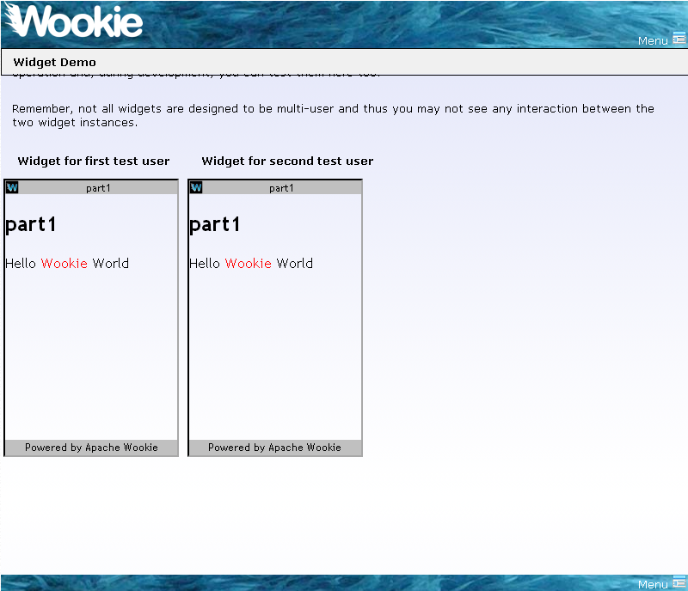

Slide 27
Next steps
Tutorial 2 will demonstrate
  How to use external libraries
  How to work with settings
Try creating a widget using the “wave” template
  Demonstrates how to communicate between users

