Slide 1
Apache Wookie (Incubating)
Creating your first widget
Ross Gardler
wookie-dev@incubator.apache.org
http://incubator.apache.org/wookie

Slide 2
Objective focussed outline
Creating a widget from the template
Running in developer mode
Modify the widget
Using external libraries
Using external APIs (not via the proxy)
Setting widget properties
Packaging for distribution

Slide 3
Task focussed outline
Create a development environment
Create a hello world widget from supplied templates
Run Wookie in standalone mode
Edit the widget
Create a real widget with geo-lookup
Display map of current location
Store settings
Package widget as .wgt

Slide 4
Development Environment

Slide 5
Create Development Environment
What you need:
  Wookie source code
  Ant + Ivy
  JDK
  Your favourite editor
    Javascript, HTML, CSS
    Java (if you want to hack on the server)

Slide 6
Using the Workshop CD
Copy the “wookie” folder to your preferred project location
Copy “apache-ant” into your preferred applications application directory
Install JDK from “java” folder
Configure your environment
  Set ANT_HOME
  Add $ANT_HOME/bin to your $PATH

Slide 7
Your first widget
Hello World!

Slide 8
Create a Hello World Widget
Wookie comes with a skeleton widget template:
Answer some questions about your widget
  Short Name: part1
  Description: Code from first practical session of Wookie training day
  Default height: 320
  Default width: 200
You now have a widget in $WOOKIE_HOME/widgets/[SHORT_NAME]
cd $WOOKIE_HOME/widgets
ant seed-widget

Slide 9
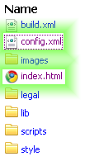
Widget File Structure

Slide 10
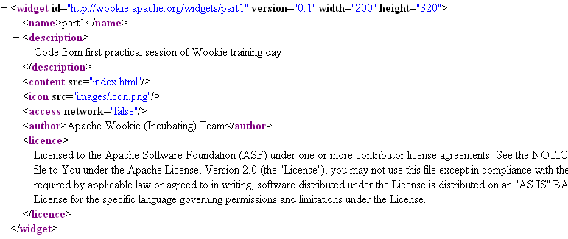
config.xml

Slide 11
index.html
<html xmlns="http://www.w3.org/1999/xhtml">
<head>
<meta http-equiv="pragma" content="no-cache"/>
<meta http-equiv="Content-Type" content="text/html; charset=UTF-8" />
<title>part1</title>
</head>
<body>
<h1>Hello World...</h1>
</body>
</html>

Slide 12
Running Wookie in Developer Mode
Developer mode allows easy building and testing of widgets

Slide 13
Developer Mode
Building Wookie auto deploys all widgets in the $WOOKIE_HOME/widgets directory
We can run in development mode with:
Visit http://localhost:8080/wookie
[ASIDE] To run in debug mode
cd ..
ant clean-db run
ant -Djvmargs="-Xdebug -Xrunjdwp:transport=dt_socket,address=8000,server=y,suspend=n" run

Slide 14
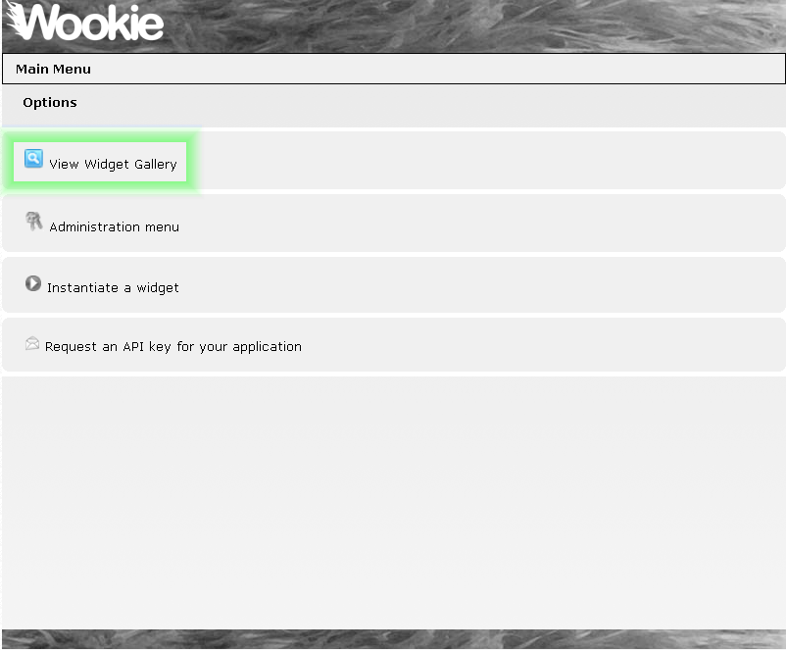

Slide 15
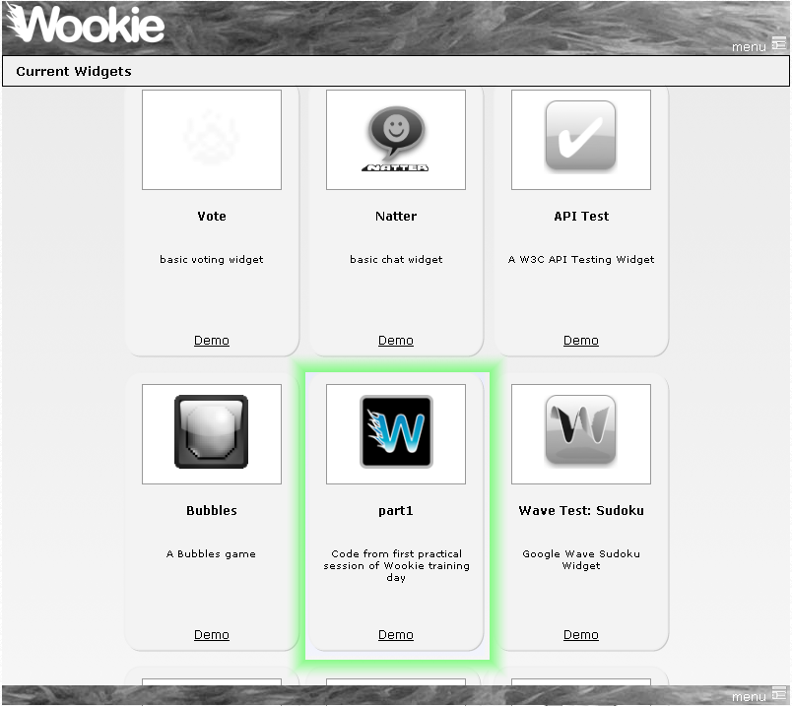

Slide 16
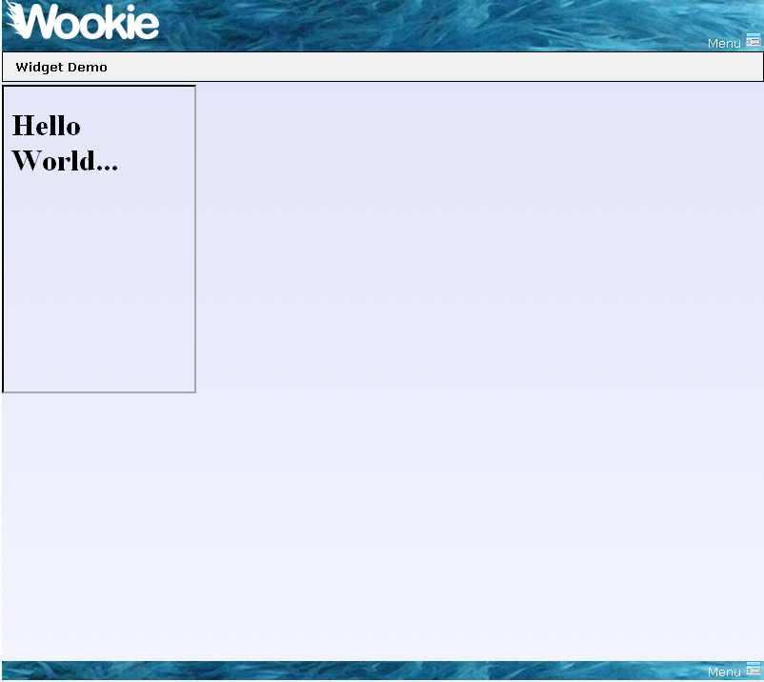

Slide 17
Editing static parts of a widget
Changing the layout of your widget

Slide 18
Editing a Widget
$WOOKIE_HOME/widgets/part1/index.html
  The initial widget page
Edit it in your favourite editor
  Perhaps to say “Hello Wookie World”
Save

Slide 19
Adding some style
It’s just HTML, so use CSS
  style/screen.css is added by template
Try changing the style in index.html, perhaps:
Don’t forget the css:
Deploy (you will be asked the name of the widget to deploy)
Refresh Browser
<span class="recent_change">Wookie</span>
.recent_change {
color: red;
}
ant deploy-widget

Slide 20
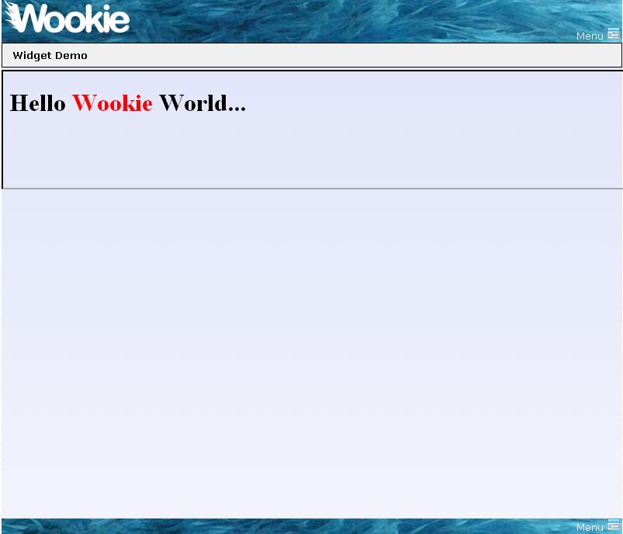

Slide 21
Lets do something real...
Map widget with geo-location

Slide 22
Geolocation Widget
There’s a great Javascript library for geolocation
  http://code.google.com/p/geo-location-javascript
Lets see what we can do with it
  From $WOOKIE_HOME/tutorials/geoLocation
    Replace contents of index.html with the contents of basicGeoWithoutFallback.html
    Copy geo.js to the scripts directory of your widget
Deploy
Refresh your browser
ant deploy-widget

Slide 23
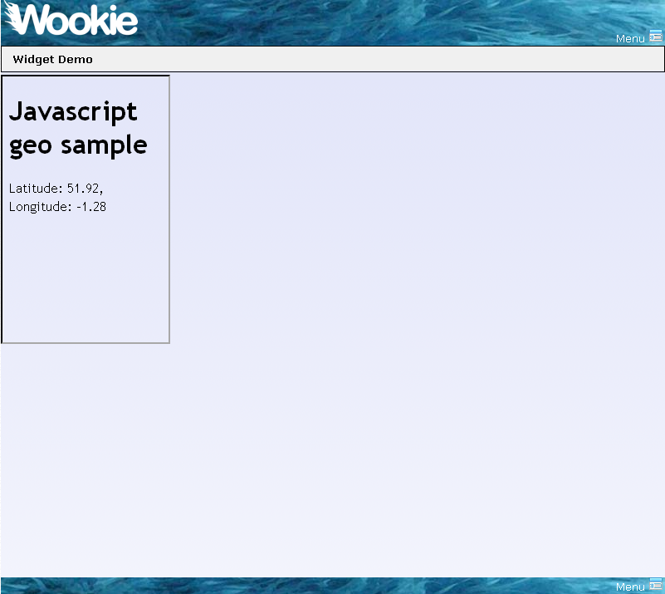
Note, this will only work if you are on a supported
platform:
iPhone OS 3.x,
Browsers with Google Gears support (Android, Windows Mobile)
Blackberry Devices (8820, 9000,...)
Nokia Web Run-Time (Nokia N97,...)
webOS Application Platform (Palm Pre)
Torch Mobile Iris Browser
Mozilla Geode
If not, you will get and error message.

Slide 24
The code
Import Javascript libraries
  <script src="scripts/geo.js" type="text/javascript"></script>
HTML elements to contain info
  <span id=“longitude”/>
  <span id=“latititude”/>

Slide 25
The code (2)
Get current location using geo-location library
  geo_position_js.getCurrentPosition(success_callback,error_callback,{enableHighAccuracy:true});
Update the page using DOM
  document.getElementById("latitude").innerHTML = p.coords.latitude.toFixed(2);
  document.getElementById("longitude").innerHTML = p.coords.longitude.toFixed(2);

Slide 26
Simulating GPS
For development lets simulate a moving GPS device

Slide 27
Simulating Movement
In development we can’t walk around to test
  geoLocation library allows simulation of an active GPS
  lets simulate someone moving through oxford
From $WOOKIE_HOME/tutorials/geoLocation
  Copy geo_position_js_simulator.js to the scripts directory of your widget
  We’ll define a path for our “walker” in Javascript

Slide 28
OpenStreetMap
Display a map from OpenStreetMap
  http://www.openstreetmap.org
From $WOOKIE_HOME/tutorials/geoLocation
  Copy contents of osmWithSimulator.html to your widgets index.html
  Copy map_osmWithSimulatorAndLayers.js to your widget script directory with the name map.js
  Copy images/map to your widget images directory
Deploy
Refresh your browser
ant deploy-widget

Slide 29
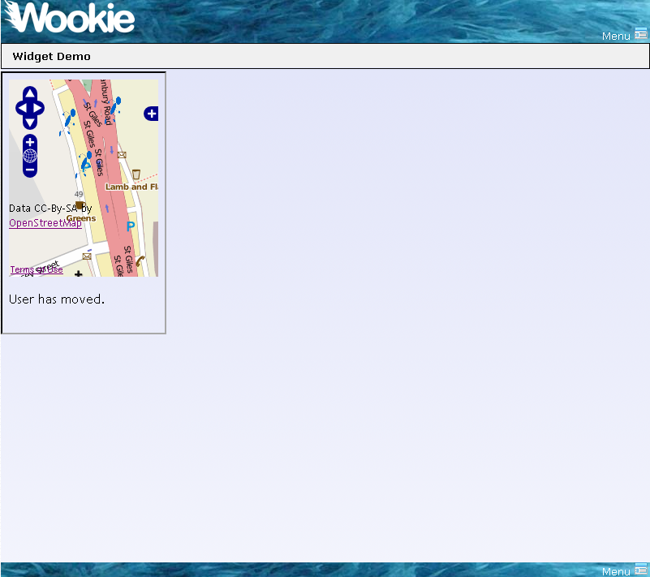

Slide 30
The code
There is nothing special in this step that is unique to widgets
The javascript is all from
  The geo-location getting started guide
  The OpenLayers API

Slide 31
Widget Settings
Personalising a widget

Slide 32
Storing Settings
Add a setting to hide the status line
  From $WOOKIE_HOME/tutorials/geoLocation
    Copy contents of osmWithSimulator.html to your widgets index.html
    Copy contents of map_osmWithSimulatorAndSettings.js to script/map.js
Deploy
Refresh your browser
ant deploy-widget

Slide 33
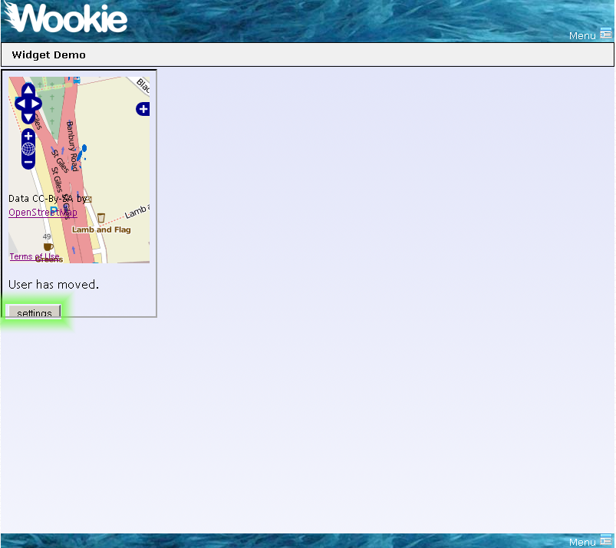

Slide 34
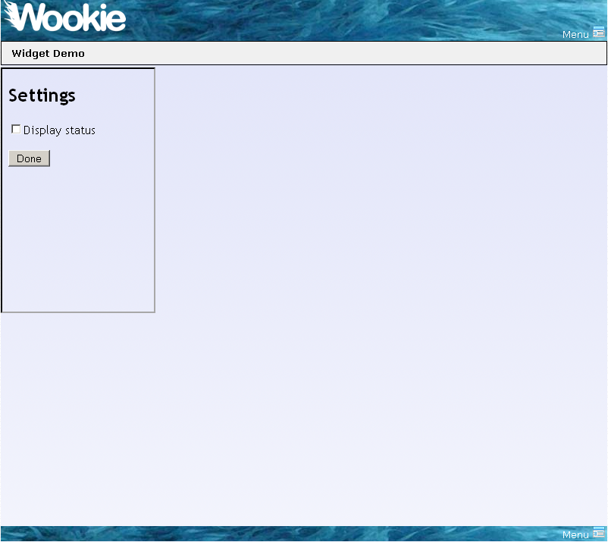

Slide 35
The code
Widget.preferences
  Gives access to preferences stored for the widget
Widget.preferences.setItem(name, value)
  Widget.preferences.setItem('displayStatus', this.checked)
Widget.preferences.getItem(name)
  Widget.preferences.getItem("displayStatus")

Slide 36
Build for Deployment
Widgets are packaged as *.wgt files for deployment

Slide 37
oucs0040@OUCS-OSSW-RG /cygdrive/c/projects/wookie
$ ant build-widget
Buildfile: build.xml
build-widget:
[input] What is the short name of the widget you wish to build?
part1
_get-widget-name:
_validate:
_clean:
_init:
build-widget:
[echo] Widget package created at c:\projects\wookie\build/widgets/part1.wgt
BUILD SUCCESSFUL
Total time: 2 seconds

Slide 38
Deploy to a server
To deploy a widget on a running server
  Build the wgt file
  Place the file in the “upload” directory of the server
    webapp/wookie/upload

Slide 39
You’re done, you can now build widgets
Lets summarise

Slide 40
Widget development cycle
Create a widget from the template
Deploy in developer mode
  Test
    manually or using a framework such as Selenium
  Edit
  Re-Deploy to running development server
Package for distribution

