Slide 1
Apache Wookie (Incubating)
Building a real widget
wookie-dev@incubator.apache.org
http://incubator.apache.org/wookie

Slide 2
Built a Hello World Widget yet?
This tutorial assumes you know the basics already.
If you've not build at least a “hello world” widget then you should start with tutorial 1.

Slide 3
Done Hello World?
Have you already built a Hello World widget?

Slide 4
Objective focussed outline
Using external libraries
Using external APIs (not via the proxy)
Setting widget properties
Packaging for distribution

Slide 5
Task focussed outline
Create a real widget with geo-lookup
Display map of current location
Store settings
Package widget as .wgt

Slide 6
Making a real widget
Map widget with geo-location
NOTE: It is assumed you have worked through tutorial 1, so you have a working widget

Slide 7
Geolocation Widget
There’s a great Javascript library for geolocation
  http://code.google.com/p/geo-location-javascript
Lets see what we can do with it
  From $WOOKIE_HOME/tutorials/geoLocation
    Remember you should be worlding with the hello world widget from tutorial 1
    Replace contents of index.html with the contents of basicGeoWithoutFallback.html
    Copy geo.js to the scripts directory of your widget
Deploy and refresh the browser
ant deploy-widget

Slide 8
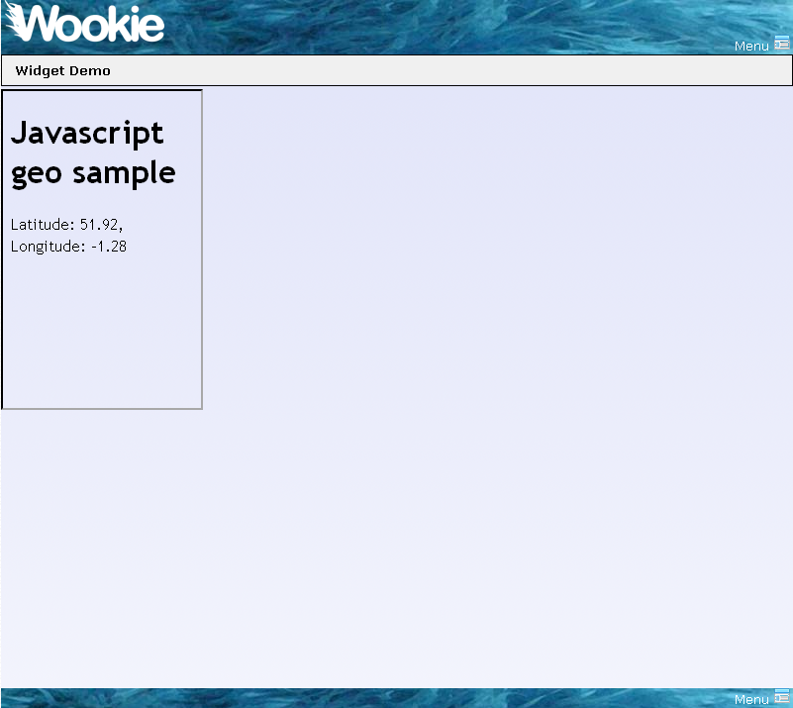
Note, this will only work if you are on a supported
platform:
iPhone OS 3.x,
Browsers with Google Gears support
  Android, Windows Mobile
Blackberry Devices (8820, 9000,...)
Nokia Web Run-Time (Nokia N97,...)
webOS Application Platform (Palm Pre)
Torch Mobile Iris Browser
Mozilla Geode
If not, you will get and error message.

Slide 9
How it works
Import Javascript libraries
  <script src="scripts/geo.js" type="text/javascript"></script>
HTML elements to contain info
  <span id=“longitude”/>
  <span id=“latititude”/>

Slide 10
How it works (2)
Get current location using geo-location library
  geo_position_js.getCurrentPosition(success_callback,error_callback,{enableHighAccuracy:true});
Update the page using DOM
  document.getElementById("latitude").innerHTML = p.coords.latitude.toFixed(2);
  document.getElementById("longitude").innerHTML = p.coords.longitude.toFixed(2);

Slide 11
Simulating GPS
For development lets simulate a moving GPS device

Slide 12
Simulating Movement
In development we can’t walk around to test
  geoLocation library allows simulation of an active GPS
  lets simulate someone moving through oxford
From $WOOKIE_HOME/tutorials/geoLocation
  Copy geo_position_js_simulator.js to the scripts directory of your widget
  We’ll define a path for our “walker” in Javascript

Slide 13
OpenStreetMap
Display a map from OpenStreetMap
  http://www.openstreetmap.org
From $WOOKIE_HOME/tutorials/geoLocation
  Copy contents of osmWithSimulator.html to your widgets index.html
  Copy map_osmWithSimulatorAndLayers.js to your widget script directory with the name map.js
  Copy images/map to your widget images directory
Deploy
Refresh your browser
ant deploy-widget

Slide 14
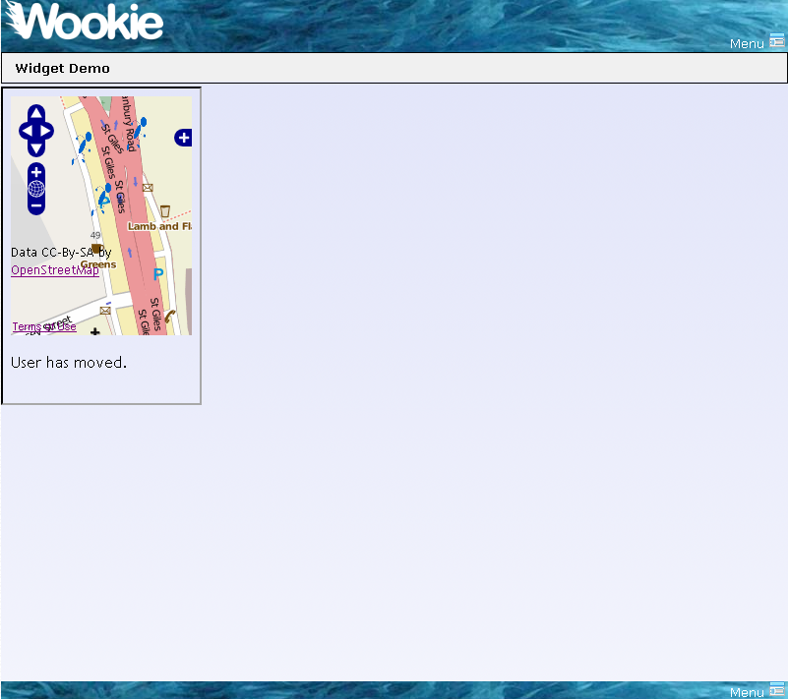

Slide 15
The code
There is nothing special in this step that is unique to widgets
The javascript is all from
  The geo-location getting started guide
  The OpenLayers API

Slide 16
Widget Settings
Personalising a widget

Slide 17
Storing Settings
Add a setting to hide the status line
  From $WOOKIE_HOME/tutorials/geoLocation
    Copy contents of osmWithSimulator.html to your widgets index.html
    Copy contents of map_osmWithSimulatorAndSettings.js to script/map.js
Deploy
Refresh your browser
ant deploy-widget

Slide 18
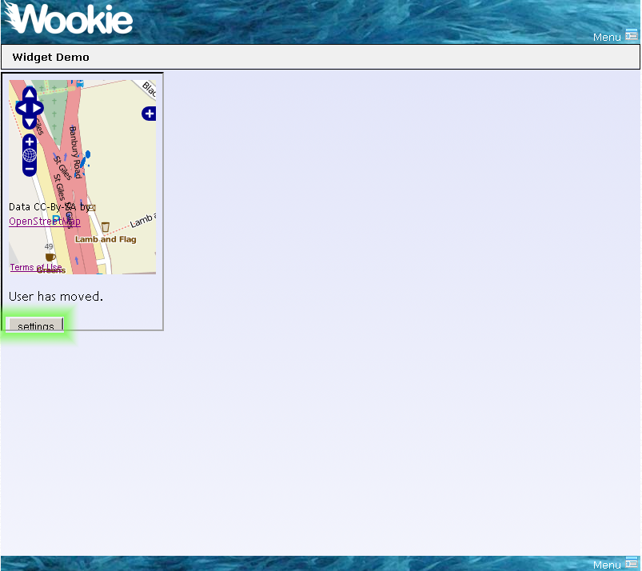

Slide 19
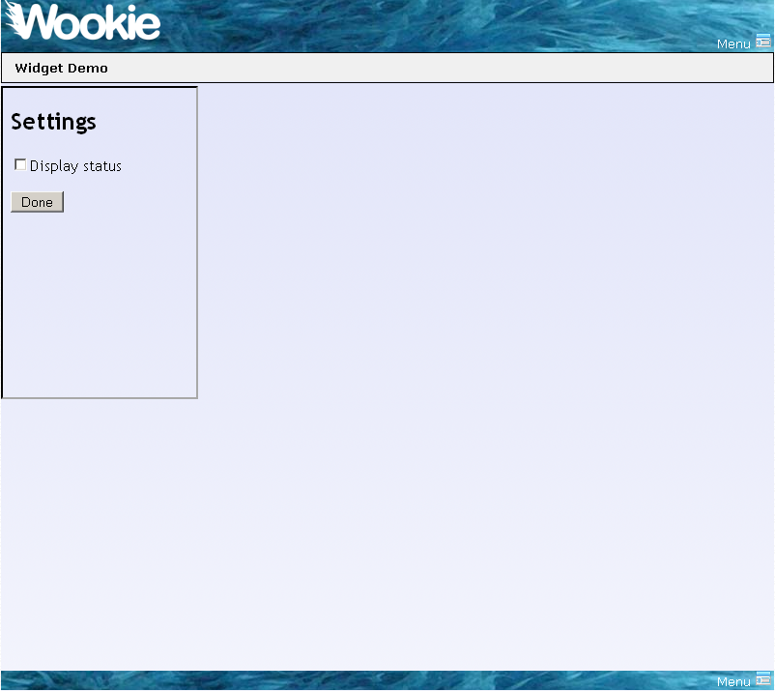

Slide 20
The code
Widget.preferences
  Gives access to preferences stored for the widget
Widget.preferences.setItem(name, value)
  Widget.preferences.setItem('displayStatus', this.checked)
Widget.preferences.getItem(name)
  Widget.preferences.getItem("displayStatus")

Slide 21
Build for Deployment
Widgets are packaged as *.wgt files for deployment

Slide 22
oucs0040@OUCS-OSSW-RG /cygdrive/c/projects/wookie
$ ant build-widget
Buildfile: build.xml
build-widget:
[input] What is the short name of the widget you wish to build?
part1
_get-widget-name:
_validate:
_clean:
_init:
build-widget:
[echo] Widget package created at c:\projects\wookie\build/widgets/part1.wgt
BUILD SUCCESSFUL
Total time: 2 seconds

Slide 23
Deploy to a server
To deploy a widget on a running server
  Build the wgt file
  Place the file in the “upload” directory of the server
    webapp/wookie/upload

Slide 24
You’re done, you can now build widgets
Lets summarise

Slide 25
Widget development cycle
Create a widget from the template
Deploy in developer mode
  Test
    manually or using a framework such as Selenium
  Edit
  Re-Deploy to running development server
Package for distribution

