Slide 1
DSAI Project
Team 6
Members: Hanafi, Ismail, Kok Siang, Shaun, Xiangrong, Zachary

Slide 2

Introduction (Dataset used)
Dataset:
Citi Bike Trip Histories (CSV files)from https://citibikenyc.com/system-data
JC-202505-citibike-tripdata (Jersey City May 2025)
Data includes:
Ride ID
Start Time, Ended Time
Start and End Station:
ID
Name
Latitude
Longitude
Member or Casual

Slide 3

Introduction (Project Goal)
Build an automated ELT Data Pipeline
Extract valuable business insights from the dataset, focusing on:
Usage trends
Revenue and Trip Count Composition
Start and End Station Popularity
Anomaly Detection

Slide 4
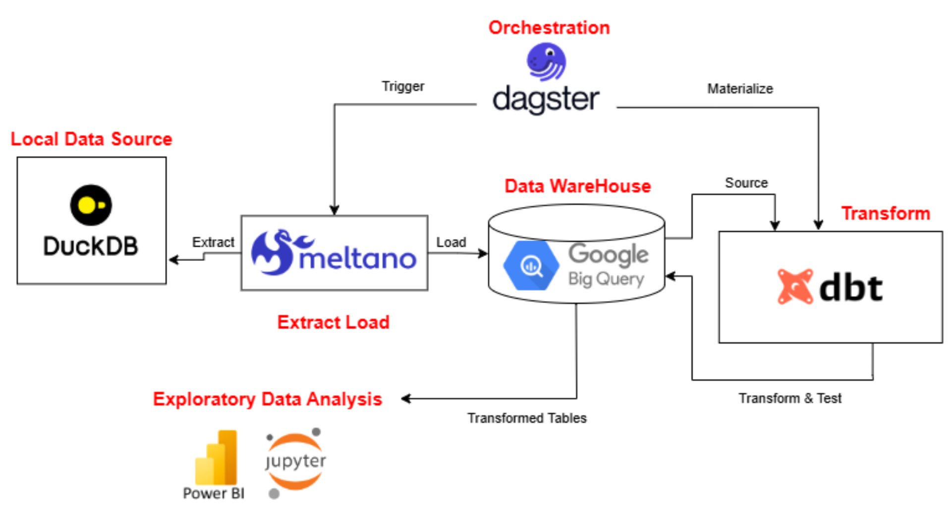
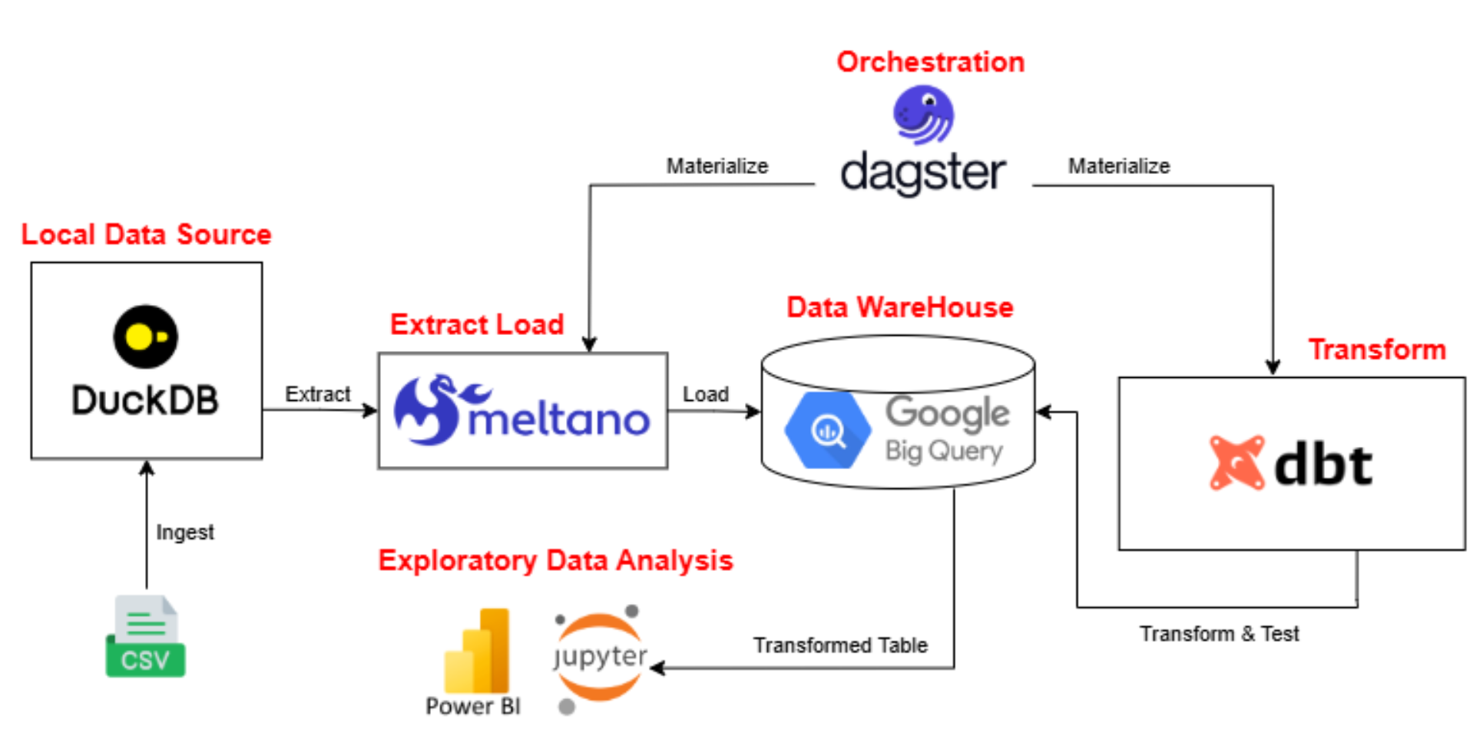
Introduction (ELT Data Warehouse Architecture)

Slide 5
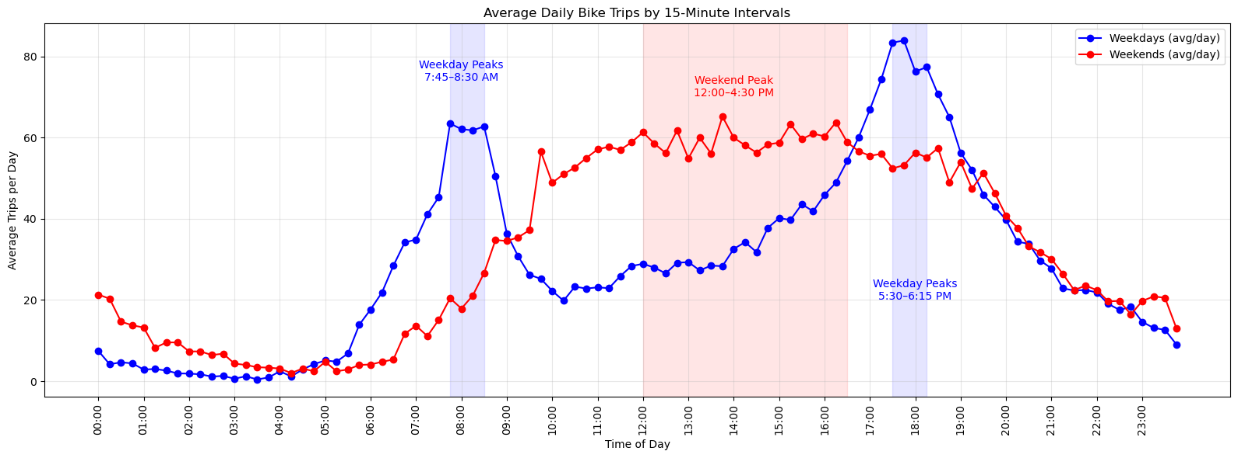
EDA (Usage Trends)
Findings
Peak timings on Weekdays aligns with commute times.
Peak timings on Weekends shows a more leisure-oriented usage.
Action to take
Implement Increase price rate on peak periods for casual users
Analyse Usage Trends throughout the Day
Avg Trip Count per Day in 15 mins intervals
Separated by Weekday and Weekends

Slide 6
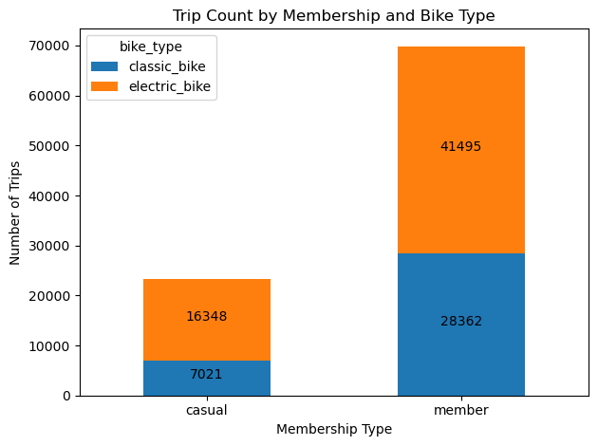
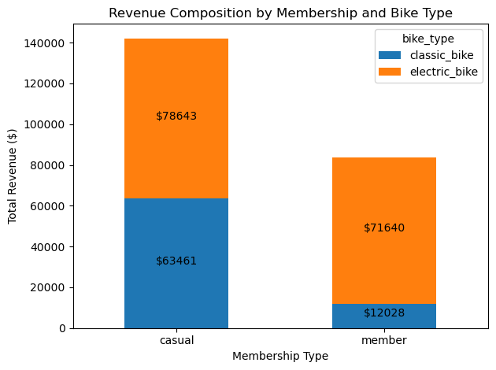
EDA (Revenue and Trip Composition)
Findings
Casual users generates more revenue despite having lower trip count in both classic and electrical bike
Classic bike generates lower revenue per trip for member user
Action to take
Increase the electric bike rates for casual users to encourage them to use the classic bike
Analyse Revenue and Trip Count Composition
Based on Membership and Bike Type

Slide 7
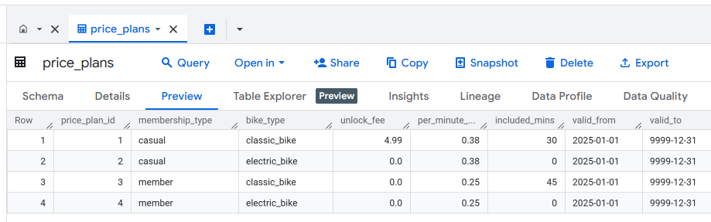
EDA using Jupyter Notebook
Revenue Insights
Price Plan

Slide 8
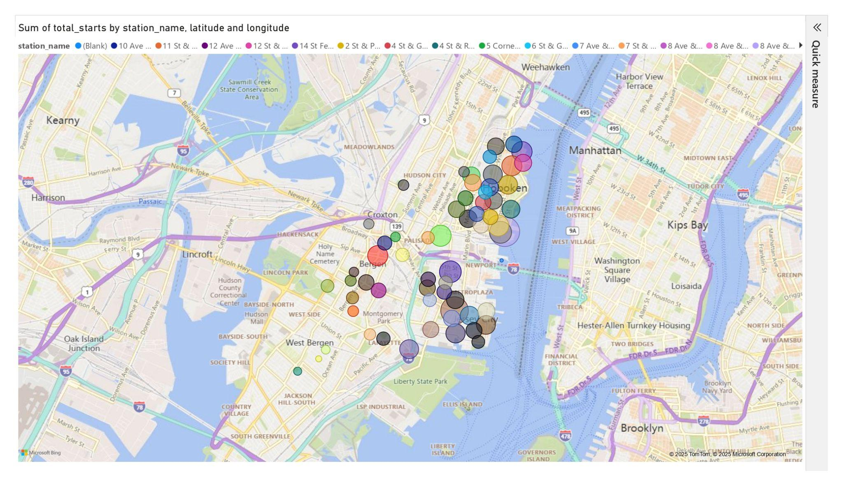
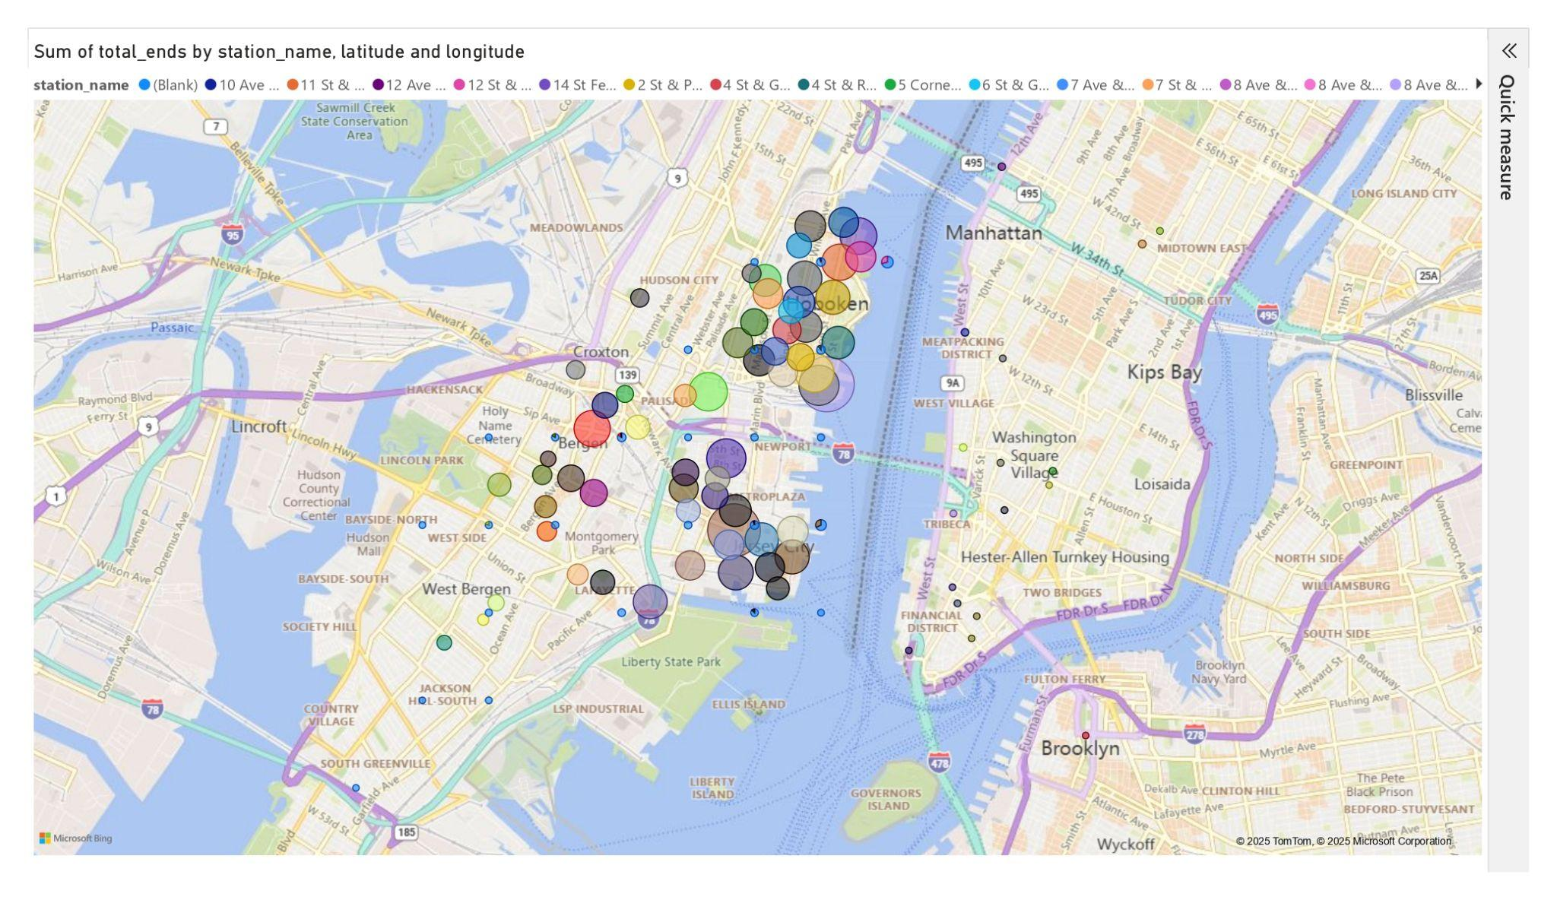
EDA (Start and End Station Popularity)
Calculated based on station_name, latitude and longitude, and total_starts and total_ends
Findings: The popular bike stations are gathered around Hoboken and Jersey City, which is where the metro areas are. Bergen and Montgomery Park also seem to have a fairly big cluster
Action: Develop more bike stations at Bergen and Montgomery Park

Slide 9
EDA (End Station Popularity)
Calculated based on station_name, latitude and longitude, and total_starts and total_ends

Slide 10
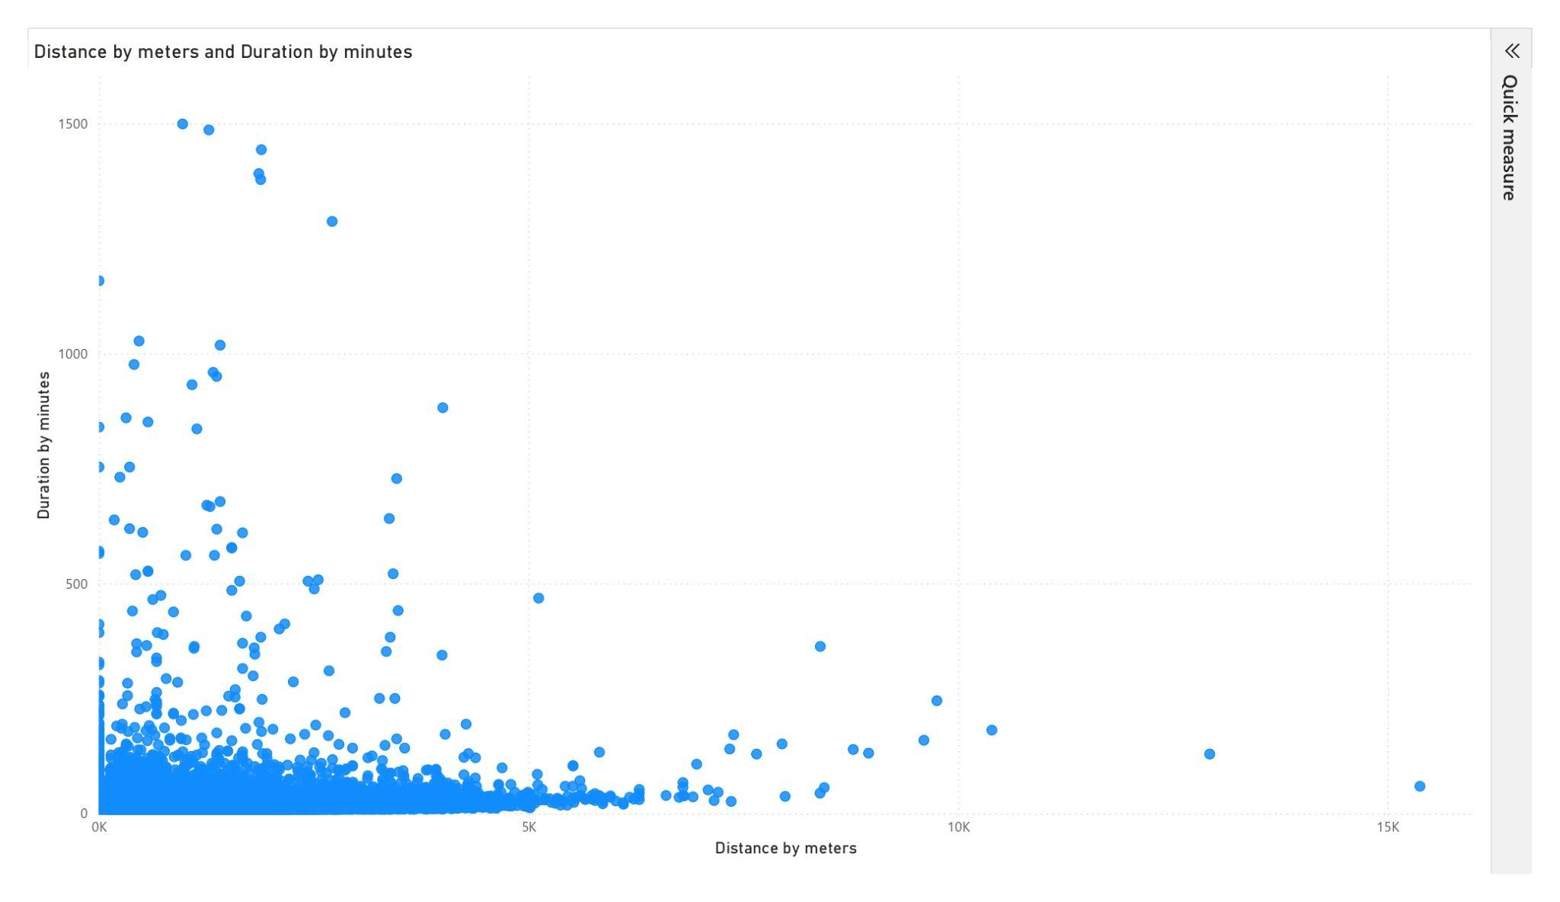
EDA using Power BI
Anomaly Detection
Based on data from duration_minutes and distance_metres
Findings:

Slide 11
EDA (Anomaly Detection)
Based on data from duration_minutes and distance_metres
Findings: Most data are clustered within the range of 500 minutes and 5km, but there are outliers found
Actions to take: Investigate the outliers and find out the cause

Slide 12
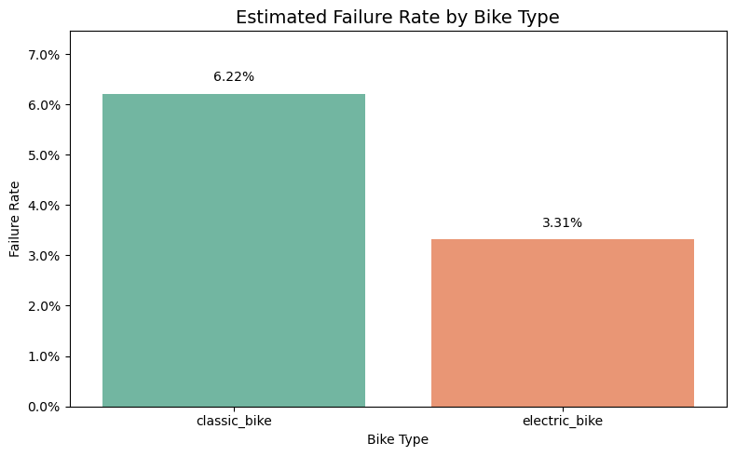
EDA (Potential Failure Rate)
Calculated using Jupyter Notebook based on outliers in duration_minutes and distance_metres
Findings: Classic bikes seem to have a potentially higher failure rate than electric bikes
Action to take: investigate the failure rate of the classic bikes, and see how it can be reduced

Slide 13
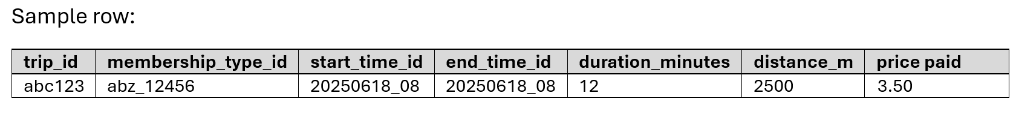
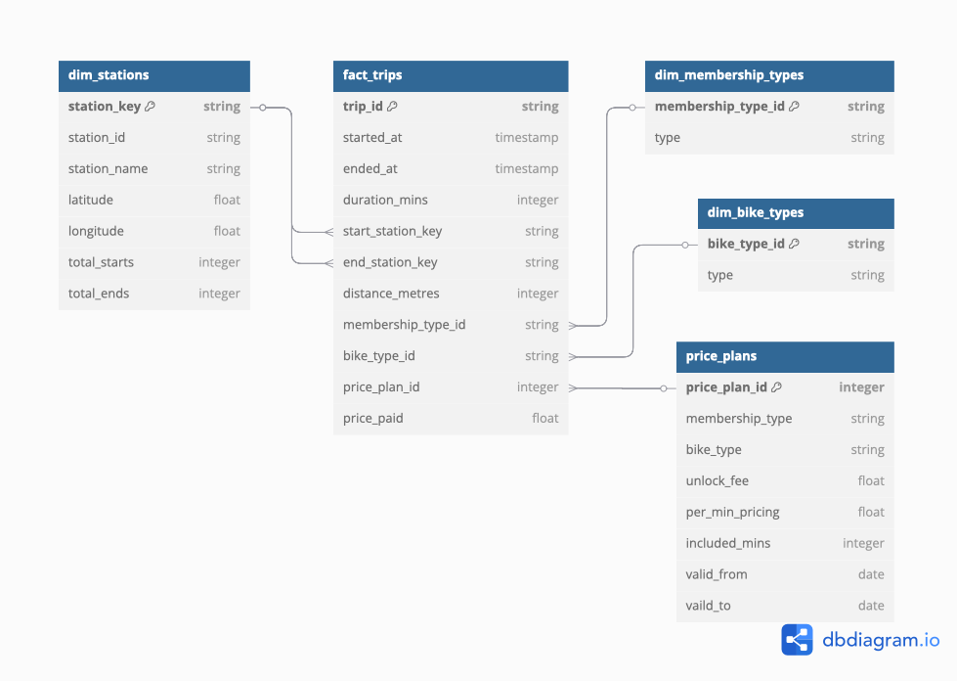
dbdiagram
In our star schema the fact_trips table uses these five foreign‐key columns to join out to the dimension tables:
start_station_key → dim_stations.station_key
end_station_key → dim_stations.station_key
bike_type_id → dim_bike_types.bike_type_id
membership_type_id → dim_membership_types.membership_type_id
price_plan_id → dim_price_plans.price_plan_id

Slide 14
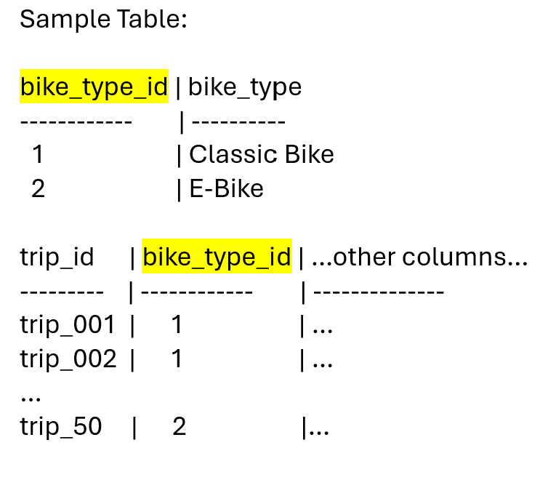
dbdiagram
In our Citibike star schema, every dimension table row (“one” side) can relate to multiple trip records in the fact table (“many” side)
Ref: fact_trips.bike_type_id > dim_bike_types.bike_type_id
Ref: fact_trips.start_station_key > dim_stations.station_key
Ref: fact_trips.end_station_key > dim_stations.station_key
Ref: fact_trips.membership_type_id > dim_membership_types.membership_type_id
Ref: fact_trips.price_plan_id > dim_price_plans.price_plan_id

Slide 15
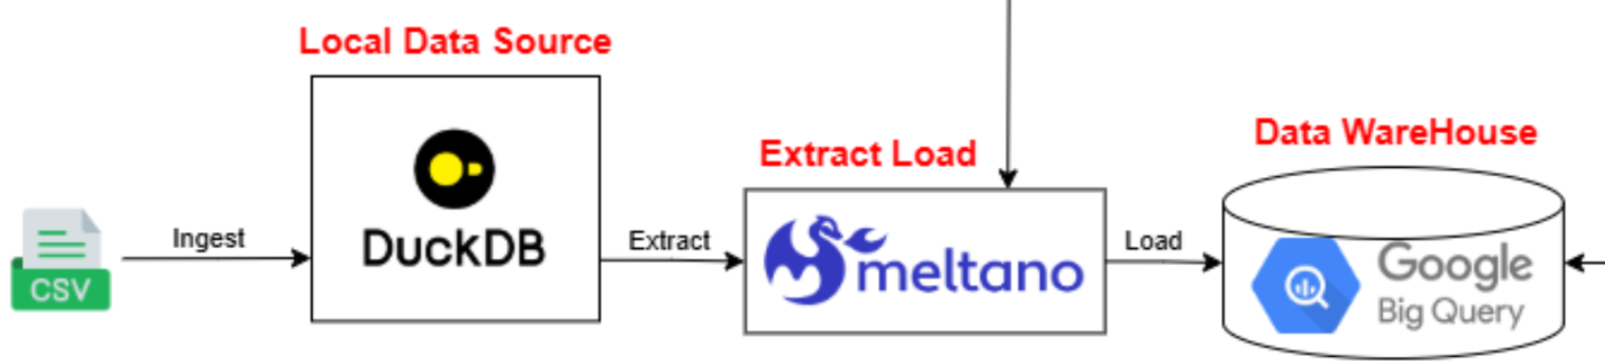
Ingestion
Data is downloaded as csv file from the citybikenyc website and load into DuckDB (local data source).
We use Meltano to orchestrate an EL pipeline
Extractor ( tap-duckdb ): to stream the raw data out of DuckDB
Loader ( target-bigquery ): will receive that stream and load it into BigQuery inside Google Cloud Project
Once the raw data is available in BigQuery, we can use dbt to clean, test and model the newly-ingested data.

Slide 16
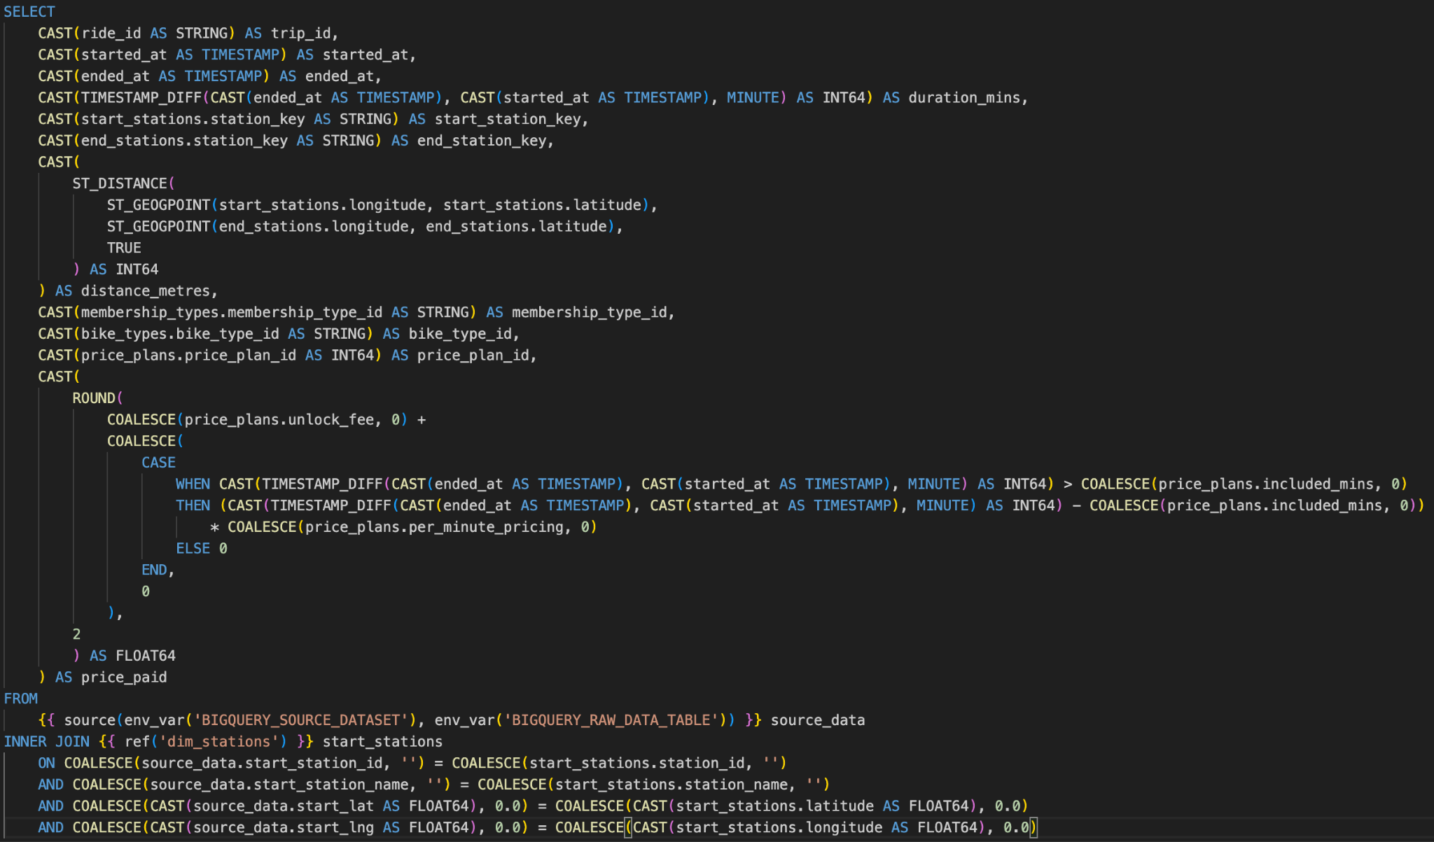
Key implementation logic for target tables (1/2)
SQL code snippet for fact_trips table
New features
duration_mins: computing difference between start and end times
distance_metres: using BigQuery’s functions (ST_DISTANCE, ST_GEOPOINT)
price_paid: referencing price_plans seed table to compute price paid per trip
Defensive coding
Explicit casting to mitigate inference differences between dbt and BigQuery
Using COALESCE function to mitigate errors due to missing/null values
Using common environment variables by implementing python-dotenv

Slide 17
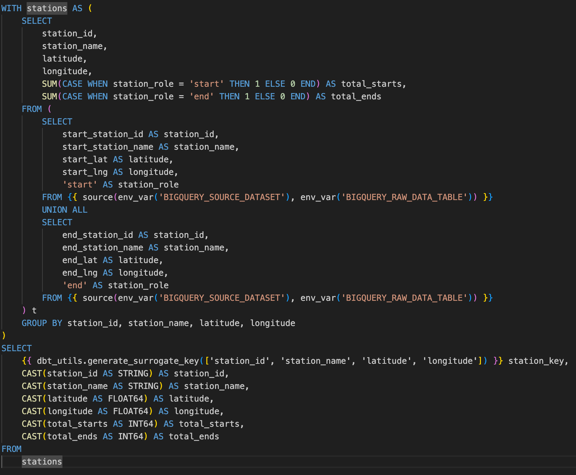
Key implementation logic for target tables (2/2)
SQL code snippet for dim_stations table
New features
Every station as an unique record: using CTE to combine all start and end stations into a temp table and group them by four columns to uniquely identify every station
total_starts, total_ends: using a temp column to store roles of every station and counting how many times each station is used as the start station for trips, likewise for end station
Data quality
Generating primary key based on four columns to mitigate incomplete source data which can give rise to downstream discrepancies (e.g., distance computation with null or zero results)
Notes:
Null or zero distance (3,873 / 93,227 in fact_trips, ~4.15%)

Slide 18
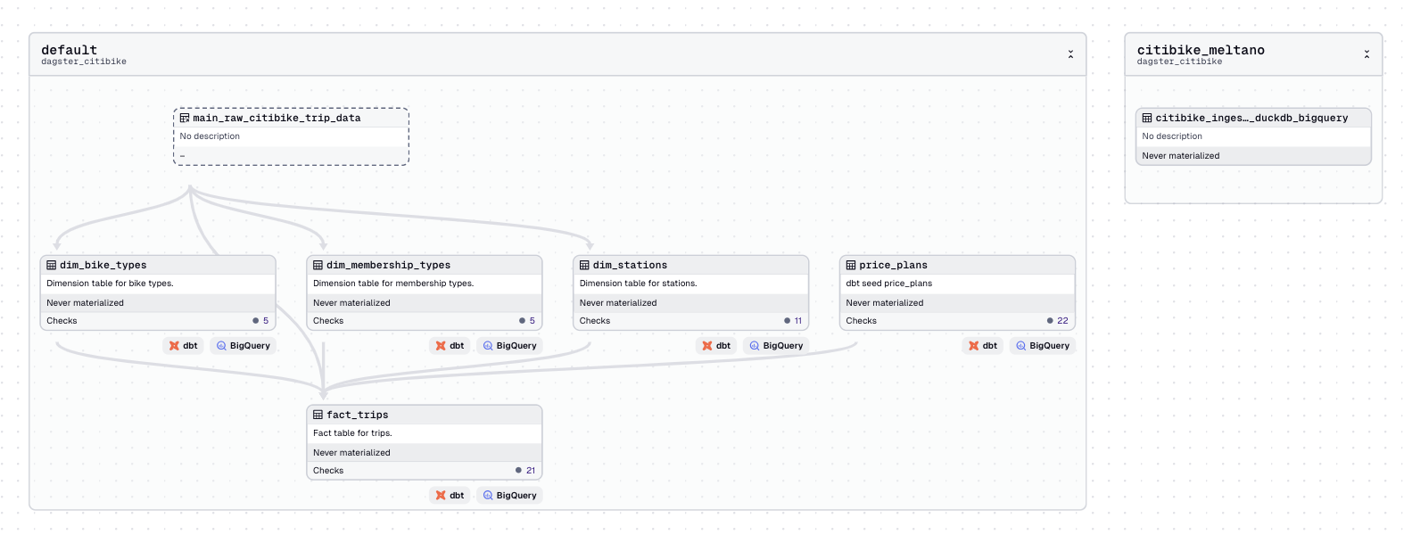
Dagster Orchestration

Slide 19
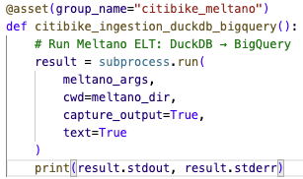
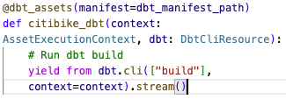
Dagster - Assets

Slide 20
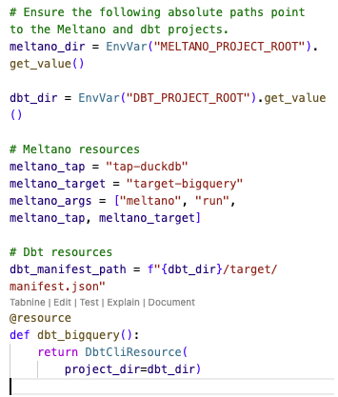
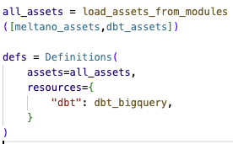
Resources
Definitions

