Slide 1
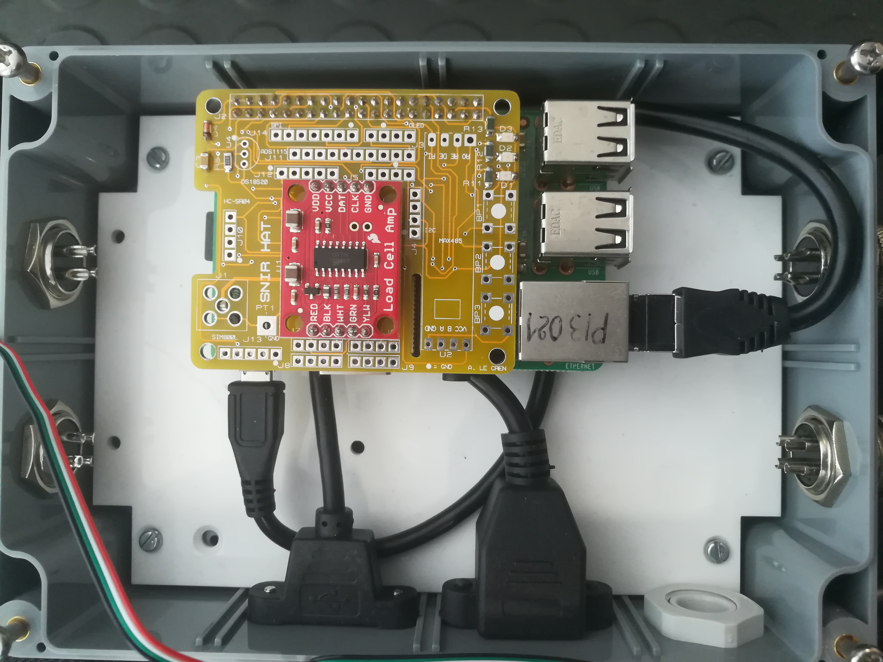
What is the importance of Raspberry Pi in the system ?
Power supply
Ethernet wire
Notes:
- The system is not complete, it is being manufactured.
- In the red circle, we can see the power supply. It’s necessary for the raspberry Pi works that is collected the informations, saved them inside it and sent them in cloud computing.
- In the purple circle, the Ethernet wire allows of send the collected informations in cloud computing and communicate between beehive and the website.
- The shield is a component to be plugged in the raspberry Pi. It allows of connect balance and many sensors.
- The SD card is used to save the collected information before sending.

Slide 2
Beehive schematic
Sensors
Beehive
Raspberry Pi
Scales

