Slide 1
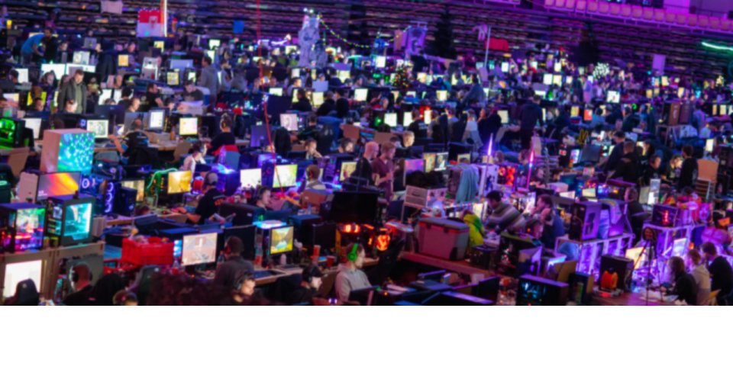
LAN PARTY
<numéro>/<nombre>

Slide 2
Summary
What is a LAN party ?
How to organize a LAN party?
  →Equipment
  →Room size
  →Budget
Packet tracer map
Conclusion
<numéro>/<nombre>

Slide 3
Definition
LAN = Local Area Network
Local Video Games Event
<numéro>/<nombre>
Notes:
LAN-party
or more simply LAN is an event
bringing together video game players with the aim of
play multiplayer video games using a local area
network instead of the internet.

Slide 4
Steps to organize a LAN Party
Maximum number of people
Necessary equipment
list types of device (desktop, laptop, consoles)
<numéro>/<nombre>
Notes:
Think about the maximum number of people you can support
Make sure you have all the necessary equipment
Before the event, ask everyone to list their types of devices (desktop, laptop, video games consoles)

Slide 5
Our project
300 guests will be present
188 desktops and 100 Wi-Fi connected laptops
Budget : 20 000 €
Size of room
<numéro>/<nombre>
Notes:
Size of room : 26m*37m
Area : 962m²

Slide 6
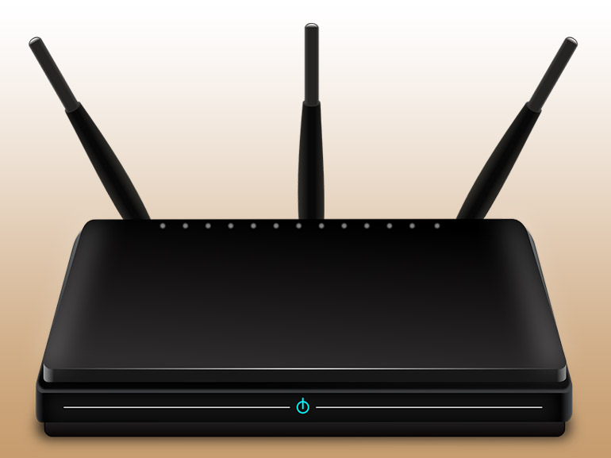
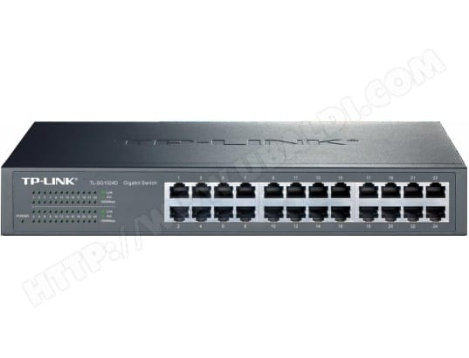
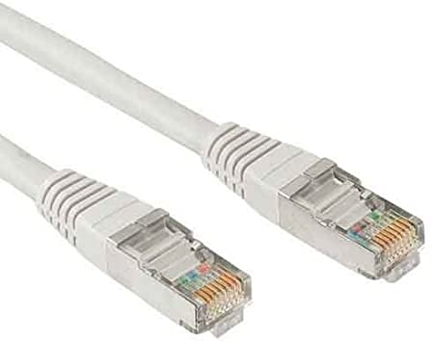
Thinking of hosting a LAN party? What to do first?
Equipment :
1 Wireless router
Price : ?
4 Switchs
Price : ?
Ethernet cable category 6
Price : ?
<numéro>/<nombre>

Slide 7
Packet tracer
<numéro>/<nombre>

Slide 8
Conclusion
<numéro>/<nombre>
Notes:
- To conclude, we found that the organization of a LAN party was very useful because it offers easy communication of data and centralized data, however the installation cost is high (router, switch ...)

