Slide 1
Job Search Automation
Presented by Andrew Pacumio

Slide 2
Automated Tasks
Scrape the Indeed.com website
Update Google Sheets with jobs found
Create job specific cover letters

Slide 3
APIs Used
Google Maps API
Geographical coordinates of job
Google Sheets API
Update google sheets for job tracking

Slide 4
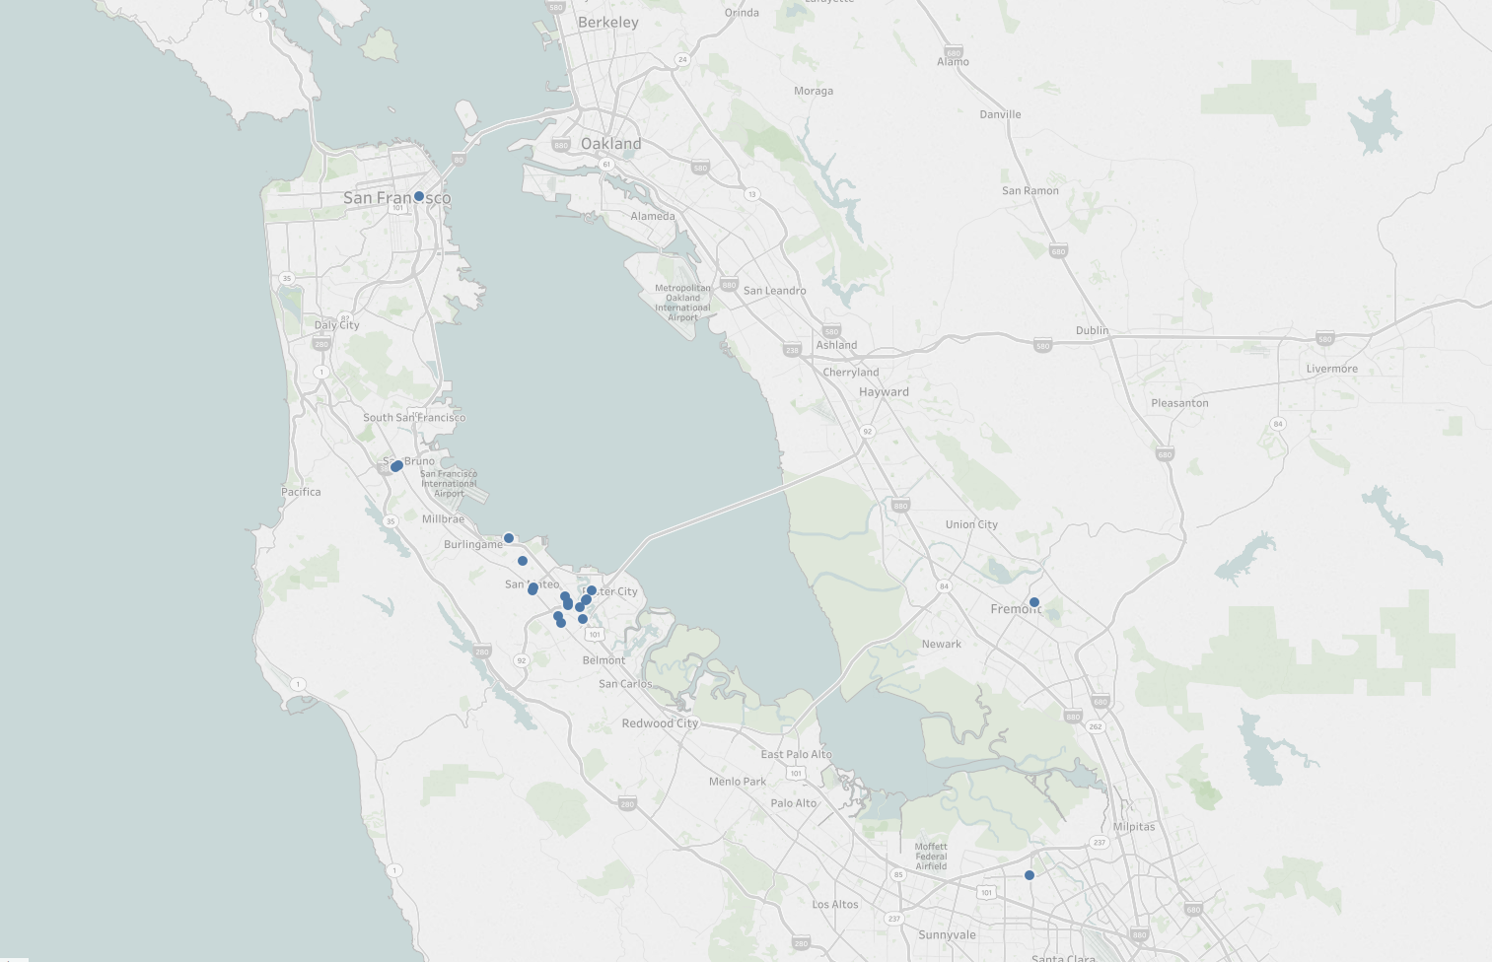
Map View

Slide 5
Live Demo

Slide 6
Next Steps
Create a UI for job search
Plot the jobs locations on a map
Upload the files to Google Drive

Slide 7
Limitations
Google sheets override
Long folder names get cut off
Only works for “Easily Apply” jobs

