Slide 1
Question 8.1
Baby Weights ~Smokers/Non-smokers Moms

Slide 2
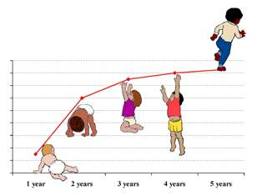
Smoking vs Non-Smoking ~ Baby Weight
Predictor variable
Smoking =1
Non-Smoking =0
Response variable
Baby Weight in ounces
This Photo by Unknown Author is licensed under CC BY-NC-ND

Slide 3

Summary Table
(a) Write the equation of the regression line.
(b) Interpret the slope in this context, and calculate the predicted birth weight of babies born to smoker and non-smoker mothers.
(c) Is there a statistically significant relationship between the average birth weight and smoking?

Slide 4
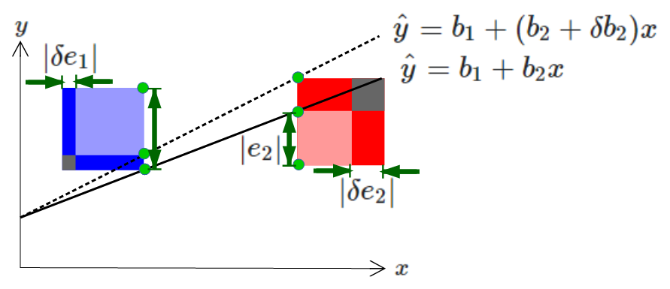
RESULTS
Write the equation of the regression line.
Y = 123.05 + (-8.94)x
(b) Interpret the slope in this context, and calculate the predicted birth weight of babies born to smoker and non-smoker mothers.
The slope predicts birth weight of a child born from a smoking parent will have a -8.94 ounce difference from the average weight of a non-smoking parent.
123.05 + (-8.94)*1 = 114.11 (Smoking Mom – Average Weight of Baby)
123.05 + (-8.94)*0 = 123.05 (Non-Smoking Mom- Average Weight of Baby)
(c) Is there a statistically significant relationship between the average birth weight and smoking?
Since the p-value is very low and less than .05, there is a significant relationship between average birth weight and smoking moms
Notes:
In Slide Show mode, select the arrows to visit links.

