Slide 1

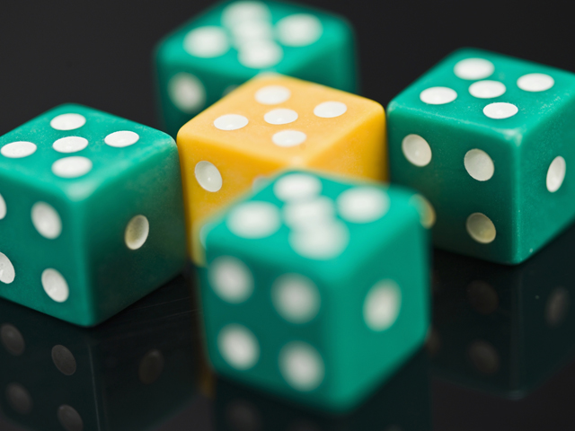

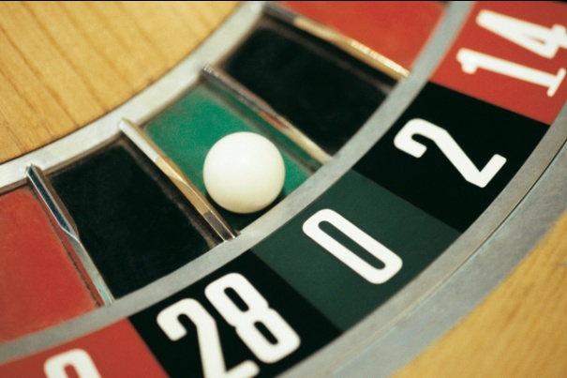
Probability

Slide 2
Structure of Probability
Experiment – is a process that produces an outcome.
The flip of a coin
The flip of two coins
The draw of a card
The roll of a die
The vote of a person
The outcome of a test
Anything that produces an outcome

Slide 3
Structure of Probability
Sample space - set of all outcomes from an “experiment”. Example, S = {Heads, Tails} is a sample space.
Trial- one repetition of an experiment (e.g., flipping the coin)

Slide 4
Structure of Probability
Event – a single outcome from an “experiment.” Example, Event A = {Heads} is an outcome. What might be an event associated with rolling a die?
Complement - the set of outcome(s) excluded by an event. Example, Event A^{c} = A’ = {not Heads} = {tails} is the complement of {Heads} in this example. What is the complement of the event that I roll a six on a single die? What is the complement of having either a heads or a tails on the single flip of a coin?

Slide 5
Some Important Concepts-Unions
Unions - “Either/Or”
The union of A or B is the set of all events for which either A or B occur. The UNION of A, B is formed by combining elements from both sets, and is denoted by
A U B. Read as “A or B.”
Example: pick a card. The union of picking a red card (event A) or a queen (event B) is picking any red card or the two black queens (28 total cards): everything in the blue and yellow circles.
What is P(A U B)?
{A♥,K♥,J♥,
10♥,9♥,8♥,
7♥,6♥,5♥,
4♥,3♥,2 ♥}
{A♣,K♣,J♣,
10♣,9♣,8♣,
7♣,6♣,5♣,
4♣,3♣,2 ♣}
Q♥ Q♣
Q ♦ Q♠
{A♦,K♦,J♦,
10♦,9♦,8♦,
7♦,6♦,5♦,
4♦,3♦,2 ♦}
{A♠,K♠,J♠,
10♠,9♠,8♠,
7♠,6♠,5♠,
4♠,3♠,2 ♠}

Slide 6
Some Important Concepts-Intersections
Intersections - “Both/And”
The intersection of A and B is the set of all events for which both A and B occur. An INTERSECTION is denoted
A ∩ B. The symbol is read as “and”. “A and B”
Often, we simply write AB to represent this intersection.
Example: pick a card. The intersection of picking a red card and a queen is picking both a red card and a queen = Queen of Diamonds and Queen of Hearts: Only items in the overlapping circles.
{A♥,K♥,J♥,
10♥,9♥,8♥,
7♥,6♥,5♥,
4♥,3♥,2 ♥}
{A♣,K♣,J♣,
10♣,9♣,8♣,
7♣,6♣,5♣,
4♣,3♣,2 ♣}
Q♥ Q♣
Q ♦ Q♠
{A♦,K♦,J♦,
10♦,9♦,8♦,
7♦,6♦,5♦,
4♦,3♦,2 ♦}
{A♠,K♠,J♠,
10♠,9♠,8♠,
7♠,6♠,5♠,
4♠,3♠,2 ♠}

Slide 7
Independent Events
Occurrence of one event does not affect the occurrence or nonoccurrence of the other event. Formally, P(AB) = P(A)*P(B).
Independent Events – the occurrence or nonoccurrence of one has no affect on the occurrence of the others
Example: Draw 1 card, return to deck, randomize, draw 2d card
Event A = {Q♥₁, Q♥₂ }
Notes:
18

Slide 8
Dependent Events
Occurrence of one event does affect the occurrence or nonoccurrence of the other event
Dependent Events – the occurrence or nonoccurrence of one has an affect on the occurrence of the others
Example: Draw 1 card, don’t return to deck, randomize, draw 2d card
We cannot have {Q♥₁, Q♥₂ }
Notes:
18

Slide 9
Mutually Exclusive, Collectively Exhaustive
Mutually Exclusive Events – events such that the occurrence of one precludes the occurrence of the other
These events have no intersection
Example: Draw 1 card from the deck
Event A = {Q♥ ∩ Q♠} = ∅
Collectively Exhaustive Events – listing of all possible elementary events for an experiment
Example:
{A♥,K♥,Q♥,J♥,10♥,9♥,8♥,7♥,6♥,5♥,4♥,3♥,2♥,A♦,K♦,Q♦,J♦,10♦,9♦,8♦,7♦,6♦,5♦,4♦,3♦,2♦,A♣,K♣,Q♣,J♣,10♣,9♣,8♣,7♣,6♣,5♣,4♣,3♣,2♣,A♠,K♠,Q♠,J♠,10♠,9♠,8♠,7♠,6♠,5♠,4♠,3♠,2 ♠}
{A♣,K♣,J♣,
10♣,9♣,8♣,
7♣,6♣,5♣,
4♣,3♣,2 ♣}
Q♥ Q♣
Q ♦ Q♠
{A♦,K♦,J♦,
10♦,9♦,8♦,
7♦,6♦,5♦,
4♦,3♦,2 ♦}
{A♠,K♠,J♠,
10♠,9♠,8♠,
7♠,6♠,5♠,
4♠,3♠,2 ♠}
PollEverywhere.com
Notes:
7

Slide 10

Marginal Probability
The probability of a simple event happening, for example, the probability of A={heads} on the flip of a coin, is called marginal probability and is written P(A).
Marginal also indicates that this probability may be often calculated from the margins of a table.
Assume my experiment is a single spin of the roulette wheel. Let B = {green}. What is P(B)?
A

Slide 11
Union Probability
Unions - “Either/Or”
The union of A or B is the set of all events for which either A or B occur. The union of A, B is formed by combining elements from both sets, and is denoted by
A U B. Read as “A or B.”
The probability of a union is written P(A U B) or P(A or B).
Let A be the event I draw an even number on a draw of the ping pong balls from a bucket of 20.
Let B be the event I draw a multiple of 5.
What is P(A or B)? (Think about successful outcomes divided by total possible outcomes.) What method of assigning probabilities are we using?
A
B

Slide 12
Joint Probability
The intersection of A and B is the set of all events for which both A and B occur. An intersection is denoted
A ∩ B. The symbol is read as “and”. “A and B”
Often, we simply write AB to represent this intersection.
The joint probability of both A and B is the probability of an intersection and is written P(A ∩ B) or just P(AB).
Let A be the event I draw an even number on a single draw of the ping pong balls from our bucket.
Let B be the event I draw a multiple of 5.
What is P(AB)?
A
B

Slide 13

Conditional Probability
Sometimes, we wish to use conditional phrases. To do so, we use the “pipe” symbol
A | B which is read “A” given that “B” happened
If B already happened, then the area of interest is only within B.
The probability of A|B is called conditional probability and written P(A|B)
Let A be the event I draw an even number on a single draw of the ping pong balls from our bucket.
Let B be the event I draw a multiple of 5.
Before investigating the formal rules, what is P(AB)?
B

Slide 14
Mutually Exclusive Events: Addition Rule for Unions
Events A and B are mutually exclusive if both cannot occur at the same time, that is, if their intersection is empty.
For mutually exclusive events, the probability of either A or B events occurring follows
P(A or B) = P(A) + P(B)
A is the event I roll a 1 on a die. B is the event that I roll a 5 on a die. These two events are mutually exclusive. What is P(A or B)?
A
B

Slide 15
General Addition Rule
If events A and B are NOT mutually exclusive, the general rule of addition applies
A is the event I roll a 1 on a die. B is the event I roll an odds.
These events are NOT mutually exclusive. If I roll a 1, both happen.
The general rule of addition applies.
P(A or B) = P(A) + P(B) – P(AB)
In our example, P(A) = ? P(B) = ? P(AB) = ? P(A or B) = ?
A
B
AB

Slide 16

Independent Events Multiplication Rules
Events are independent when the occurrence of one event does not change the probability that another event will occur.
If A and B are independent, P(A|B) = P(A) because the occurrence of event B does not change the probability that A will occur.
If A and B are independent, P(B|A) = P(B) because the occurrence of event A does not change the probability that B will occur.
If A and B are independent, then P(A and B) = P(A) • P(B)
Example: Flip a coin and roll two dice. Let A be the result of the coin flip and B be the sum of the dice. What is the probability of A={heads} and B={12}?
X

Slide 17

General Multiplication Rule-Dependent Events
Events are dependent when the occurrence of one event does change the probability that another event will occur.
If A and B are dependent, P(A|B) ≠ P(A) because the occurrence of event B does change the probability that A will occur.
If A and B are dependent, then
P(A and B) = P(A) • P(B|A)
P(A and B) = P(B) • P(A|B)
Example: Let A = {even} on the first draw without replacement of a ping pong ball from the bucket full of 20. Let B = {even} on the second draw from that same bucket.
What is P(A)? What is P(B|A)? What is P(A and B)?

Slide 18
Law of Conditional Probability
The conditional probability of A given B is the joint probability of A and B divided by the marginal probability of B.
I have 16 females in one of my classes and 28 males. Exactly 6 of the women are over 5’ 6”, and exactly 22 of the males are over 5’6.”
Let A be the event the person selected is over 5’6.”
Let B be the event that I select a woman.
What is P(AB)?
What is P(B)?
What is P(A|B)?

Slide 19
“Revision" of Probabilities: Bayes’ Rule
An extension to the conditional law of probabilities
Enables revision of original probabilities with new information
Note, the numerator of Bayes’ Rule and the law of conditional probability are the same
The denominator is a collective exhaustive listing of mutually exclusive outcomes of A.
The denominator is a weighted average of the conditional probabilities with the weights being the prior probabilities of the corresponding event
Notes:
43

Slide 20
Urinalysis
Approximately 5.00% of the workforce is known to use marijuana.
A test for marijuana is 95.00% sensitive (meaning that it correctly identifies a true user 95.00% of the time).
The same test for marijuana is 92.00% specific (meaning that it correctly identifies a true negative 92.00% of the time.)
A worker comes up positive for marijuana use by this test.
Given that he is positive, what is the probability he is actually a user?
Let B = event he is positive. Let A₁ = event he is user.
What is P(B|A₁)? 95.00% sensitivity
What is P(A₁)? 5.00% are users
What is P(B|A₂)? 100.00% - 92.00% = 8.00% will be positive although not users
What is P(A₂ )? 95.00% are not users
Why so low?

Slide 21
Multiplication Rule of Counting
Multiplication rule of counting: If there are m ways a first event can occur and n ways a second event can occur, the total number of ways the two events can occur is given by m x n.
Example: I have 4 different colors of dice and 3 different colors of coins. How many different sets of 1 die and 1 coin are possible?
A cafeteria offers 5 salads, 4 meats, 8 vegetables, 3 breads, 4 desserts, and 3 drinks. A meal is two servings of vegetables, which may be identical.
How many meals are available?

Slide 22
Sampling from a Population with Replacement
Sampling with Replacement: If I am sampling n items from a population of N distinct items, then I have N^{n} possibilities.
Suppose I’m going to take a sample of 5 ping pong balls from the trash can in which I have 20 stored. Suppose I am going to return each ball after drawing it. How many possibilities do I have?

Slide 23
Factorial Rule of Counting fa=function(a){factorial(a)}
Factorial rule of counting: The number of ways n objects can be arranged in order. =fact(n)
n! = n x (n – 1) x (n – 2) x ... x 1
Let’s look at 6 different colored cubes and place them in six different places….Watch…

Slide 24
Combinations fx=function(N,n){factorial(N)/(factorial(n)*factorial(N-n))}
Combinations: The number of ways n objects can be arranged taken r at a time. Order is not important. Consider combinations for sampling without replacement. =combin(n,r)
How many ways can I get 2 heads on the flip of 3 coins?
How many ways can I get 3 heads on the flip of 4 coins?
How many ways can I get 19 ping-pong balls from 20?

Slide 25
Permutations fy=function(N,n){factorial(N)/factorial(N-n)}
Permutations: The number of different ways N objects can be arranged taken n at a time. Order is important. =permut(n,r)
How many ways can I select three ping pong balls and assign to three distinct locations?

Slide 26
Discrete Probability Mass Functions (PMFs)
An Introduction

Slide 27
Probability functions
A probability function maps the possible values of X against their respective probabilities of occurrence, P(X=x)
P(X=x) is a number from 0 to 1.0.
The area under a probability function is always 1.

Slide 28
PMF, Roll of Fair Die
x
P(X=x)
1
P(X=1)=1/6
2
P(X=2)= 1/6
3
P(X=3)=1/6
4
P(X=4)=1/6
5
P(X=5)=1/6
6
P(X=6)=1/6

Slide 29
Cumulative Distribution Function
1.0
P(x)
5/6
2/3
1/2
1/3
1/6
1
2
3
4
5
6
x

Slide 30

Discrete vs. Continuous Distributions
Discrete distributions – constructed from discrete (individually distinct) random variables.
The domain of the discrete distribution is finite and countable.
The probability mass function (PMF)
Continuous distributions – based on continuous random variables.
While a continuous distribution may have finite lower and upper bounds, an infinite set of values is possible (just add more significant digits!)
A continuous variable takes on values at every point over a given interval.
The probability density function (PDF)
Notes:
4

Slide 31
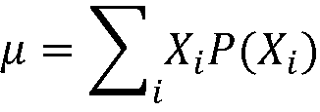
Describing a Discrete Distribution
Expected Value = Mean of discrete distribution – is the long run average . E(X)=μ
If the process is repeated long enough, the average of the outcomes will approach the long-run average (mean).
Requires the process to eventually have a number which is the product of many processes (e.g., flipping two coins repeatedly).
Mean of a discrete distribution

Slide 32
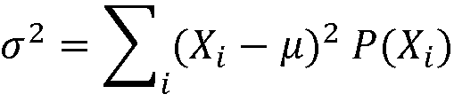
Describing a Discrete Distribution
Variance of a discrete distribution are solved by using X in a manner similar to computing these values for grouped data. Var(X)=σ²
So, what is the standard deviation?

Slide 33
The Binomial and Poisson
To be or not to be…That is a binomial!
The Poisson: a fishy distribution

Slide 34
Binomial Probability Mass Function
Characteristics
There are only two possible outcomes on a particular trial of an experiment.
The outcomes are mutually exclusive.
The random variable is the result of counts.
Each trial is independent of any other trial, although independence is not too much of a concern if the sample is less than 1/20th of the population (simulation studies).

Slide 35
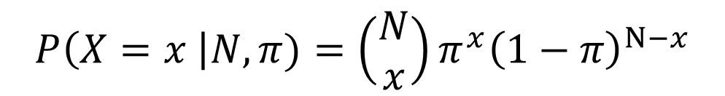
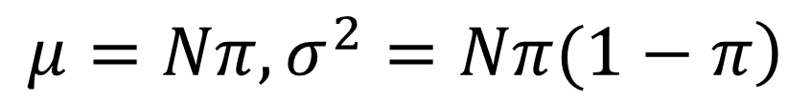
Binomial dbinom,pbinom,rbinom,qbinom
$$P\left(X=x \right|N,π)=\left(\begin{matrix}N \\ x\end{matrix}\right)π^{x}{\left(1−π\right)}^{N−x}$$
n is the sample size
π is the probability of success
1-π is the probability of failure, also known as q
In layman’s terms, we are choosing the number of ways we can obtain x successes out of N trials.
We are then multiplying the probability of getting x successes (π ^{x}) by the probability of getting n-x failures (1- π)^{n-x} .
$$\left.μ=Nπ, σ^{2}=Nπ(1−π\right)$$
hist(rbinom(10000,100,.5),main="Binomial",col="red"

Slide 36
Poisson PMF, Law of Rare Events dpois,ppois,rpois,qpois
The Poisson probability distribution describes the number of times some event occurs during a specified interval. The interval may be time, distance, area, or volume. The Poisson is actually an approximation of the binomial distribution for very rare events.
Poisson was Napolean Bonaparte’s statistician. He developed this distribution by modeling deaths due to being kicked by mules.
Assumptions of the Poisson Distribution
The probability is proportional to the length of the interval.
The intervals are independent.

Slide 37
Poisson Distribution
The probability function: derives from the binomial
Mean value
Variance
Standard deviation
If the interval (t) is 1, then the mean, variance, and standard deviation are as follows
Mean value
Variance
Standard deviation
Notes:
34

Slide 38
Poisson Distribution
We can still calculate the mean using our formula, and doing so results in finding λt.
Notes:
34

Slide 39
Examples
The rate of medication errors across the United States is 2 per 1000 orders. (Volume). A sample from your local hospital finds 5 errors in a sample of 2000. What is the probability that this hospital is within the US standard?
A. Model as a Poisson.
P(Y >= 5 | λ = 2, t=2) = 1 – P(Y<=4) =
1-ppois(4,4)
B. Model as a Binomial.
P(X>=5 | N = 2000, π= .002) = 1-P(Y<=4)
1-pbinom(4,2000,.002)
par(mfrow=c(2,1))
hist(rpois(1000,4),col="blue")
hist(rbinom(1000,2000,.002),col="red")
What is the expected number of medication errors per 2000 for the Poisson? λt = 4
What is the expected number of medication errors for the Binomial? np = 2000 x .002 = 4
What is the variance of the Poisson? λt = 4
What is the variance of the Binomial? npq = 2000 x .002 x .998 = 3.992

Slide 40
Hypergeometric PMF dhyper, phyper, rhyper, qhyper
Sampling without replacement from a finite population
The number of objects in the population is denoted N.
Each trial has exactly two possible outcomes, success and failure.
Trials are not independent
X is the number of successes in the n trials
The binomial is an acceptable approximation, if n < 5% N. Otherwise it is not.
Notes:
25

Slide 41
Hypergeometric PMF
N is population size
n is sample size
S is number of successes in population
x is number of successes in sample
Notes:
26

Slide 42
Example
You decide to play the Texas Lotto. In the Lotto, you choose any six numbers from the sequentially numbered set {1, 2, 3…54}.
What is the probability that you choose all six winning numbers? dhyper(6,6,48,6)
What is the probability that you choose three or more winning numbers? sum(dhyper(3:6,6,48,6))

