Slide 1
BANG FOR YOUR TAXPAYER BUCK
TEACHER RATINGS IN THE ALBANY SCHOOL DISTRICT
Team Members:
Jack Russo
Anthony Pagan
Alexander Niculescu

Slide 2
TEAM TIMELINE
10/10-10/12
Team Formed
Slack Channel Created
Trial Goto Meeting Account created
Decided on a data Source
Decided to use Slack and Github to share data
10/13-10/17
Selected Data
Reviewed data and determined unusable via Slack and Goto Meeting
Selected new data source
Decided to narrow down scope
Merged Code
10/18-10/21
Retrieved data and imported to db for analysis
Exported to CSV for further tidying
Prepared presentation
Data /Presentation Tweak via Github
Team Introduction
Data Collection and Analysis
Data and Presentation Prep
T

Slide 3
The Most Valued Data Science Skills:
Prerequisites:
Having an interdisciplinary understanding of math and computer science
Being at the right place at the right time
Skills Needed:
Inquisitiveness and impetus for change
Enthusiasm
Return on Investment
Notes:
Interdisciplany understanding is a no brainer
Right place at the right time - without funding, or support even the best analytics can get lost in a sea of data
Using outliers to identify issues
Being passionate, and telling a compelling story
Adding value to an organization, or being the catalyst of change

Slide 4
What’s Wrong With New York City’s Public Schools?
In 2015 the Governors’ office released a report on the failing state of education in New York State. Here were some key points…
https://www.governor.ny.gov/sites/governor.ny.gov/files/atoms/files/NYSFailingSchoolsReport.pdf

Slide 5
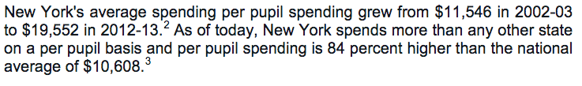

Slide 6
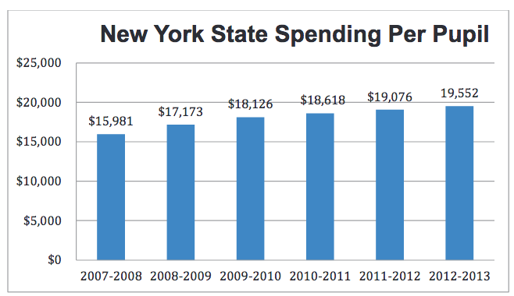

Slide 7
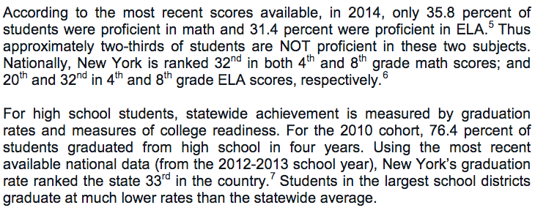

Slide 8
GIVEN THIS UNSETTLING TREND, OUR TEAM WANTED TO USE NY STATE DATA TO VERIFY THESE FINDINGS.
HTTPS://DATA.NYSED.GOV/DOWNLOADS.PHP

Slide 9
HOWEVER TWO THINGS BECAME CLEAR AFTER REVIEWING THE AVAILABLE DATA: 1. THE DATA WAS TOO UNRULY/INCOMPLETE TO EVALUATE THE CORRELATION BETWEEN PER PUPIL EXPENDITURE AND EDUCATION OUTCOMES. 2. WE COULD BETTER CONTRAST TEACHER EVALUATIONS RATINGS AND PER PUPIL EXPENDITURE. WE WILL CONTRAST THE CORRELATION BETWEEN DATA AND REPORTED STATISTICS.

Slide 10
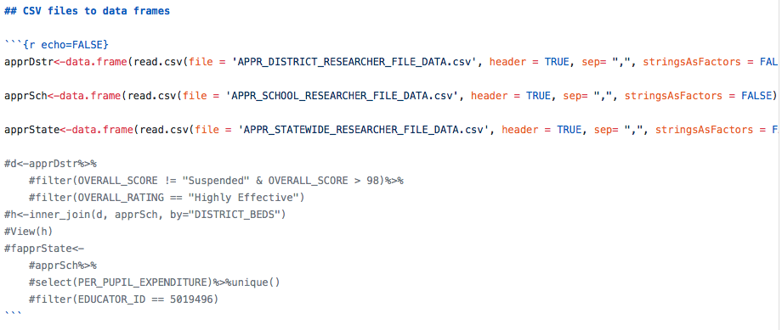
FIRST WE JOINED THE DATA USING THE FOLLOWING METHODS.

Slide 11
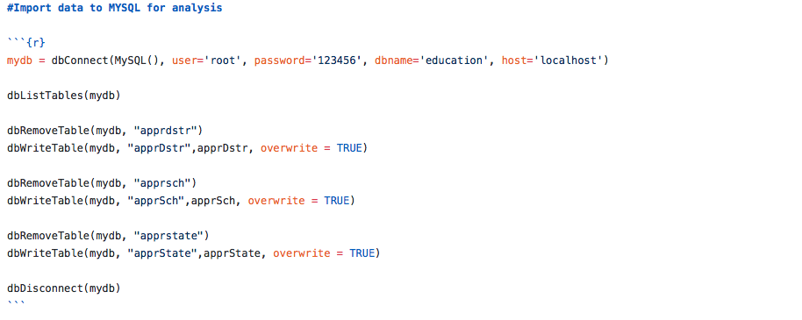

Slide 12
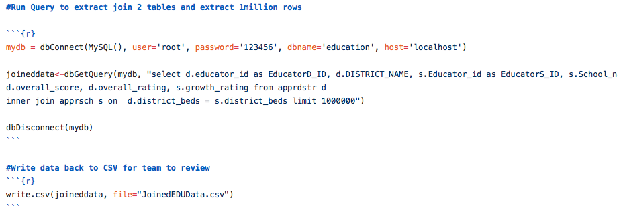

Slide 13
NOTE WE WERE ONLY ABLE TO MERGE THE DATA FOR THE ALBANY SCHOOL DISTRICT.

Slide 14
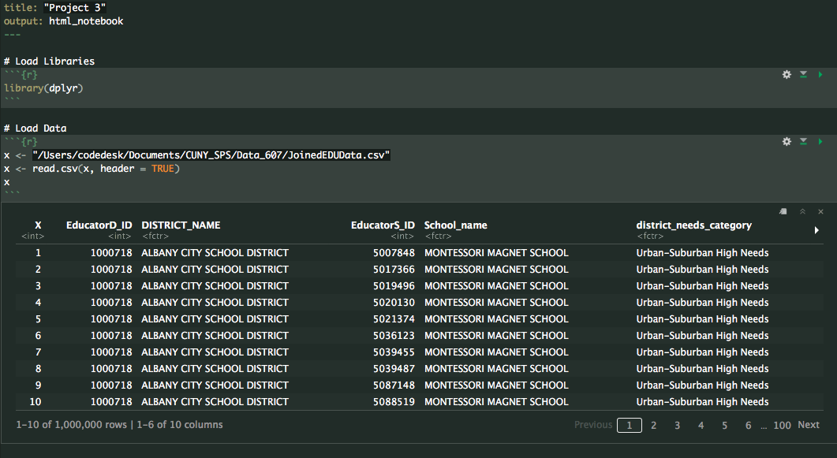
THEN WE CLEANED THE DATA AND PREPARED IT FOR ANALYSIS.

Slide 15
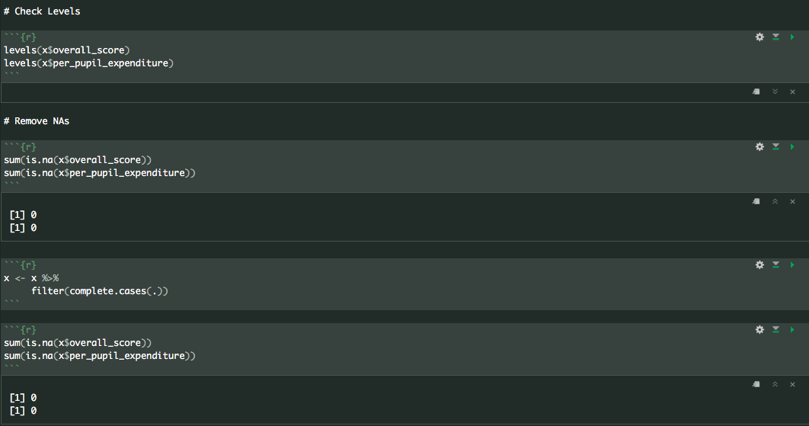
THEN WE CLEANED THE DATA AND PREPARED IT FOR ANALYSIS.

Slide 16
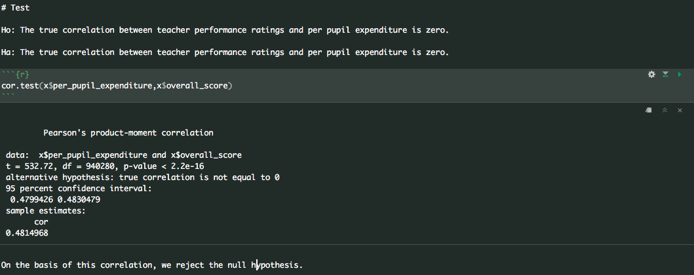
THEN WE ANALYZED THE DATA.

Slide 17
TWO CAVEATS: 1. PER PUPIL EXPENDITURE WAS ESSENTIALLY A BINARY, SINCE EXPENDITURE ONLY HAD TWO LEVELS “MEDIUM” AND “HIGH”. AS SUCH THIS COULD HAVE CONTRIBUTED TO THE STRENGTH OF THE CORRELATION. 2. THERE WERE ABOUT 60K “SUPPRESSED” RATINGS WHICH WERE REMOVED FOR THIS ANALYSIS. THIS WAS STILL LESS THAN 10% OF THE TOTAL OBSERVATIONS.

Slide 18
Sources Cited
https://www.governor.ny.gov/sites/governor.ny.gov/files/atoms/files/NYSFailingSchoolsReport.pdf
HTTPS://DATA.NYSED.GOV/DOWNLOADS.PHP

Slide 19
Questions?

