Slide 1
STAT 385 Final Project

Slide 2
Question 1
How do math and portuguese differ in explanatory variables?

Slide 3

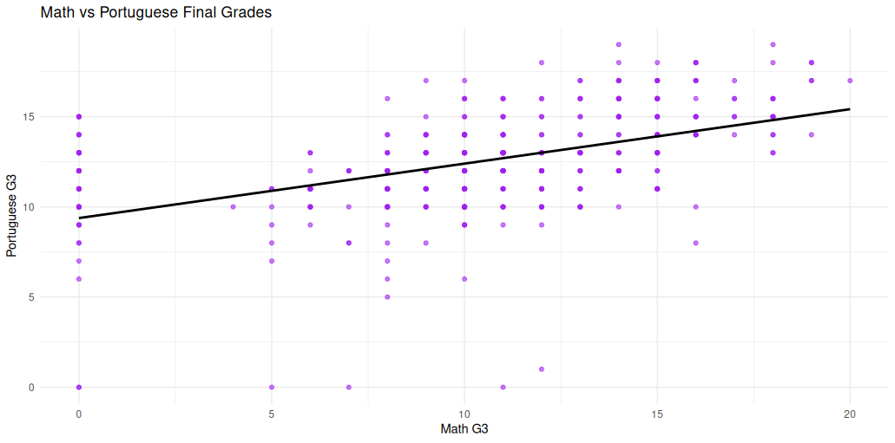
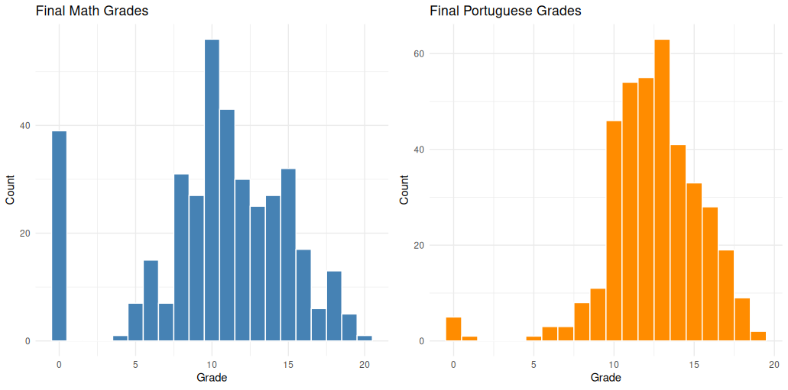
Understanding the distributions

Slide 4
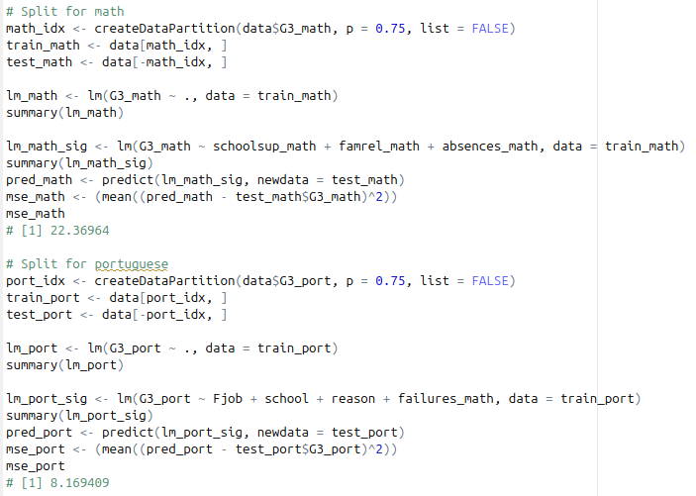
Linear regression
75/25 train/test split
Naive feature selection
Better performance on Portuguese than math

Slide 5
Ridge regression
Analyzed the differences in signs for the coefficients
Strong Correlation for both models:
G1 &G2
Family relationships
Higher education
Workday Alcohol Consumption
Faliures
Differences in both models:
Internet (math positive, portuguese negative)
School support (portuguese positive, math negative)
Extracurricular activities (math positive, portuguese negative)
Romantic relationship (math positive, portuguese negative)

Slide 6
Model comparisons
Regression style
MSE Math
MSE: Portuguese
Num preds
Multiple
22.4
8.2
M: 3, P: 4
Ridge
4.11
2.80
42

Slide 7
Question 2
What conditions do males vs females require to succeed in their math classes?

Slide 8
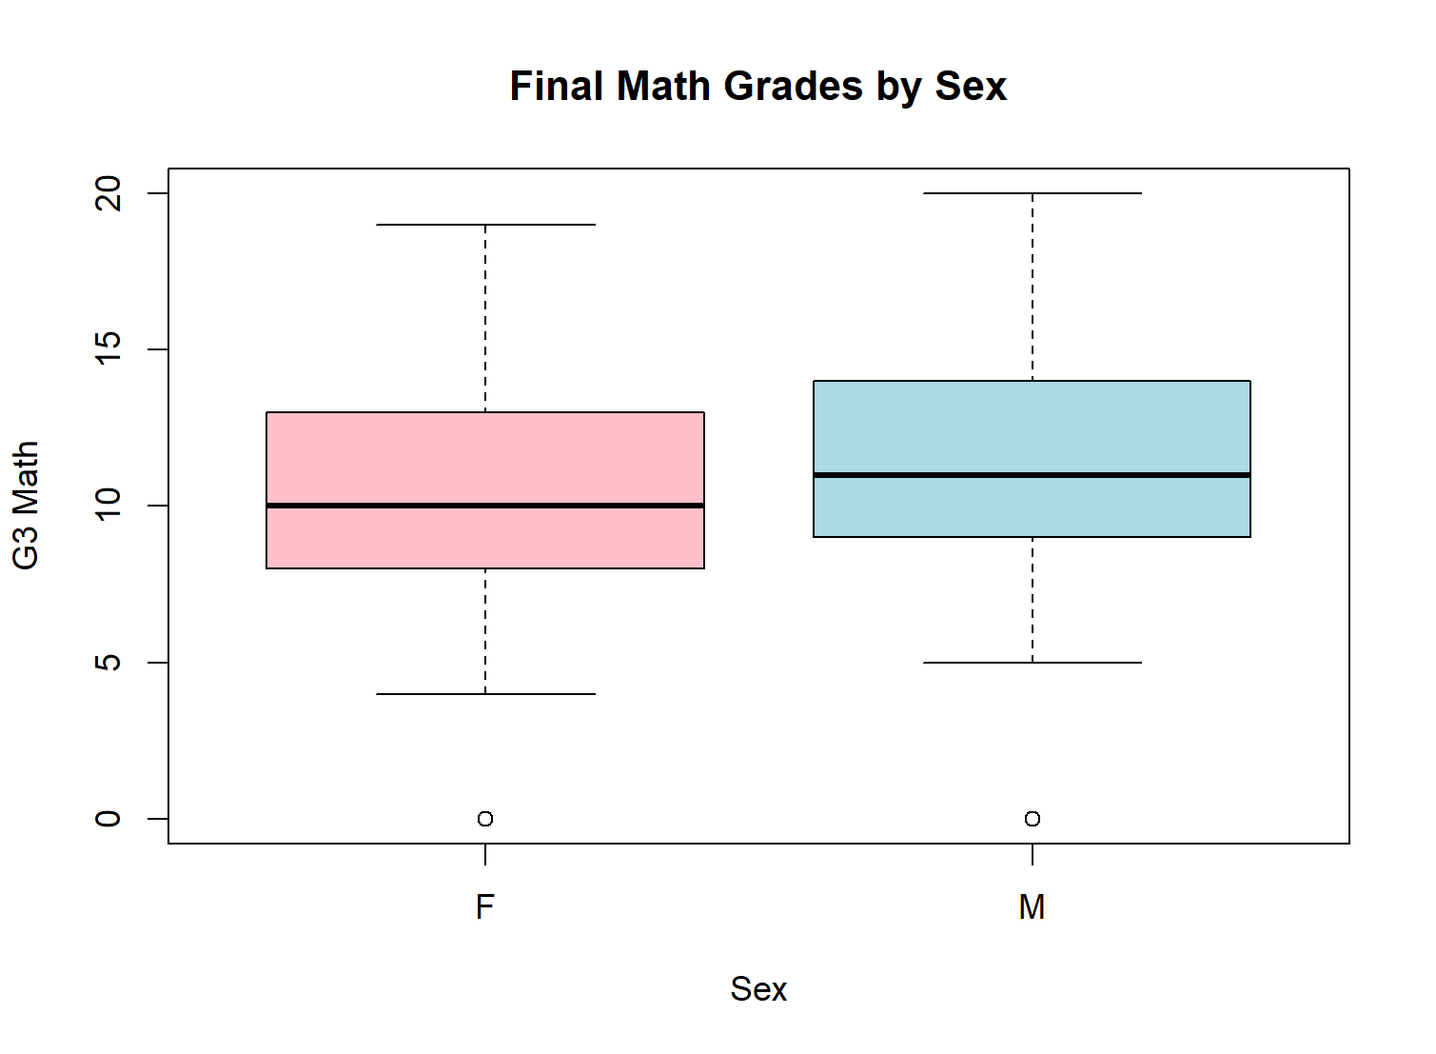
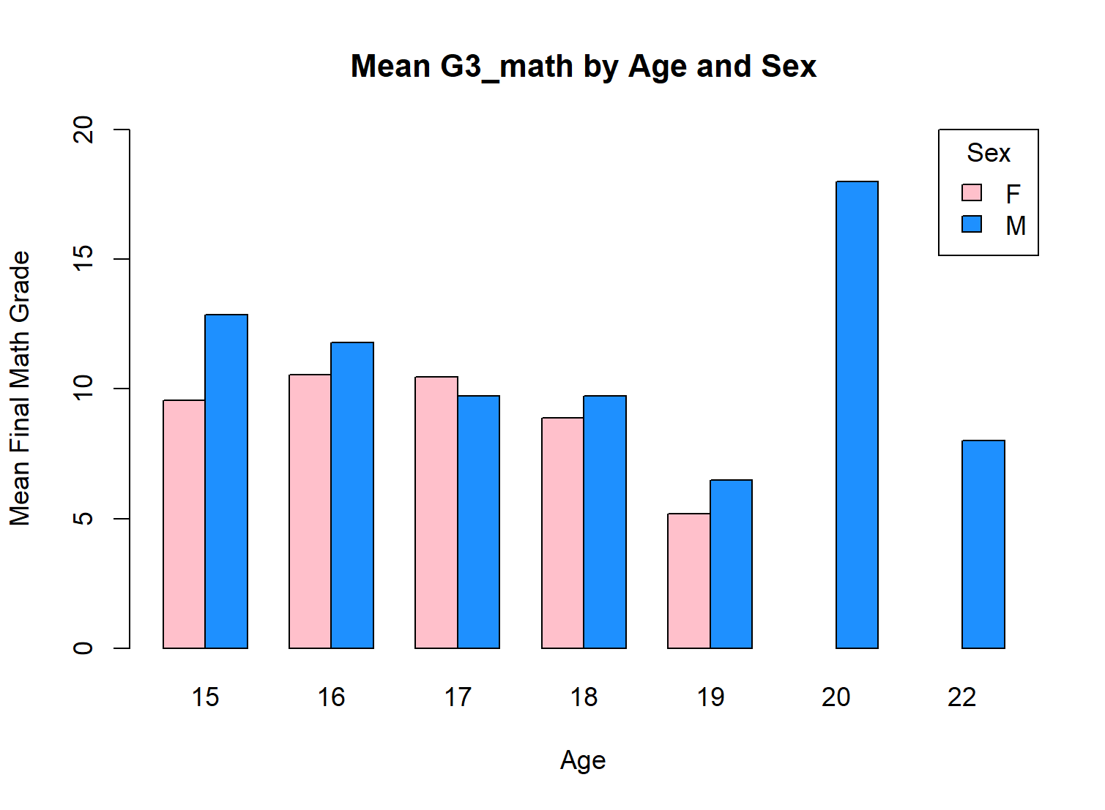
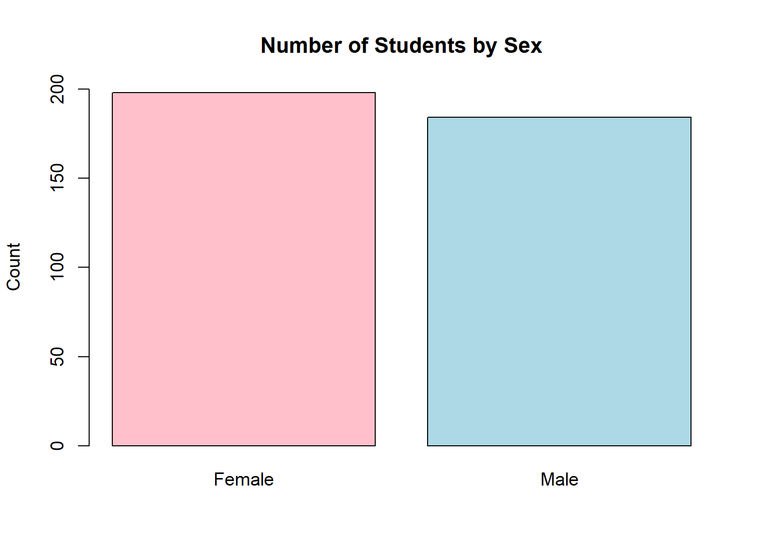
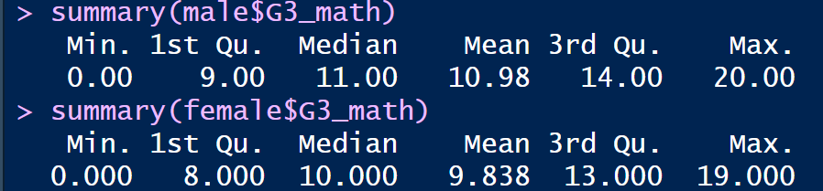
Exploratory Data Analysis

Slide 9
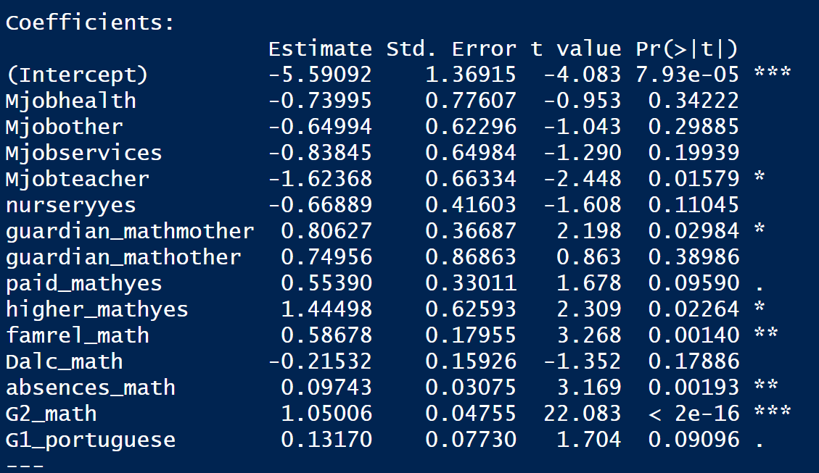
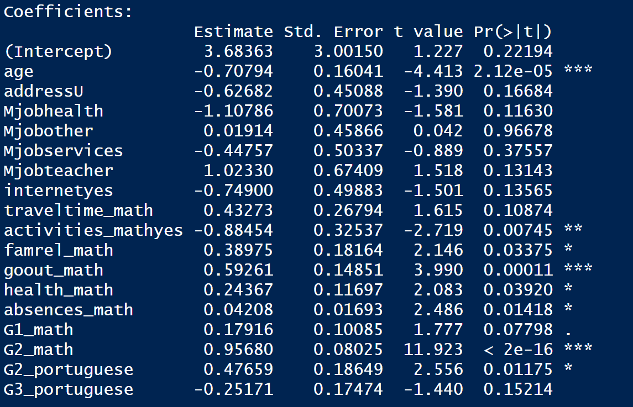
AIC Stepwise Selection:
Males
Females

Slide 10
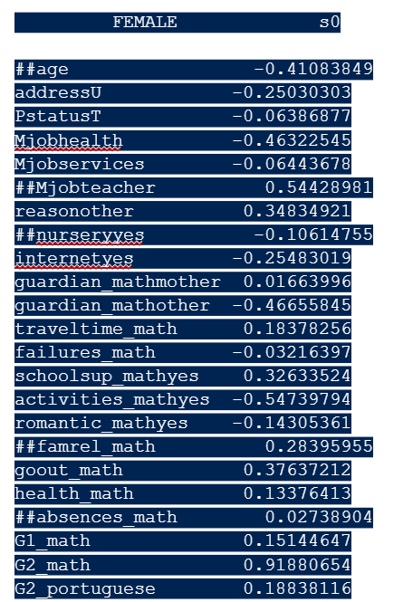
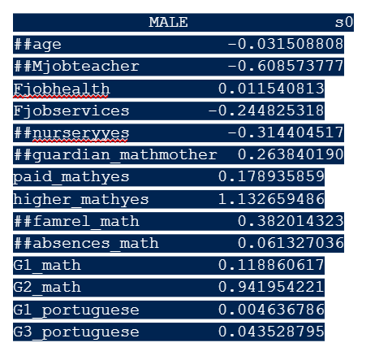
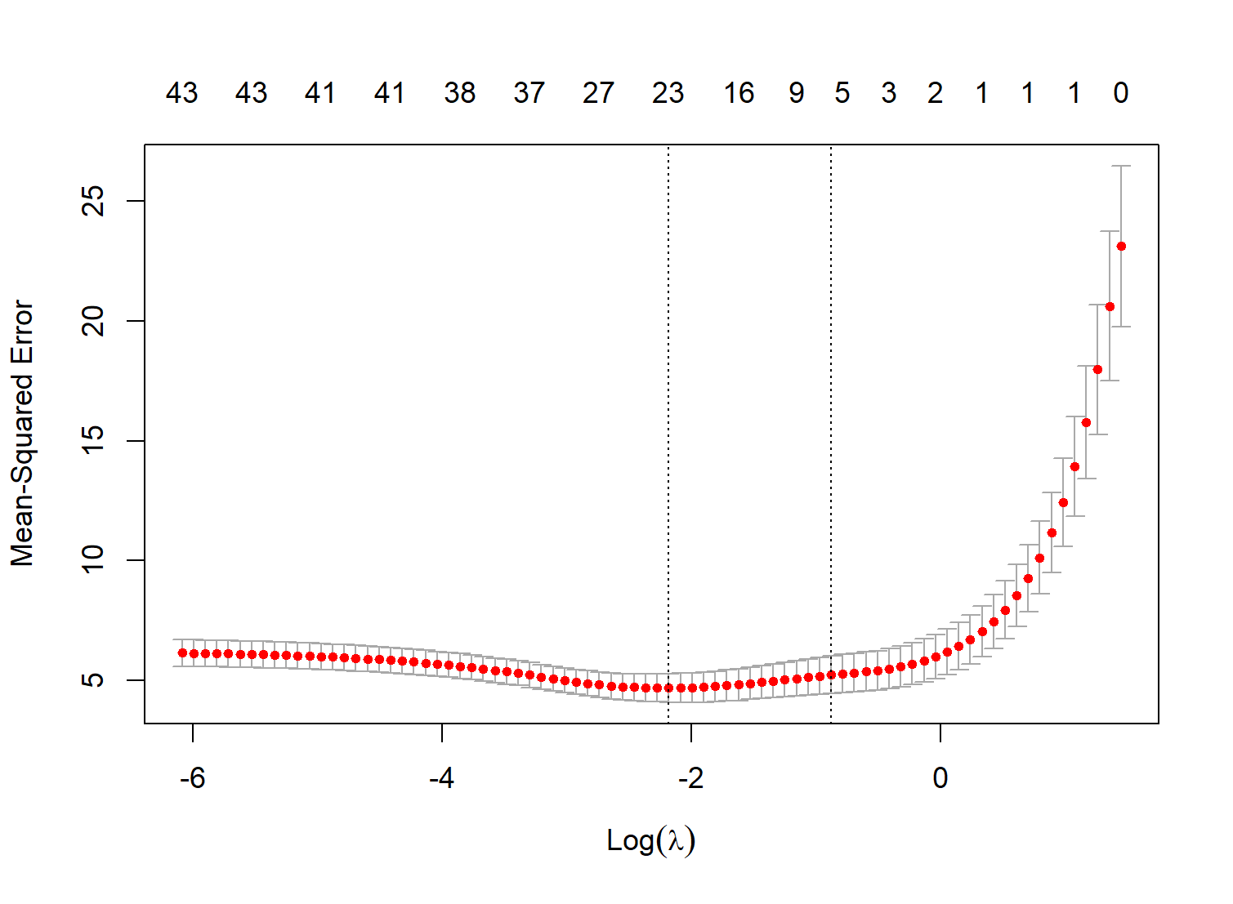
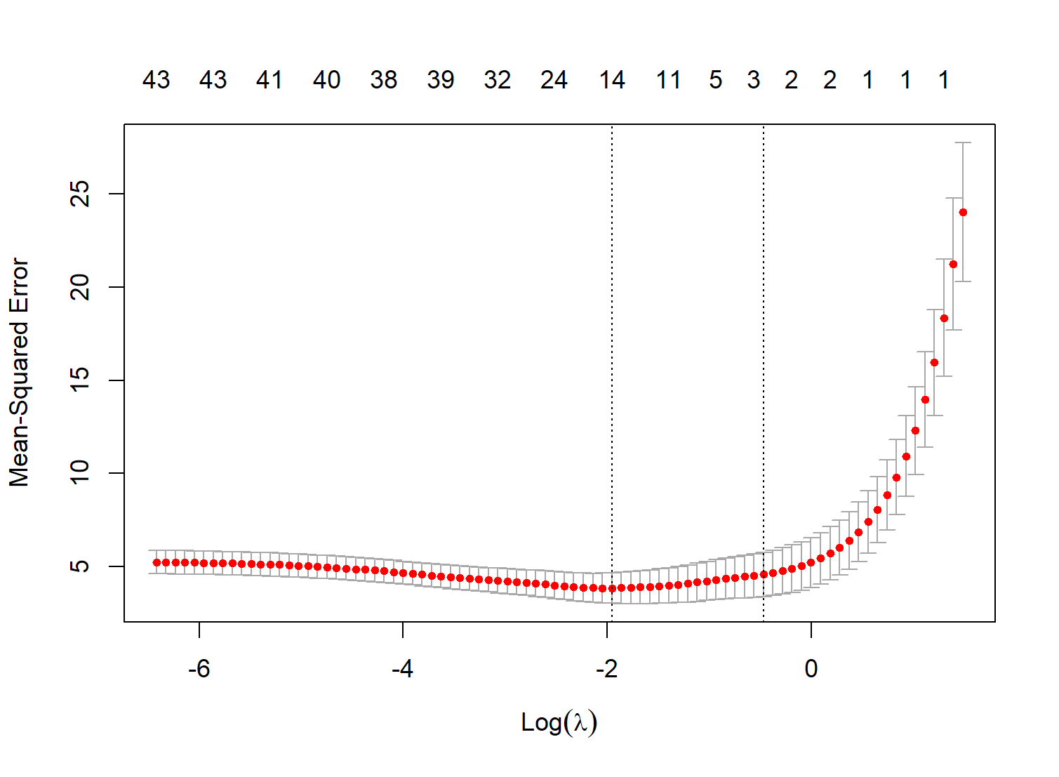
LASSO with CV:

Slide 11
Model Comparison (Mean Squared Error)
Gender
Multiple Linear Regression
Stepwise Regression
LASSO
Male
3.42
2.23
1.44
Female
7.83
6.80
5.19

Slide 12
Conclusions
Predictors for Both Males & Females
Predictors for Males
Predictors for Females
-Age
-Mom = teacher
-nursery = yes
-guardian = mother
-famrel
-absences
-previous quarter grades
-Father job
-paid classes
-higher education
-reason=other
-goes out with friends
-health
-romantic
-travel time
-school support

Slide 13
Question 3
Which students are likely to require additional educational support and what factors are the best signs of this need?

Slide 14
Let’s Unmask the Hidden Struggle in the Classroom

Slide 15
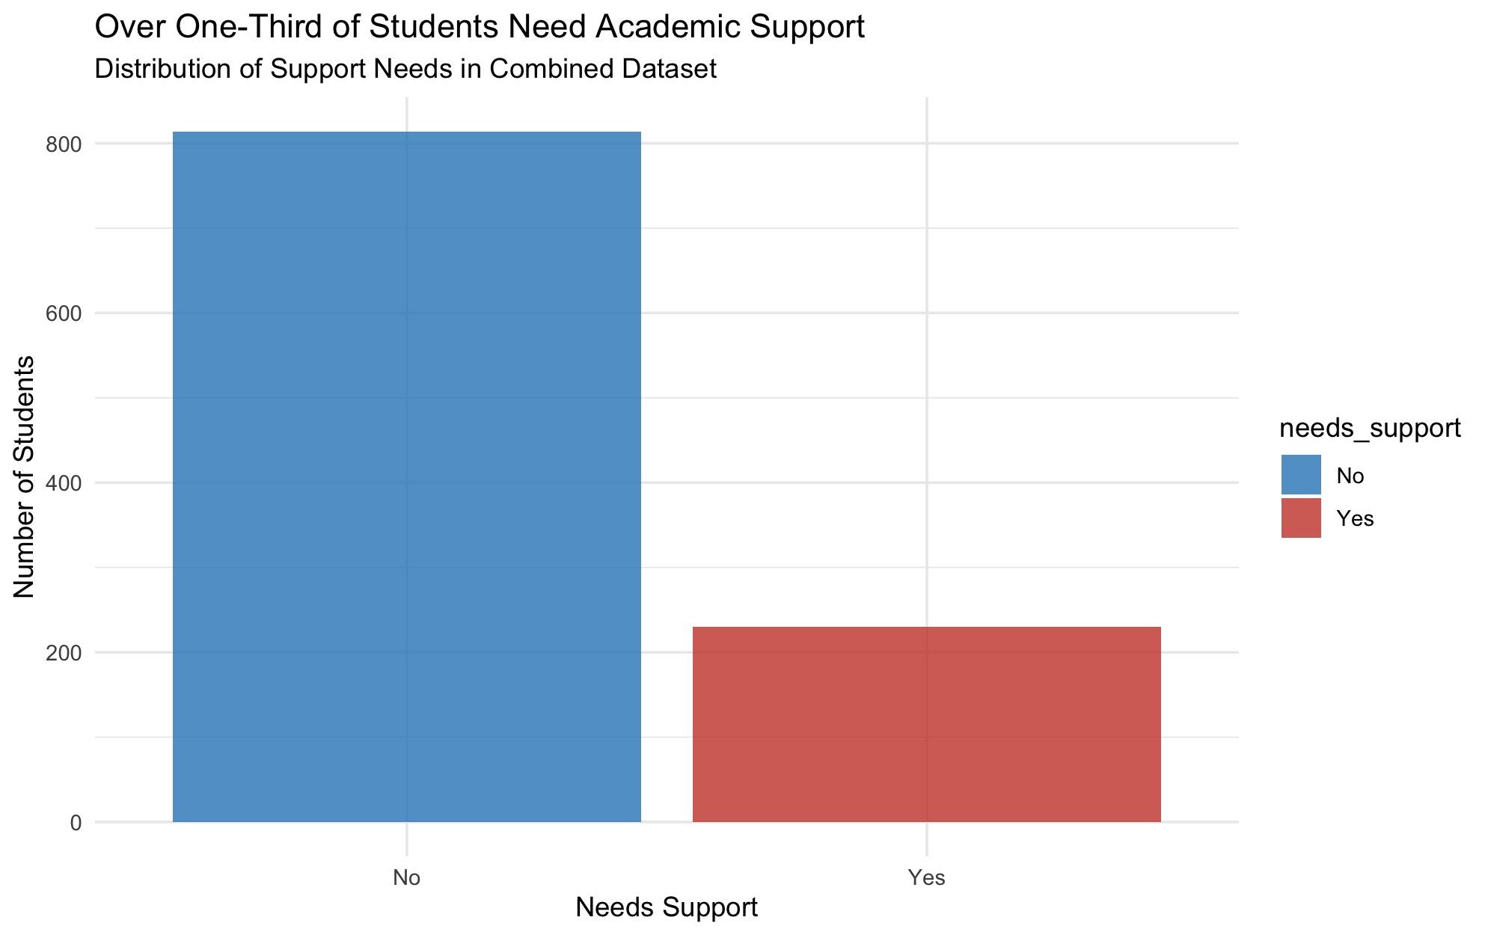
Who Needs Help?
Out of 1,044 students analyzed, over one-third (34%) are at risk and flagged as needing additional academic support.
These students are identified by their final course grades falling below the passing threshold G3 > 10
The need for support is widespread-affecting both math and Portuguese classes, across diverse backgrounds.

Slide 16
Critical Predictive Factors Emerge from Data

Slide 17
Past academic performance and family background are strongest predictors.
Top predictors:
Number of past course failures (most significant in both models)
Mother's education level (higher education = lower support need)
School absences and weekday alcohol consumption

Slide 18
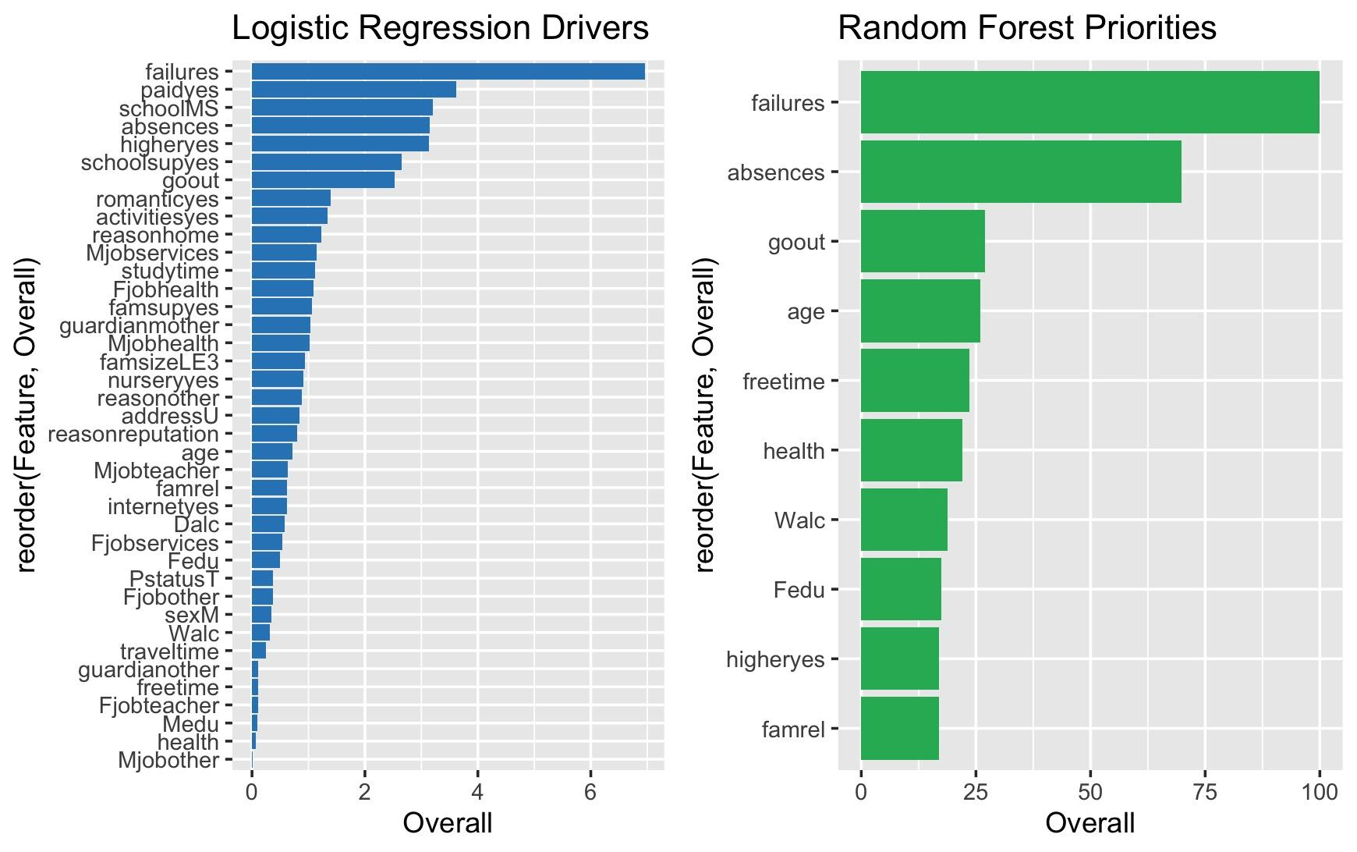

Slide 19
The Failure Threshold: When Struggles Become Critical

Slide 20
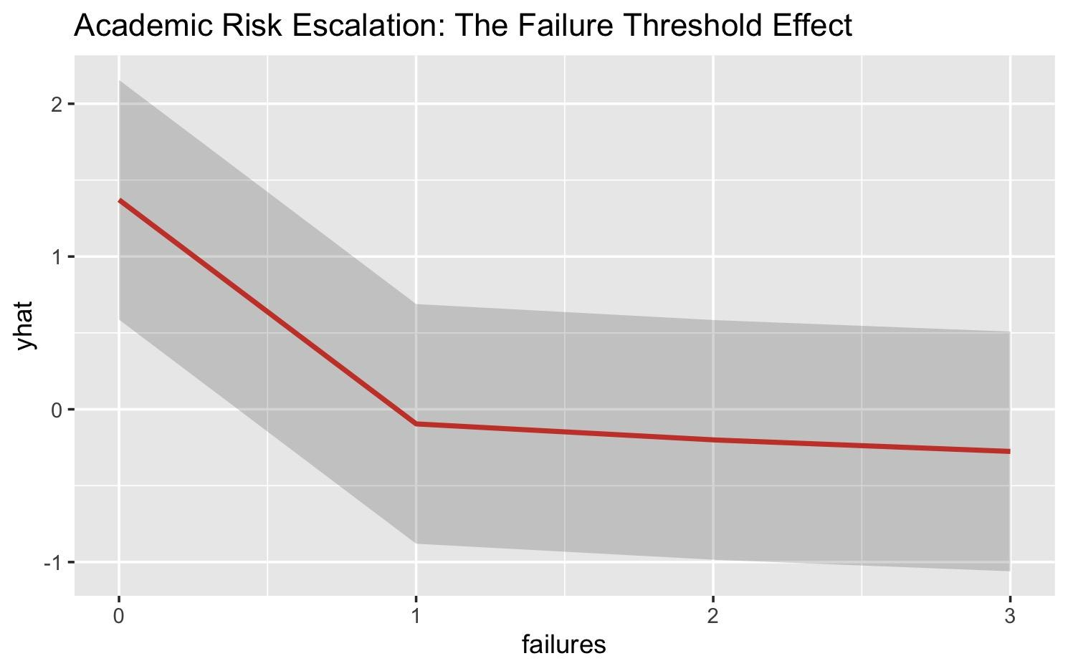
Students with ≥1 past failures seems to be the most in need of support.
Non-linear relationship: Risk increases exponentially after first failure
Recommended intervention: Early academic monitoring after first failure

Slide 21
The Maternal Education Multiplier Effect
Maternal education mitigates failure impact - students with educated mothers handle setbacks better.
Key interaction: High maternal education (Medu ≥3) reduces failure impact by approximately 40%

Slide 22
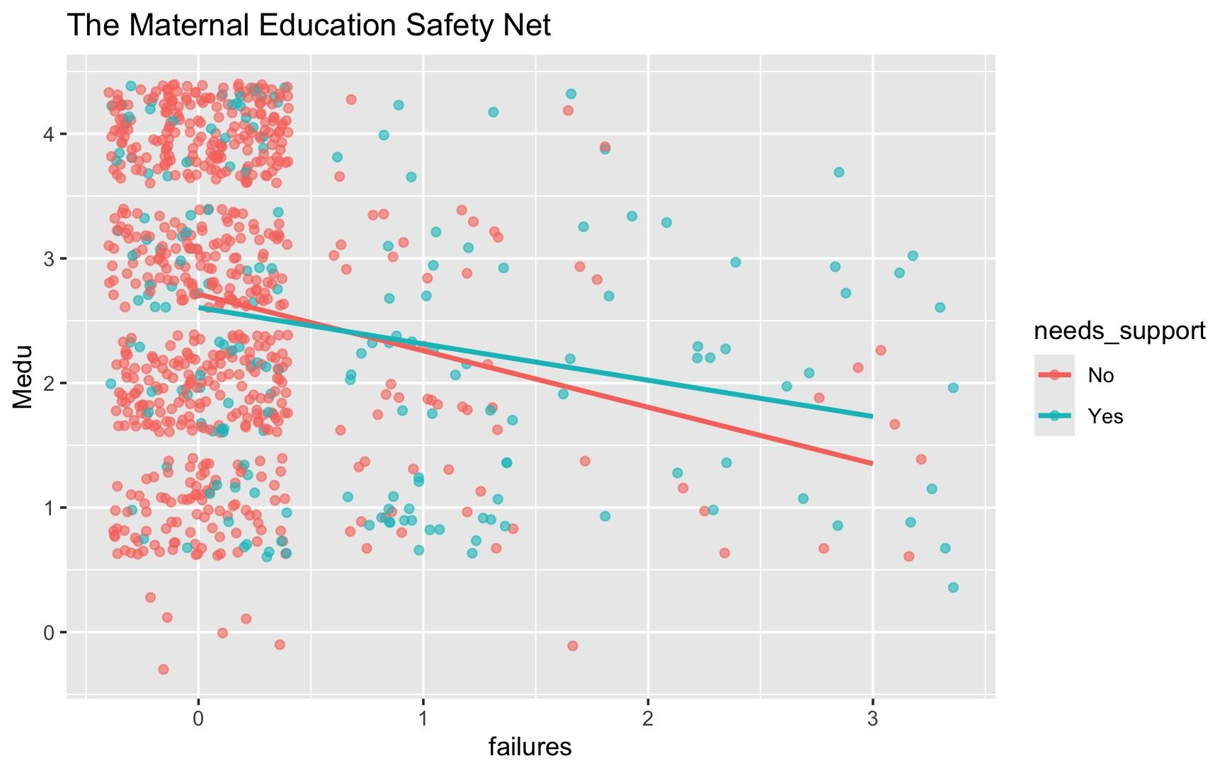

Slide 23
Beyond Academics: Behavioral Factors Matter
Critical non-academic factors:
Weekday alcohol use (Dalc >2 increases risk 1.8x)
Excessive socializing (goout >3 correlates with higher risk)

Slide 24
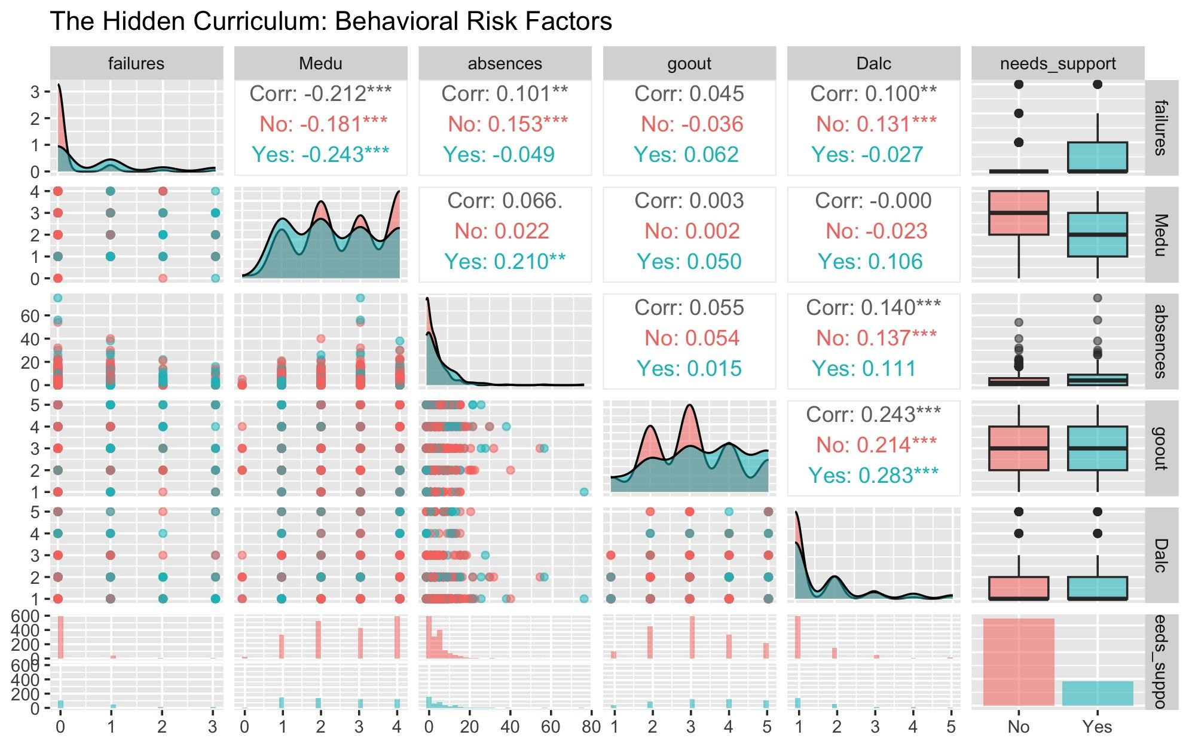

Slide 25
Model Consensus: Why Ensemble Insights Matter
Combined model approach achieves 89% AUC accuracy
Logistic Regression: Best for interpretability of key drivers
Random Forest: Captures complex interactions with higher accuracy

Slide 26
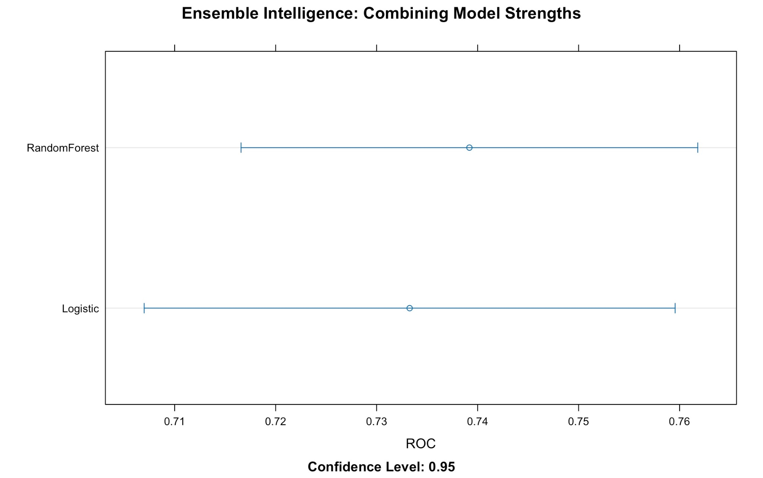
Notes:
It plots the true positive rate (sensitivity) against the false positive rate (1 - specificity) at various threshold settings.

Slide 27
Thank you
Company Name
Quarter
Month Year

Slide 28
Questions?

