Slide 1

Python Project Implementation of Hidden Markov Model and some HMM Applications
Under the guidance of Dr.Ashok Palaniappan

Slide 2
Done by,
Sunayanaa.S
(119013040)
Anuradha.K
(119013045)
Rajaroobini.S
(119013028)

Slide 3
What is a HMM ?
HMM stands for Hidden Markov Model
A Markov model is a model describing a sequence of possible events
In HMM, the probability of each event depends only on the state attained in the previous event.
In a Hidden Markov Model the system being modelled is assumed to be a Markov Process but with hidden states (or unobserved) states.
A sequence of emissions is observed, but the sequence of states the model went through to generate the emissions is not known.
Analyses of hidden Markov models seek to recover the sequence of states from the observed data with Viterbi algorithm.

Slide 4
Parameters of an HMM model
Initial probability: Initial probabilities are the values given to choose one state among the given states.
Transition Matrix: Transition matrix has the probability values of transitioning from one state to another.
Emission Matrix: Emission matrix contains the probabilities of the observable state given the hidden state.

Slide 5
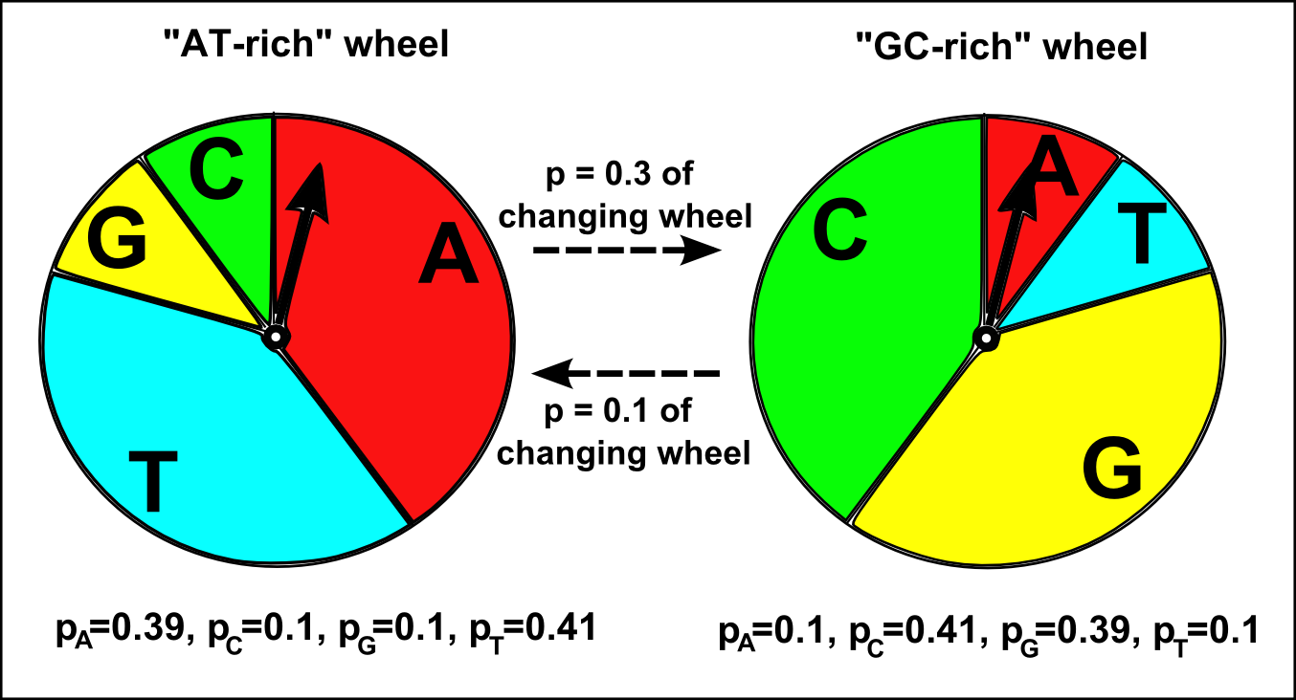
Implementation of HMM without using Viterbi algorithm
We tried to create an HMM model without using viterbi algorithm
Here the input are the following:
Initial probabilities
Transition matrix
Emission matrix
Desired length of sequence to be generated

Slide 6
Pseudocode for HMM
1. The values in the transition and emission matrix to be obtained from user.
2.The first observation state of the sequence is selected using the initial probability variable
(from user)
3. The variable firststate is assigned a state such that the probability of the state being
selected is the same as that in initial probability variable by using random() function from
the random module (which generates a random number between 0 and 1) and a series of if
statements.
4. This state is stored in the list ‘obsstates’.
5. The first nucleotide (hidden state) is selected using the probability values in association with
the state given by the user as emission matrix.

Slide 7
Pseudocode for HMM
6. As in step 2 random() is used.
7. This nucleotide is stored in the list ‘newseq’
8. The observable state (AT-rich/GC-rich) of the previous position(1st) is obtained and stored in a variable. The observable state of the second position of the sequence(AT-rich/GC-rich) is
selected using the transition matrix. As in step(3) this can stored in obsstates by appending
it to the list.
9. The nucleotide in the second position is selected using the emission matrix. As in step(5) this is stored in newseq by appending the list.
10. Steps 6 and 7 are repeated for the remaining positions in the sequence of length=seqlen.
11. Print newseq to get the sequence predicted by HMM.

Slide 8
Pseudocode for Viterbi
The values in the transition and emission matrix to be obtained from user.
The first observation state of the sequence is selected using the initial probability variable (from user)
The variable firststate is assigned a state such that the probability of the state being selected is the same as that in initial probability variable by using random() function from the random module (which generates a random number between 0 and 1) and a series of if statements.
This state is stored in the list 'obsstates'.
The first nucleotide (hidden state) is selected using the probability values in association with the state given by the user as emission matrix.

Slide 9
Pseudocode for Viterbi
As in step 2 random() is used.
This nucleotide is stored in the list 'newseq'.
The observable state (AT-rich/GC-rich) of the previous position(1st) is obtained and stored in a variable. The observable state of the second position of the sequence(AT-rich/GC-rich) is selected using the transition matrix. As in step(3) this can stored in 'obsstates' by appending it to the list.
The nucleotide in the second position is selected using the emission matrix. As in step(5) this is stored in 'newseq' by appending the list.
Steps 6 and 7 are repeated for the remaining positions in the sequence of length=seqlen.
Print newseq to get the sequence predicted by HMM

Slide 10
Applications of HMM
To predict AT-rich and GC-rich regions in a sequence
To predict intron ( non-coding) and exon (coding) regions in a sequence.
To predict the secondary structural elements for a given protein sequence.

Slide 11
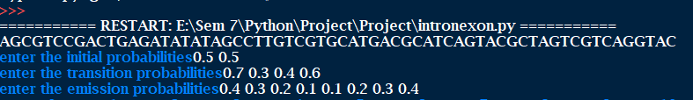
Input

Slide 12
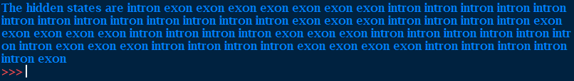
Output
The output we got was a sequence of the required length obeying the probability values which were given (as transition matrix, emission matrix and initial probability of the first nucleotide)

Slide 13
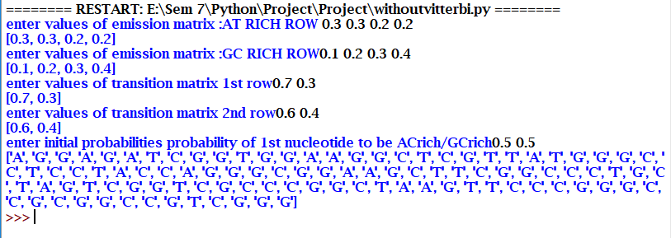
Demonstration Input and Output

Slide 14
How can it be Improved?
For example,
Only continuous exonic or intronic regions are significant but when the most probable states in the model are not consecutively present it doesn’t make any biological significance.
We could filter out such regions by finding a threshold, and if the stretch of sequence satisfies the threshold those regions alone could be displayed.
Usage of appropriate packages like numpy , random and aggregate functions will improve the efficiency of the code.

Slide 15
Thank You!

