Slide 1
PYTHON PROGRAMMING PREDICTION OF SECONDARY STRUCTURE USING CHOU-FASMAN ALGORITHM AND DETERMINING PHYSICOCHEMICAL PROPERTIES

Slide 2
BY :
MATHANGI.S
119013017
BTECH BIOINFORMATICS
SIVAKAMA MEENAKSHI
119013038
BTECH BIOINFORMATICS
HINDHEEYA VIJAYKUMAR
119013010
BTECH BIOINFORMATICS

Slide 3
PROTEIN STRUCTURE
Protein structure is the three-dimensional arrangement of atoms in an amino acid-chain molecule.
Proteins are polymers – specifically polypeptides – formed from sequences of amino acids, the monomers of the polymer.
To be able to perform their biological function, proteins fold into one or more specific spatial conformations driven by a number of non-covalent interactions such as hydrogen bonding, ionic interactions, Van der Waals forces, and hydrophobic packing.

Slide 4
Protein structures range in size from tens to several thousand amino acids.
Levels of protein structures :
Primary structure - The primary structure of a protein refers to the sequence of amino acids in the polypeptide chain.
Secondary structure - Secondary structure refers to highly regular local sub-structures on the actual polypeptide backbone chain.
Tertiary structure - Tertiary structure refers to the three-dimensional structure of monomeric and multimeric protein molecules.
Quaternary structure - Quaternary structure is the three-dimensional structure consisting of the aggregation of two or more individual polypeptide chains (subunits) that operate as a single functional unit (multimer).

Slide 5
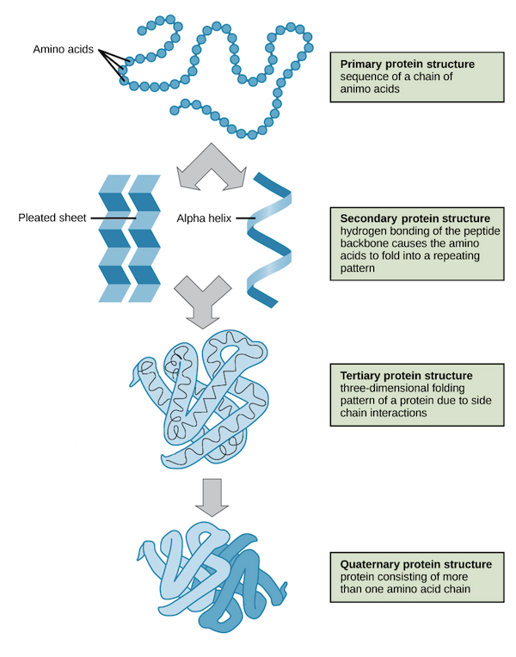

Slide 6
SECONDARY STRUCTURE
Secondary structure refers to highly regular local sub-structures on the actual polypeptide backbone chain.
Two main types of secondary structure –
α-helix
β-strand or β-sheets
Secondary surface refers to the interaction of the hydrogen bond donor and acceptor residues of the repeating peptide unit.
The secondary structure mainly stabilizes the folding of the peptide backbone.

Slide 7
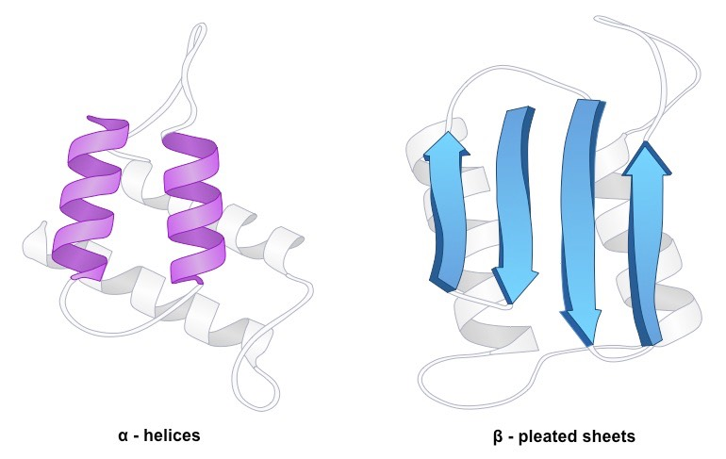
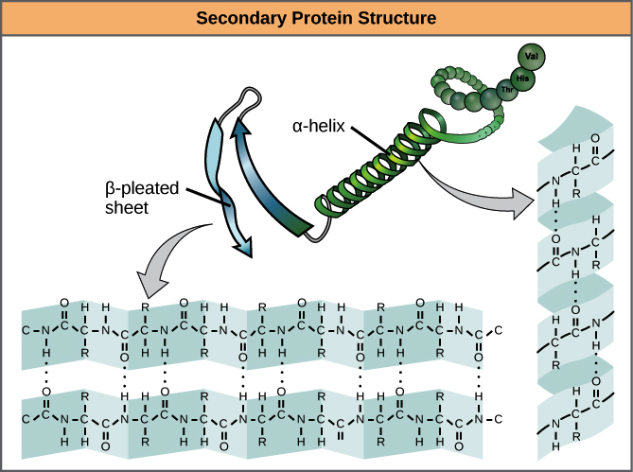

Slide 8
CHOU–FASMAN METHOD
The Chou–Fasman method is an empirical technique for the prediction of secondary structures in proteins.
The method is based on analyses of the relative frequencies of each amino acid in alpha helices, beta sheets, and turns based on known protein structures.
A set of probability parameters were derived for the appearance of each amino acid in each secondary structure type, and these parameters are used to predict the probability that a given sequence of amino acids would form a helix, a beta strand, or a turn in a protein.
50–60% accurate

Slide 9
CHOU–FASMAN ALGORITHM
STEP 1 – Initialize alpha helix
STEP 2 – Find start
STEP 3 – Find stop
STEP 4 – Sum alpha helix
STEP 5 – Initialize beta sheet
STEP 6 – Sum beta sheet
STEP 7 – Compare alpha helix with beta sheet
STEP 8 – Predict secondary structure

Slide 10
PROBLEM STATEMENT
Secondary structure prediction is done. In this method the Chou-Fasman secondary prediction method is incorporated and physiochemical properties are found for the given amino acid sequence. These are found using the python methods.
Input – Amino acid sequence

Slide 11
OUTPUT
The start and end positions of the alpha helix regions.
The start and end positions of the beta sheet regions.
The start and end positions of the turn regions.
Factors calculated :
Extinction coefficient : It refers to several different measures of the absorption of light in a medium.
Grand average of hydropathicity (GRAVY) : The GRAVY value for a protein or a peptide is calculated by adding the hydropathy values of each amino acid residues and dividing by the number of residues in the sequence or length of the sequence. Increasing positive score indicates a greater hydrophobicity.
Molecular weight : The molecular weight of protein is calculated by the addition of average isotopic masses of amino acids in the provided protein and the average isotopic mass of one water molecule.
Composition of amino acid

Slide 12
PSEUDOCODE
1. Input the protein sequence. 2. Create a dictionary corresponding to the propensities of amino acids for forming alpha helix, beta sheet and turns. 3. Input the sequence as argument to the function CF_find_alpha(seq). 4. Scan the selected residues: 5. Iteration for helix, 6. Extract residues with window size : 6 7. Check for 4 out of 6 contiguous residues have propensity(helix)>100. 8.If true, start and end positions are found using the function CF_extend_alpha(seq).

Slide 13
9. Iteration for beta sheet
10. Extract residues with window size : 5 11. Check for 3 out of 5 contiguous residues have propensity(sheet)>100. 12.If true, start and end positions are found using the function CF_extend_beta(seq).
13.If(product of turn propensities(I,i+1,i+2,i+3))>0.00075 and if(average of turn propensities(I,i+1,i+2,i+3)>100 and turn propensity>(alpha propensity, beta propensity), then turn is assigned.
14. Call the function mol_weight(seq)
15.The sequence entered is converted to list

Slide 14
16. add the molecular weights of all the amino acids from the respective dictionary. 17. Display the overall molecular weight. 18. Call the function ext(): 19. for i in len(list): 20. add up the contribution values of the 3 amino acids (Trp, Phe, Tyr) according to their number present. 21. Display the calculated extinction coefficient. 22. Call the function GRAVY (seq): 23. for i in (0,len(seq)): 24. add the hydropathy values of all the amino acids from the respective dictionary and divide by the length of the residues. 25. Display the obtained average hydropathy value for the protein.

Slide 15
26. Call the function composition (seq): 27. for i in (0,len(seq)): 28. count the number of each amino acids and calculate its percentage over the entire sequence and assign it to a dictionary. 29. Display the dictionary corresponding to the amino acid composition.

Slide 16
PROBLEM IN THE CODE!
During the propensity calculation there are overlapping regions that are present i.e. the same region is present in both alpha helix and beta sheet. The code is not able to differentiate if these regions have high alpha propensity or beta propensity.
We are working on it !

Slide 17
THANK YOU !

