Slide 1
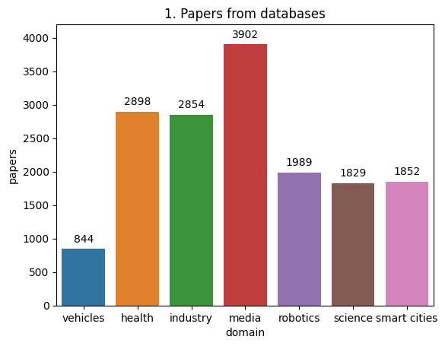
Search using databases APIs
IEEEXplore
Springer Nature
Scopus
Science Direct
ArXiv
Core
Semantic Scholar
Microsoft Research
Search parameters:
<Domain> + <ML> + <Deployment>
16,618 papers

Slide 2
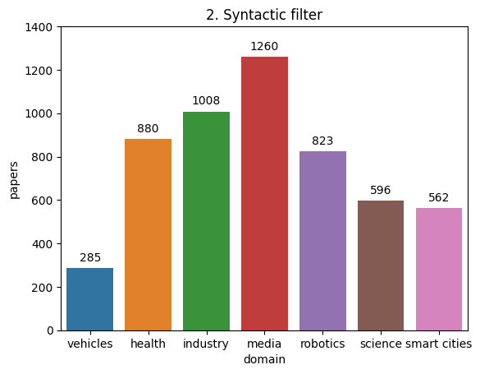
Syntactic filter in abstract
Select the papers that include keywords in abstract
5,414 papers

Slide 3
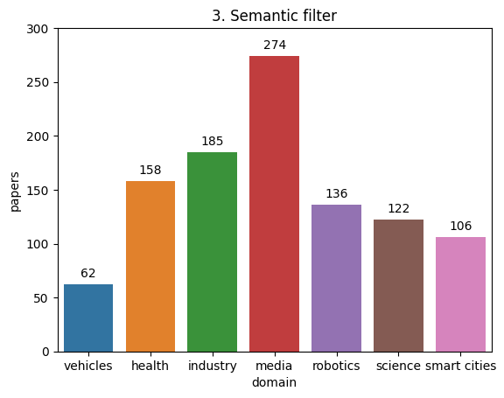
Semantic filter in abstract
Select sentences that contains keywords (e.g., deployment) from abstracts
Build dependency graph for each sentence
Select papers based on distance between the nominal subject of a sentence and the keyword
1,043 papers

Slide 4
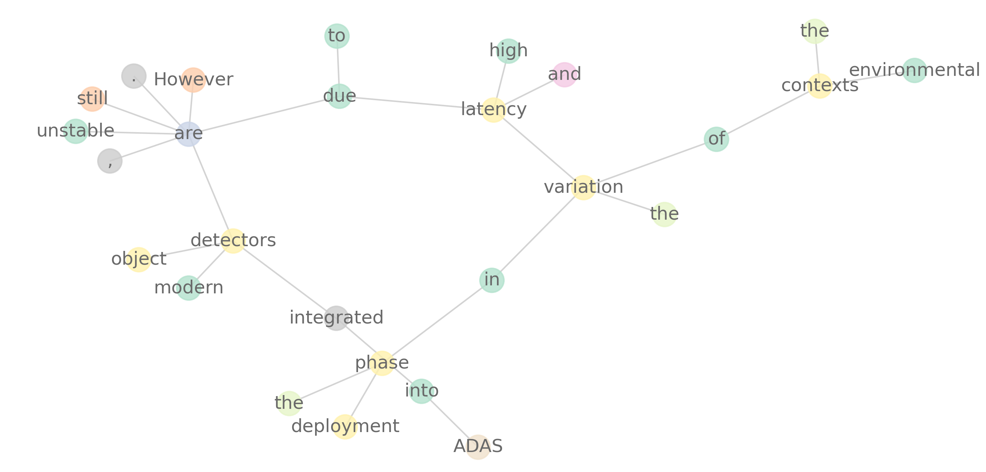
Autonomous vehicles example: Advanced Driving Assisted System

Slide 5
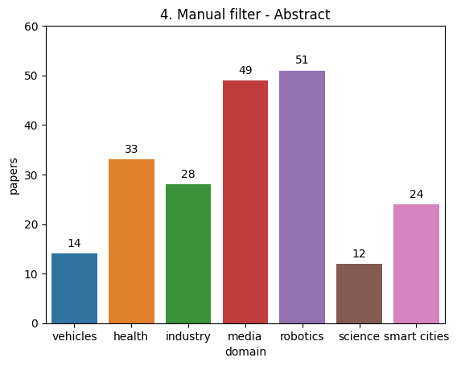
Filter by reading abstract
Deployment as part of experiments (e.g., robotics, drones)
Software architectures to deploy, manage, and monitor AI-based systems
211 papers

Slide 6
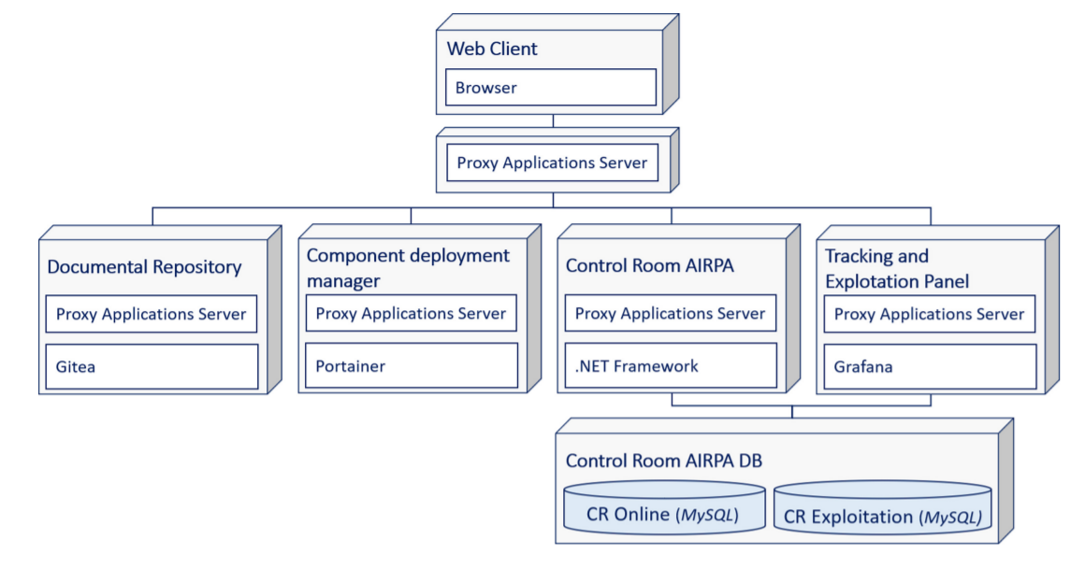
AIRPA: An Architecture to Support the Execution and Maintenance of AI-Powered RPA Robots [1]
Robotics process automation based on AI
Architecture to upload, deploy, manage and monitor robots and AI components
User interface
Logic
Data
[1] Martínez-Rojas, A., Sánchez-Oliva, J., López-Carnicer, J.M. and Jiménez-Ramírez, A., 2021, September. AIRPA: An Architecture to Support the Execution and Maintenance of AI-Powered RPA Robots. In International Conference on Business Process Management (pp. 38-48). Springer, Cham.

Slide 7
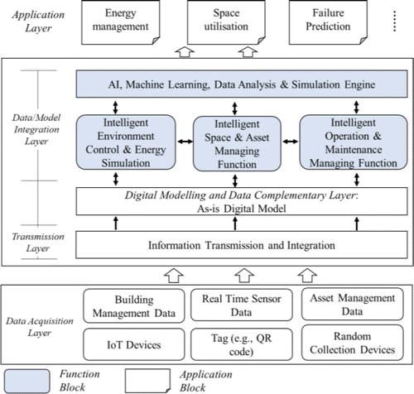
Developing a Dynamic Digital Twin at a Building Level: using Cambridge Campus as Case Study [2]
Hierarchical architecture
Integrate heterogeneous entities
Support intelligent management of buildings
Case study at the Institute for Manufacturing – West Cambridge
[2] Lu, Q., Parlikad, A.K., Woodall, P., Don Ranasinghe, G., Xie, X., Liang, Z., Konstantinou, E., Heaton, J. and Schooling, J., 2020. Developing a digital twin at building and city levels: Case study of West Cambridge campus. Journal of Management in Engineering, 36(3), p.05020004.

Slide 8
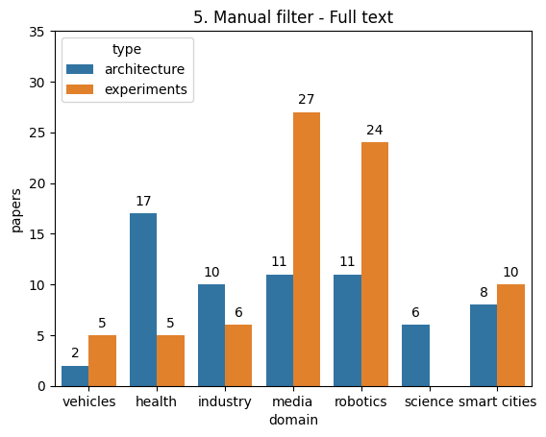
Filter by having a look to the full text
142 papers
65 architectures
77 experiments

Slide 9
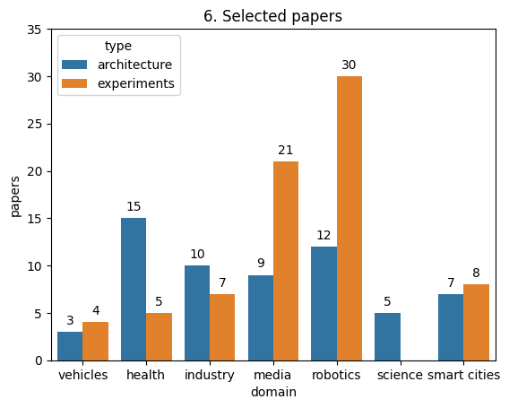
Snowballing process
Using semantic scholar API to get papers that cited the 142 papers
1338 papers
Applying syntactic, semantic and manual filters
9 additional papers
Manual removal of repeated:
A total of 136 papers
61 architectures
75 experiments

Slide 10
