Slide 1
MoviesViz
File created on: 10/11/2023 11:21:41 PM

Slide 2
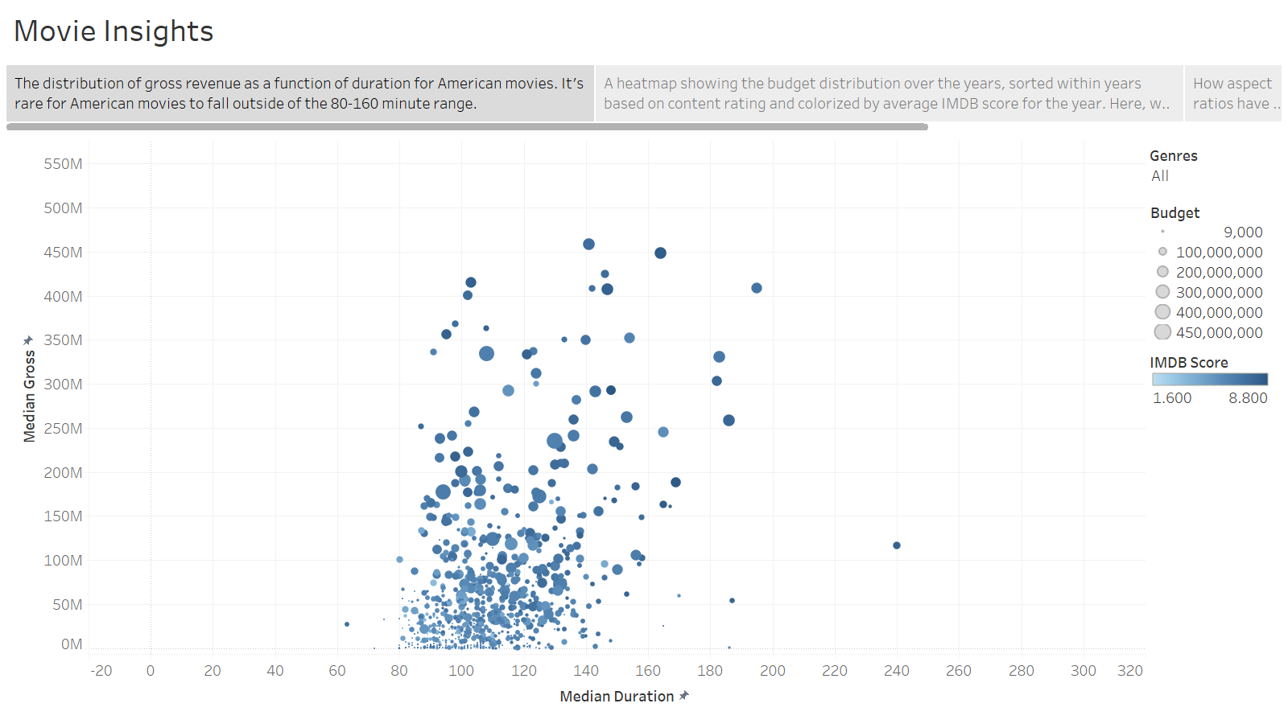

Slide 3
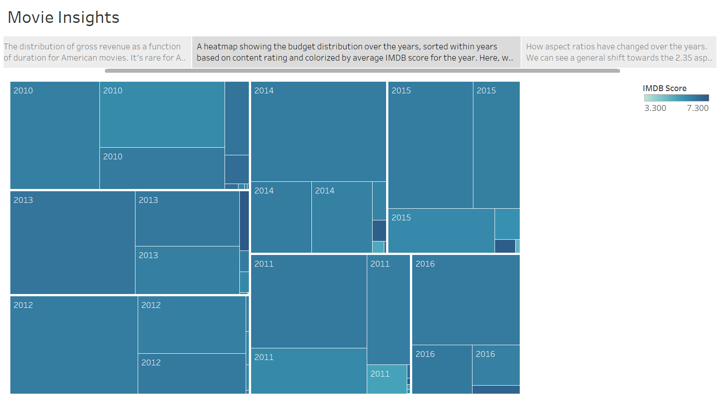
Here, we can see that despite their relatively lower budgets, G-rated movies have the highest ratings across multiple years.

Slide 4
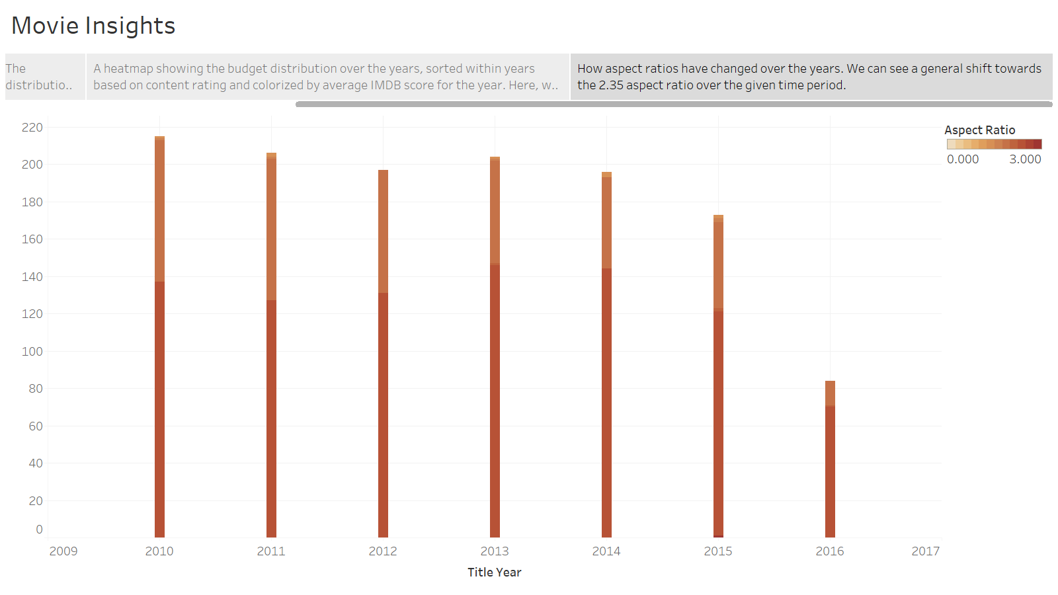

Slide 5
Reflection and Critique
Overall, my process involved a lot of trial and error as well as tutorial watching and internet searching. While the tutorial provided was helpful, it made creating visualizations seem a lot simpler than what the video’s process was. Like the video, I would start out with my own questions that I wanted to explore more about. These questions were very similar to the ones we were tasked with creating in our earlier homework assignments before we explored the data. This gave me a framework to approach my exploration. There were many times, however, that when I tried to input certain measures or dimensions, it would either not display correctly or not display what I wanted it to display. Luckily, there were some features I found helpful with combating this, like the transpose feature.
Overall, I would rate Tableau very highly. The formatting and editing of things like titles, keys, and marks were very easy and had more options compared to the free tools that we used in previous homework. The story point feature is also very conducive to sharing insights. Additionally, the automatic displaying based off whatever you dragged and dropped into the columns and rows was better than the free tools. When I used RAWGraphs and Datawrapper, for example, you would have to choose your graph type beforehand and match your dimensions to that, while Tableau would display a view based off whatever you chose.
One critique I have of Tableau is the learning curve. There are so many features available were trying to figure out what buttons to click to display a certain view becomes a bit difficult if you just go in blind. This contrasts with the free tools which were very beginner friendly. However, I was able to work through this with the ample documentation and tutorials online for different graphs. The steeper learning curve will pay off in the long run with the increased functionality that Tableau provides.

