Slide 1
Starbucks Visualization
Avinash Palliyil

Slide 2
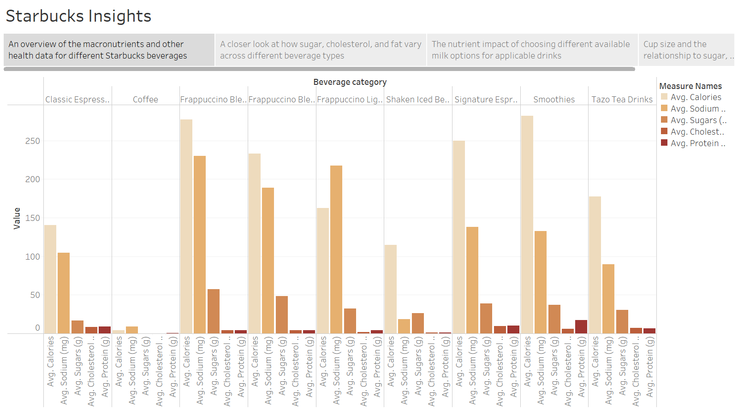

Slide 3
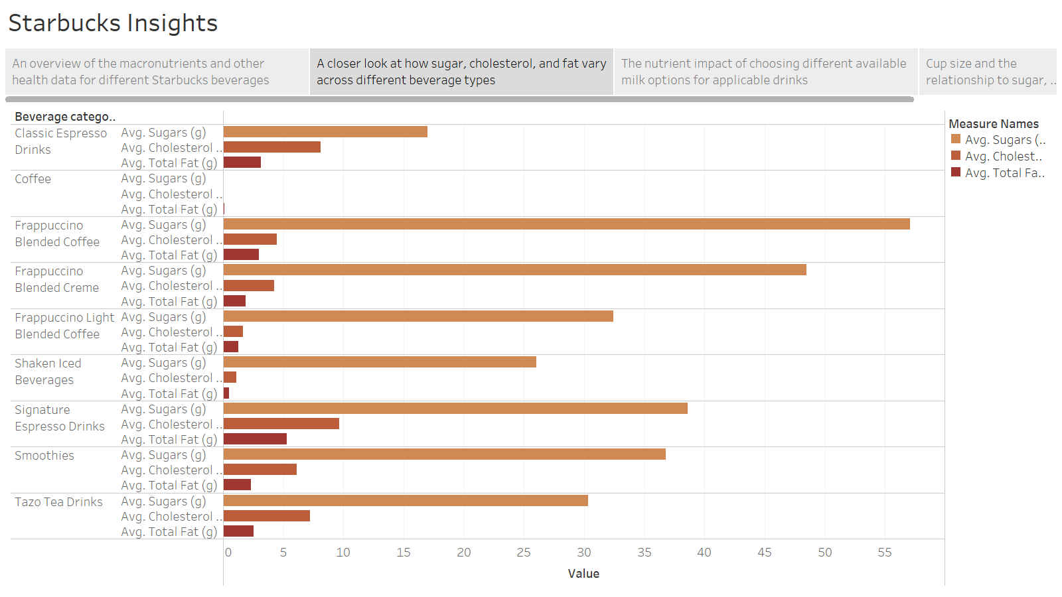

Slide 4
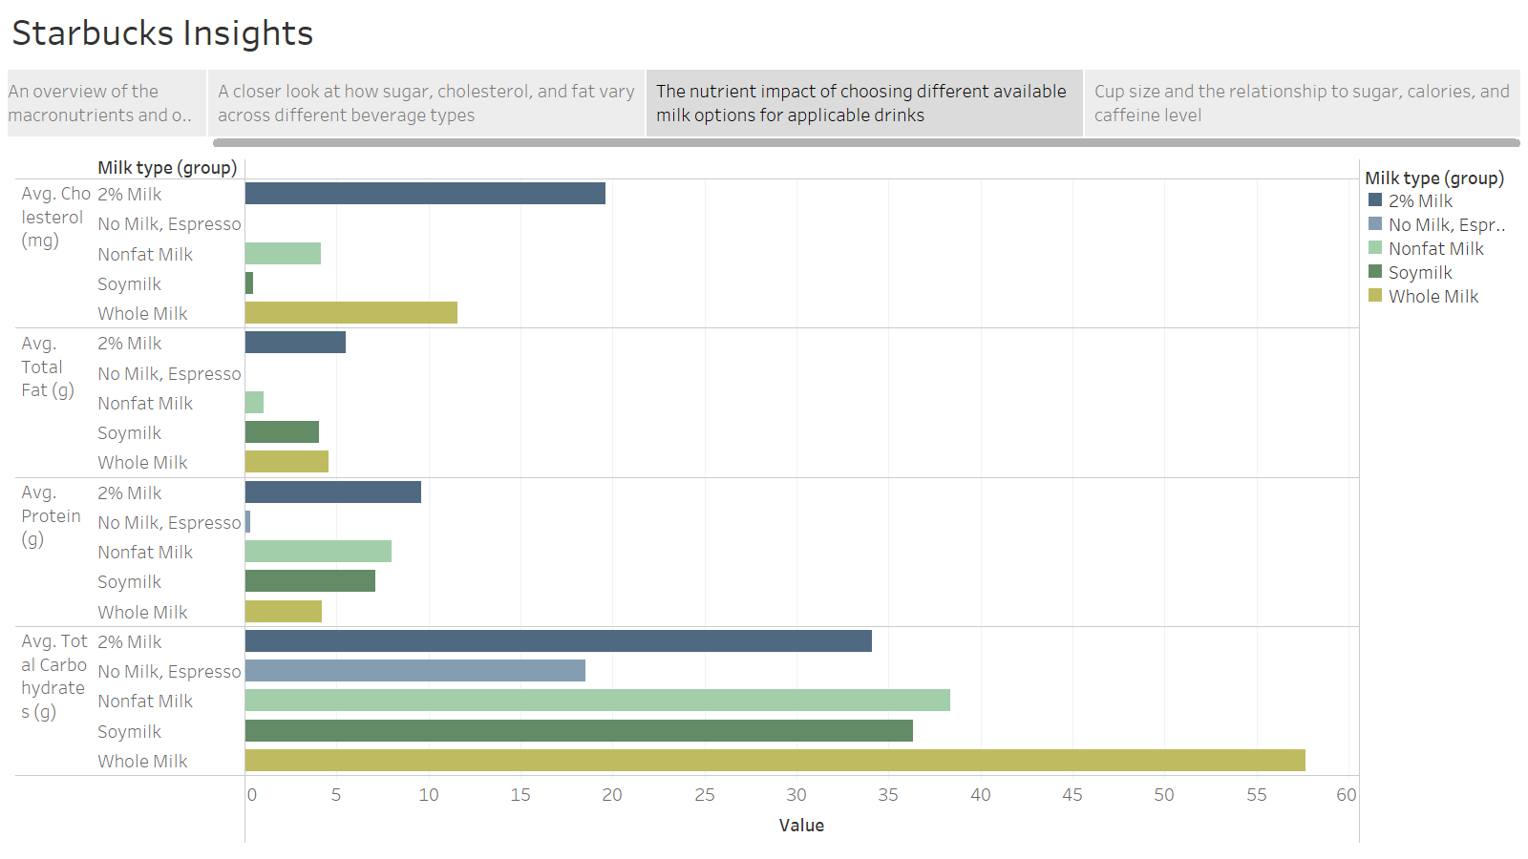

Slide 5
