Slide 1
Beginners Guide to Documenting API’s
Joanna Bujes & Paul Wallace

Slide 2
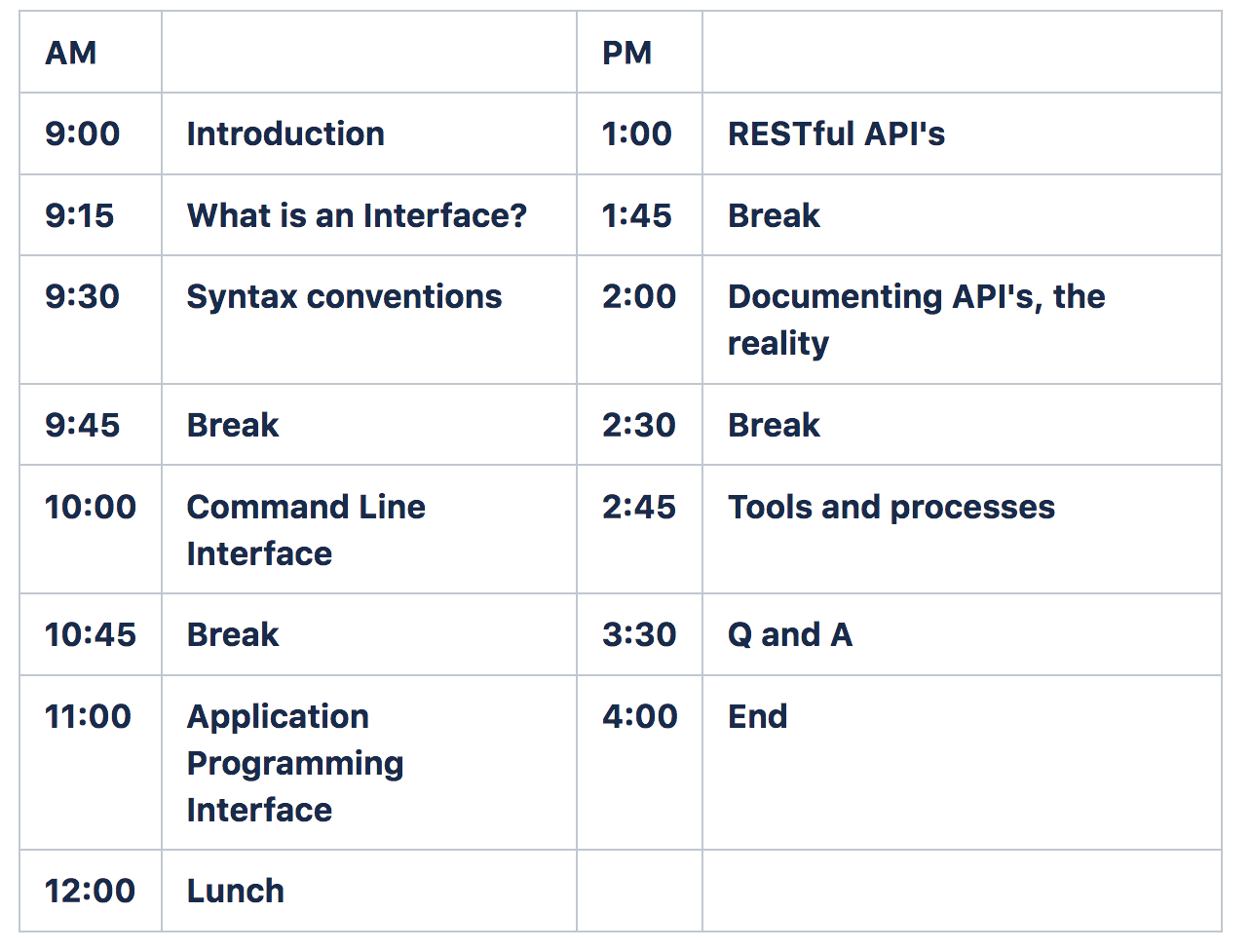

Slide 3
What is an interface?
Most generally, a means of getting a service without caring how that service is provided.
Buttons in an elevator
A stamped, addressed envelope
A remote control for a given device – TV, DVD player, stereo
Notes:
The first and most important things to understand before you start working with API’s

Slide 4
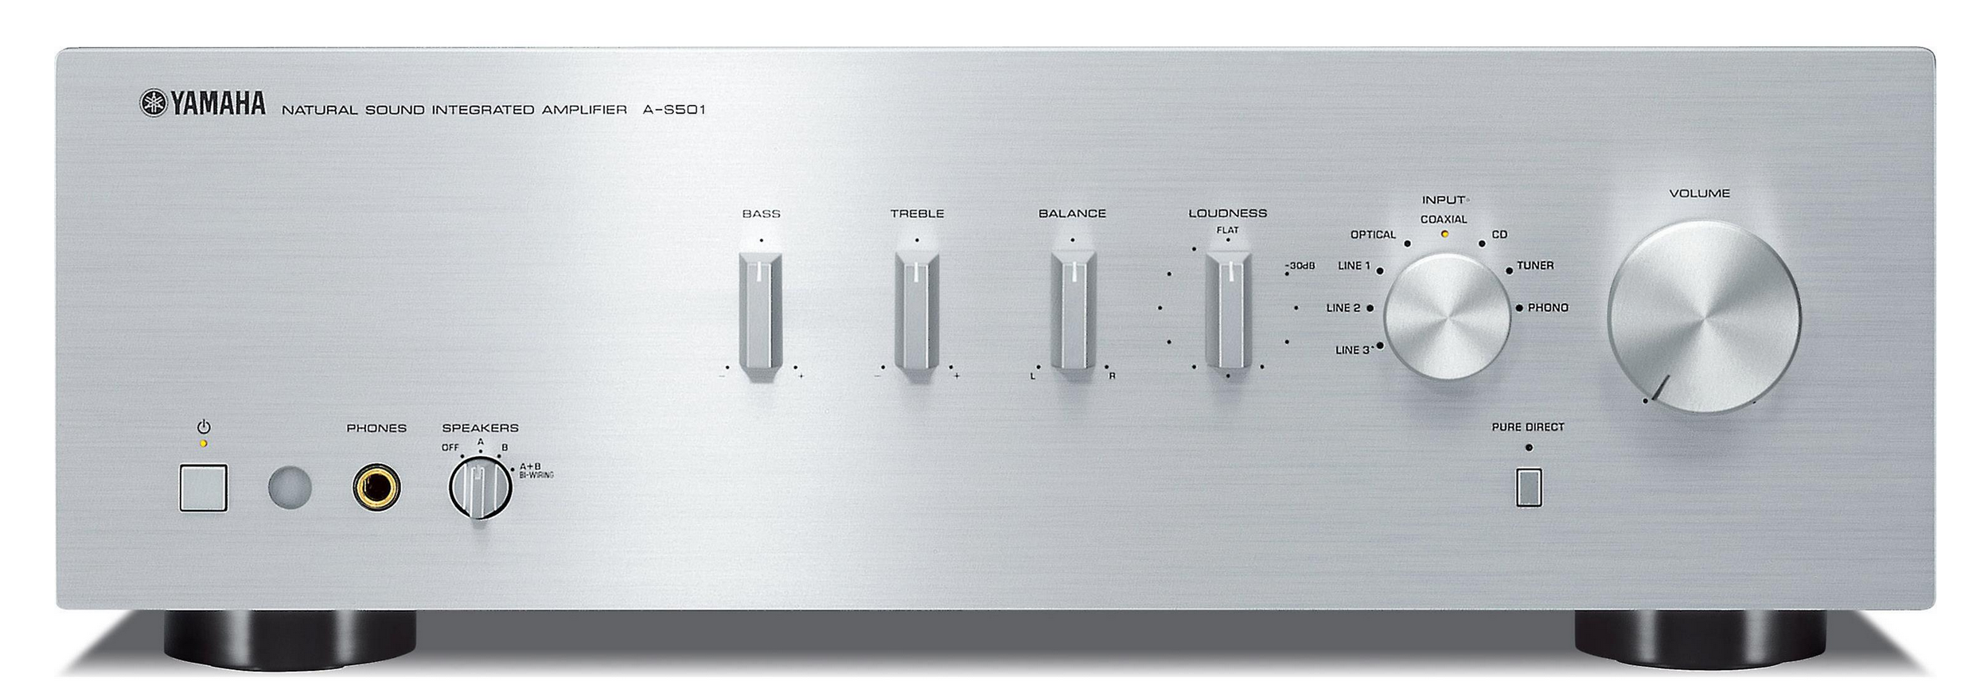
A stereo amplifier:
It takes input from a CD player, a tuner, a record player
It sends output to one or more speakers
You control the inputs, outputs, and sound using the controls shown
Notes:
Let’s start with a physical interface…

Slide 5
If we were to translate the actions of these controls into English sentences:
Set volume to 11.
Set treble to 0.
Set bass to 2
Set input to CD
Set output to speaker A.
Notes:
…that we could speak to Siri…

Slide 6
The Amplifier’s interface
Describing generally how the amplifier can be configured:
SetVolume value
SetTreble value
SetBass value
SetInput cd | phono | tuner | tape
SetOutput A | B | AB
SetAmplifier -v value -t value -b value -in cd | phono | tuner | ta -out A | B | AB
SetAmplifier -v 11 -t -2 b 5 -in phono -out AB
Notes:
After Siri hears our commands, Siri’s code analyzes our speech to pick out those elements that can be expressed as commands, creates those commands, and executes them. For the computer to understand these commands,
They must be expressed in a pre-defined way; when we document the commands we use syntax conventions to express what the program expects.

Slide 7
Syntax conventions
Format | Meaning
element <element> | A variable for which you must supply specific information.
literal | A value that you must specify exactly as shown.
a | b | Select either a or b.
[ element ] | An optional element.
element… | An element that you can repeat.
Notes:
Metalanguage to specify the different components of a command: whether an element must be entered iterally, whether a value should be substituted for a variable, whether an element is optional or repeatable.

Slide 8
From Syntax to specific command
CreateFile filename …
For example: CreateFile telephone.txt birthdays.txt
RenameFile oldName newname
For example: RenameFile Taxes.pdf Taxes2018.pdf
SetAlarm <time> [<snooze_interval>]
For example: SetAlarm 1600 10

Slide 9
Syntax and meaning
A good command is syntactically correct and results in a realistic/meaningful action.
article adjective noun verb article adjective noun. ← syntax
The blue house kicked the shaggy dog.
The fierce lion pounced on the frightened antelope.
Fierce pounced frightened lion the antelope the frightened on.
Notes:
When you describe a command, you must care both for correct syntax AND reasonable values

Slide 10
Syntax and Reality
What information might we want to add to the following syntax diagrams:
SetAmplifier –v value –t value -b value -in cd | phono | tuner | ta –out A | B | AB
SetAlarm <time> [<snooze_interval>]
ChangePassword old new [expiration_date]
Notes:
Don’t blow out your speakers 2. Provide units 3. exp date

Slide 11
Software interface
A way to get the services of a software component without having to know anything about how that is implemented.
Graphical User Interfaces
Command Line Interfaces
Application Programming Interfaces – domain specific
RESTful APIs
Notes:
So now that we understand the concept of an interface and syntax, let’s look at how that plays out in the context of software.

Slide 12
Command Line interface
A way of interacting with a program by issuing commands in the form of successive lines of text entered in a command shell.
The command might be passed to the Operating System for some action, or it might be passed to an application installed on your machine: the application will interpret and execute the command.
The syntax and meaning of these interfaces needs to be documented.
Notes:
Let’s start with the simplest case of an API: the CLI

Slide 13
CLI command syntax
A CLI consists of a set of commands, a set of command options, and optionally constants and environment variables.
Commands are particular to the shell or program and specify actions/verbs.
The parameters you pass to these commands are the elements that the commands need to do their work or elements that the commands act on.
General syntax for a command:
Command parameter1 parameter2 parameter3 …

Slide 14
Shells, user interface to os
Whoami bujes
pwd /Users/bujes/repos/doc
ls
ALSUdragonbook.pdf Simon's analysis prezo.docx
Compilers.docx Static Code Analysis.docx
Man <command> Displays help for the command.

Slide 15
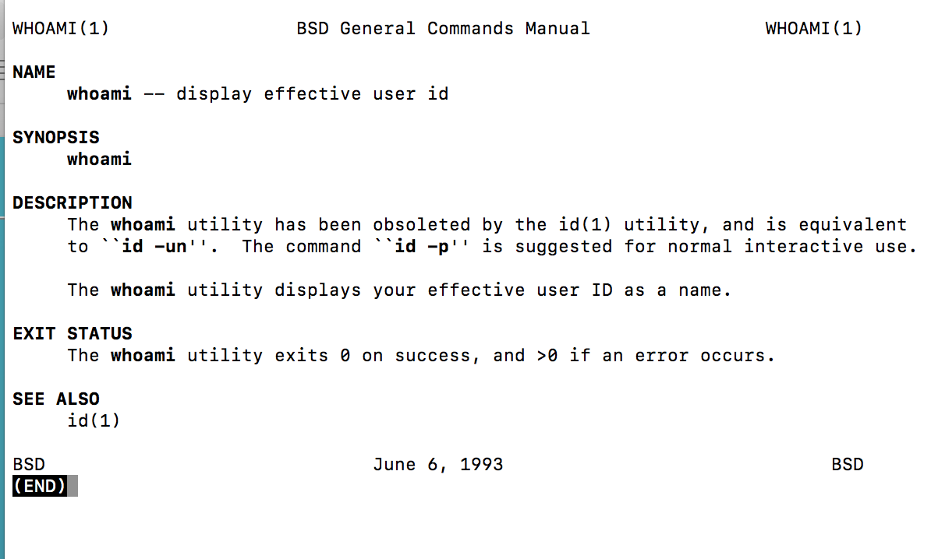
man whoami

Slide 16
Documenting a command
Documenting a command requires the following information.
Summary
Syntax
Detailed information about syntax elements: options, parameters, defaults.
Description and Usage Notes
Examples
Error Codes
Related Material
Notes:
Follows from man pages for bash commands.

Slide 17
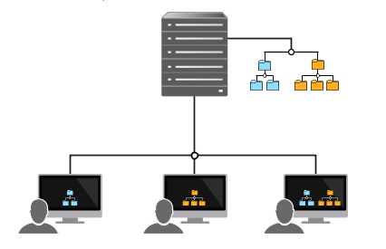
Workspaces and depots

Slide 18
CLI Examples
https://www.perforce.com/manuals/v15.1/cmdref/p4_cachepurge.html
https://www.perforce.com/manuals/v15.1/cmdref/p4_archive.html

Slide 19
CLI exercises
Explain what each command does:
P4 cachepurge –a –D install.txt upgrade.txt
P4 cachepurge –m 100 -D upgrade.txt
Write a command for each description:
The following example shows how you would use the p4 cachepurge command to delete enough content to leave 1000 bytes of free space.
The following example shows what would happen if you deleted all revisions of the file mysource.c, but it does not actually delete the revisions.

Slide 20
From command to description:
P4 cachepurge –a –D install.txt upgrade.txt
This command deletes all revisions of the files install.txt and upgrade.txt.
P4 cachepurge –m 100 –D upgrade.txt
This command deletes 100 revisions of the file upgrade.txt.

Slide 21
From description to command:
The following example shows how you would use the p4 cachepurge command to delete enough content to leave 1000 bytes of free space.
P4 cachepurge –f 1000 –D upgrade.txt
The following example shows what would happen if you deleted all revisions of the file mysource.c, but it does not actually delete the revisions.
P4 cachepurge –n –a –D mysource.c

Slide 22
What we’ve learned
What a command line interface is
What syntax conventions are
How to use syntax to define a command prototype
How to create a command from a prototype
How to describe the action of a command

Slide 23
API’s and Libraries
What is a library?
Why do we use libraries?
How do we access code in a library?
What are standard libraries?
What are 3’d party libraries?
Notes:
Moving into API’s: in order to understand what an API is, you have to understand code libraries.

Slide 24
Libraries
A library is a group of functions and declarations created for use by other programs.
A library is written in a particular language and can only be used by software written in that language.
A library exposes its services through an API. The API is defined in a header file that contains the syntactic definitions (declarations) of the functions and data structures you need to use to obtain its services.
The code that implements the services defined by the API is not visible to the programmer who uses the API.
Notes:
Note: it’s different from CLI which is not language-dependent. It is called by a program, not a user: hence Application Program Interfacce.

Slide 25
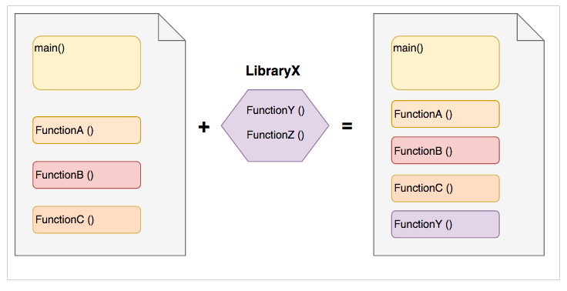
Program Structure
Notes:
Programs are collections of functions. Libraries contain functions too: those functions that you want to reuse and share.
When you link in a library, it is as if the functions you are calling in that library were included in your source code file.
Two types of libraries: standard and 3’d party.

Slide 26
standard libraries
Standard libraries are shipped with each programming language. They provide common functions and data types that programs use. For example math functions, string manipulation functions, input/output functions, and so on.
#include <stdio.h>
int main () { printf ("Hi there") }
int printf(const char *format, ...) //declaration of printf in header file.
Notes:
Discuss stdio is the header file. That header file contains a declaration for printf. You can call that function without actually knowing what statements make up the body of that function.
Early programming languages included i/o functions, but by putting it in a library, you can make it o/s and processor independent.

Slide 27
3’d party libraries
3’d party libraries provide functionality that help you use the services of that party.
--An Operating system publishes an API that enables your application to run on that operating system.
--An application publishes an API to help you access data or services particular to that application.
Search for “facebook api” “twitter api” “<your_favorite_app> api” to see how common these api’s are and what they have to offer.
Notes:
OS is interface between computer hardware and the application that runs on that hardware.

Slide 28
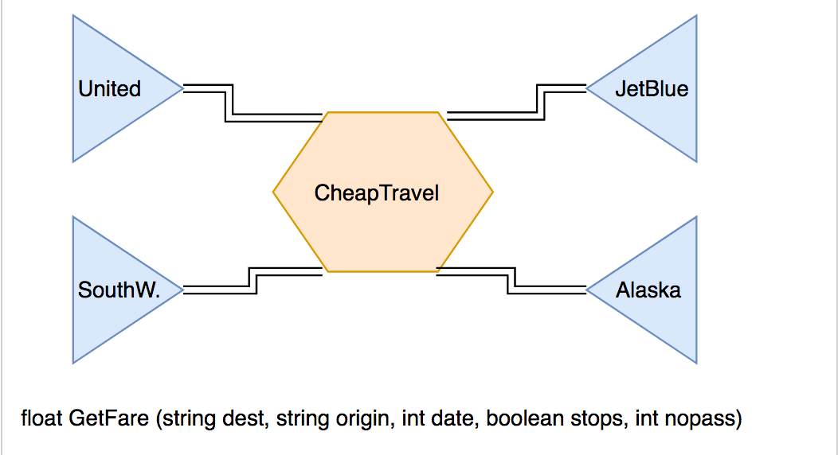
Using 3’d party API’s
Notes:
The API published by the airlines helps CheapTravel to get information about available flights and prices, and to display that information to the user. Discuss call and diff from command syntax.

Slide 29
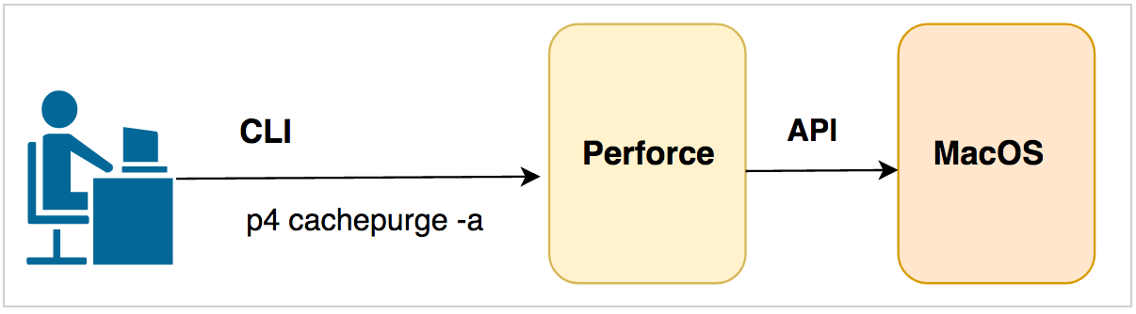
CLI vs API
CLI Command prototype: p4[g-opts]cachepurge-a[-n-R-O][-in][-Sn][-Dfile...] Actual command: P4 cachepurge –a –D install.txt upgrade.txt
API
Declaration: float GetFare (string dest, string origin, int date, boolean stops, int nopass)
Invocation: Price = GetFare (“NYC”, “OAK”, 352020, false, 2)
Notes:
Note the diff between who uses CLI and API; 2. note the difference between the language independent command and the language dependent function call: means you need to understand types.
If you did not have the type declarations, the compiler would not be able to know what you mean by a given input.

Slide 30
Simple and Complex Data Types
The parameters you pass to commands generally specify data, and that data is typed.
Simple types include integers, floats, strings, and Booleans
Complex types include arrays, and structures composed of simple types.
An array is a collection of simple types and may not contain more than one type.
A structure may contain a mixture of types.
Notes:
As you saw from the getFare declaration, each parameter is typed. And the types are more complicated than the ones normally needed for a CLI command.

Slide 31
Data type examples: complex data types
struct account { int account_number;
char *first_name;
char *last_name;
float balance;
};

Slide 32
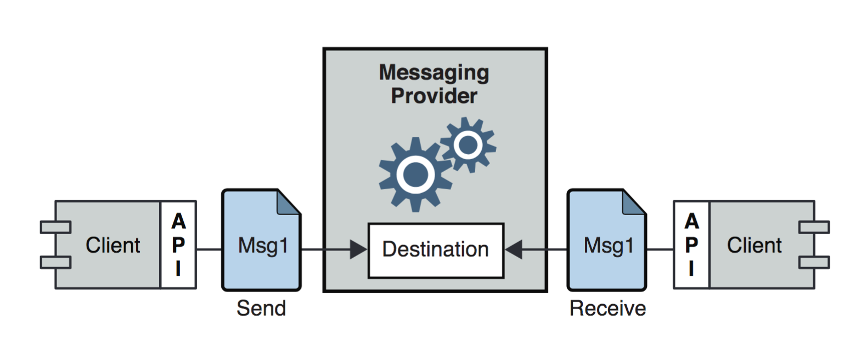
A messaging Application
Client application uses API calls to define and send a message.
The message is relayed via destination on a server
The client uses API calls to connect to the server and retrieve the message.
The service rendered here is that the secure and reliable transmission here is handled by the code that implements the API.

Slide 33
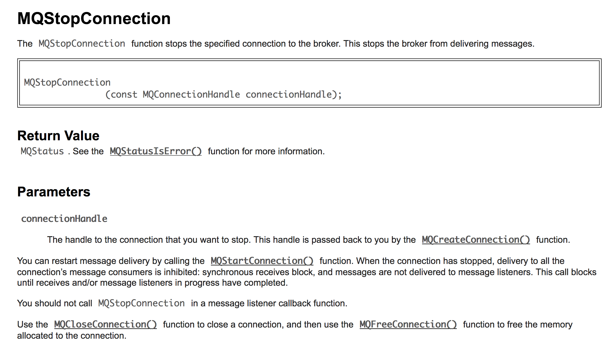
Notes:
What the call does, limitations; related functions.

Slide 34
Time for Lunch

Slide 35
API Naming
Should be self explanatory; avoid cryptic abbreviations
Use terms consistently (remove/delete)? (insert/add)?
Strive for symmetry: balance add w delete…etc.
If you get it right, it should read like prose. if (car.speed() > 2 * SPEED_LIMIT
speaker.generateAlert (“Watch out for cops!”);
Parameter – units, form, ownership, default value.
Ownership: if I pass an object to an API /method, do I still own that object? Can I change it? Or have I transferred ownership of that object?

Slide 36
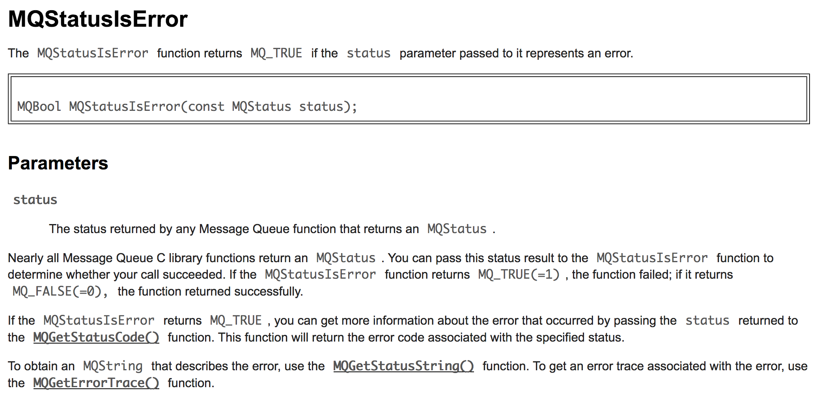
Notes:
Explains why this function and what to do next depending on what is returned.

