Slide 1
How this works in the real world
API documentation commonly includes dozens of functions and many data structures.
These functions and data structures are presented in a reference format, almost always in alphabetical order.
In addition to the reference material, a user also needs to understand the basic use cases for the API and also the basic concepts or standards that are introduced by the API.
Notes:
….more than one function…..What does it mean to say that something is “reference” information? Examples of reference info? Principles of order?

Slide 2
Requirements of reference information
Consistency: use consistent formats, terminology, parallel constructions, examples.
Be explicit about agency: end user, developer, administrator, dev ops.
But remember: Reference information is not enough. You must also develop procedural and conceptual information
Procedures: how do I use the API to get something done.
Concepts: what basic concepts must I understand to make sense of the procedures and reference information.
Notes:
…for API’s

Slide 3
Editing and maintaining API documentation
Editing and maintenance tasks are often assigned to beginning writers. You might be asked to
Proofread or edit existing documentation
Re-organize or cleanup existing documentation (p4 archive)
Correct or expand existing documentation to provide better info
Expand existing documentation if the API/CLI changes
Notes:
Two ways of working on API docs

Slide 4
Creating new API documentation
Once you become more experienced, you will be able to document an API from scratch.
Your inputs might consist of the following:
For API’s: The header file (with comments)
A specification that describes the functions and data structures of the API or the commands of the CLI
White papers or other collateral associated with the API
Research that your do; training you undertake

Slide 5
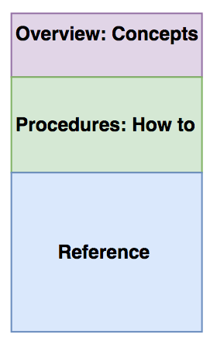
Although your book is meant to be read from front to back; you will be most productive writing it from back to front.

Slide 6
Working backwards
Write the reference section first. -- you can be productive before you understand everything -- for a rushed release, it is acceptable to just have the reference
Write the procedural section next to explain how the functions are meant to work together to accomplish a task.
Write the conceptual section last to explain those things without which the user could not understand the rest: set context, describe the basic workflow.
API documentation is incomplete without these three types of docs.

Slide 7
The maintenance workflow
Developer files a bug describing the change or addition.
You ask for clarification if needed.
You update the doc.
Developer reviews the docs and verifies, or asks for further changes
Update until verified.

Slide 8
Writing new API doc
Read the specification, header file, and other collateral.
Look for the user view.
Research basics you don’t understand
Write an outline of the proposed doc and have dev verify it.
Start writing the reference; get sanity checks along the way.
Write the procedural chapters and the introduction.
Send doc to review.
Incorporate comments.
Publish

Slide 9
Working with engineers
Engineers tend to be focused on the implementation of the API/CLI.
Product managers, support, and sales engineers sometimes have a better understanding of the user view.
It is unreasonable to expect the engineer to do your work for you. You are responsible for learning the basics.
Engineers are generally patient and understanding, especially when it’s not three days before a deadline.

